Slide 1
Drift-Sense: Navigation-Error Recovery
SEMICON / Applied Materials Hackathon | Idea Submission
Team Details
Team Name | Quantized Minds
Member 1 | Bandari Govardhan – 24215a0409
Member 2 | Pakala Karthik – 24215a0411
Member 3 | Gandham Karunakar – 25215a0412
College | BV RAJU INSTITUTE OF TECHNOLOGY
Contact | 6305557390 24215A0409@GMAIL.COM
Guide | Dr. U. Gnaneshwara chary
Drift-Sense | Navigation-Error Recovery
1

Slide 2
Problem Statement
Drift-Sense: Navigation-Error Recovery
A high-magnification Reference shows a small wafer region. Later, stage drift causes a wider, lower-magnification Search image. The Reference pattern now appears ~10× smaller inside the Search image.
Task: recover the exact centre coordinates (x, y) of that pattern.
Why it is difficult
• DRAM and FinFET layouts are highly periodic — many locations look almost identical
• Ordinary template matching often selects the wrong peak
• Accurate recovery is essential for automated inspection and high-throughput metrology
Drift-Sense | Navigation-Error Recovery
2

Slide 3
Idea Description
Key concept: Scale-aware hybrid localization — classical multi-peak matching + Siamese ranking
• DRAM
Contact arrays, word/bit lines
• FinFET
Fin and gate line structures
Same pipeline handles both using style-aware synthetic data.
Supported Styles
Simple template matching returns only the single highest peak. On periodic layouts that peak is often wrong.
We keep Top-20 peaks and let a Siamese network re-rank them, recovering the true location when classical #1 fails.
Why better than simple matching?
Drift-Sense | Navigation-Error Recovery
3

Slide 4
Proposed Solution — Full Pipeline
1. Generate
Ref + Search
2. 10× Scale
Normalize
3. NCC
Top-20 Peaks
4. Siamese
Ranking
5. Decision
Rule
6. Output
(x, y)
→
→
→
→
→
Dataset Generator
Localization Algorithm
• DRAM & FinFET styles
• Exact 10× scale relationship
• Independent SEM-like noise
• Rotation, blur, edge bloom
• Full ground-truth centres
• Easy / Medium / Hard / Trap modes
• Trap mode creates classical failures on purpose
• Exact 10× down-scale of Reference
• Normalized Cross-Correlation (NCC)
• Top-20 peaks + non-max suppression
• Siamese CNN (96×96 patches)
• Ranking / margin loss training
• Decision: classical if score > 0.85
else use best Siamese candidate
Drift-Sense | Navigation-Error Recovery
4

Slide 5
Math We Used — In Simple Words
1. Normalized Cross-Correlation
2. Why Top-20 (not only Top-1)
We slide the small template over the Search image and measure similarity after removing average brightness.
Source: Lewis (1995), Gonzalez & Woods, OpenCV TM_CCOEFF_NORMED
(We use the standard method — we did not invent it.)
On periodic layouts the best match is often wrong. The true location is almost always still in the top 20.
So we keep 20 candidates and turn the problem into ranking.
3. Siamese Ranking
4. Ranking Loss + Decision Rule
Network compares Reference patch vs each candidate and gives a similarity score.
Source: Bromley et al. (Siamese nets), Chopra et al. (similarity learning).
Loss: correct candidate must score higher than wrong ones by a margin.
Rule: if classical > 0.85 use classical, else use Siamese.
(Engineering choice from our experiments.)
Drift-Sense | Navigation-Error Recovery
5

Slide 6
Innovation & Uniqueness
Exact 10× scale handling
Multi-peak recovery
1
2
Explicit normalization matching the problem statement
Top-20 peaks keep the true location even when #1 is wrong
Siamese on hard negatives
Confidence hybrid rule
3
4
Trained on classical failures and near-GT shifts
Classical trusted when sure; CNN only when needed
Transparent pipeline
Trap-mode generator
5
6
Every stage saved as image — fully inspectable
Creates deliberate classical failures to measure recovery
Drift-Sense | Navigation-Error Recovery
6

Slide 7
Results — Quantitative
Difficulty | Accuracy | Notes
Easy | 100% | Classical sufficient
Medium | 100% | Classical sufficient
Hard | 100% | Hybrid works well
Trap (hard periodic) | ~70–75% | CNN recovers many failures
Overall | ≈ 93–94% | Mean error < 1 pixel
Runtime: Classical 15–25 ms | Full hybrid typically < 70 ms per 1000×1000 pair
SUCCESS
Green (GT) and Red (prediction) overlap
HONEST FAILURE
Strong periodic distractor still confuses system
Drift-Sense | Navigation-Error Recovery
7

Slide 8
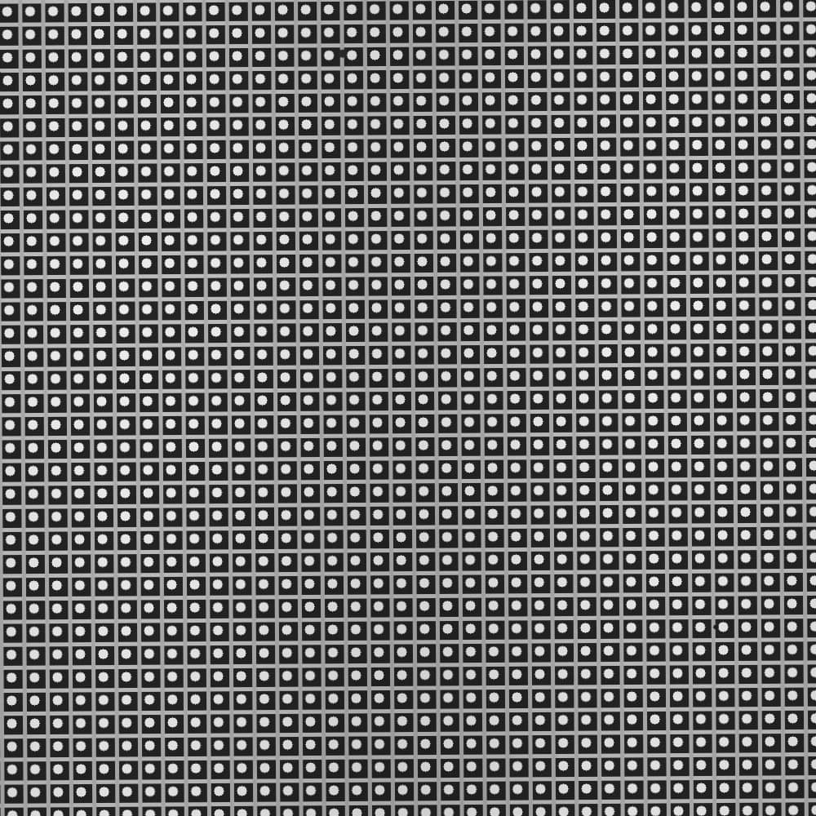
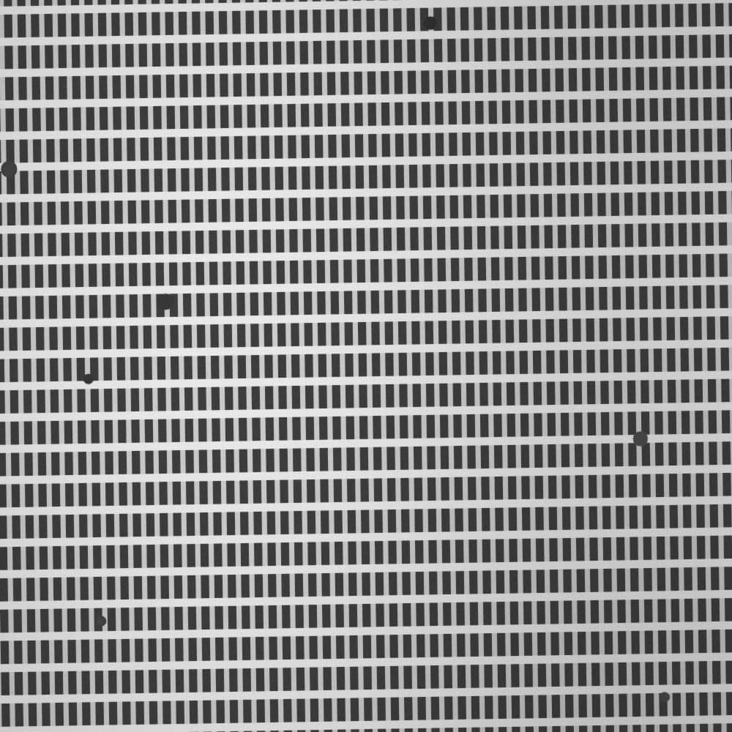

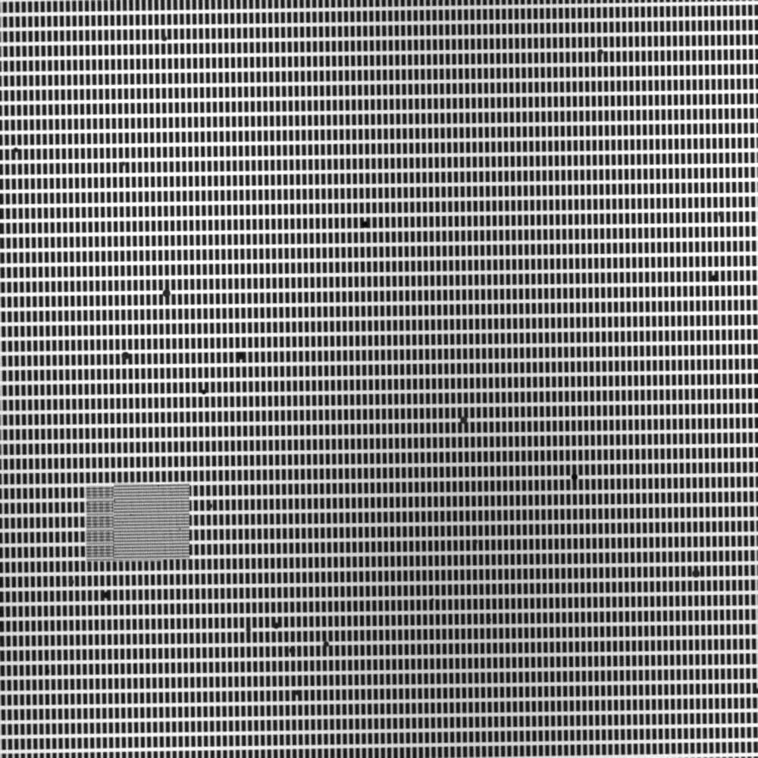
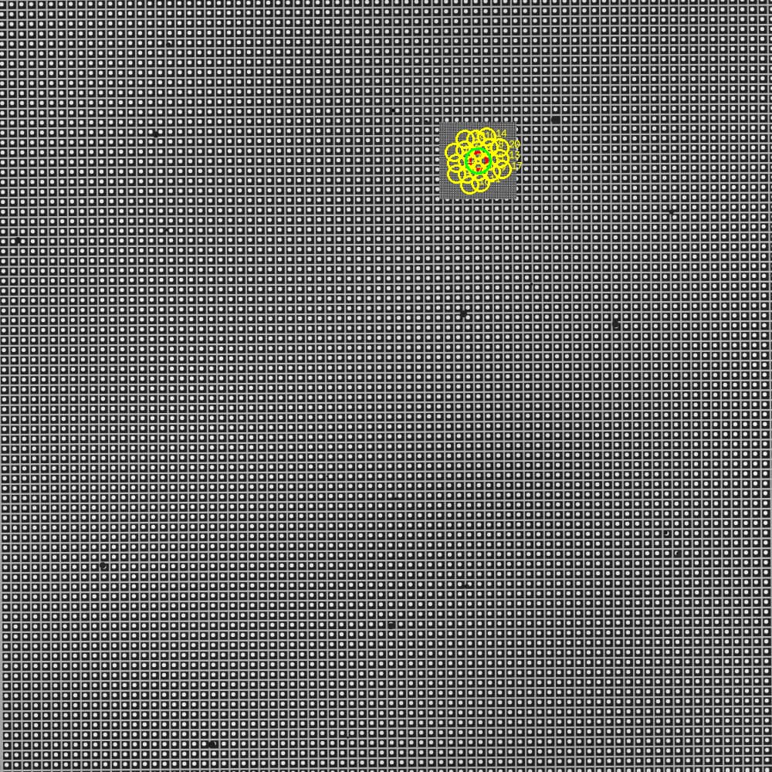
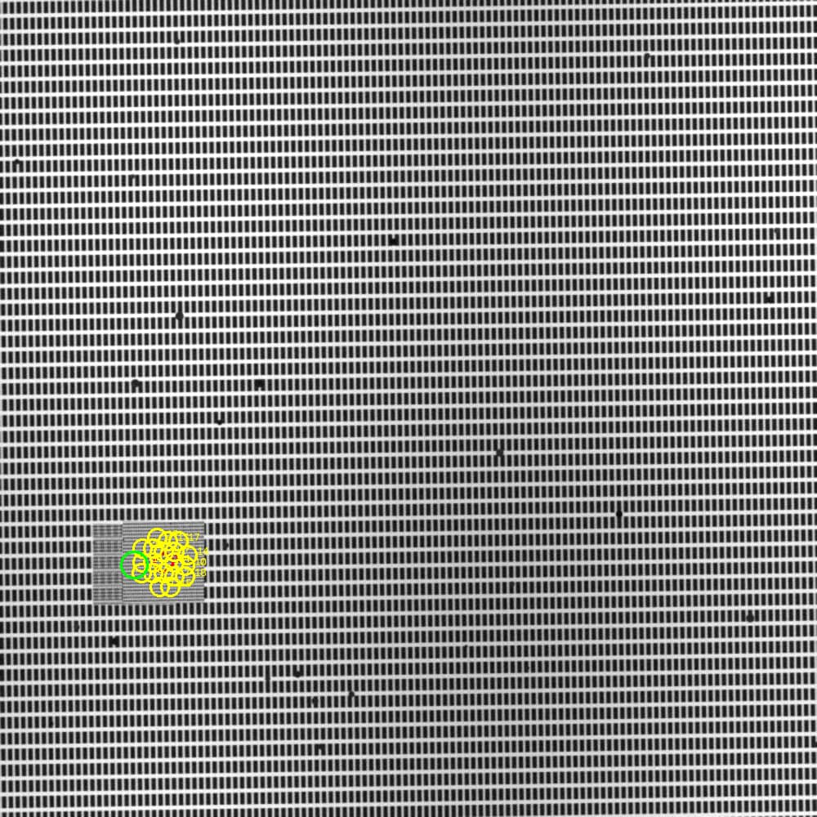
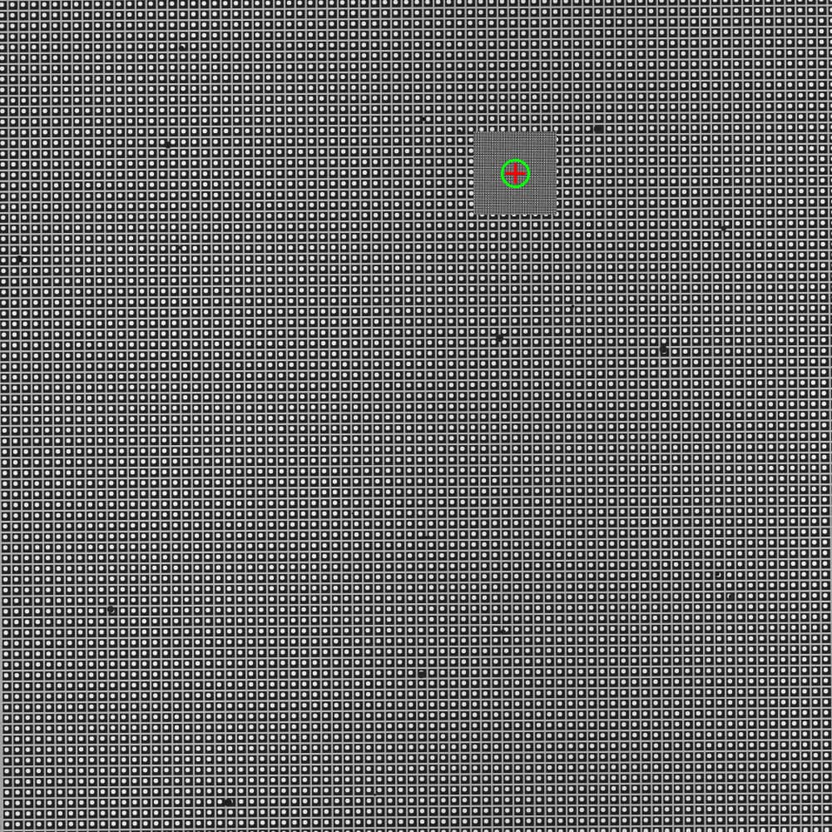
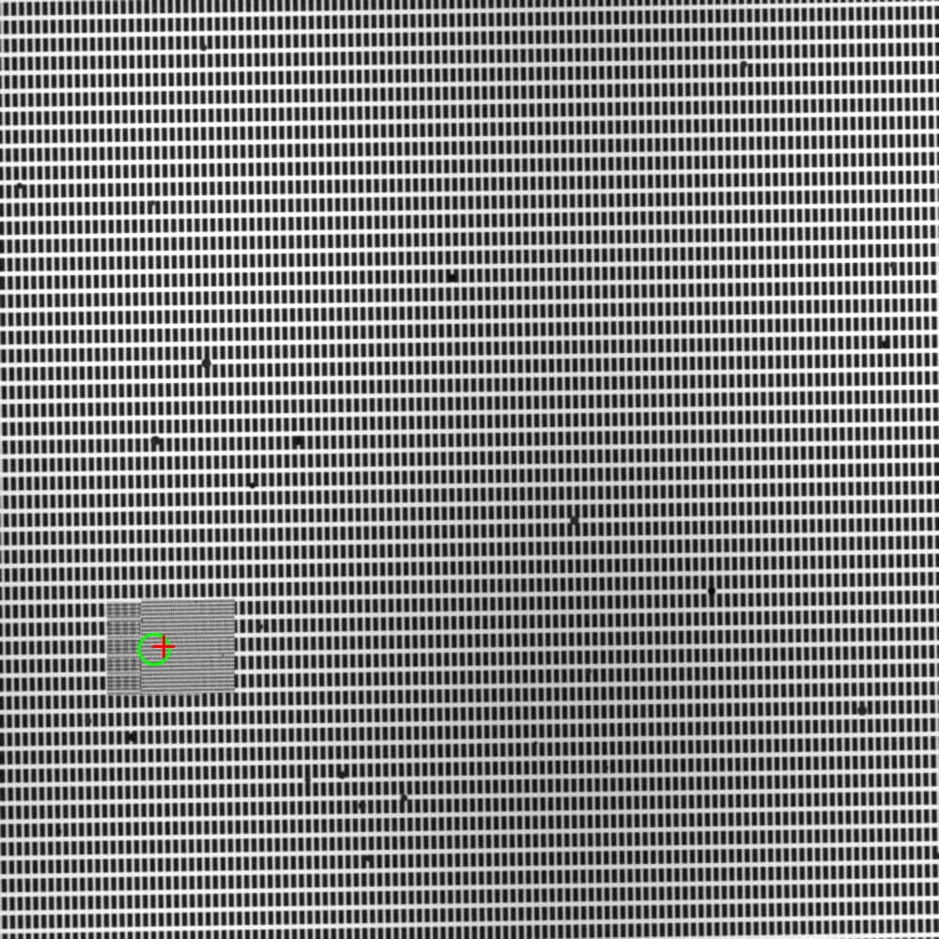
Visual Results — From Reference to Final Prediction
Insert images from outputs/ into the boxes below
② Reference
② SEARCH
③ CLASSICAL TOP-20
④ FINAL RESULT
Drift-Sense | Navigation-Error Recovery
8

Slide 9

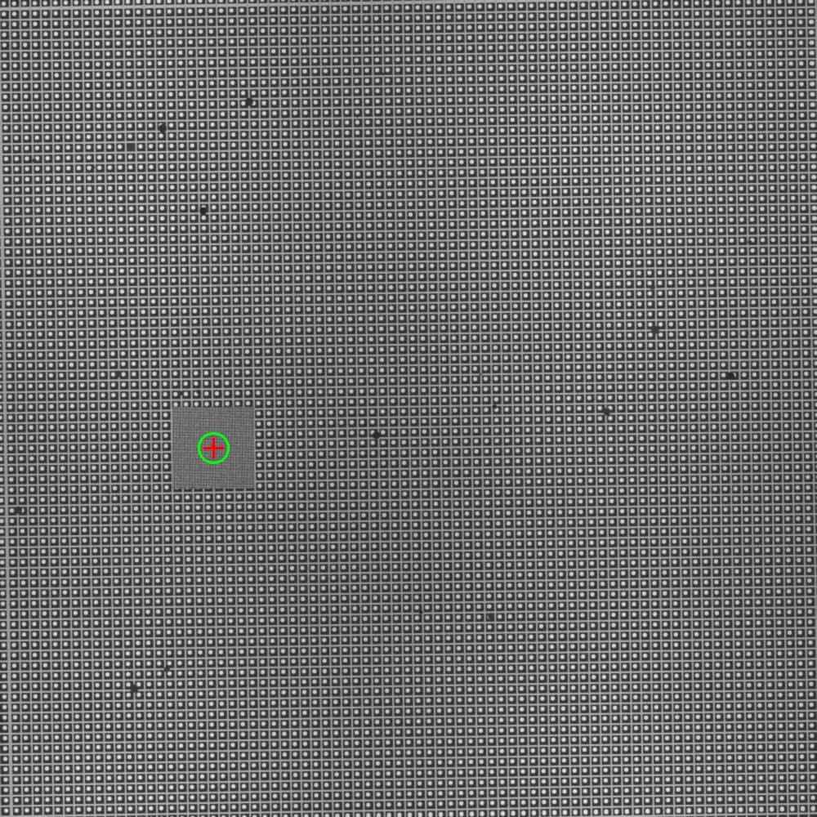
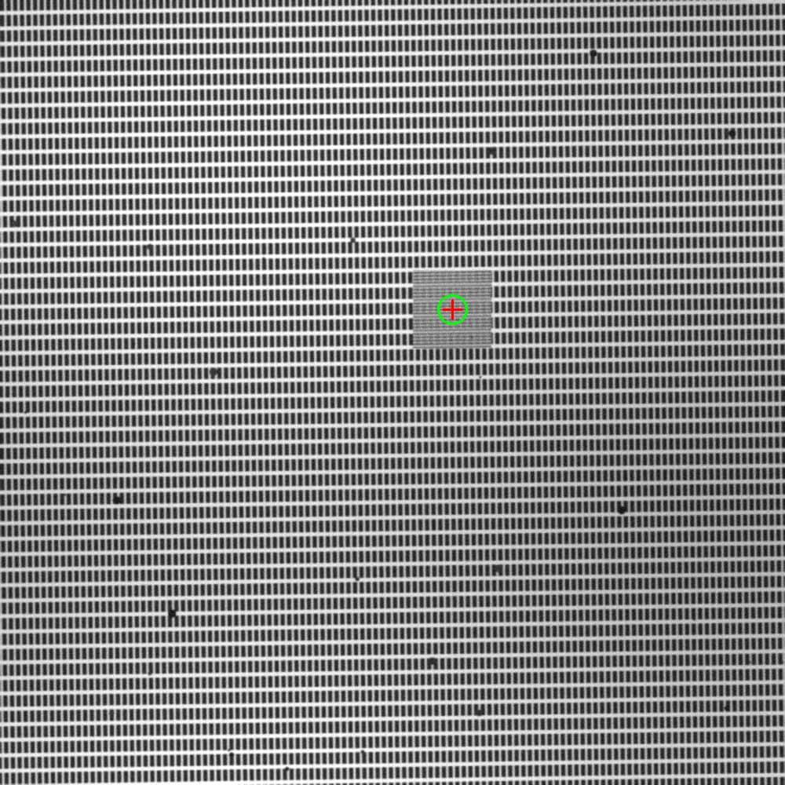
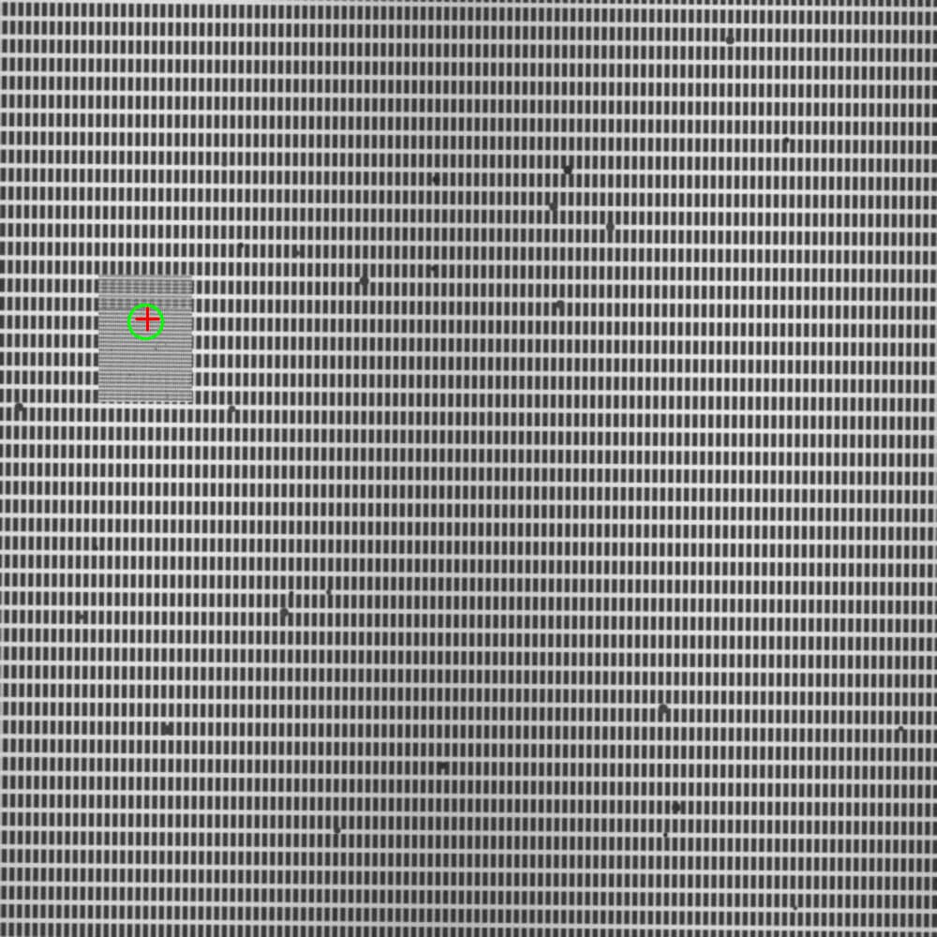
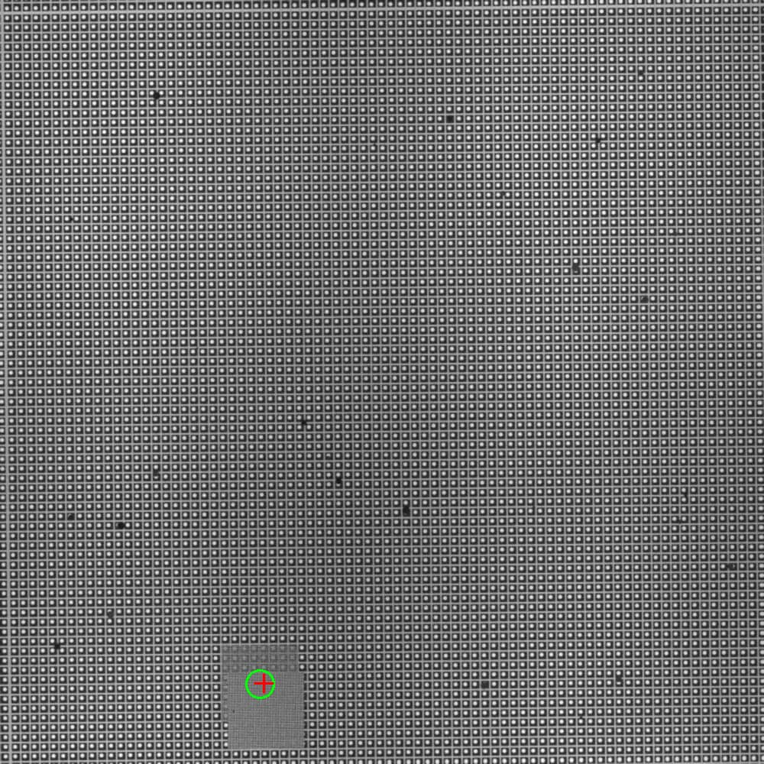
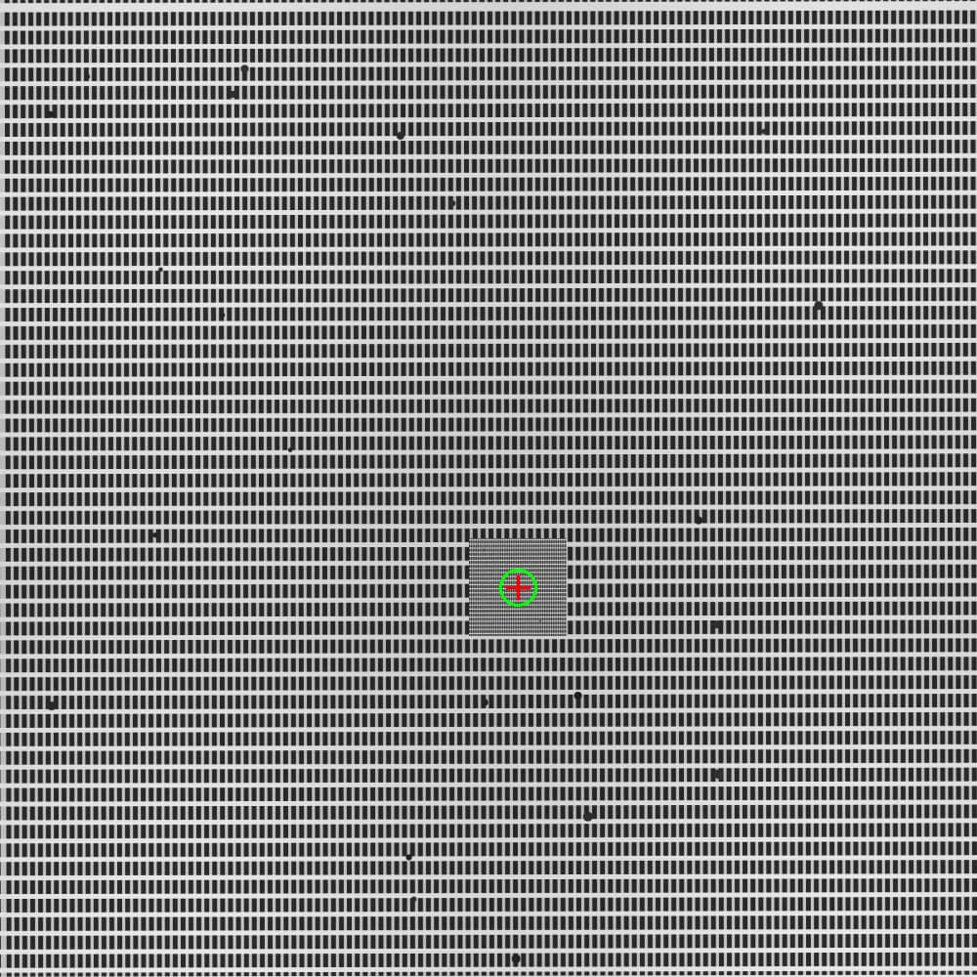
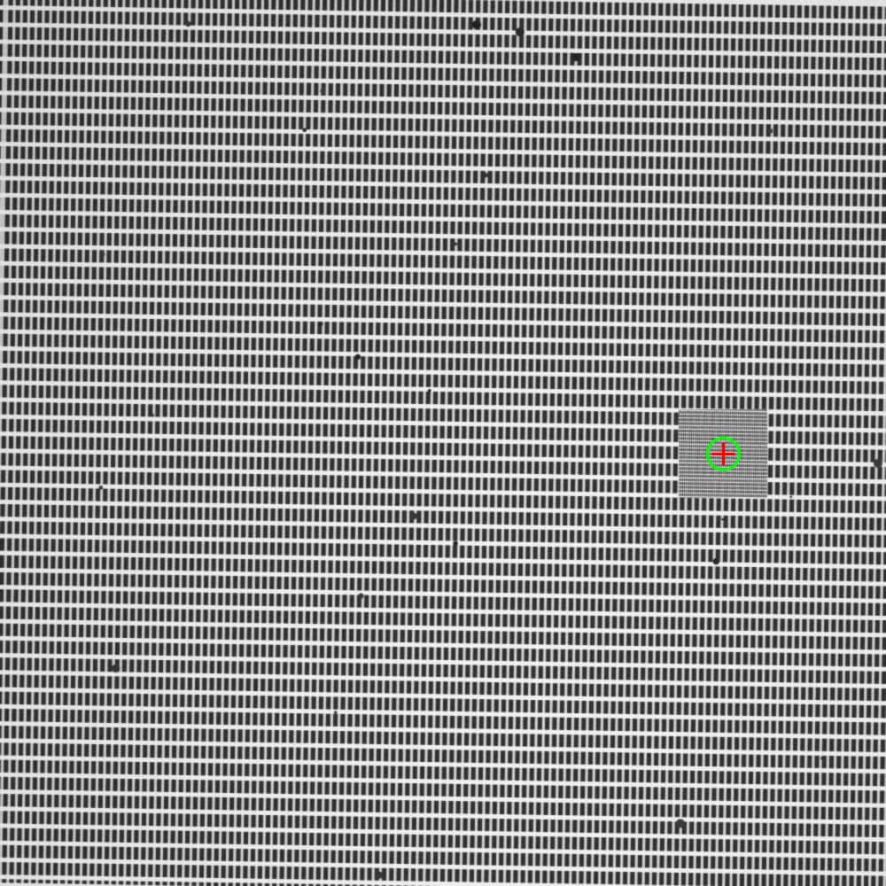
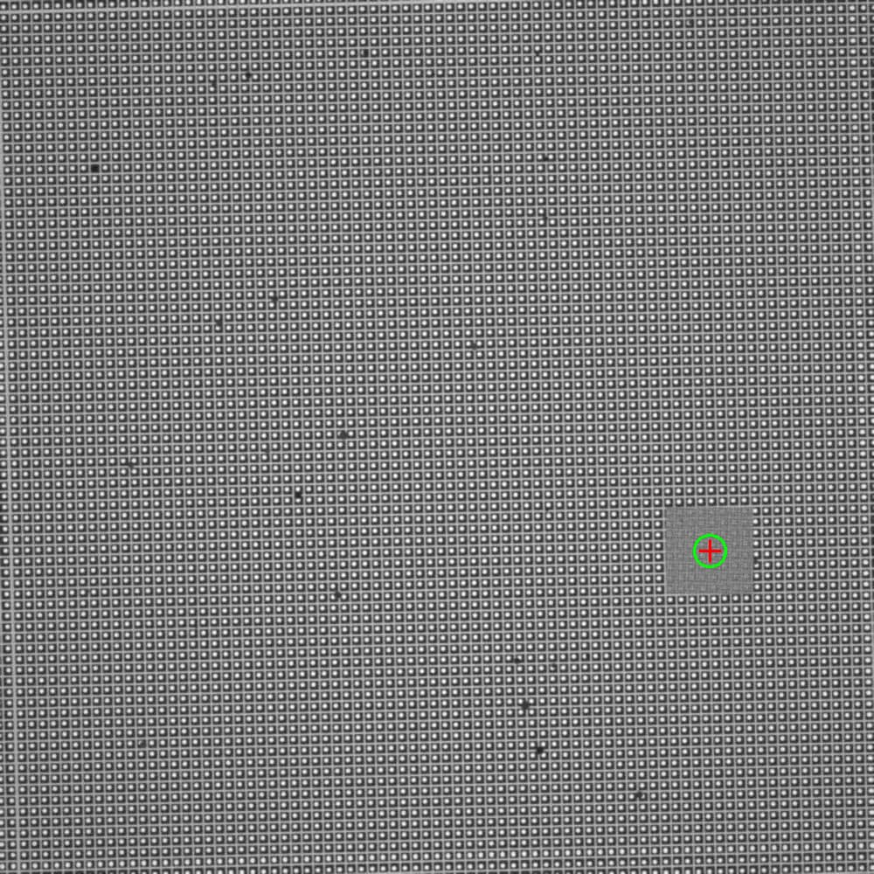
Visual Evidence — Success & Honest Failure
SUCCESS CASE
HONEST FAILURE CASE
Green (GT) and red (prediction)
are separated
(easy / medium / hard) Green and red overlap Error
Green (GT) and red (prediction)
are separated
Drift-Sense | Navigation-Error Recovery
9

Slide 10
Technology & Feasibility
Tech Stack
Python 3, OpenCV, PyTorch, NumPy, Pillow
Hardware
NVIDIA RTX 3050 4GB (CUDA) + standard CPU
Dataset Generation
Hundreds of pairs in minutes; full GT recorded
Inference Time
20–70 ms per pair (classical or hybrid)
Model Size
siamese_final_96.pt — lightweight (< 10 MB)
Feasibility
Runs on a laptop; single-command inference script
Drift-Sense | Navigation-Error Recovery
10

Slide 11
GitHub & Video Link
GitHub Repository (Mandatory)
https://github.com/bandarigovardhan7390/DriftSense-Navigation-Error-Recovery/tree/main
Repository contains:
• README with complete setup instructions
• Standalone dataset generator
• Standalone inference script (scripts/inference.py) — outputs only x,y
• Model weights (siamese_final_96.pt)
• Training notes, math formulation, full source code
• requirements.txt
Drift-Sense | Navigation-Error Recovery
11

Slide 12
References (Sources of the Math)
Normalized Cross-Correlation
[1]Lewis, J.P. (1995). Fast Normalized Cross-Correlation. | Gonzalez & Woods, Digital Image Processing. | OpenCV TM_CCOEFF_NORMED.
Siamese Networks
[2]Bromley et al. (1993/1994). Signature Verification using a “Siamese” Time Delay Neural Network. | Chopra, Hadsell, LeCun (2005). Learning a Similarity Metric Discriminatively.
Ranking / Metric Learning
[3]Margin ranking losses used in metric learning; similar spirit to FaceNet-style embedding losses (Schroff et al.).
SEM / Semiconductor context
[4]Secondary-electron edge brightening and shot-noise behaviour in SEM literature; wafer navigation and periodic-layout inspection practice.
Our contribution
[5]System design: exact 10× handling + Top-20 peaks + Siamese trained on hard periodic negatives + confidence rule + full transparency.
Drift-Sense | Navigation-Error Recovery
12

