Slide 1
PolygonRotation
Shashank Bandaru
EECS · COSC594
5 May 2026

Slide 2

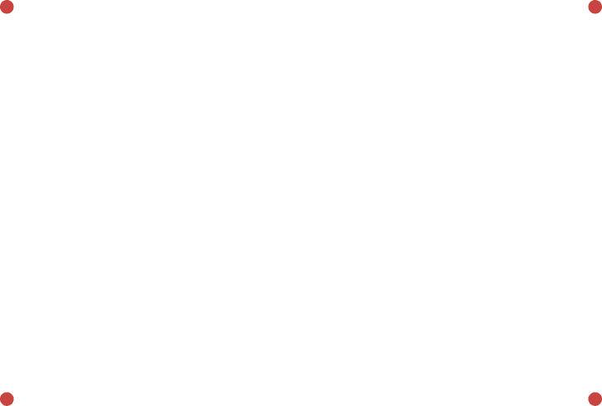

The Problem
y
y
2
2
1
1
0
0
1
1
2
2
3
3
x
x
Given a polygon as a set of points, rotate it along the y-axis and get the volume of the resulting object.

Slide 3



The Problem
y
y
2
2
1
1
0
0
1
1
2
2
3
3
x
x
Given a polygon as a set of points, rotate it along the y-axis and get the volume of the resulting object.

Slide 4
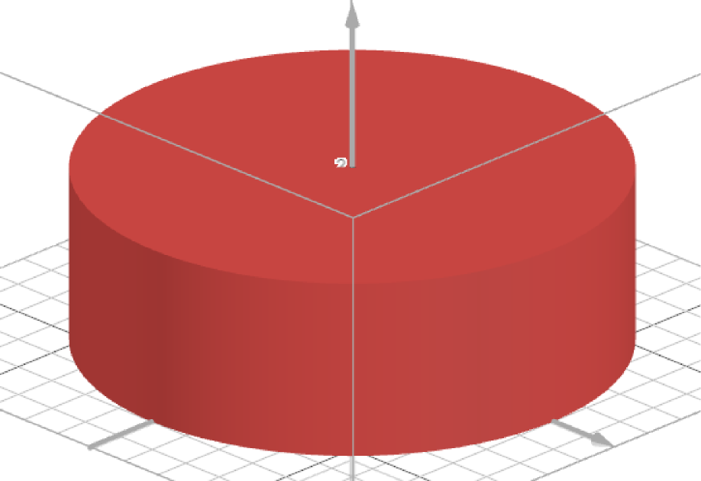
The Problem
If we were to rotate around the y-axis, we get a cylinder with a radius of 3 and a height of 2.

Slide 5
Prototype and Constraints
Class: PolygonRotation
Method: getVolume
Parameters:
Return: double
x will contain [3, 50] elements
y will contain the same number of elements as x
Each element of x and y will be [-100, 100]
The polygon will be convex
All vertices of the polygon will be distinct
Only two points on the y-axis
(0, ymin) and (0, ymax) where ymin<ymax
Vertices are listed in clockwise order starting with (0, ymax)
y coordinates will be [ymin, ymax]
No 3 points will be on the same line
Returned value be within 1e-9 of the correct value
int[] | x
int[] | y

Slide 6
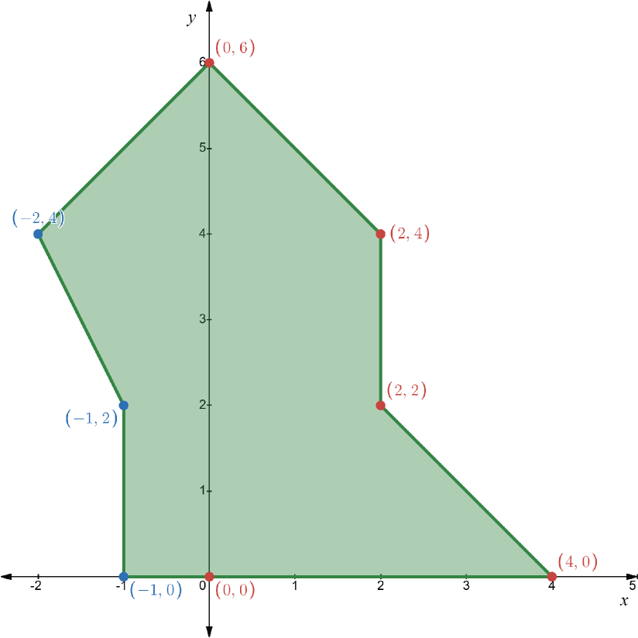
An Irregular Polygon
x | 0, 2, 2, 4, 0, -1, -1, -2
y | 6, 4, 2, 0, 0, 0, 2, 4
Given a polygon as a set of points, rotate it along the y-axis and get the volume of the resulting object.

Slide 7
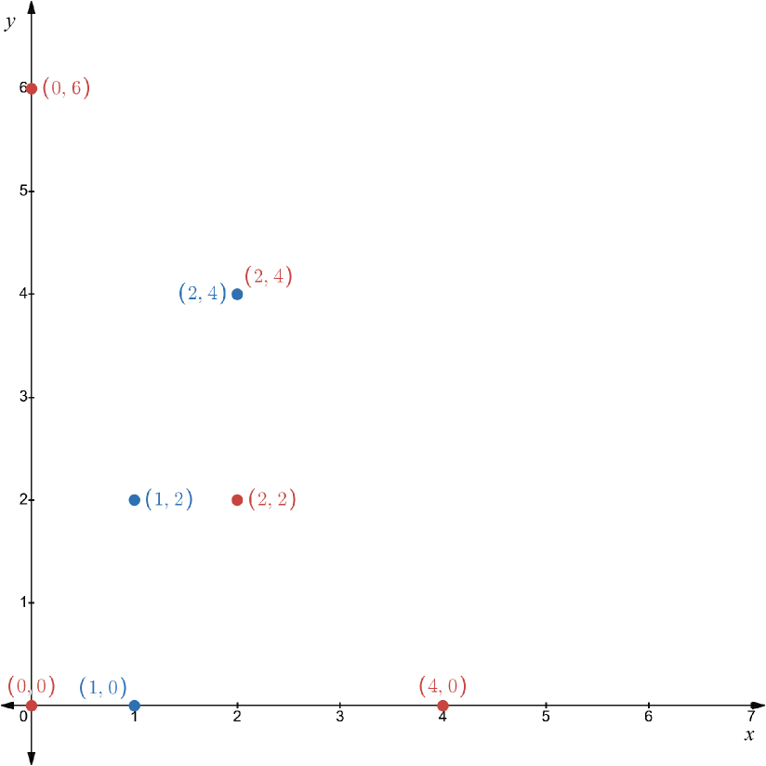
An Irregular Polygon
Make the negative points positive by taking their absolute value.

Slide 8
An Irregular Polygon
Now choose the outer most points of each y value.

Slide 9
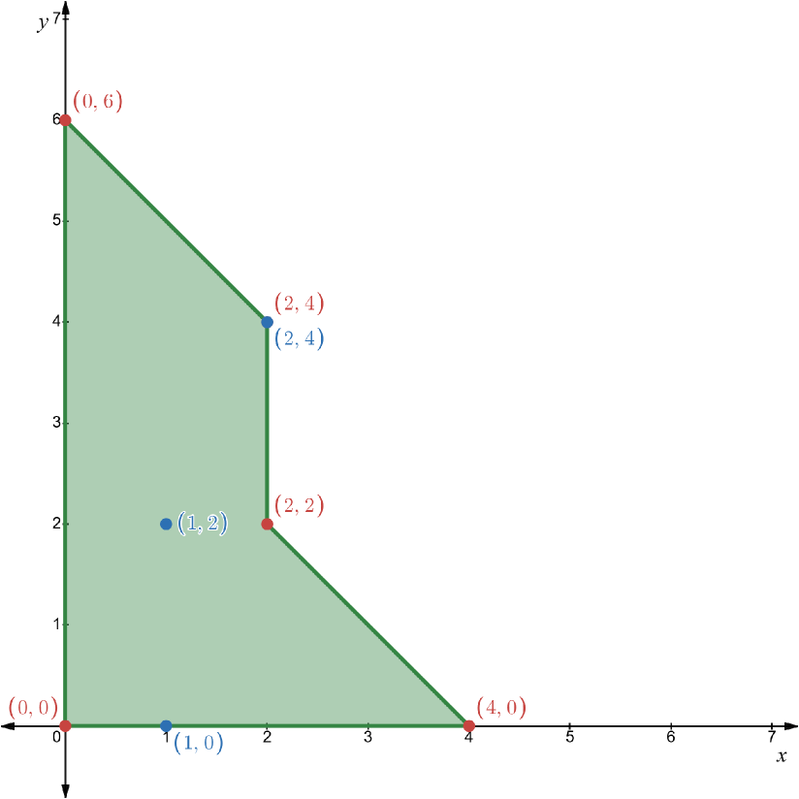
An Irregular Polygon
Now we have a new polygon that we can get the volume of.

Slide 10
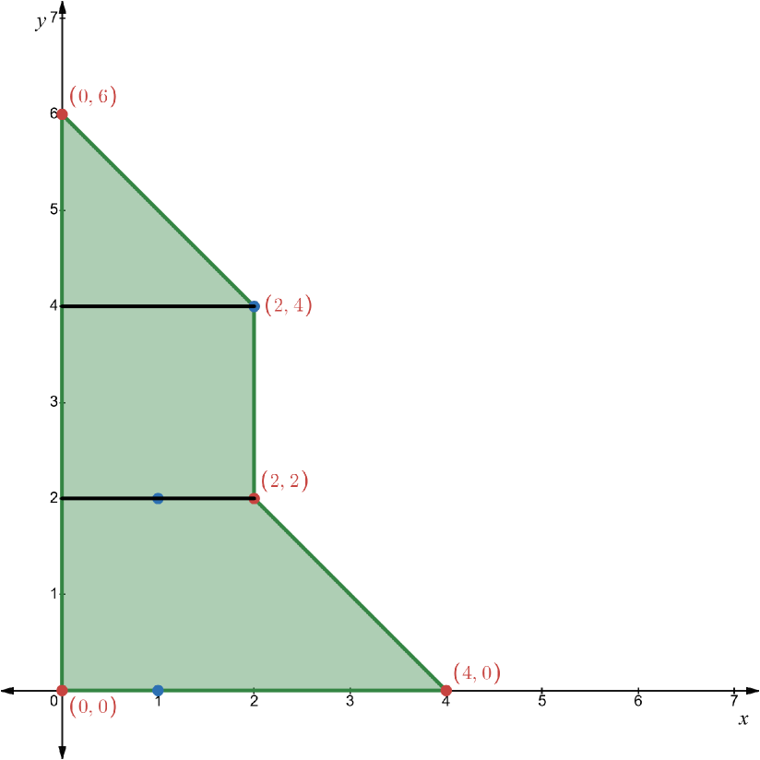



An Irregular Polygon
If we split the polygon along the y values, notice we have three simple polygons we can get the volume of.

Slide 11


An Irregular Polygon
If we split the polygon along the y values, notice we have three simple polygons we can get the volume of.
These are the only shapes that we can encounter: a triangle, a square, and a trapezoid.

Slide 12

An Irregular Polygon
However, we do not need to use three separate equations. We can use the frustum equation which accommodates all of these shapes.

Slide 13




An Irregular Polygon

Slide 14
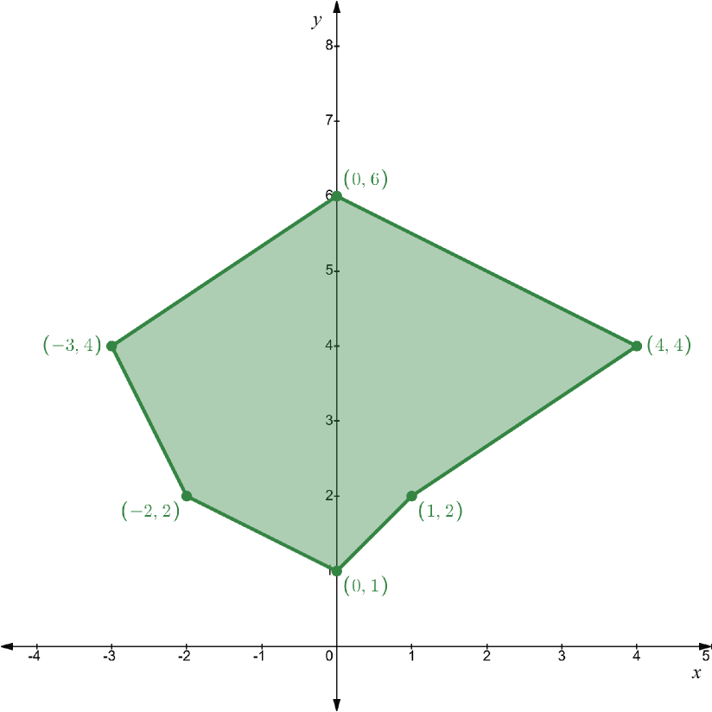
Crossing Points
x | 0, 4, 1, 0, -2, -3
y | 6, 4, 2, 1, 2, 4
Given a polygon as a set of points, rotate it along the y-axis and get the volume of the resulting object.

Slide 15
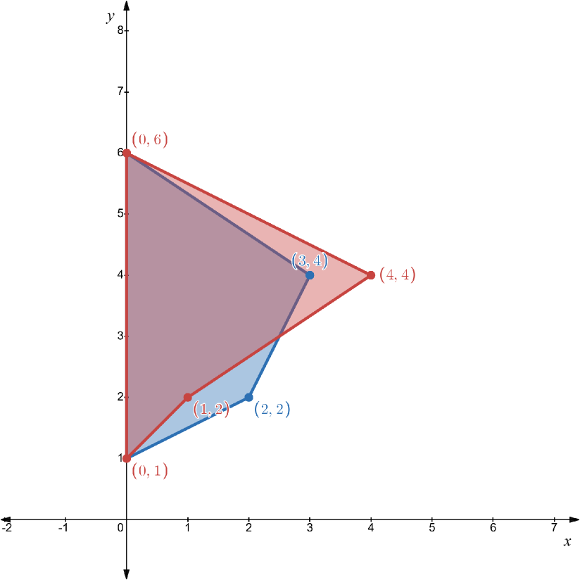
Crossing Points
This time let’s visualize the negative and positive polygons separately.

Slide 16
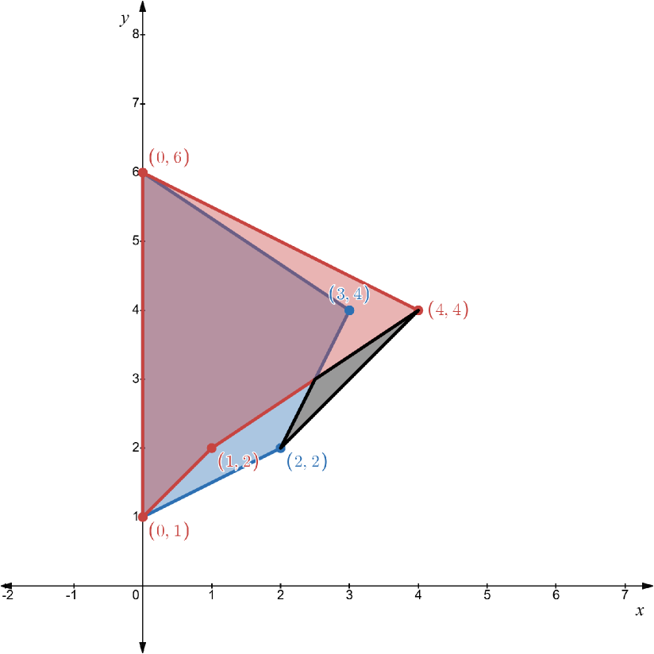
Crossing Points
If we were to take the outer most points, we would add space that isn’t apart of the object. So, we need to do some interpolation to find the crossing point.

Slide 17

Crossing Points
To find the crossing points, we check all combinations of line segments. If we find one, we add it to the list of points.

Slide 18
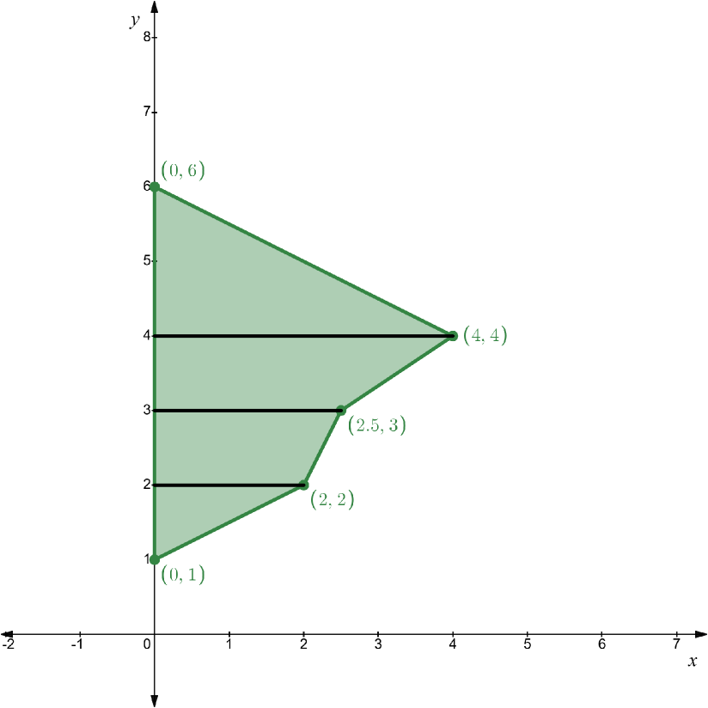

Crossing Points
Now we do the same as the last problem, take the outer most points at each y value. And calculate the volume by taking slices of the polygon.

Slide 19





Running Time
Separating the positive and negative points:
Checking for crossing points:
Selecting the outer most points:
Calculating volume:
Overall:

Slide 20
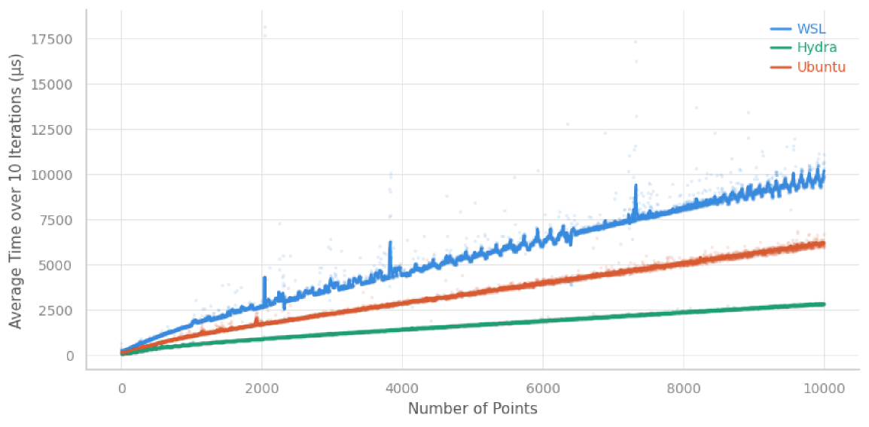
Performance
System Specs
Ubuntu on WSL - AMD Ryzen 9 5900HX 3.30 GHz
Ubuntu Dual Boot - AMD Ryzen 9 5900HX 3.30 GHz
Hydra 0 - Intel Core i7-10700 4.8GHz

Slide 21
583
56
Opened the Problem
Submitted a Solution
TopCoder Statistics
19 3.3%
37:32 20:21
Correct Solutions
Average Correct Time

Slide 22
PolygonRotation
Shashank Bandaru
EECS · COSC594
5 May 2026

