Slide 1
Texas Level Operations Management Case
Competition 2017
Team- MAVERICK
Saket Kumar
Sanjana Banda
Shaurya Trehan
13th November, 2017

Slide 2
DEFINE- Business Case Overview
Company :- ABC Inc
Leading construction company- Dallas,TX
Project:- New Office Space for XYZ Technology Solutions
Start Date:- Nov 21, 2017 | End Date:- May 21, 2018
Constraint :- Products Acquisition for project
PRODUCT DETAILS | MODE | QUANTITY
CATERPILLAR 365CL HYDRAULIC EXCAVATOR | ROAD | 1
CATERPILLAR D10R CRAWLER TRACTOR | ROAD | 1
CRATE OF PLASTIC INJECTION MATERIAL | ROAD/AIR | 1
CATERPILLAR 777 ROCK TRUCK | ROAD | 1
CATERPILLAR C3000 FORKLIFT | RAIL | 14
Problem statement
Most Optimal Route for transporting machines to the construction site in terms of time and cost
Nov- 18
Product to be picked up from all locations
Nov - 20
Product to be delivered to construction site
Nov -21
Project Start Date
Product
Logistics Timeline

Slide 3
MEASURE- Calculation of Total Costs
ROAD
Trailer Type Cost
AIR
RAIL
Rail Transit
Line Haul/Mile
Capacity(Axles, Weight)
State Permit Cost
Over Width
Over Height
Route Cost
Carriage Cost
Air Transit Cost
Transportation Cost
To the Airport
From the Airport
Drayage
Warehouse → Vendor
Vendor → Rail Ramp
Rail Lane Rate

Slide 4
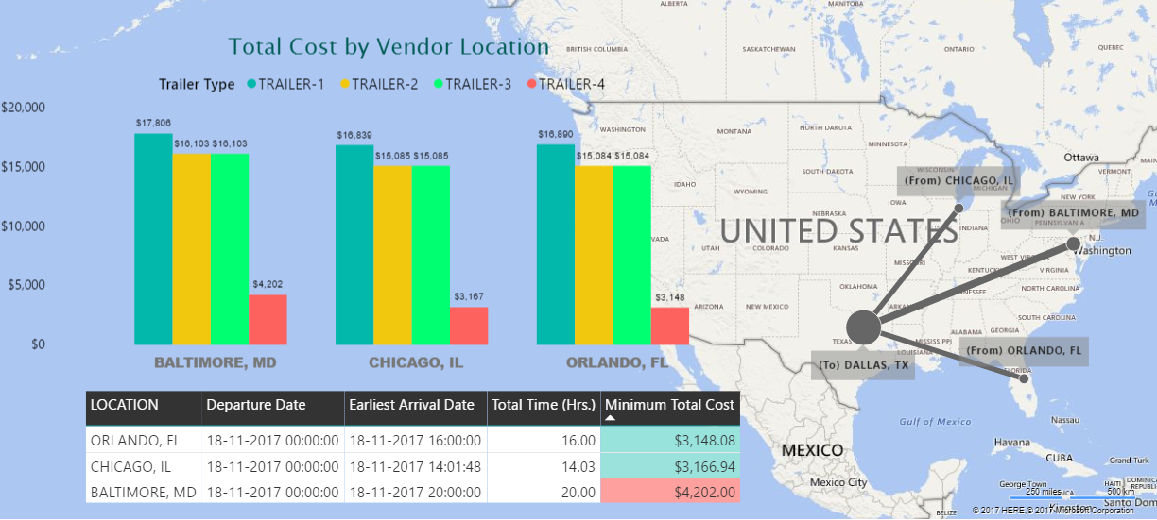
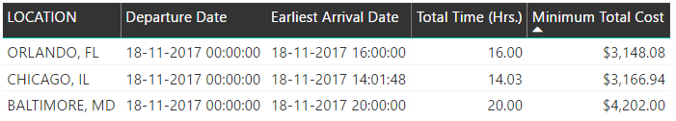
ANALYZE- Product Cost and Time
Mode of Transportation :- Road
Product :- Caterpillar 365CL Hydraulic Excavator
Route Map :- Line Thickness~ Total Cost

Slide 5
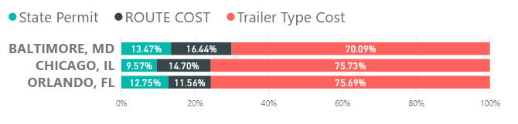
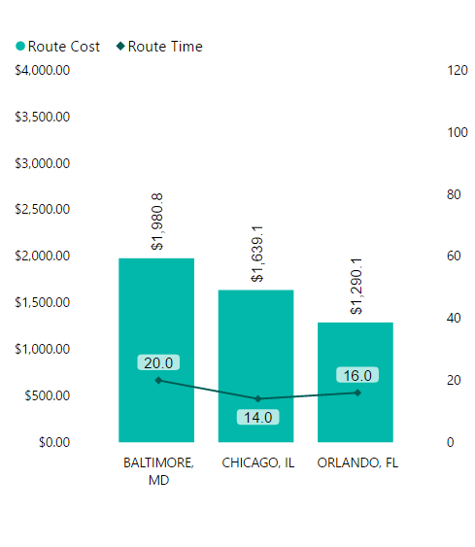
ANALYZE- Product Cost and Time
Mode of Transportation :- Road
Product :- Caterpillar 365CL Hydraulic Excavator
Route Map :- Line Thickness~ Total Cost
Inferences:-
Trailer Type Cost has a significant impact on Total Cost
Route Cost/ Hour Ratio
          Baltimore: - 99.04 $/hr
          Chicago: - 117.07 $/hr
          Orlando: - 80.6 $/hr
Total Cost
Determines the Extra Expenditure due to traffic delays
Least Route Cost/Hr and also the most optimal route

Slide 6
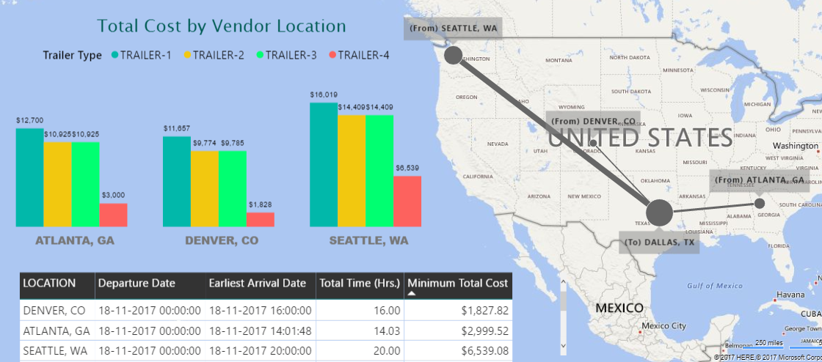
ANALYZE- Product Cost and Time
Mode of Transportation :- Road
Product :- Caterpillar 777 Rock Truck
Route Map :- Line Thickness~ Total Cost

Slide 7
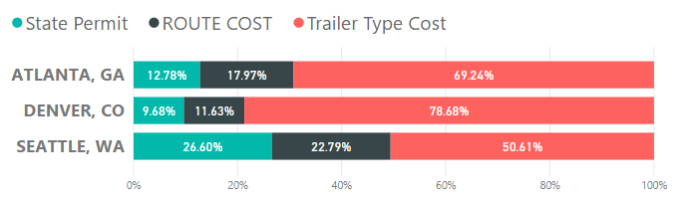
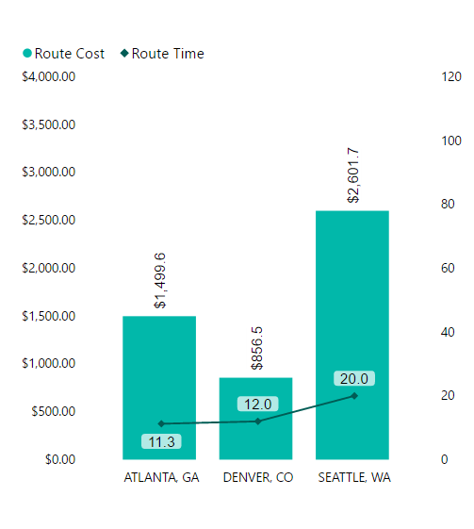
ANALYZE- Product Cost and Time
Mode of Transportation :- Road
Product :- Caterpillar 777 Rock Truck
Route Map :- Line Thickness~ Total Cost
Inferences:-
Trailer Type Cost has a significant impact on Total Cost
Route Cost/ Hour Ratio
          Denver: - 71.38 $/hr
          Atlanta: - 132.7 $/hr
          Seattle: - 130.08 $/hr
Total Cost
Determines the Extra Expenditure due to traffic delays
Least Route Cost/Hr and also the most optimal route

Slide 8
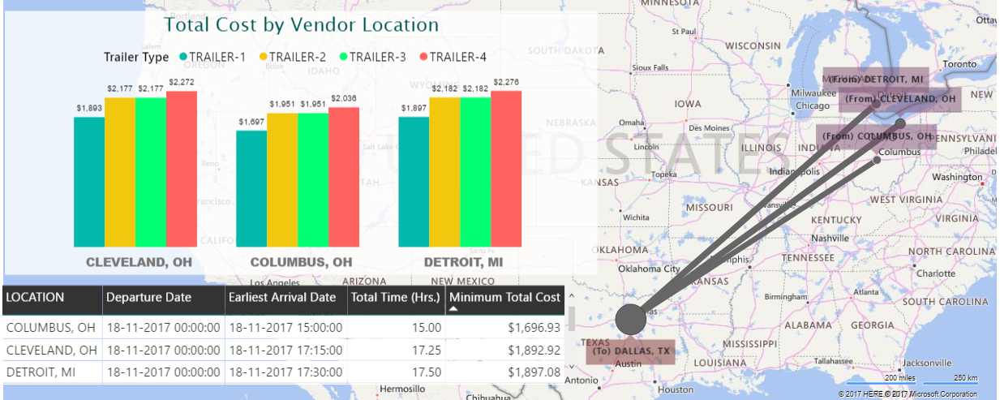
ANALYZE- Product Cost and Time
Mode of Transportation :- Road
Product :- Crate of Plastic Injection Material
Route Map :- Line Thickness~ Total Cost

Slide 9
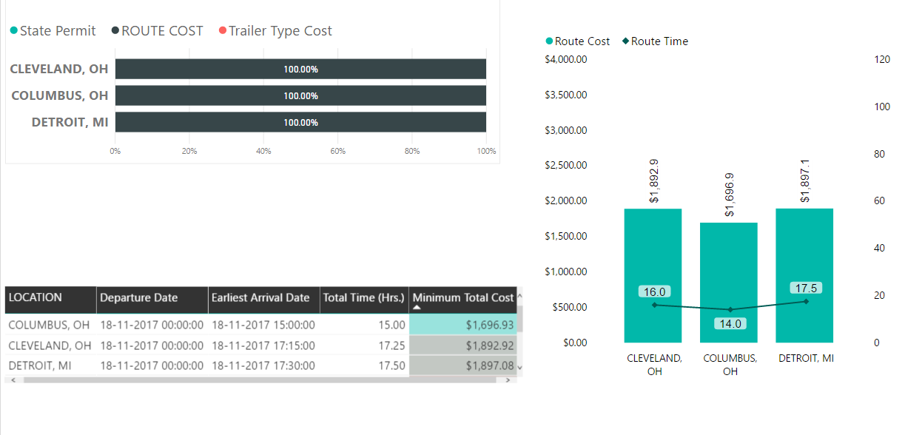
ANALYZE- Product Cost and Time
Mode of Transportation :- Road
Product :- Crate of Plastic Injection Material
Route Map :- Line Thickness~ Total Cost
Total Cost
Inferences:-
Trailer Type and State Permit cost has no impact on Total Cost
Route Cost/ Hour Ratio
          Cleveland: - 118.30 $/hr
          Columbus: - 119.06 $/hr
          Detroit: - 108.40 $/hr
Determines the Extra Expenditure due to traffic delays
In spite of having highest route cost/hr ratio, total cost break-evens at 20 hour traffic delay

Slide 10
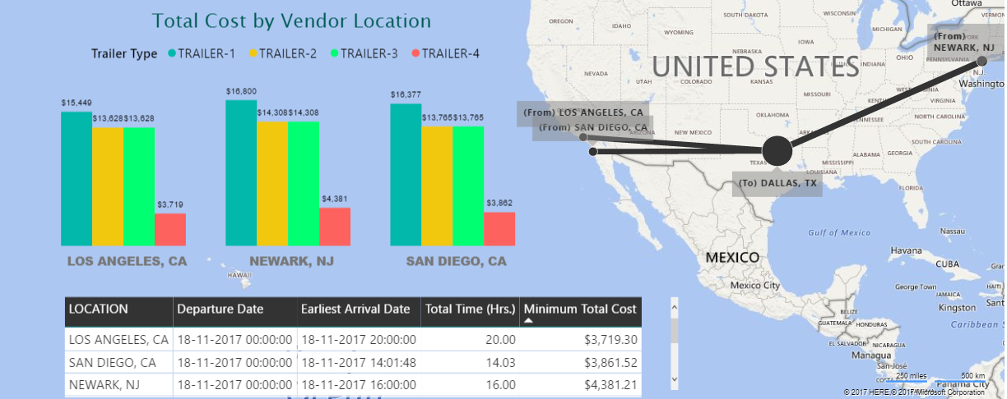
ANALYZE- Product Cost and Time
Mode of Transportation :- Road
Product :- Caterpillar D10R Crawler Tractor
Route Map :- Line Thickness~ Total Cost

Slide 11
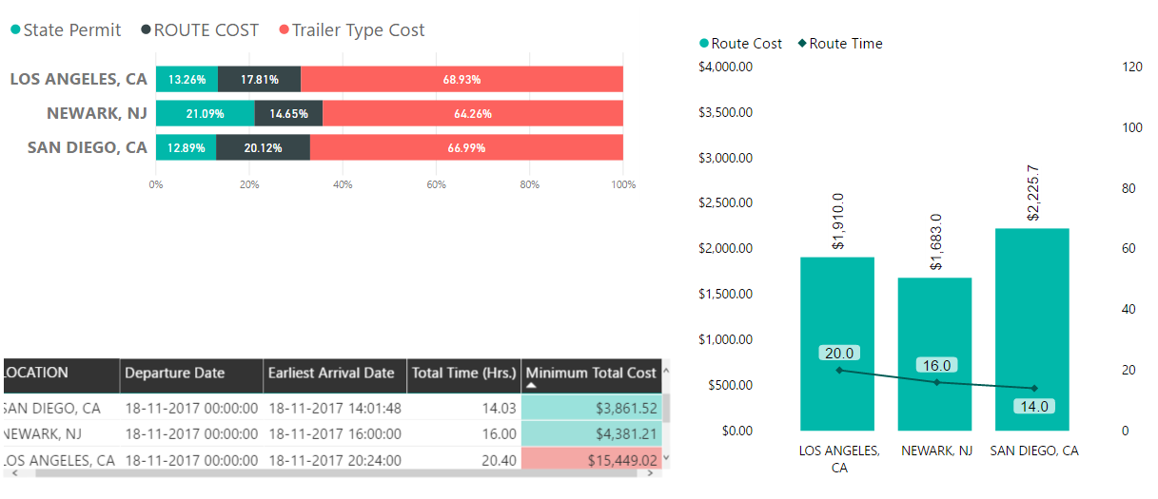
ANALYZE- Product Cost and Time
Mode of Transportation :- Road
Product :- Caterpillar D10R Crawler Tractor
Route Map :- Line Thickness~ Total Cost
Total Cost
Inferences:-
Trailer Type Cost has a significant impact on Total Cost
Route Cost/ Hour Ratio
          Los Angeles: - 95.5 $/hr
          Newark: - 105.18 $/hr
          San Diego: - 158.98 $/hr
Determines the Extra Expenditure due to traffic delays
Least Route Cost/Hr and also the most optimal route

Slide 12
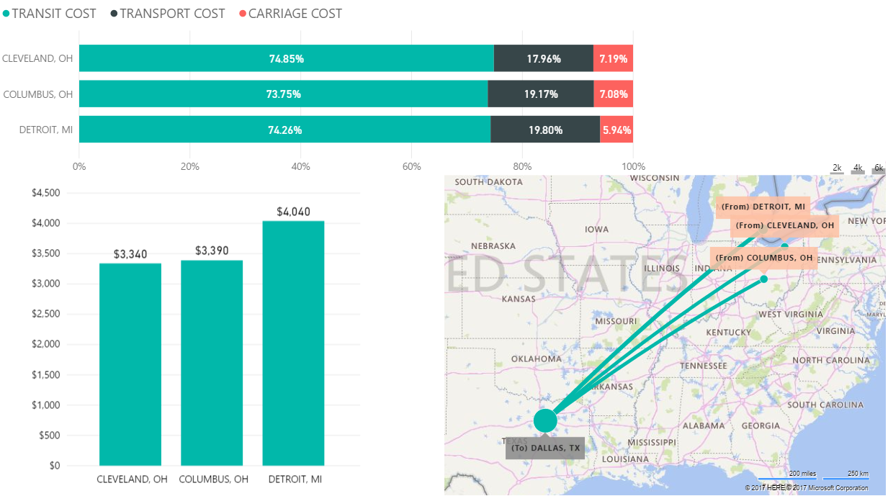
ANALYZE- Product Cost and Time
Mode of Transportation :- Air
Product :- Crate of Plastic Injection Material
Route Map :- Line Thickness~ Total Cost
Total Cost
Cleveland has the least Total Cost of 3340$ via Air, while Columbus has the least total cost of 1696$ via road.
Inference:-
Although shipment by Air has high safety and reliability, twice the costs and 3 days time is too high a trade-off to be considered.

Slide 13
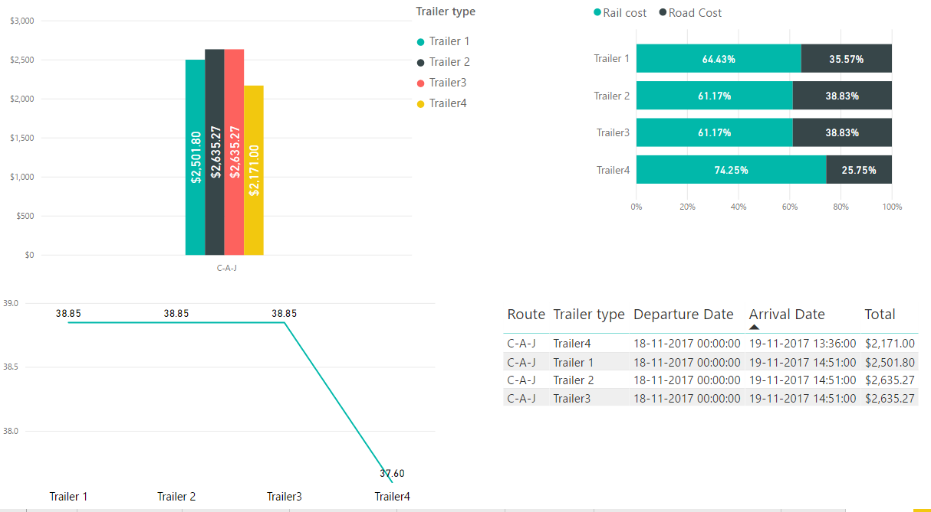
ANALYZE- Product Cost and Time
Mode of Transportation :- Rail
Product :- CATERPILLAR C3000 FORKLIFT
Route :- Chicago-Aurora-Joliet-San Antonia-Dallas
Total Cost
Most optimal route using Trailer 1,2 and 3: -
                -> 7 Products from Vendor- Joliet
                -> 5 Products from Vendor- Aurora
                -> 2 Products from Vendor- Joliet
Methodology :- Utilizing Maximum Capacity of Vendors in a single route
Inference : - As net cost of repeated trips exceeds the additional cost and time of using trailer-4, Trailer-4 is the most optimum choice in terms of costs and time trade-off
14 Products
Most optimal route using Trailer 4: -
                -> 5 Products from Vendor- Aurora
                -> 9 Products from Vendor- Joliet
14 Products

Slide 14

ANALYZE- Product Cost and Time
Mode of Transportation :- Rail
Product :- CATERPILLAR C3000 FORKLIFT
Route :- Indianapolis-Bloomington-Carmel-San Antonia-Dallas
Total Cost
Most optimal route using Trailer 1,2 and 3: -
                -> 7 Products from Vendor- Carmel
                -> 5 Products from Vendor- Bloomington
                -> 2 Products from Vendor- Carmel
Methodology :- Utilizing Maximum Capacity of Vendors in a single route
Inference : - As net cost of repeated trips exceeds the additional cost and time of using trailer-4, Trailer-4 is the most optimum choice in terms of costs and time trade-off
14 Products
Most optimal route using Trailer 4: -
                -> 5 Products from Vendor- Bloomington
                -> 9 Products from Vendor- Carmel
14 Products

Slide 15
Outcome- Most Optimized Route
Product | MOT | Route(From) | Route(To) | Trailer Used | Total Cost($) | Earliest Arrival Date/Time
CATERPILLAR 365CL HYDRAULIC EXCAVATOR | Road | Orlando | Dallas | 6 & 9 Axle High Tonnage Double Drop Expandable | 3148 | 11-18-2017 16:00
CATERPILLAR D10R CRAWLER TRACTOR | Road | Los Angeles | Dallas | 6 & 9 Axle High Tonnage Double Drop Expandable | 3719 | 11-18-2017 20:00
CRATE OF PLASTIC INJECTION MATERIAL | Road | Columbus | Dallas | 48’ and 53’ Flatbed | 1697 | 11-18-2017 15:00
CATERPILLAR 777 ROCK TRUCK | Road | Denver | Dallas | 6 & 9 Axle High Tonnage Double Drop Expandable | 1827 | 11-18-2017 16:00
CATERPILLAR C3000 FORKLIFT | Rail | Chicago-Aurora-Joliet | San Antonio-Dallas | 6 & 9 Axle High Tonnage Double Drop Expandable | 2171 | 11-19-2017 13:36
Total Cost : - 12562 $

Slide 16
Our Key Service Qualities/Characteristics
Safety
GPS telematics tool to monitor drivers locations in real-time enables to control the speed of driving.
Truck driver is also alerted with crash points and accident prone areas to avoid any untoward mishaps and to deliver the product on time.
Scale
Our network with the best truck vendors across united states avails backups for the transportation of the product on time with 100% commitment.
Quality
Advanced truck routing(Google API Direction services), digital mapping and scheduling software solutions are used by making use of algorithms specifically to optimize road based transportation operations providing the most optimized cost.

