Slide 1
Data Observability Databand

Slide 2






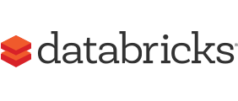


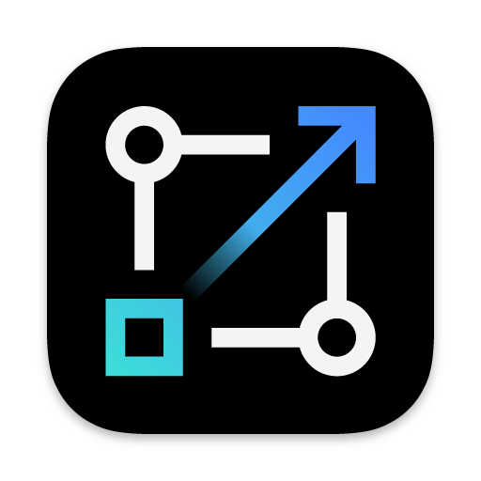





Data pipelines feed modern enterprises
Data Analytics
Business analytics and dashboards
Data Engineering
Data Product
Client facing systems
Data Science
Machine learning and predictive analytics
Tracking:
Apache Airflow
DataStage NextGen
Python
Spark/JVM Applications
dbt
Snowflake
Redshift
Azkaban
Notes:
It is importance to ensure the accuracy of data products before sending them outside the organization or using them to take business decision, something that is difficult to do in a real-time data environment.
The solution to this problem is data observability, which allows data science teams to ensure the accuracy and timely updates of their dashboards. Data pipelines are used to move data in an automated way, with modern data stack tools such as Spark, Airflow, dbt, snowflake, and datastage next gen.
In a data landscape, there are typically two teams: data engineers who massage data into a usable format for data scientists, and data analysts who focus on speed and performance. However, it can be challenging to track and observe data pipelines with different tools, skills, and interests across multiple teams.
Databand offers a solution that can observe data pipelines across multiple teams and technologies.

Slide 3


IBM Data Fabric
The Databand acquisition bridges two of IBM’s strategic directions, IBM Data Fabric and IBM Observability.
Ingest
DataStage
Orchestrate
IBM Observability
Watson Pipelines
Application Observability
Data Observability
Model
Observability
Instana
Databand
OpenScale
Catalog
OpenScale
WKC
Store
Netezza
Consume
Watson Studio
Notes:
Databand intersects two areas of the business
IBM Observability
IBM Data Fabric
By bridging these two categories, can we know offer full observability

Slide 4


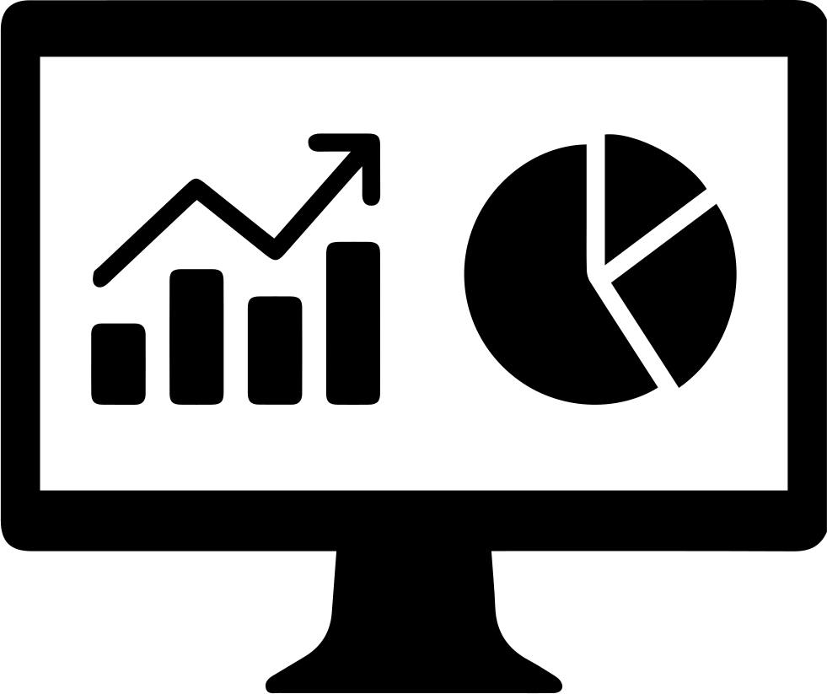



Databand focuses on observing data in motion
Solution
Proactive Data Observability: Shift left and solve problems at the source
Sources
Data Lake
Data Warehouse
Data Access
CRITICAL
(Data engineers)
(Analysts, Scientists)
Observe data pipeline process quality
Status
Performance
Latency
Observe data quality and reliability
Schema changes
Data shape
Data freshness
Supported data pipelines and workflow managers
Airflow: Python, Spark, dbt, SQL and other operators
Notes:
Let’s review some of the specifics of what Databand can do today in the areas of data observability.
Databand focuses on data observability for data in motion, in other words on monitoring data that’s currently being used in data pipelines..
Databand provides observability for process quality and data quality. For process quality it monitors data pipeline execution status, performance, and latency, and in the area of data quality some of the top items that our solution monitors are schema changes, data shape, and data freshness..

Slide 5



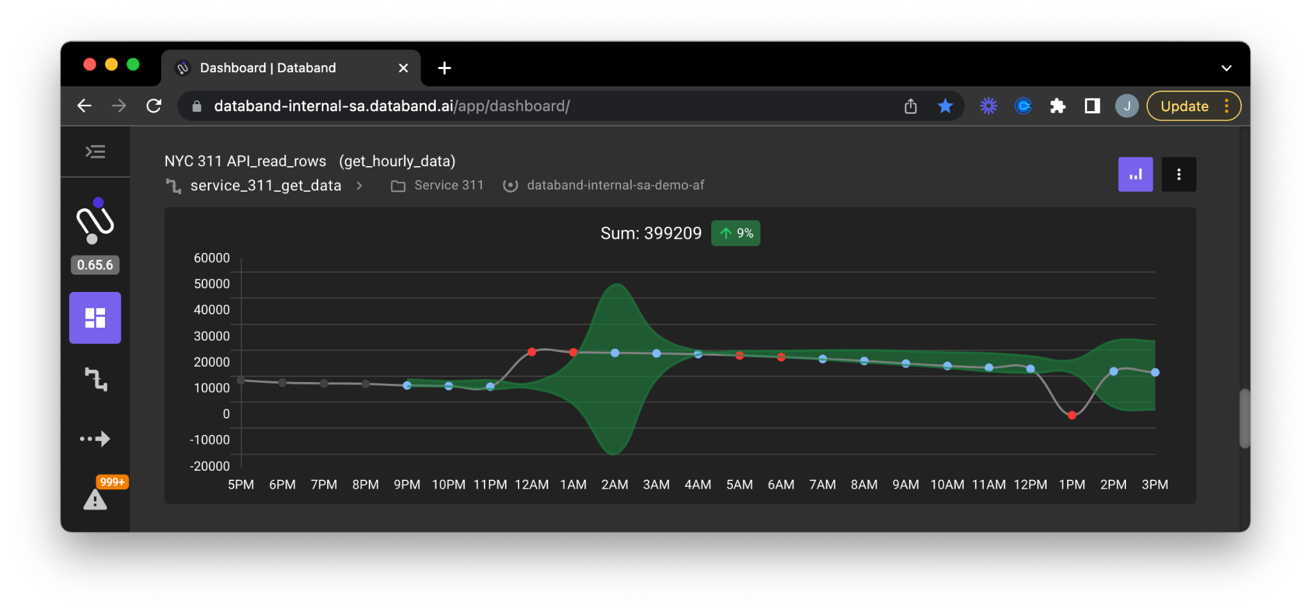


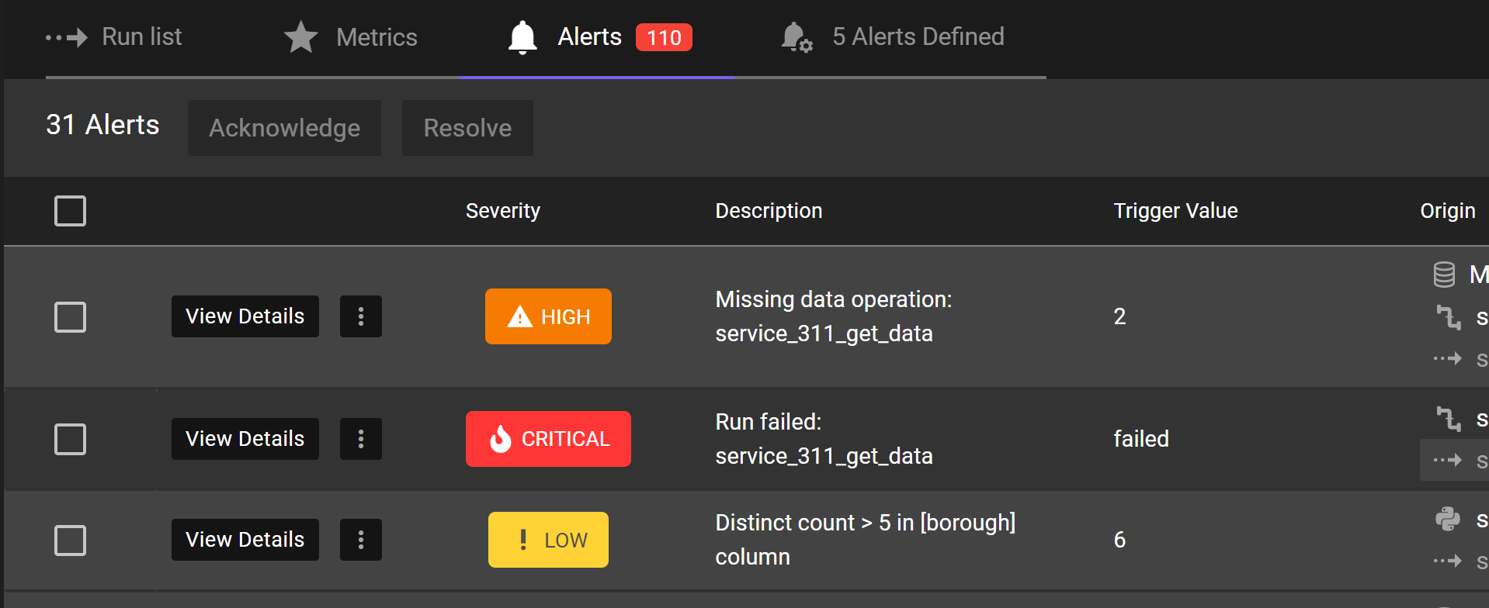
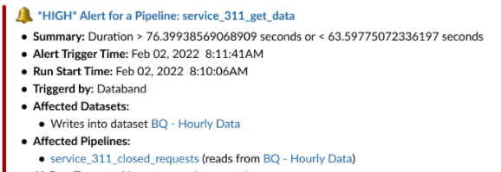
Databand Platform Data observability & incident management
1 Automatically collect metadata From all key solutions in the modern data stack – DQ, PQ, DL
2 Build historical baseline Based on common data pipeline behavior.
Collect
Profile
4 Resolve through automation Create smart workflows to remediate data quality issues and keep SLAs on track.
3 Alert on anomalies and rules Based on deviations or breaches.
Resolve
Alert
Notes:
Databand automatically collects metadata with minimal setup required for pipelines run in Airflow or Spark jobs, and a small SDK wrapper for other technologies.
Databand builds a historical baseline of how data typically behaves in pipelines, allowing for automatic alerts when something out of the ordinary occurs.
Databand helps users identify important alerts in the noise of pipeline activity. For example, if a pipeline fails and then restarts within its SLA, no warning is needed. However, if a pipeline takes longer than usual, Databand sends an alert that can be downgraded if the error is resolved multiple times without intervention. Alerts can be sent through various channels, including Slack and direct phone notifications.
Databand offers an incident management system that provides a dashboard to track pipeline lineage and resolution.

Slide 6
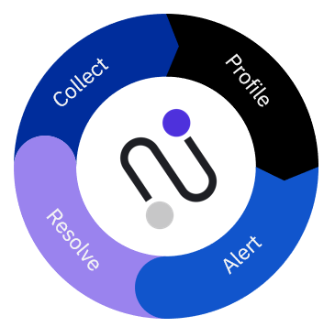
Contact and links
Powerpoint is good, but to get a better feel for how Databand works in action. Please watch this 3 min video:
https://youtu.be/63xuqS2DYz8
Want to know more?
Feel free to contact:
Johan.vastfalt@ibm.com
Stefan.west@se.ibm.com

