Slide 1


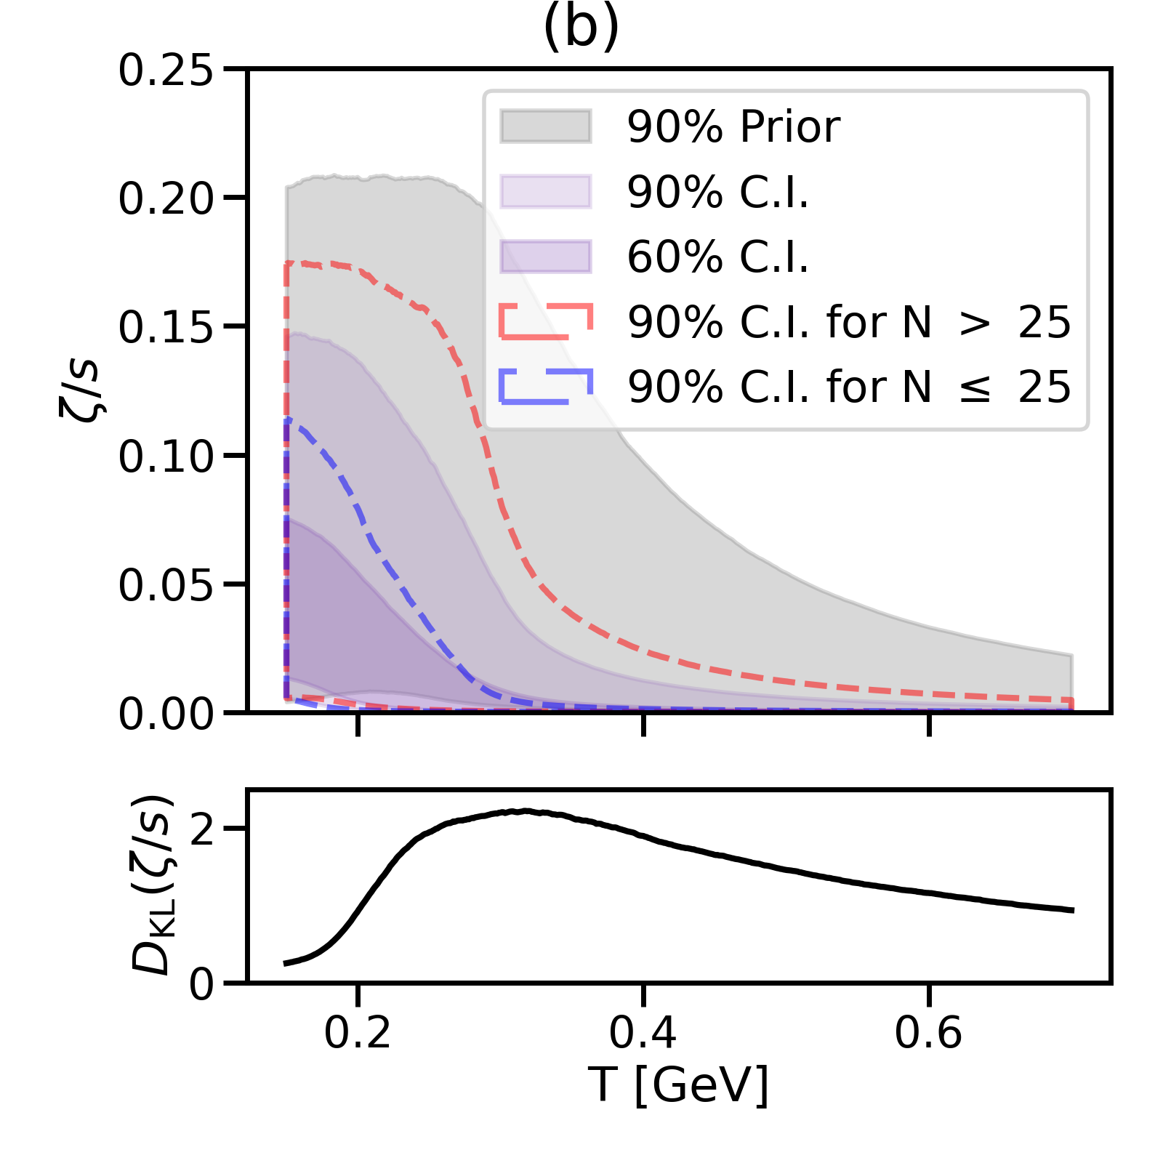
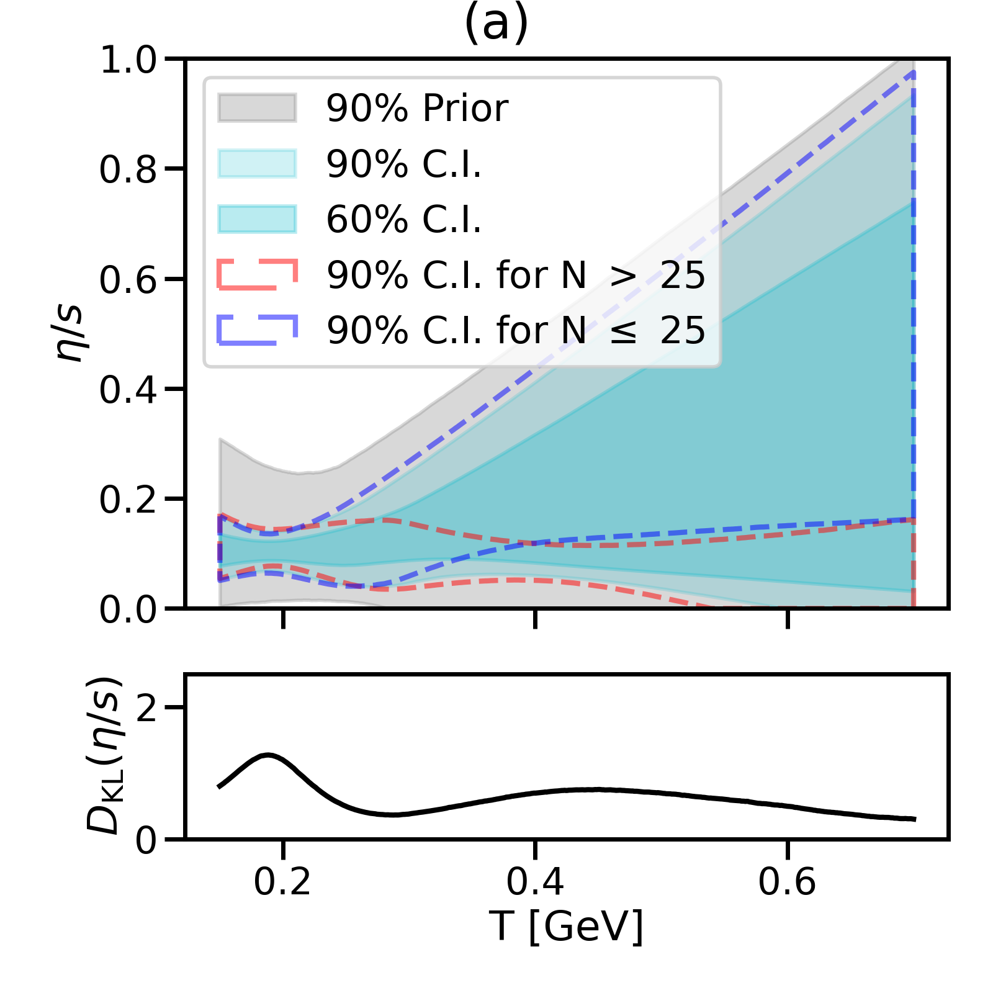
BAND Science Highlight:
Bayesian calibration of the VAH model for heavy-ion collisions
specific bulk viscosity specific shear viscosity
The novel Viscous Anisotropic Hydrodynamics (VAH) model can simulate relativistic heavy-ion collisions from very early times, eliminating the need for a separate far-off-equilibrium pre-hydrodynamic model. VAH was calibrated on LHC data using Bayesian tools in the BAND Software Framework. This calibration allowed us to constrain the specific shear and bulk viscosities of quark-gluon plasma up to tempera-tures of about 700 MeV, much higher than for any previous analysis.
Liyanage et al., PRC 108 (2023) 054905
VAH model
PRC 108 (2023) 054905
JETSCAPE SIMS model
PRL 126 (2021) 242301
Figure: Prior (grey) and posterior (colored) credible intervals for the tempera-ture-dependent specific bulk (left) and shear (right) viscosities in the new VAH model (top) and the JETSCAPE SIMS model (bottom). LHC data from Pb+Pb collisions at an energy of 2.76 TeV per nucleon pair were used for the calibra-tion. The bottom panels show the information gain (Kullback-Leibler divergence) from the prior to the posterior probability distributions as a function of tempera-ture. Note the different temperature ranges explored by the two models.

