Slide 1



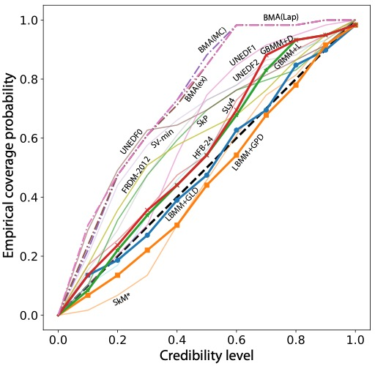
BAND Science Highlight
Bayesian Dirichlet mixing of imperfect models
Problem: To develop methods to improve the predictability of complex computational models in the experimentally-unknown domains,
Method: We propose a Bayesian statistical machine learning framework utilizing the Dirichlet distribution that combines results of several imperfect models. To illustrate the method, we study the ability of Bayesian model averaging and mixing techniques to mine nuclear masses.
Results: The global and local mixtures of models reach excellent performance on both prediction accuracy and uncertainty quantification and are preferable to classical Bayesian model averaging. We also show that improving model predictions through mixing rather than mixing of corrected models leads to more robust extrapolations.
Publication: Sci. Rep. 13, 19600 (2023)
Figure: Empirical coverage probability for raw models without statistical correction together with BMA and BMM variants. The empirical coverage probability was calculated with equal-tailed credibility intervals. The reference line (diagonal) is marked by a dashed line.

Slide 2
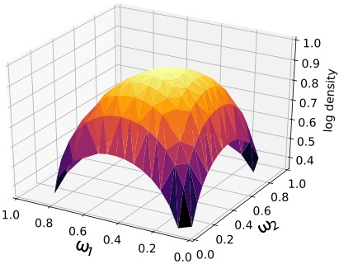
Local Bayesian Dirichlet mixing of imperfect models
To improve the predictability of complex computational models in the experimentally-unknown domains, we propose a Bayesian statistical machine learning framework utilizing the Dirichlet distribution that combines results of several imperfect models.
Contact: Vojta Kejzlar (vkejzlar@skidmore.edu)
Witek Nazarewicz (witek@frib.msu.edu)

