Slide 2
Steps for data extraction and transformation
Data Source:
Step 1: choose data source
Data extraction:
Step 2: connect data source to excel
Step 3: clean the data using excel formulas
Data collection:
Step 4: append the new data for every one minute
Data computations:
Step 5: calculate the price change in last 24 hours
Data Aggregations:
Step 6: calculate the min, max of each company and append.

Slide 3
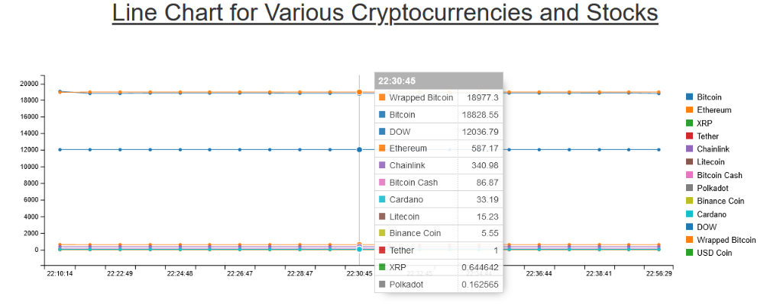
Steps to visualize data in web
Step 1: Execute the below command to run the program in localhost from the root directory i.e., “Streaming-Visualization\Web Visualization”
Command: python -m SimpleHTTPServer
Step 2: Goto http://localhost:8000/
Step 3: Below is the screen displayed in the web page.

Slide 4
Visualization Using Tableau
Step 1: Import excel data through the Microsoft excel.
Step 2: Drag your corresponding sheet in to the dashboard then you will see the data in the data source.
Step 3: Create a parameter by right clicking in the tableau.
Step 4: Change the allowable values from all to list.
Step 5: Write the crypto currency names according to the data in the Display as column and click on OK.
Step 6: Create a calculated field by right clicking in the tableau and write some code.
Step 7: Insert time in the columns row and parameter in the rows and select line graph in the marks.

