Slide 1
Transforming Casual Riders into Annual Members
Cyclistic Bike-Share Program
Date: 01-12-2024
Presented by: B. Ramya

Slide 2
Table of Contents
Introduction
Objectives
Methodology
Data Preparation
Key Findings
Visual Insights
Recommendations
Conclusion
Future Opportunities
Q&A

Slide 3
Introduction
Who is Cyclistic?
A Chicago-based bike-share program.
Fleet: 5,800+ bikes and 692 docking stations.
Goal: Increase annual memberships by converting casual riders.

Slide 4
Methodology
Steps:
Ask
Prepare
Process
Analyze
Share
Act
Tools Used: R, Excel, Descriptive Analytics, Visualizations.

Slide 5
Data Preparation
Unified column names across datasets.
Removed unnecessary fields like location and demographics.
Consolidated user types into “casual” and “member.”
Added calculated metrics: ride duration and date fields.

Slide 6
Key Findings
Usage Patterns:
Casual riders peak on weekends (Sundays).
Members show consistent usage across all days.
Ride Duration:
Casual rider’s average longer trips, especially on weekends.

Slide 7
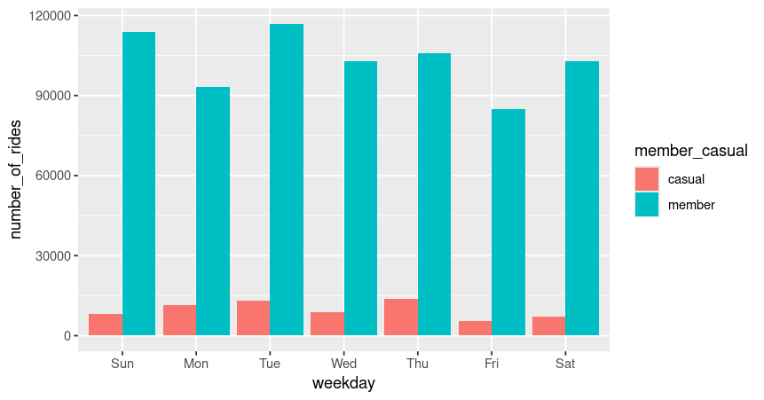
Visual Insights
The chart compares weekly ride trends for members and casual riders.
Members: Consistent usage throughout the week, peaking on Tuesday.
Casual Riders: Higher activity on weekends, indicating leisure-oriented usage.
Members consistently outnumber casual riders across all days.
Highlights distinct usage patterns between the two groups.

Slide 8
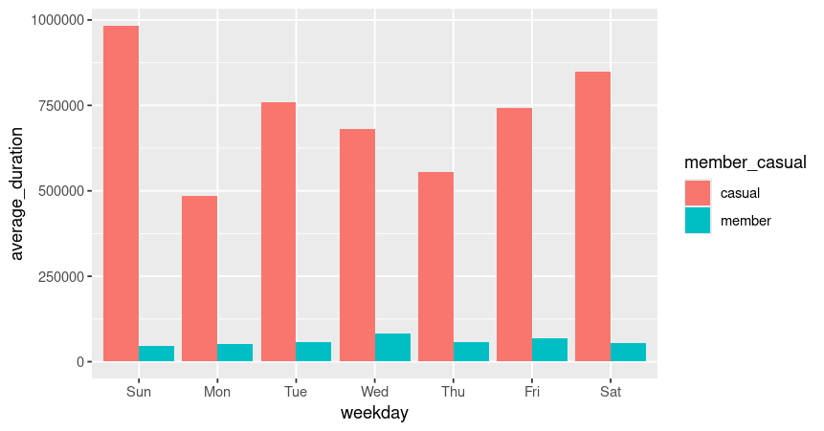
Average Ride Duration by Day of Week.
Casual users have longer ride durations than members.
Peak durations for casual users on weekends (Saturday, Sunday).
Members show consistent, shorter durations across all days.
Indicates casual users ride for leisure, members for routine trips.

Slide 9
Recommendations
Weekend Promotions:
Target casual riders with weekend membership discounts.
Commute Marketing:
Highlight weekday benefits of memberships.
Loyalty Programs:
Reward frequent casual riders with ride credits or membership trials.

Slide 10
Conclusion
Summary: Understanding rider behavior is key to increasing memberships.
Additional Insights:
Annual members show patterns that align with daily commuting needs, emphasizing stability.
Casual riders demonstrate a recreational approach, highlighting potential weekend-focused campaigns.
Next Steps: Implement targeted campaigns, refine data tracking for emerging trends, and monitor effectiveness of membership drives.

Slide 11
Future Opportunities
Enhanced Technology Integration: Leverage app-based notifications to promote membership benefits in real-time.
Sustainability Goals: Emphasize the environmental benefits of consistent bike-share usage.
Community Engagement: Partner with local businesses to offer discounts tied to memberships.

Slide 12

Questions and Feedback

