Slide 1

Seasonal Agriculture Performance Analysis
Ramya Bandi
Chaitanya Bharathi Institute of Technology
AICTE STU ID :STU6a675f1cb8c3c1785159452

Slide 2

PROBLEM STATEMENT
Agricultural activities are influenced by seasonal variations in environmental conditions, farming practices, resource availability and market conditions. As a result, agricultural performance may differ from one season to another.
However, raw agricultural data does not clearly explain how agricultural performance changes across seasons or what patterns can be observed in different seasonal conditions.
The problem is to analyze the given agricultural dataset and investigate seasonal differences in agricultural performance by identifying meaningful patterns, trends, relationships and variations within the available data.

Slide 3
Project Description
Seasonal Agriculture Performance Analysis is a data analysis project that focuses on understanding how agricultural performance changes with different seasons and farming conditions.
The project uses agricultural data containing details such as crop production, farming practices, environmental conditions, resource usage, and economic factors.
The main aim of the project is to study the data and find useful patterns and differences between seasons. By comparing factors such as production, resource usage, and environmental conditions, the project helps identify which conditions are associated with better or lower agricultural performance.
The analysis can help in understanding the effect of seasonal changes on farming and provide useful insights that can support better agricultural planning and decision-making.

Slide 4
WHO ARE THE END USERS?
Farmers – To understand seasonal changes and improve farming practices.
Agricultural Researchers – To study trends and patterns in agricultural performance.
Agricultural Officers – To support planning and provide better guidance to farmers.
Government Departments – To assist in agricultural policies and resource planning.
Agribusinesses – To understand crop production and market-related trends.
Students & Academics – For studying and analyzing agricultural data.

Slide 5

Technology Used
Google Colab – For writing and running the analysis.
Python – Main programming language used.
Pandas – For data cleaning and data analysis.
NumPy – For numerical calculations.
Seaborn – For data visualization.
Matplotlib – For creating graphs and charts.

Slide 6
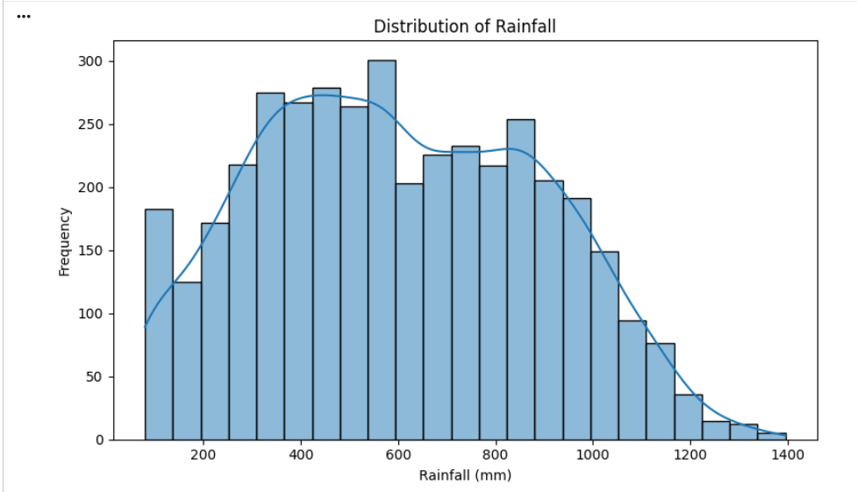
RESULTS
The rainfall distribution shows variation in rainfall levels across the observations, with most values concentrated within a particular range and some observations receiving relatively higher or lower rainfall. This indicates variability in rainfall conditions across the dataset.

Slide 7
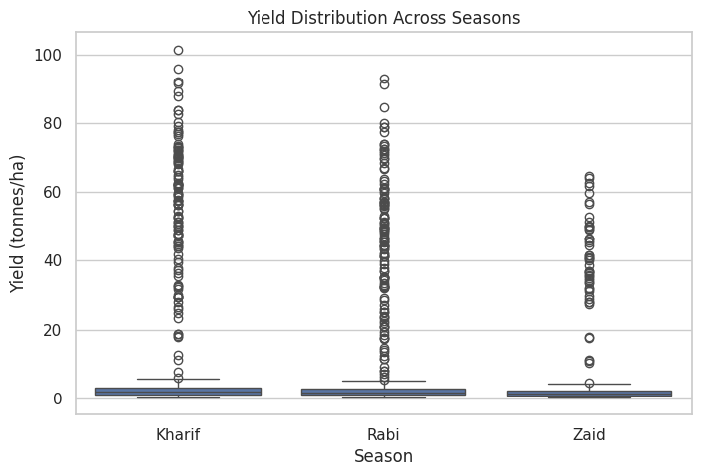
RESULTS
The Kharif season achieves the highest peak crop yield (over 100 tonnes/ha), outperforming Rabi and Zaid, though typical median yields remain low across all seasons.

Slide 8
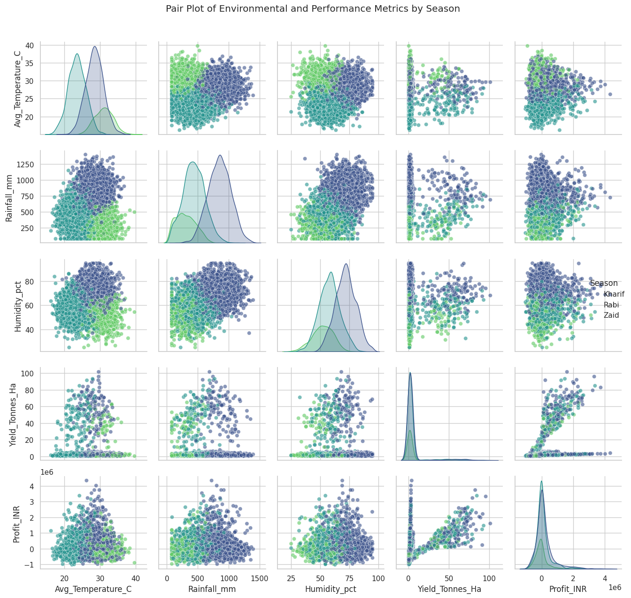
RESULTS
Yield acts as the primary driver of profitability across all seasons, while environmental metrics like rainfall and temperature reveal distinct, season-specific climate clusters.

Slide 9
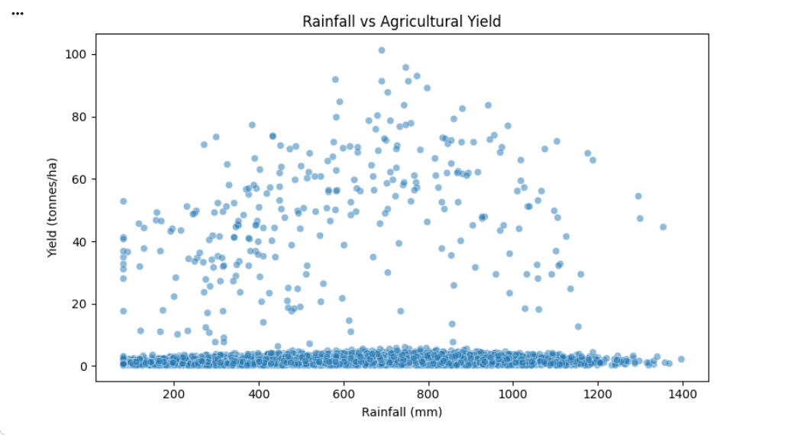
RESULTS
The scatter plot shows a positive association between rainfall and agricultural yield. Generally, yield tends to increase as rainfall increases, although the data points are widely scattered, indicating that rainfall is not the only factor influencing yield.

Slide 10
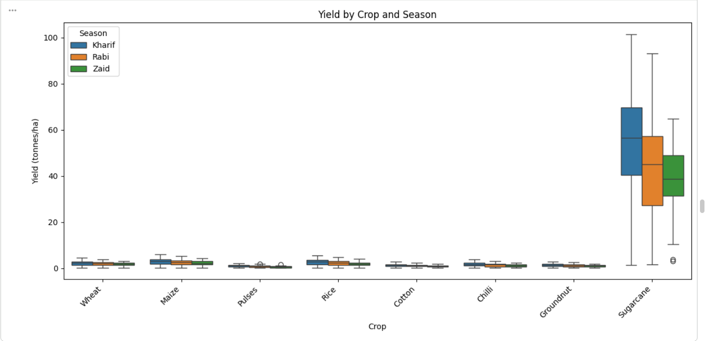
RESULTS
The box plot compares crop yield across different crops and seasons. It shows the variation and distribution of yield for each crop-season combination, helping identify differences in agricultural performance.

Slide 11
Future scope
Crop Yield Prediction – Use machine learning to predict crop production for different seasons.
Weather-Based Analysis – Include real-time weather data to study its effect on agriculture.
Smart Farming – Use the insights to support better irrigation, fertilizer, and resource management.
Early Risk Detection – Identify possible risks such as low rainfall, poor yield, or unfavorable conditions.
Interactive Dashboard – Develop a dashboard where users can easily view seasonal trends and agricultural insights.
Real-Time Data Integration – Connect the system with live agricultural and environmental data for more accurate analysis.

Slide 12
GitHub Link
https://github.com/bandiramya/Seasonal-Agriculture-Performance-Analysis.git

Slide 13
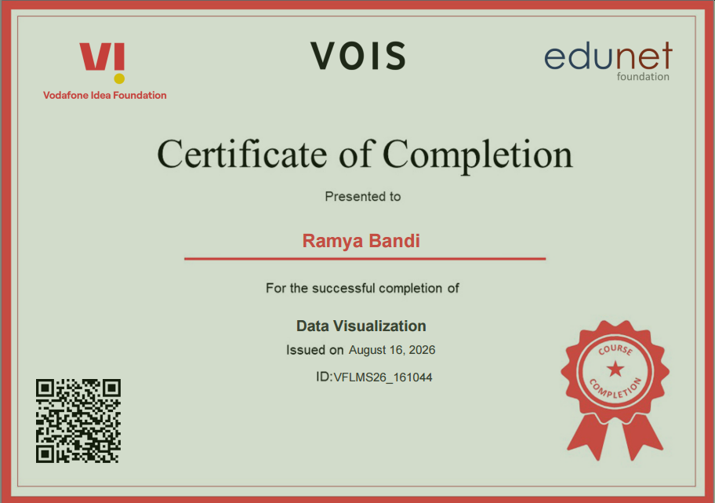
VOIS Course completion certificate - Course name- Data Visualization

Slide 14
Thank you
.
.

