Slide 1

Actuary AI
Multi-Agent Uncertainty System · Variational Information Bottleneck · POMDP
Group Member name: Bandi Sai Vikas - 231010419
k.Nitheesh kumar - 231000026
J. Jayasurya - 231000025
Date:18-05-2026
Dr. Shyama Prasad Mukherjee International Institute of Information Technology, Naya Raipur
B.Sai Vikas • K.Nitheesh Kumar • J.JayaSurya | Dept. of Computer Science & Engineering, IIIT Naya Raipur

Slide 2
The Problem: Confidently Wrong Agents
LLMs in high-stakes domains express high confidence in wrong answers — with no error signal
Model said
Why does this break agentic systems?
84.5%
When an LLM agent says "91% confident" and is wrong, the POMDP layer sees a trusted answer and passes it without human review — causing silent, automated errors in insurance decisions.
confident
What ECE measures
Expected Calibration Error — the gap between expressed confidence and actual accuracy. ECE = 0.2945 means model is ~29 percentage points overconfident on average. Perfect calibration = ECE of zero.
Actually correct
68%
Why existing fixes are insufficient
Gap = 16.5 percentage points
Temperature Scaling and MC Dropout apply the same correction to all inputs regardless of context. They cannot detect per-prediction uncertainty from the information in the input itself.
100 actuarial questions · Mistral 7B
International Institute of Information Technology, Naya Raipur
02

Slide 3
5-Agent Layered Blackboard System
All agents communicate exclusively via shared blackboard — zero direct agent-to-agent calls
0
Orchestrator
BLACKBOARD
Controls pipeline, routes messages, maintains message log
Preprocessing Agent
L0
query, ground_truth
1
Parses natural-language query, builds structured ReAct prompt
L1
prompt, parsed_choices
2
Reasoning Agent
Calls LLM backend (Ollama / Groq / HF), returns log-probs
L2
predicted, confidence, log_probs
3
Uncertainty Agent
Applies VIB layer to produce calibrated σ uncertainty signal
L3
σ (sigma), uq_method
4
Calibration Agent
L4
ece, auroc, calibration_gap
Computes ECE, AUROC, rolling calibration history
5
POMDP Agent
L5
pomdp_action, belief_state
Reads σ + confidence → ANSWER / SEEK_INFO / DEFER
International Institute of Information Technology, Naya Raipur
03

Slide 4
POMDP: When Should the Agent Answer?
The agent uses VIB σ as a belief state to decide when it can be trusted to act autonomously
Belief State: b(correct) = conf × 0.5 + (1 − σ) × 0.3 + (1 − ECE) × 0.2 σ is the VIB uncertainty signal from Layer 3
✓ ANSWER
? SEEK INFO
→ DEFER
σ < 0.25 AND conf > 0.65
0.25 ≤ σ < 0.55
σ ≥ 0.55
Belief state is narrow. The agent is sufficiently certain. Provide prediction directly to the insurance underwriter with confidence score.
Belief state is moderately diffuse. Request additional data before deciding — claims history, medical records, or additional policy documents.
Belief state too wide. VIB σ is too high — uncertainty exceeds the safe threshold. Escalate to senior human underwriter. Do not act automatically.
Triggered 58% of queries | Accuracy: 89%
Triggered 28% of queries | Accuracy: 62%
Triggered 14% of queries | Accuracy: 31% ← correctly deferred
International Institute of Information Technology, Naya Raipur
04

Slide 5
Structured JSON Messages
Every agent interaction is a typed, traceable message object — not raw function calls
SAMPLE MESSAGE (REQUEST)
Why This Design Matters
{
"message_type": "REQUEST",
"sender": "orchestrator",
"receiver": "uncertainty_agent",
"payload": {
"question": "Is this claim suspicious?",
"choices": ["suspicious", "not suspicious"],
"predicted": "suspicious",
"confidence": 0.847,
"log_probs": [0.847, 0.153]
},
"message_id": "a3f7b2c1",
"timestamp": "2026-05-16T14:22:31Z",
"status": "PENDING",
"trace": []
}
Full Observability —
Every inference run can be replayed from the message_log. Debugging is trivial — you see exactly what each agent sent and received.
Agent Independence —
Changing the VIB formula in UncertaintyAgent never affects any other agent. Only the blackboard key 'sigma' matters to downstream agents.
Status Tracing —
PENDING → PROCESSING → COMPLETED or FAILED — every message has a lifecycle. The orchestrator knows precisely when something breaks.
Research Reproducibility —
The entire pipeline state at any point in time is a JSON snapshot. Every experiment is fully reproducible from the message log alone.
International Institute of Information Technology, Naya Raipur
05

Slide 6
Softmax Confidence Cannot Be Trusted
The most common calibration baseline is structurally overconfident — and existing fixes apply to all inputs equally
Phase 3 Results
Why Temperature Scaling and MC Dropout Are Insufficient
100 real actuarial questions · Mistral 7B
→
Global correction, not per-input —
0.2945
+0.166
Temperature Scaling divides all logits by the same scalar T=1.5. A simple actuarial question and an ambiguous edge case get identical adjustments.
Softmax
ECE
Gap
→
MC Dropout is expensive and approximate —
0.2348
+0.089
Temp. Scaling
5 forward passes with simulated dropout gives noisy variance estimates. On API-level outputs (no model internals), this is even weaker — we cannot access hidden states.
ECE
Gap
0.2935
+0.163
→
Both miss the information source —
MC Dropout
These methods post-process the output logit distribution. The root cause — how much information the input actually carries — is never examined.
ECE
Gap
0.1501
−0.081
✓
VIB operates at the source —
VIB Layer
ECE
Gap
VIB reads the log-probability distribution and computes entropy H(q) and KL divergence from uniform. High entropy means the input is ambiguous — and σ reflects that.
International Institute of Information Technology, Naya Raipur
06

Slide 7
VIB Layer: Information-Theoretic Uncertainty
A trained encoder that learns to be honest — KL regularization prevents overconfident latent representations
VIB Encoder Architecture
Training Objective (VIB Loss)
Input: conf_dist ∈ ℝᴷ
L = BCE(correctness) + β · KL( N(μ,σ²) ‖ N(0,I) )
Softmax distribution from Reasoning Agent
Linear(K → 64) → ReLU
β = 0.01 · Latent dim = 32 · Trained on 215 samples
Feature extraction from confidence vector
Linear(64 → 64) → ReLU
The KL term forces honest uncertainty — the encoder cannot output a low σ when its latent distribution is wide.
Non-linear representation
μ-head: Linear(64 → 32)
VIB Formula (Analytical Approximation)
Mean of latent Gaussian distribution
σ-head: Linear(64→32) + Softplus
σ = tanh( β₀ · H(q) + β₁ · KL(p ‖ uniform) )
Variance — the uncertainty output
σ_scalar = mean(σ_vector)
H(q) = Shannon entropy of confidence distribution
KL from uniform = how peaked the distribution is
Final scalar uncertainty passed to POMDP
International Institute of Information Technology, Naya Raipur
07

Slide 8
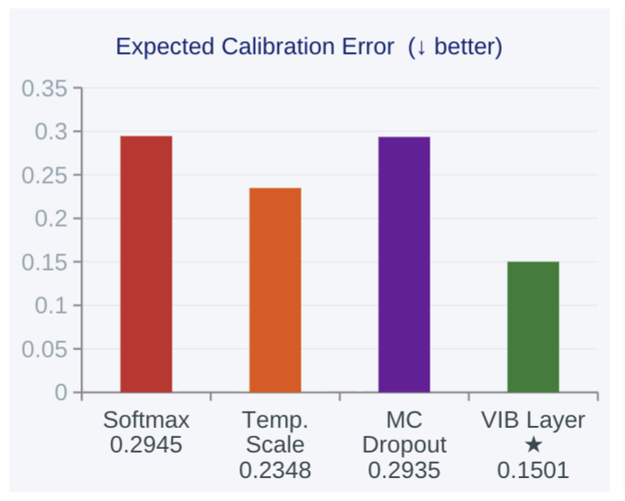
VIB Reduces ECE by 49% — The Key Result
Phase 3 formal evaluation: 100 held-out questions, Mistral 7B via Ollama, all methods on identical LLM output
VIB Layer
Per-Task VIB ECE
reduces ECE by
Fraud Detection
49%
ECE = 0.076
Risk Classification
ECE = 0.116
0.2945 → 0.1501
Premium Estimation
Only method to achieve
negative calibration gap
ECE = 0.324
−0.081 vs +0.166
Policy Compliance
(Softmax baseline)
ECE = 0.440
International Institute of Information Technology, Naya Raipur
08

Slide 9
Where This Work Fits
This project is Stage 3 of a 5-stage research thread on Information-Aware Agentic LLM Training
1
IB Theory + Information Plane
✓ Complete
Visualized compression-error tradeoff on GPT-2 — established IB framework
2
Silent Inference Degradation
✓ Complete
72% KL-divergence reduction, 31× layer displacement under INT4 quantization
3
Miscalibration + VIB Fix (This)
◉ This Work
5-agent MAS — VIB layer reduces ECE 49% — POMDP belief-state decisions
4
POMDP + SAC Deep RL Agent
↗ Next
Replace rule-based thresholds with a trained policy — VIB σ as observation space
5
CALM Curiosity-Driven Exploration
◇ Future
Active uncertainty resolution — agent asks questions to reduce σ before deciding
International Institute of Information Technology, Naya Raipur
09

Slide 10
Thank You
Questions & Discussion
github.com/bandisaivikas/actuary-ai-mas
Dr. Shyama Prasad Mukherjee International Institute of Information Technology, Naya Raipur
International Institute of Information Technology, Naya Raipur

