Slide 1
Project 04: Bank Churn Prediction
Introduction To Neural Networks
PGP-AIML-BA-UTA
May 24, 2024

Slide 2
Contents / Agenda
Executive Summary
Business Problem Overview and Solution Approach
EDA Results
Data Preprocessing
Model Performance Summary
Appendix

Slide 3
Executive Summary
The primary goal of this project is to identify the most effective machine learning model to predict which customers are likely to leave the bank, also identified as ‘churn’.

Slide 4
Business Problem Overview and Solution Approach
Many businesses like banks worry about the problem of customer churn. This issue becomes more problematic as the barriers to entry, or the costs of change to the customer are minimal.
While more expensive ‘subscription’ types may ensure a kind of ‘brand loyalty’ it is to be expected that subscriptions that cost little may illicit a level of churn expected. I.E. Free checking accounts.
The overall view is to identify customers that may leave a bank within the next six months.
The narrower scope is employ a methodology that will build a neural network classifier to predict this possibility.
We will examine several models and select an appropriate model based upon the metric of ‘Recall’ to keep the scope of the project smaller.

Slide 5
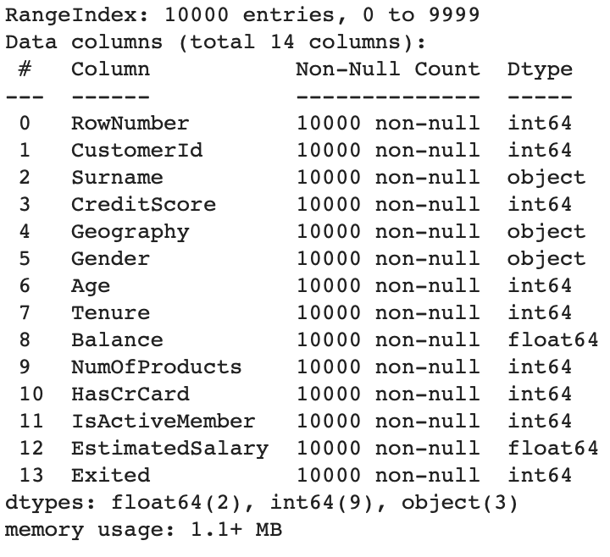
Sanity Tests
We have the following in our dataset:
10,000 Rows and 14 Columns.
OBSERVATIONS:
The following features do not provide measurable information on a ‘prima - facie (on its face) level, so we can consider dropping these in future aspects of the project.
RowNumber
CustomerID
Surname

Slide 6
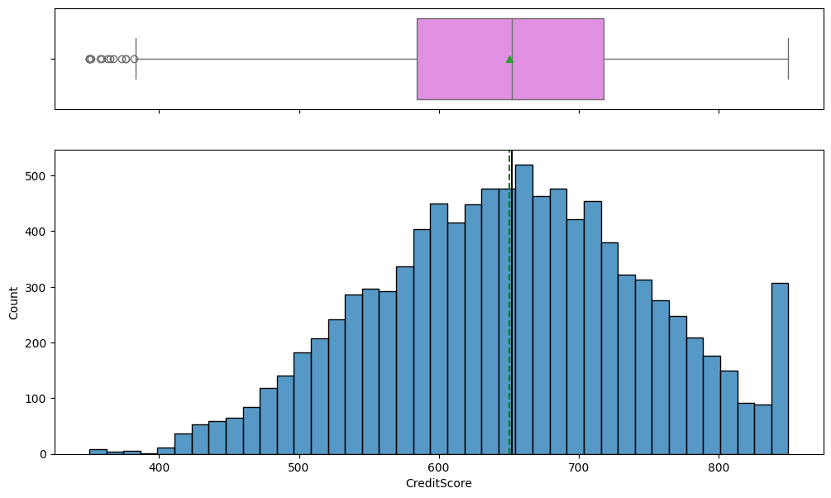
EDA Results: Univariate Analysis
Starting with Credit Score
OBSERVATION: We can see that we have something of an even distribution with a few outliers in the 100-400 credit range. These are most likely not customer we want to focus on especially given that we have a very robust 550 - 725 credit score.

Slide 7
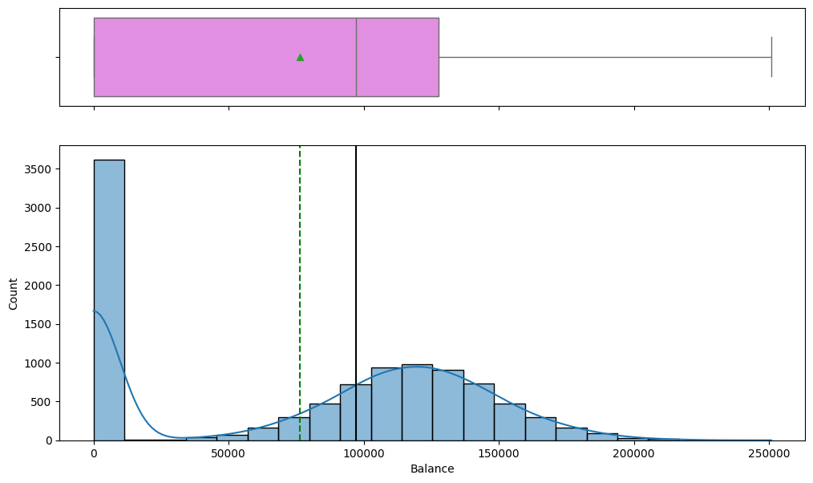
EDA Results: Univariate Analysis
Banking Balances
Observations: It would appear that 35% of our customers keep a balance of $0 - $1,000. The assumption is that a third of our customers are living paycheck to paycheck.
With a more normally distributed populations between the $5,000 - $20,000 area. We may be able to assume that 65% of our customers keep higher balances than the previous group.

Slide 8
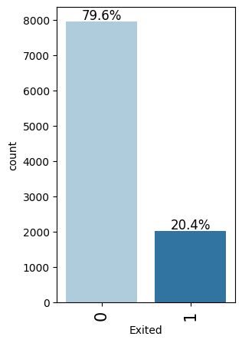
EDA Results: Univariate Analysis
Customers who exit within a six-month period.
OBSERVATION: 20.4% of our customers have exited our banking services resulting in a loss of 2,040 customers.

Slide 9
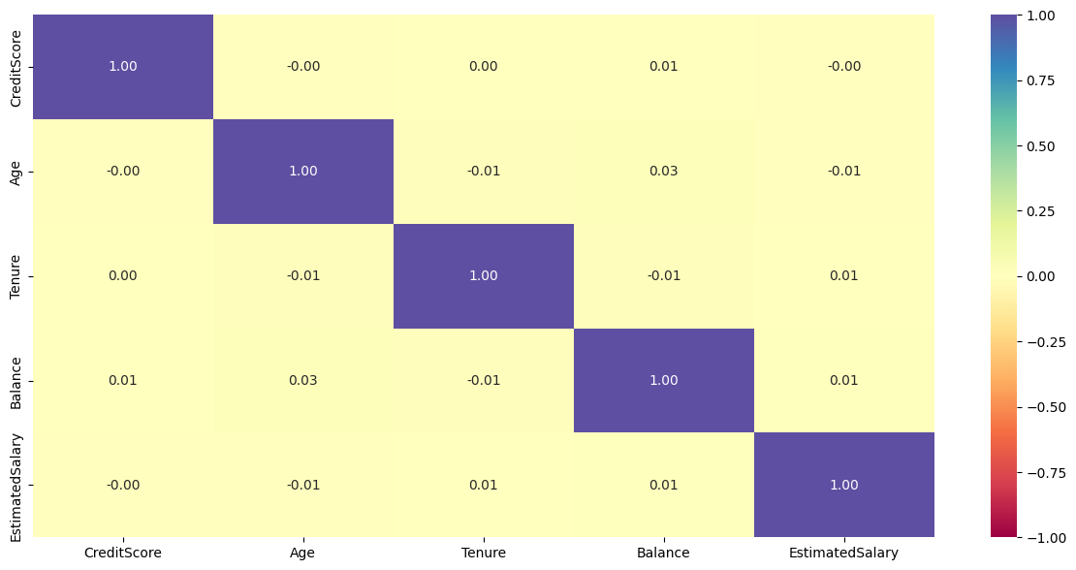
EDA Results: Bivariate Analysis
Starting with a heat map is a ‘heuristic’ or a ‘quick dirty’ way of identifying key pieces of correlation.
OBSERVATIONS:
The current heat map shows some levels of negative correlation and positive correlation among features that can be examined on a numerical level.
Unfortunately these levels show very weak correlation so not a lot can be determined from the data pictured here.

Slide 10
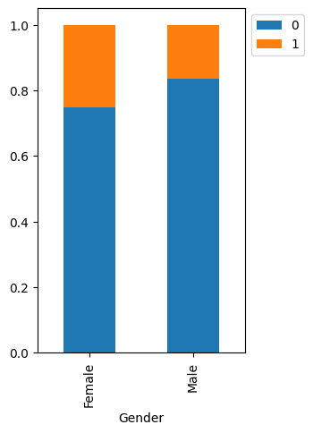
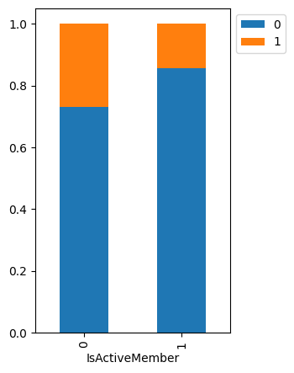
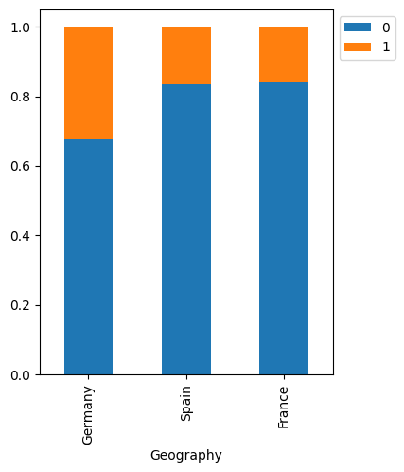
EDA Results: Bivariate Analysis - Churn
OBSERVATIONS: Here we can see that there are some key elements that indicate higher churn levels, where Germany has higher churn from the other countries using the banks services.
Member Activity also seems to take a role has well. If one tends to not be an active member, higher degrees of churn are seen.
Additionally we see the same incidents of churn in members that happen to be female.

Slide 11
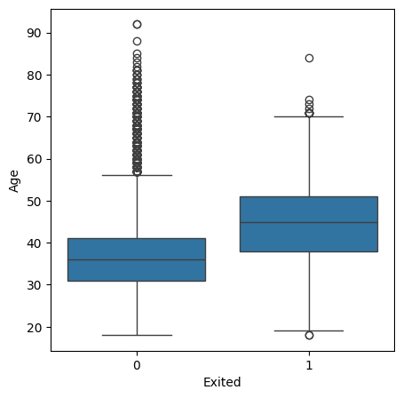
EDA Results: Bivariate Analysis - Churn Age
OBSERVATION: Out of all the boxplot’s performed across features such as Credit Score, Tenure, Bank Balance, Number of Products, and estimated salary, the plot on age was one of the more telling, showing that a majority of churn happened in the higher age brackets. Higher ages seemed to be strong outliers with those who have not churned, but this tends to occur close to the sixties and above ages.

Slide 12
Data Preprocessing
Duplicate value check
Checking for duplicates was performed using the nunique method, and showed that values tended to be in line with expectations.
Missing value treatment
Missing Values were tested for and found that no missing values existed in the data set.
Data preparation for modeling
Dummy Variable Creation to select object dtypes.
Splitting data into our training sets and testing sets. We split randomly and set test size to 0.2. This gives us the following sizes/shape.
X Train | 6000, 11
X Validation | 1500, 11
X Test | 2500, 11
Y Train | 6000
Y Validation | 1500
Y Testing | 2500

Slide 13
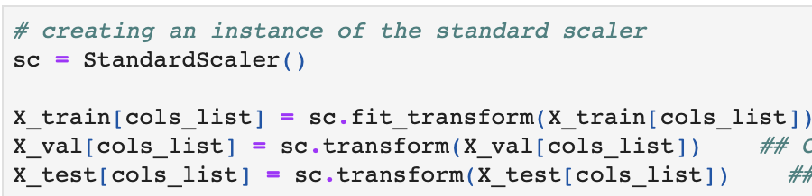
Data Preprocessing
DATA NORMALIZATION:
We performed some basic data normalization to ensure the datasets are on the same scale.
We performed this action utilizing Scikit Learn ‘Standard Scaler’.

Slide 14
Model Performance Summary
Introduction:
Model Preparation: Included;
‘Dense’ layers so all the neurons were connected.
Rectified Linear Units for activation
‘Dense’ hidden layers and
Sigmoid function for binary classification
Model Training: We trained all of the following models using;
Batch Sizes of 32
Epochs of 100
Verbosity of 1
Observations: The later models and optimizations were a bit off the charts. Creating larger batch sizes may smooth out the validation curves more, however keeping batch sizes to 32 seemed to work regardless.
SIDE NOTE: Recall was used as the metric across all models.

Slide 15
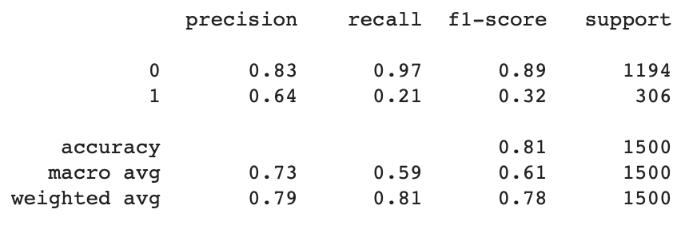
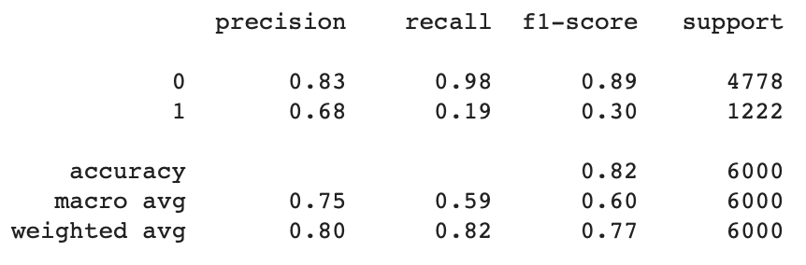
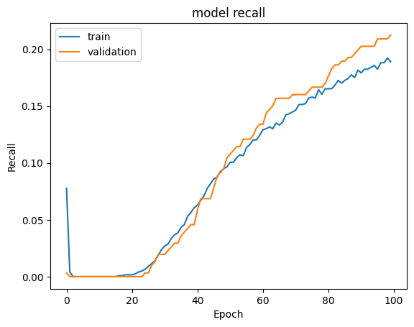
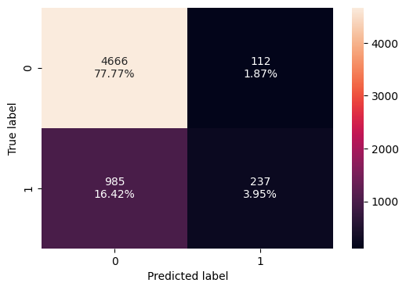
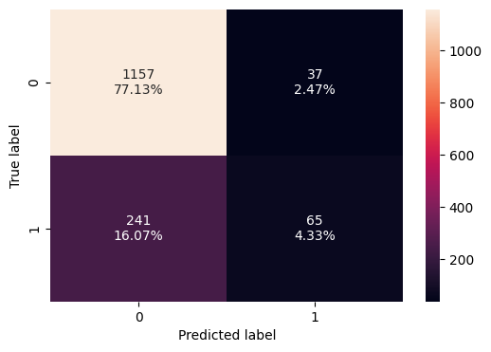
Model Performance Summary: SGD Recall
Initially, the recall for both training and validation is very low, indicating poor performance.
As training progresses, recall improves steadily for both datasets.
By the end of 100 epochs, the recall for the training set is around 0.20, while the validation set is slightly higher.
The close alignment of the training and validation recall suggests that the model is learning effectively without significant overfitting.
The confusion matrices indicate that the model is better at predicting non-churn customers than churn customers, with a significant number of false negatives in both training and validation datasets.
Classification for Validation
Classification for Training

Slide 16
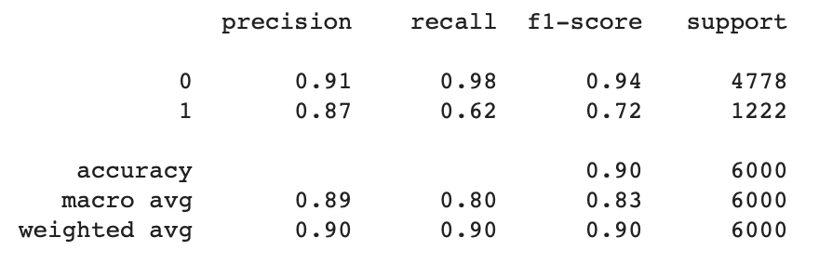
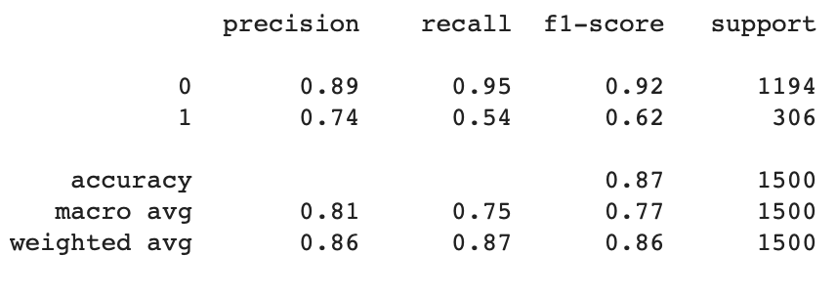
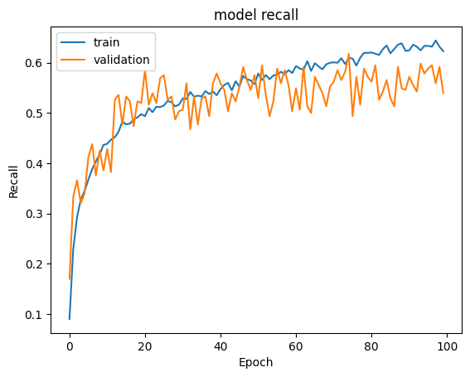
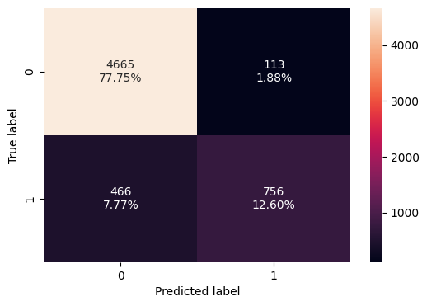
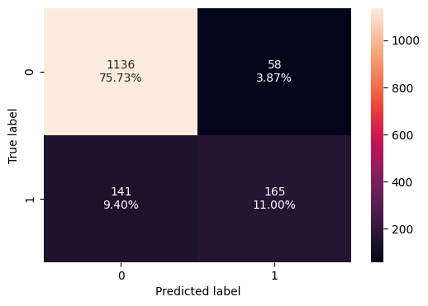
Model Performance Summary: Adam Optimizer
The training recall shows a steady increase, indicating the model is learning effectively.
The validation recall fluctuates but generally trends upwards,
Adam Optimizer: Shows better recall performance and a more balanced confusion matrix, indicating it is more effective at identifying churn customers.
SGD Optimizer: Shows lower recall performance and higher false negative rates, indicating it struggles more with identifying churn customers.
The Adam optimizer appears to be the better choice for this classification task based on the provided metrics and visualizations.
Classification for Validation
Classification for Training

Slide 17
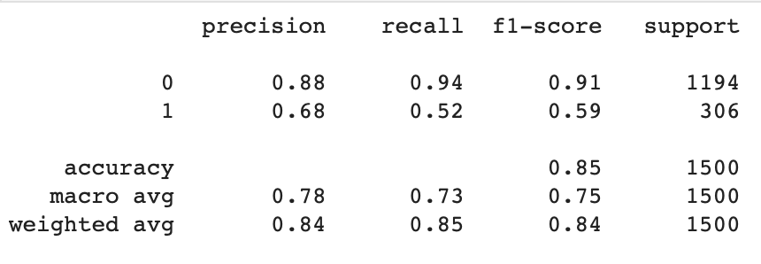
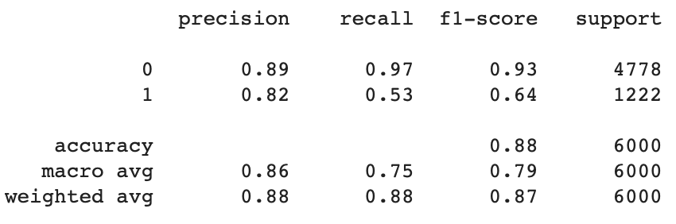
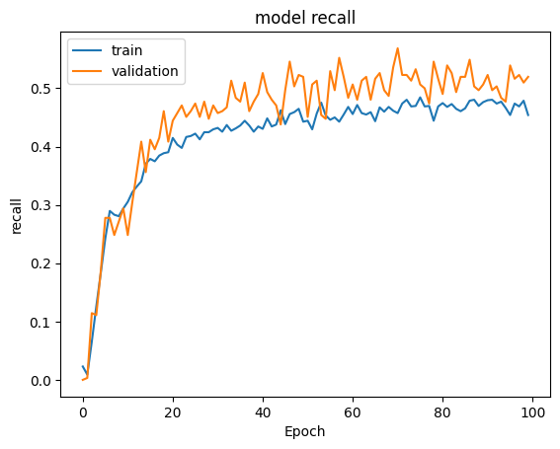

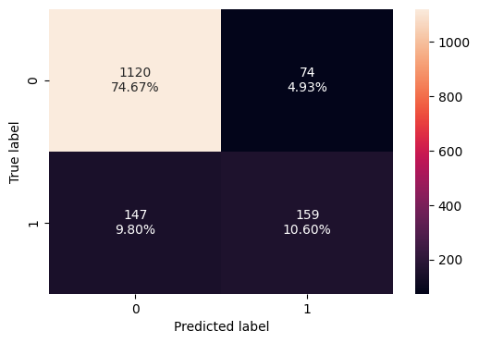
Model Performance Summary: Adam W Dropout
The model trained with the Adam optimizer and dropout regularization is improving in recall over time, with the training recall being slightly more stable than the validation recall.
The model trained with the Adam optimizer and dropout regularization is improving in recall over time, with the training recall being slightly more stable than the validation recall.
The confusion matrices indicate that the model performs reasonably well on both training and validation datasets, with a higher percentage of true negatives and true positives. However, there is still room for improvement in reducing false negatives and false positives.
Classification for Validation
Classification for Training

Slide 18
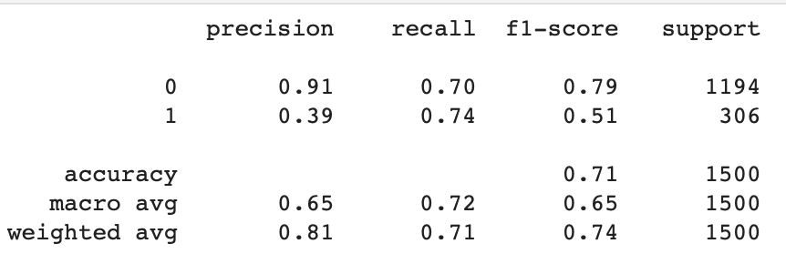
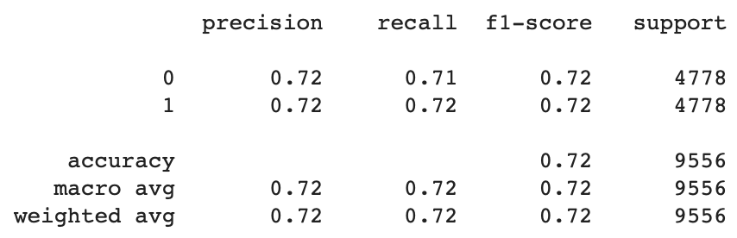
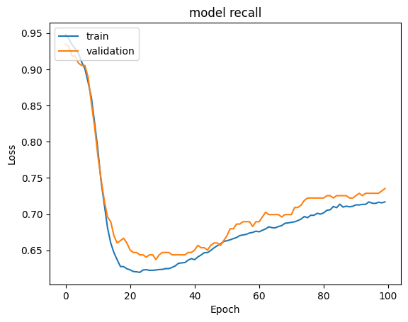
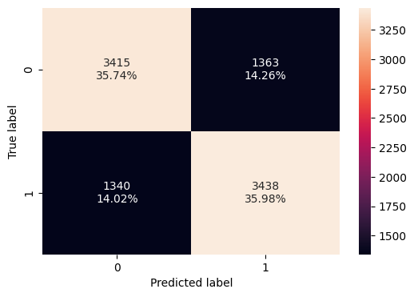
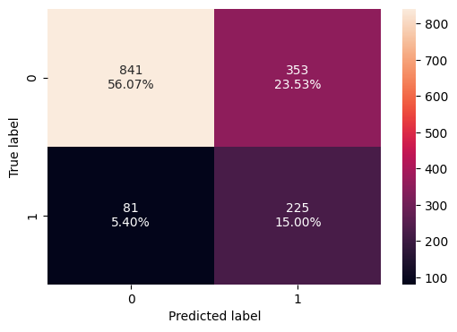
Model Performance Summary: SMOTE and SGD Optmizer
The model trained with the SMOTE algorithm and SGD optimizer is improving in recall over time, with the training recall being slightly more stable than the validation recall.
The confusion matrices indicate that the model performs reasonably well on both training and validation datasets, with a higher percentage of true negatives and true positives.
The loss plot suggests that the model may be overfitting to the training data, as indicated by the increasing training loss after epoch 20.
Classification for Validation
Classification for Training

Slide 19
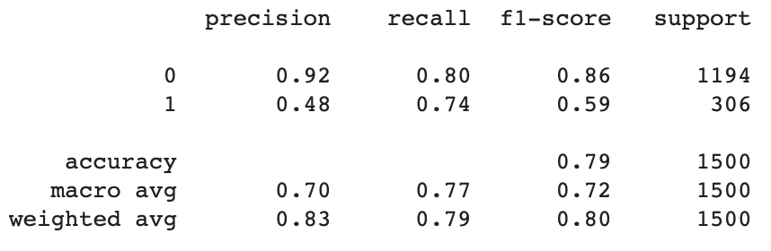
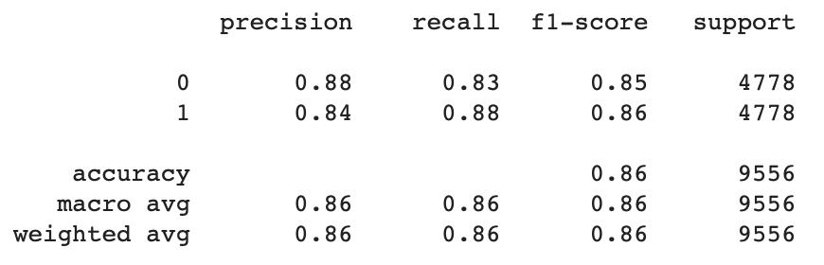
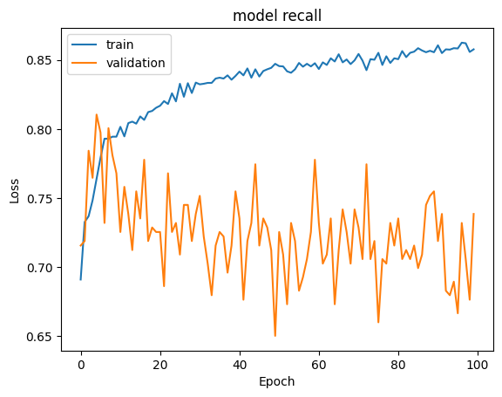
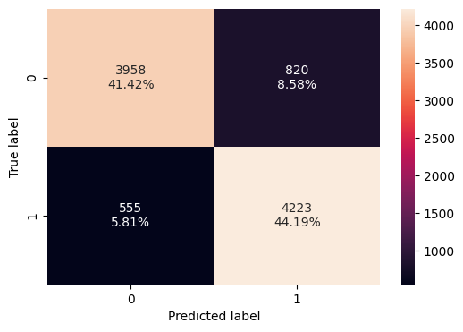
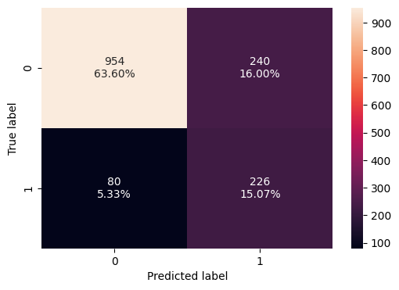
Model Performance Summary: SMOTE and ADAM
The model shows training recall being more stable and steadily increasing. The validation recall, while fluctuating, also shows an overall upward trend, indicating that the model is learning to generalize better to unseen data.
The confusion matrices indicate that the model performs reasonably well on both training and validation datasets, with a higher percentage of true negatives and true positives.
There is still room for improvement in reducing false negatives and false positives.
The fluctuations in validation recall suggest that the model may be overfitting to the training data, which is a common issue when using powerful optimizers like Adam.
Classification for Validation
Classification for Training

Slide 20
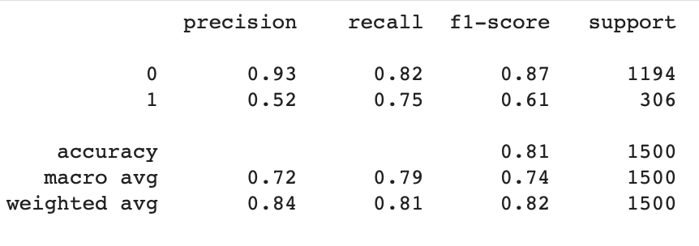
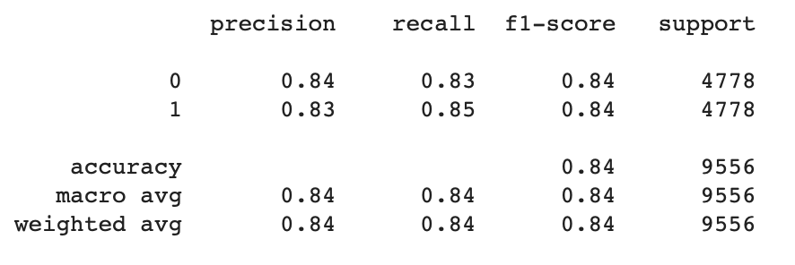
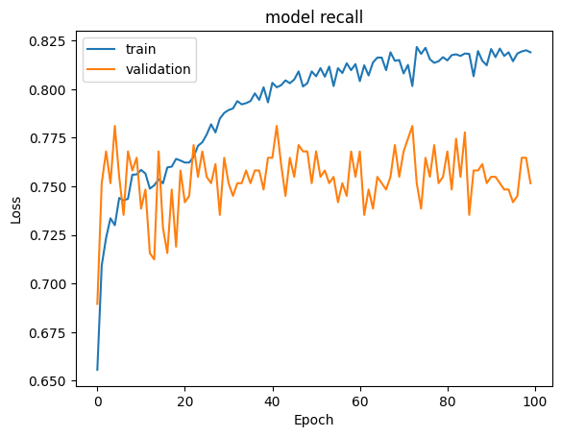
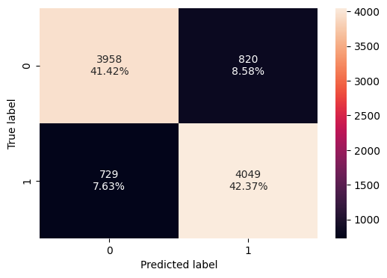
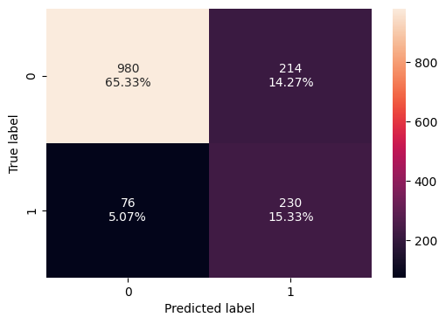
Model Performance Summary: SMOTE, Adam, and Dropout
The following model was trained with the SMOTE algorithm, Adam optimizer, and dropout regularization.
Model is improving in recall over time, with the training recall being more stable and steadily increasing.
The validation recall, while fluctuating, also shows an overall upward trend, indicating that the model is learning to generalize better to unseen data.
Confusion matrices indicate that the model performs reasonably well on both training and validation datasets.
Fluctuations in validation recall suggest that the model may be overfitting to the training data. Once again, this is most like due to the Adam optimizer.
Classification for Validation
Classification for Training

Slide 21
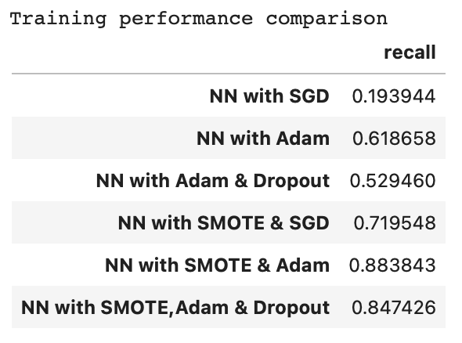
Model Performance Summary: Training Set Comparison
The highest recall value is achieved by the model using SMOTE and Adam(0.883843), indicating that this combination is the most effective in identifying positive instances.
The model using SMOTE, Adam, and Dropout also performs well with a recall of 0.847426, suggesting that dropout regularization helps but slightly reduces recallcompared to using SMOTE and Adam alone.
The NN with SGD has the lowest recall (0.193944), indicating poor performance in identifying positive instances.
The NN with Adam and NN with Adam & Dropout show moderate recall values, withAdam alone performing better than when combined with dropout.

Slide 22
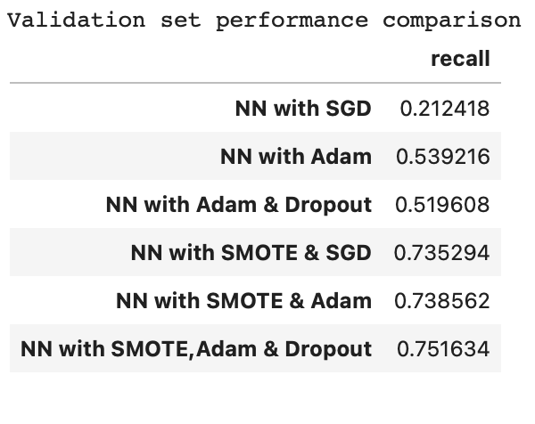
Model Performance Summary: Validation Set Comparison
The highest recall value on the validation set is achieved by the model using SMOTE, Adam, and Dropout (0.751634), indicating that this combination is the most effective in identifying positive instances on unseen data.
The model using SMOTE & Adam also performs well with a recall of 0.738562, suggesting that SMOTE and Adam together are effective even without dropout.
The NN with SGD has the lowest recall (0.212418), indicating poor performance in identifying positive instances.
The NN with Adam and NN with Adam & Dropout show moderate recall values, withAdam alone performing slightly better than when combined with dropout.

Slide 23
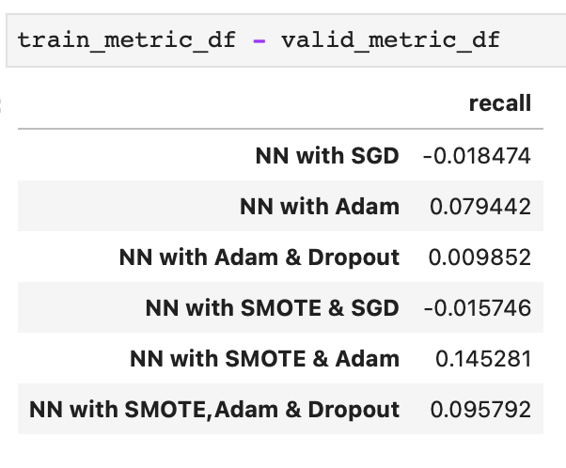
Model Performance Summary: Training To Validation
NN with SGD and NN with SMOTE & SGD have negative recall differences, indicating potential overfitting or poor generalization to the validation set.
NN with Adam and NN with SMOTE & Adam show the highest positive recall differences, suggesting better generalization and performance on the validation set.
The inclusion of SMOTE (Synthetic Minority Over-sampling Technique) and Adam optimizer generally improves the recall difference, as seen in the configurations with positive values.
The addition of Dropout to the models with Adam optimizer slightly reduces the recall difference, indicating a potential trade-off between regularization and performance.
Conclusion:
Configurations using the Adam optimizer, especially when combined with SMOTE, show the best generalization.

Slide 24
APPENDIX

Slide 25
Data Background and Contents
Images were saved directly from the exported HTML document that originated from the Jupyter notebook.
All data was ran in Google Colab.
Other images were obtained by simply getting screenshots.
Feel free to contact me, for the original Jupyter notebook, or for any questions you may have.
Thanks!

