Slide 1


Slide 2


RIZQI NUR ASSYAUFI
− bandithijo.github.io
 ① ②  bandithijo → gmail.com

t.me
/GNULinuxIndonesia /VimID
/JekyllID /ArchLinuxID
/dotfiles_id /ruby_id

Slide 3
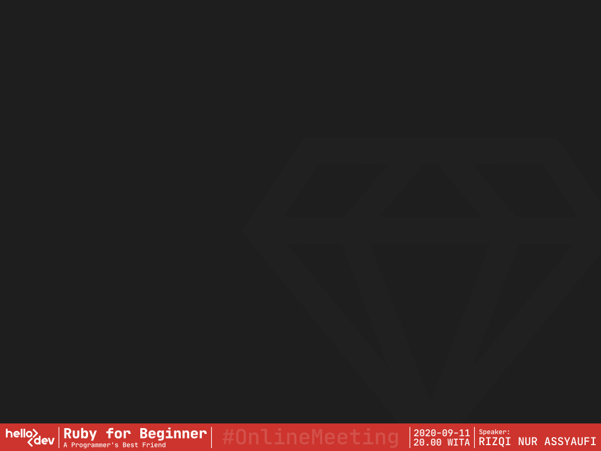
bandithijo
2017

Agung Setiawan
IDRails.com
Online Course
2019
VirtualSpirit
Technology
Junior Backend
Ruby on Rails
Developer

Slide 4
.Introduction to
 Ruby

Slide 5
> Sedikit tentang Ruby
:creator => Yukihiro “Matz” Matsumoto
:inspired => [ Perl, Smalltalk, Eiffel, Ada, Lisp ]
:public_release => 1995
:mass_acceptance => 2006 < DHH.create(Ruby on Rails,
Basecamp,
2003)
Matz.said(“trying to make Ruby natural, not simple”)
_.append(“Ruby is simple in appearance,
but is very complex inside,
just like our human body.”)
Source: About Ruby - http://www.ruby-lang.org/en/about/

Slide 6
> Is Ruby Dead Programming
Language?
:dev_a => “We moved away from Ruby.
It’s a dying language...
and it has scalability problem”
:dev_b => “Let’s host our projects on
GitHub & GitLab, use Stripe as
our payment processor, crowdfund
with KickStarter, and
livestream on Twitch. Also,
write about our industry and
programming on dev.to”
Source: Nate Hopkins @hopsoft - https://twitter.com/hopsoft/status/1169706322851328000

Slide 7
> Is Ruby Dead Programming
Language?
success_stories(“Ruby”)
=> {
Simulations: [Nasa, Motorola, etc.]
3D_Modeling: [Google Scketchup, etc.]
Robotics : [Morpha Project (Siemens), etc.]
Security : [Metasploit Framework, etc.]
Web Apps : [Basecamp, etc.]
etc. : [...] }
Source: Ruby Lang Success Stories - http://www.ruby-lang.org/en/documentation/success-stories/

Slide 8
> Is Ruby Dead Programming
Language?
Ruby.who(“INDONESIA”).value
=> [ Bukalapak, Cookpad Indonesia, Midtrans,
Quipper, Vidio, HIJUP, Alodokter, Apisentris,
BBM, BelanjaQu, Binary Academy, Dropsuite,
Forstok, GO-JEK, Jualo, Jurnal, Karir.com,
KlikDokter, KMK Online, Mekari, Mitrais,
Peentar, Qontak, Sejasa.com, Sleekr,
Sribulancer, Starqle, Virkea, Wego, WGS ]
Source: :id_ruby – Komunitas Ruby Indonesia – https://ruby.id

Slide 9
> Is Ruby Dead Programming
Language?
Language::Ruby.is_dead?(
“Ruby is alive and thinking about next 25 years”
“dev.to/teaglebuilt/is-ruby-dead-17em”
“hackernoon.com/the-state-of-ruby-2019-is-it-dying”
“GitHub Blog - Upgrading GitHub to Ruby 2.7”
“...”
)
=> false

Slide 10
> Is Ruby Dead Programming
Language?
Framework::Rails.is_dead?(
“similartech.com/technologies/ruby-on-rails”
“similartech.com/categories/framework”
“hackernoon.com/is-ruby-on-rails-dead-in-2019”
“dockyard.com/blog/ruby-on-rails-in-2020”
“Is Ruby on Rails dying: Myth or Reality?”
“...”
)
=> false

Slide 11
> Is Ruby Dead Programming
Language?
Language::Ruby.is_dead?(
“Ruby is dead. (rubyisdead.science)”
)
=> false!
@jmcharnes.said(“isrubydead.com”)
=> NO
Just because Ruby is not popular anymore, it doesn't mean Ruby is dead, right?

Slide 12
> Kenapa Memilih Ruby?
Learning::Ruby.is_worth?(:me).value
{
a: “Membantu menterjemahkan ide/solusi, menjadi sebuah
script atau program.”
b: “Membantu menyederhanakan kerumitan.”
c: “Membantu menjembatani interaksi user dengan sistem
Operasi.”
d: “...”
} => Handy & Practical

Slide 13
> Kenapa Memilih Ruby?
PracticalThing::Ruby.can_do(:you)
=> {
a: “Full-stack web development”
b: “Web scraping & crawling”
c: “Static website generators”
d: “Automation, Backup, & DevOps tools”
e: “Build your own servers”
f: “Parsing data, cleaning & filtering”
g: “API clients (like Twitter’s or GitHub’s)”
h: “Report generators (PDF, HTML, CSV, SpreadSheet)”
i: “Command-line tools”
j: “Games (gosu, Ruby2D, etc.)”
h: “Data Science”
l: “Machine Learning & AI” }
Source: RubyGuide – Jesus Castello - https://www.rubyguides.com/2019/11/what-can-you-do-with-ruby/

Slide 14
> What’s new on Ruby 2.7?
Ruby.whats_new?(2.7)
=> {
a: “Enumerable#tally”
b: “Numbered params for Blocks [Experimental]”
c: “Array#intersection”
d: “Enumerable#filter_map”
e: “Enumerator#produce”
f: “IRB gets a face lift”
g: “Ruby patern matching [Experimental]”
h: “10x performance  for fiber & thread creattoin”
i: “Others changes, *go to source” }
Source: RubyGuide – Jesus Castello - https://www.rubyguides.com/2019/12/ruby-2-7-new-features/

Slide 15
> What’s new on Ruby 2.7?
 Ruby NEVER STOPS Improving!
Now, according to Matz…
This is the last 2.x version release.
Because next year,
we’re getting Ruby 3.0!
Source: RubyGuide – Jesus Castello - https://www.rubyguides.com/2019/12/ruby-2-7-new-features/

Slide 16
> Tips Memasang Ruby for Dev
Groom your app’s Ruby env. with Rbenv
Basic GitHub Checkout way:
$ cd
$ git clone https://github.com/rbenv/rbenv.git ~/.rbenv
$ echo 'export PATH="$HOME/.rbenv/bin:$PATH"' >> ~/.bashrc # ~/.zshrc
$ echo 'eval "$(rbenv init -)"' >> ~/.bashrc # ~/.zshrc
$ exec $SHELL
$ git clone https://github.com/rbenv/ruby-build.git ~/.rbenv/plugins/ruby-build
$ echo 'export PATH="$HOME/.rbenv/plugins/ruby-build/bin:$PATH"' >> ~/.bashrc
# ~/.zshrc
$ exec $SHELL
$ rbenv install 2.7.1
$ rbenv global 2.7.1
$ ruby -v
 /home/bandithijo
├─  project_a <- ruby 2.7.1
├─  project_b <- ruby 2.6.3
│ └─  project_c <- ruby 2.5.3
└─  project_d <- ruby 2.4.2
Source: Rbenv (GitHub) - https://github.com/rbenv/rbenv/blob/master/README.md
Source: GoRails.com - https://gorails.com/setup/ubuntu/20.04#ruby-rbenv

Slide 17
.IRB (Interactive Ruby Shell)

Slide 18
> Apa itu IRB?
IRB adalah kependekan dari Interactive Ruby.
Sebuah shell yang dapat kita gunakan untuk bermain-main dan bereksplorasi dengan Ruby dan langsung melihat hasilnya.
Definisi ini diistilahkan dengan REPL (Read-Eval-Print-Loop).
Untuk menjalankan IRB, cukup tulis di terminal dengan perintah:
$ irb
irb(main):001:0> _
Ayo kita coba jalanakan operasi matematika!
irb(main):001:0> 1 + 2 * ( 3**4 ) / 5 - 6
=> 2
Source: RubyGuides - https://www.rubyguides.com/2018/12/what-is-a-repl-in-ruby/

Slide 19
> Customisasi IRB
Secara default, bentuk dari “prompt” IRB akan seperti ini
$ irb
irb(main):001:0> _
Secara pribadi, saya kurang suka melihat prompt yang terlalu panjang.
Kita bisa menyederhanakan dengan memanggil dengan cara berbeda.
$ irb –-prompt simple
>> _
Untuk membuat prompt “simple” menjadi default yang digunakan, cukup tambahkan pada file ~/.irbc (buka dengan text editor).
IRB.conf[:PROMPT_MODE] = :SIMPLE
Nah, sekarang apabila teman-teman memanggil irb, maka otomatis akan menggunakan “simple” prompt.
Source: Rake Routes - https://www.rakeroutes.com/customize-your-irb/

Slide 20
.Variabel

Slide 21
> Apa itu Variabel?
Digunakan untuk memberikan nama & menyimpan nilai (value)
In Ruby, Variable is just a label.
...a name for something that you can use to reference this value in your Ruby programs.
Just like the name we give to real-world things.
When I say "apple" you know what I'm talking about.
I don't have to describe it to you.
That's what variables do!
nama_lengkap = ’Yukihiro Matsumoto’ <- String
tahun_lahir = 1995 <- Integer
penjajahan = 3.5 <- Float
bumi_datar = false <- Boolean
kamar_kosong = nil <- NilClass
tim_dev = [‘budi’, 1, true] <- Array
kontak_dev = { ‘nama’: ‘budi’ } <- Hash
Source: RubyGuides - https://www.rubyguides.com/ruby-tutorial/variables/

Slide 22
> Mengecek Class dari Variabel
Darimana kita tahu variable tertentu termasuk dalam Class apa?
Menggunakan .class
>> nama = ‘Yukihiro Matsumoto’
>> nama.class
=> String
>> umur = 55
>> umur.class
=> Integer
>> tim_dev = [‘Rizal’, ‘Reza’, ‘Rizqi’]
>> tim_dev.class
=> Array

Slide 23
> Scope/jangkauan Variabel?
Local variable
team_name = “Elite Lokal”
Global variable (prefix: $)
$team_name = “Elite Global”
Instance variable (prefix: @)
@fav_food = “Indomie Instance”
Class variable (prefix: @@)
@@fav_drama = “Itaewon Class”
Constant variable (Huruf Besar)
PHI = 3.14
Source: RubyGuides - https://www.rubyguides.com/ruby-tutorial/variables/

Slide 24
> Scope/jangkauan Variabel?
The difference between them?
It's on their "scope".
A variable scope answers this question:
"From where can I access this variable?"
This is only going to matter when you start learning about Object-Oriented Programming.
Source: RubyGuides - https://www.rubyguides.com/ruby-tutorial/variables/
Source: RubyGuides - https://www.rubyguides.com/2019/03/ruby-scope-binding/

Slide 25
.Working with
String (a)

Slide 26
.Working with
String (a)
> String Concatenation
> String Interpolation
> Mengecek Method pada Class
> String Mehod yang Biasa Digunakan
> Escaping Character

Slide 27
> String Concatenation
Combining multiple string
a. Menggunakan operator +
>> nama_depan = ‘Yukihiro’
>> nama_belakang = ‘Matsumoto’
>> nama_lengkap = nama_depan + nama_belakang
>> puts nama_lengkap
“YukihiroMatsumoto”
>> puts nama_depan + ‘ ‘ + nama_belakang
“Yukihiro Matsumoto”
>> puts ‘Yukihiro’ + ‘ ‘ + ‘Matsumoto’
“Yukihiro Matsumoto”
Source: RubyGuides - https://www.rubyguides.com/2019/07/ruby-string-concatenation/

Slide 28
> String Concatenation
Combining multiple string
b. Menggunakan operator +=
>> nama = ‘’
>> nama += ‘Yukihiro’
>> nama += ‘ ‘
>> nama += ‘Matsumoto’
>> puts nama
“Yukihiro Matsumoto”
Source: RubyGuides - https://www.rubyguides.com/2019/07/ruby-string-concatenation/

Slide 29
> String Concatenation
Combining multiple string
c. Menggunakan Ruby concat method
>> nama = ‘’
>> nama.concat(‘Yukihiro’)
>> nama.concat(‘ ‘)
>> nama.concat(‘Matsumoto’)
>> puts nama
“Yukihiro Matsumoto”
Source: RubyGuides - https://www.rubyguides.com/2019/07/ruby-string-concatenation/

Slide 30
> String Concatenation
Combining multiple string
d. Menggunakan operator << (alias dari Ruby concat method)
>> nama = ‘’
>> nama << ‘Yukihiro’
>> nama << ‘ ‘
>> nama << ‘Matsumoto’
>> puts nama
“Yukihiro Matsumoto”
>> puts nama << ‘Yukihiro’ << ‘ ‘ << ‘Matsumoto’
“Yukihiro Matsumoto”
>> ‘nomor rumah = ‘ << 1
# TypeError: no implicit conversion of Fixnum into String
Source: RubyGuides - https://www.rubyguides.com/2019/07/ruby-string-concatenation/

Slide 31
> String Concatenation
Combining multiple string
d. Menggunakan operator << (alias dari Ruby concat method)
Problem:
>> ‘nomor rumah = ‘ << 1
=> "nomor rumah = \u0001"
Solusi:
>> ‘nomor rumah = ‘ << 1.to_s
=> "nomor rumah = 1"
Menggunakan to_s method untuk mengkonversi Integer ke String.
Source: RubyGuides - https://www.rubyguides.com/2019/07/ruby-string-concatenation/
Source: RubyGuides - https://www.rubyguides.com/2018/09/ruby-conversion-methods/

Slide 32
> String Concatenation
Combining multiple string
e. Menggunakan Ruby prepend method (kebalikan concat)
>> nama = ‘’
>> nama.prepend(‘Yukihiro’)
>> nama.prepend(‘ ‘)
>> nama.prepend(‘Matsumoto’)
>> puts nama
“Matsumoto Yukihiro”
If you're thinking there is an append method,
well there isn't for String.
append method only for arrays.
Source: RubyGuides - https://www.rubyguides.com/2019/07/ruby-string-concatenation/

Slide 33
> String Interpolation
Interpolation or merging of variables into strings is a powerful technique. It allows you to "templatize" a string.
a. Menggunakan “#{}”
>> nama_depan = ‘Yukihiro’
>> nama_belakang = ‘Matsumoto’
>> umur_sekarang = 55
>> puts “Nama: #{nama_depan} #{nama_belakang}. Umur: #{umur}”
“Nama: Yukihiro Matsumoto. Umur: 55”
Syarat: String harus menggunakan tanda petik ganda (“...”)
Source: RubyGuides - https://www.rubyguides.com/ruby-tutorial/variables/

Slide 34
> Mengecek Method pada Class
Darimana kita tahu method apa yang tersedia dari sebuah Class?
Menggunakan .methods
>> nama = ‘Yukihiro Matsumoto’
>> nama.class
=> String
>> nama.methods
=>[ :unicode_normalize, :unicode_normalize!, :ascii_only?, :unpack, :unpack1, :to_r, :shellsplit, :encode, :encode!, :shellescape, :%, :include?, :*, :+, :pretty_print, ..., ..., ... ]
Berapa banyak jumlah method yang tersedia? (misal: String)
>> nama.class
String
>> nama.methods.count
=> 192

Slide 35
> String Method yang Biasa
Digunakan
.upcase() .downcase()
>> nama = ‘Yukihiro Matsumoto’
>> nama.upcase
=> “YUKIHIRO MATSUMOTO”
>> nama = ‘Yukihiro Matsumoto’
>> nama.downcase
=> “yukihiro matsumoto”
.capitalize() .reverse()
>> nama = ‘yukihiro matsumoto’
>> nama.capitalize
=> “Yukihiro matsumoto”
>> nama = ‘yukihiro matsumoto’
>> nama.reverse
=> “otomustam orihikuy”
.length()
>> nama = ‘Yukihiro Matsumoto’
>> nama.length
=> 18
More: Ruby-Doc - https://ruby-doc.org/core-2.7.0/String.html

Slide 36
> String Method yang Biasa
Digunakan
.sub()
.gsub()
>> nama = ‘Yukihiro Matz’
>> nama.sub(‘Matz’, ‘Akita’)
=> “Yukihiro Akita”
>> nama = ‘Budi Budi Bayu’
>> nama.gsub(‘Budi’, ‘Bayu’)
=> “Bayu Bayu Bayu”
.strip()
.split()
>> nama = ‘ matsumoto ’
>> nama.strip
=> “matsumoto”
>> nama = ‘Budi Budi Bayu’
>> nama.split(‘ ‘)
=> [“Budi”, “Budi”, “Bayu”]
dan masih banyak lagi...
More: Ruby-Doc - https://ruby-doc.org/core-2.7.0/String.html

Slide 37
> Escaping Character
Bagaimana cara melakukan escaping character pada String?
>> ‘malam jum’at’
SyntaxError: unexpected local variable or method...
>> ‘malam jum\’at’
“malam jum’at”
Alternatif gunakan double quote untuk escaping single quote:
>> “malam jum’at”
“malam jum’at”
Contoh-contoh escaping character
\’ : single quote
\” : double quote
\\ : backslash
\n : new line
\r : carriage return
\t : tab
\b : backspace
\f : form feed
\v : vertical tab
est.
More: AppSignal - https://blog.appsignal.com/2016/12/21/ruby-magic-escaping-in-ruby.html

Slide 38
.Working with
String (b)

Slide 39
.Working with
String (b)
> Get Input from User (Console)

Slide 40
> Get Input from User (Console)
Ruby use gets method to get the user input (as a string).
.gets
>> puts “Nama kamu siapa? “
>> nama = gets
Yukihiro
=> “Yukihiro\n”
“\n” didapatkan saat kita menekan tombol enter.
Bagaimana cara mengilangkannya?
Gunakan String#chomp method.
.gets.chomp
>> puts “Nama kamu siapa? “
>> nama = gets.chomp
Yukihiro
=> “Yukihiro”
Source: Ruby-Doc - https://ruby-doc.org/core-2.7.1/IO.html

Slide 41
.Working with
Number

Slide 42
.Working with
Number
> Arithmetic Operation
> Order Arithmetic Operation
> Loop with Times
> Upto & Downto

Slide 43
> Arithmetic Operation
Nothing new here…
>> 5 + 5
=> 10
>> 10 * 2
=> 20
>> 2 ** 3
=> 8
>> 10 % 2
=> 0
>> 10.even?
=> true
>> 4.odd?
=> false
>> 10 / 2.0
=> 5.0
>> 9.0 / 3
=> 3.0
Source: Ruby-Doc - https://ruby-doc.org/core-2.7.1/IO.html

Slide 44
> Order Arithmetic Operation
Perhatikan urutan dari pengerjaan operator.
Gunakan jembatan “PEMDAS” untuk mengingatnya.
Parenthesis ()
Exponential **
Multiplication *
Division /
Addition +
Substraction -
Source: Ruby-Doc - https://ruby-doc.org/core-2.7.1/IO.html

Slide 45
> Loop with times
Salah satu method yang mudah untuk melakukan looping / perulangan terhadap angka.
.times
.times (one line)
?> 3.times do
?> puts ‘HelloDev’
>> end
HelloDev
HelloDev
HelloDev
>> 3.times { puts ‘HelloDev’ }
HelloDev
HelloDev
HelloDev
?> 2.times do |n|
?> puts n
>> end
0
1
>> 2.times do { |n| puts n }
0
1

Slide 46
> Upto & Downto
Salah satu method yang mudah untuk melakukan looping / perulangan terhadap angka dengan rentang tertentu.
.upto().each
.downto().each
?> 1.upto(3).each do
?> puts ‘HelloDev’
>> end
HelloDev
HelloDev
HelloDev
?> 3.downto(1).each do
?> puts ‘HelloDev’
>> end
HelloDev
HelloDev
HelloDev
?> 1.upto(2) do |n|
?> puts n
>> end
1
2
?> 2.downto(1).each do |n|
?> puts n
>> end
1
2

Slide 47
.Comparison
Operators

Slide 48
.Branching
/Condition

Slide 49
.Collection

Slide 50
.Looping

Slide 51
.Method

Slide 52
EXTENDED

Slide 53
.File IO

Slide 54
.Error Handling

Slide 55
.Object Oriented
Programming

Slide 56
.Module

Slide 57
> Tips mencari dengan Google
Gunakan prefix “ruby” sebagai awalan kata kunci untu mencari di Google.

ruby
Kemudian, diikuti dengan keyword apa yang mau dicari.
Misal, tentang perulangan dengan method “each”.

ruby each loop
Dengan cara ini, kita dapat membuat hasil pencarian yang lebih spesifik untuk bahasa pemrograman Ruby.

Slide 58
> Referensi Belajar Ruby
 YouTube:
GoRails
Jesus Castello
Drifting Ruby
Nate Berkopec
TechmakerTV
Decypher Media
zayne
Code School
FreeCodeCamp.org
Sekolah Koding
Agung Setiawan
 WebPage:
Ruby in 20 minutes
RubyGuides.com
 Online Course:
IDRails.com

Slide 59
> Referensi Group Telegram 
untuk Bertanya seputar Ruby
Ruby Indonesia
Rails Indonesia
> Referensi Channel Telegram 
untuk Berita tentang Ruby
Ruby/Rails Inside

Slide 60
:Terima_Kasih
> Made with  by Rizqi Nur Assyaufi
@BanditHijo
⬧ 2020/09

