Slide 1


Slide 2


RIZQI NUR ASSYAUFI
− bandithijo.github.io
 ① ②  bandithijo → gmail.com

t.me
/GNULinuxIndonesia /VimID
/JekyllID /ArchLinuxID
/dotfiles_id /ruby_id

Slide 3
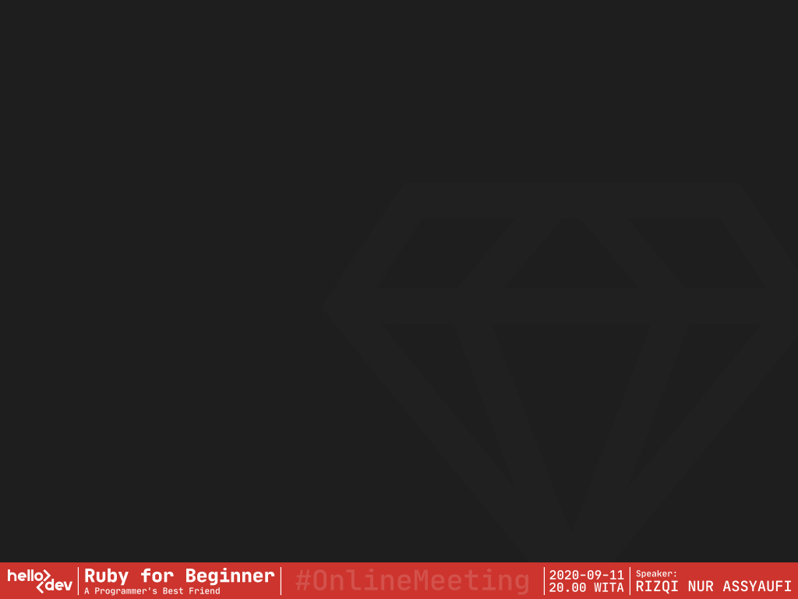
bandithijo
2017

Agung Setiawan
IDRails.com
Online Course
2019
VirtualSpirit
Technology
Junior Backend
Ruby on Rails
Developer

Slide 4
.Introduction to
 Ruby

Slide 5
> Sedikit tentang Ruby
:creator => Yukihiro “Matz” Matsumoto
:inspired => [ Perl, Smalltalk, Eiffel, Ada, Lisp ]
:public_release => 1995
:mass_acceptance => 2006 < DHH.create(Ruby on Rails,
Basecamp,
2003)
Matz.said(“trying to make Ruby natural, not simple”)
_.append(“Ruby is simple in appearance,
but is very complex inside,
just like our human body.”)
Source: About Ruby - http://www.ruby-lang.org/en/about/

Slide 6
> Is Ruby Dead Programming
Language?
:dev_a => “We moved away from Ruby.
It’s a dying language...
and it has scalability problem”
:dev_b => “Let’s host our projects on
GitHub & GitLab, use Stripe as
our payment processor, crowdfund
with KickStarter, and
livestream on Twitch. Also,
write about our industry and
programming on dev.to”
Source: Nate Hopkins @hopsoft - https://twitter.com/hopsoft/status/1169706322851328000

Slide 7
> Is Ruby Dead Programming
Language?
success_stories(“Ruby”)
=> {
Simulations: [Nasa, Motorola, etc.]
3D_Modeling: [Google Scketchup, etc.]
Robotics : [Morpha Project (Siemens), etc.]
Security : [Metasploit Framework, etc.]
Web Apps : [Basecamp, etc.]
etc. : [...] }
Source: Ruby Lang Success Stories - http://www.ruby-lang.org/en/documentation/success-stories/

Slide 8
> Is Ruby Dead Programming
Language?
Ruby.who(“INDONESIA”).value
=> [ Bukalapak, Cookpad Indonesia, Midtrans,
Quipper, Vidio, HIJUP, Alodokter, Apisentris,
BBM, BelanjaQu, Binary Academy, Dropsuite,
Forstok, GO-JEK, Jualo, Jurnal, Karir.com,
KlikDokter, KMK Online, Mekari, Mitrais,
Peentar, Qontak, Sejasa.com, Sleekr,
Sribulancer, Starqle, Virkea, Wego, WGS ]
Source: :id_ruby – Komunitas Ruby Indonesia – https://ruby.id

Slide 9
> Is Ruby Dead Programming
Language?
Language::Ruby.is_dead?(
“Ruby is alive and thinking about next 25 years”
“dev.to/teaglebuilt/is-ruby-dead-17em”
“hackernoon.com/the-state-of-ruby-2019-is-it-dying”
“GitHub Blog - Upgrading GitHub to Ruby 2.7”
“...”
)
=> false

Slide 10
> Is Ruby Dead Programming
Language?
Framework::Rails.is_dead?(
“similartech.com/technologies/ruby-on-rails”
“similartech.com/categories/framework”
“hackernoon.com/is-ruby-on-rails-dead-in-2019”
“dockyard.com/blog/ruby-on-rails-in-2020”
“Is Ruby on Rails dying: Myth or Reality?”
“...”
)
=> false

Slide 11
> Is Ruby Dead Programming
Language?
Language::Ruby.is_dead?(
“Ruby is dead. (rubyisdead.science)”
)
=> false!
@jmcharnes.said(“isrubydead.com”)
=> NO
Just because Ruby is not popular anymore, it doesn't mean Ruby is dead, right?

Slide 12
> Kenapa Memilih Ruby?
Learning::Ruby.is_worth?(:me).value
{
a: “Membantu menterjemahkan ide/solusi, menjadi sebuah
script atau program.”
b: “Membantu menyederhanakan kerumitan.”
c: “Membantu menjembatani interaksi user dengan sistem
Operasi.”
d: “...”
} => Handy & Practical

Slide 13
> Kenapa Memilih Ruby?
PracticalThing::Ruby.can_do(:you)
=> {
a: “Full-stack web development”
b: “Web scraping & crawling”
c: “Static website generators”
d: “Automation, Backup, & DevOps tools”
e: “Build your own servers”
f: “Parsing data, cleaning & filtering”
g: “API clients (like Twitter’s or GitHub’s)”
h: “Report generators (PDF, HTML, CSV, SpreadSheet)”
i: “Command-line tools”
j: “Games (gosu, Ruby2D, etc.)”
h: “Data Science”
l: “Machine Learning & AI” }
Source: RubyGuide – Jesus Castello - https://www.rubyguides.com/2019/11/what-can-you-do-with-ruby/

Slide 14
> What’s new on Ruby 2.7?
Ruby.whats_new?(2.7)
=> {
a: “Enumerable#tally”
b: “Numbered params for Blocks [Experimental]”
c: “Array#intersection”
d: “Enumerable#filter_map”
e: “Enumerator#produce”
f: “IRB gets a face lift”
g: “Ruby patern matching [Experimental]”
h: “10x performance  for fiber & thread creattoin”
i: “Others changes, *go to source” }
Source: RubyGuide – Jesus Castello - https://www.rubyguides.com/2019/12/ruby-2-7-new-features/

Slide 15
> What’s new on Ruby 2.7?
 Ruby NEVER STOPS Improving!
Now, according to Matz…
This is the last 2.x version release.
Because next year,
we’re getting Ruby 3.0!
Source: RubyGuide – Jesus Castello - https://www.rubyguides.com/2019/12/ruby-2-7-new-features/

Slide 16
> Tips Memasang Ruby for Dev
Groom your app’s Ruby env. with Rbenv
Basic GitHub Checkout way:
$ cd
$ git clone https://github.com/rbenv/rbenv.git ~/.rbenv
$ echo 'export PATH="$HOME/.rbenv/bin:$PATH"' >> ~/.bashrc # ~/.zshrc
$ echo 'eval "$(rbenv init -)"' >> ~/.bashrc # ~/.zshrc
$ exec $SHELL
$ git clone https://github.com/rbenv/ruby-build.git ~/.rbenv/plugins/ruby-build
$ echo 'export PATH="$HOME/.rbenv/plugins/ruby-build/bin:$PATH"' >> ~/.bashrc
# ~/.zshrc
$ exec $SHELL
$ rbenv install 2.7.1
$ rbenv global 2.7.1
$ ruby -v
 /home/bandithijo
├─  project_a <- ruby 2.7.1
├─  project_b <- ruby 2.6.3
│ └─  project_c <- ruby 2.5.3
└─  project_d <- ruby 2.4.2
Source: Rbenv (GitHub) - https://github.com/rbenv/rbenv/blob/master/README.md
Source: GoRails.com - https://gorails.com/setup/ubuntu/20.04#ruby-rbenv

Slide 17
.Variabel

Slide 18
> Apa itu Variabel?
Digunakan untuk memberikan nama & menyimpan nilai (value)
In Ruby, Variable is just a label.
...a name for something that you can use to reference this value in your Ruby programs.
Just like the name we give to real-world things.
When I say "apple" you know what I'm talking about.
I don't have to describe it to you.
That's what variables do!
nama_lengkap = ’Yukihiro Matsumoto’ <- String
tahun_lahir = 1995 <- Integer
penjajahan = 3.5 <- Float
bumi_datar = false <- Boolean
kamar_kosong = nil <- NilClass
tim_dev = [‘budi’, 1, true] <- Array
kontak_dev = { ‘nama’: ‘budi’ } <- Hash
Source: RubyGuides - https://www.rubyguides.com/ruby-tutorial/variables/

Slide 19
> Mengecek Class dari Variabel
Darimana kita tahu variable tertentu termasuk dalam Class apa?
Menggunakan .class
> nama = ‘Yukihiro Matsumoto’
> nama.clas
=> String
> umur = 55
> umur.class
Integer
> tim_dev = [‘Rizal’, ‘Reza’, ‘Rizqi’]
> tim_dev.class
Array

Slide 20
> Scope/jangkauan Variabel?
Local variable
team_name = “Elite Lokal”
Global variable (prefix: $)
$team_name = “Elite Global”
Instance variable (prefix: @)
@fav_food = “Indomie Instance”
Class variable (prefix: @@)
@@fav_drama = “Itaewon Class”
Constant variable (Huruf Besar)
PHI = 3.14
Source: RubyGuides - https://www.rubyguides.com/ruby-tutorial/variables/

Slide 21
> Scope/jangkauan Variabel?
The difference between them?
It's on their "scope".
A variable scope answers this question:
"From where can I access this variable?"
This is only going to matter when you start learning about Object-Oriented Programming.
Source: RubyGuides - https://www.rubyguides.com/ruby-tutorial/variables/
Source: RubyGuides - https://www.rubyguides.com/2019/03/ruby-scope-binding/

Slide 22
> Scope/jangkauan Variabel?
Local variable
team_name = “Elite Lokal”
Source: RubyGuides - https://www.rubyguides.com/ruby-tutorial/variables/

Slide 23
.Working with
String (a)

Slide 24
> String Concatenation
Combining multiple string
a. Menggunakan operator +
> nama_depan = ‘Yukihiro’
> nama_belakang = ‘Matsumoto’
> nama_lengkap = nama_depan + nama_belakang
> puts nama_lengkap
“YukihiroMatsumoto”
> puts nama_depan + ‘ ‘ + nama_belakang
“Yukihiro Matsumoto”
> puts ‘Yukihiro’ + ‘ ‘ + ‘Matsumoto’
“Yukihiro Matsumoto”
Source: RubyGuides - https://www.rubyguides.com/2019/07/ruby-string-concatenation/

Slide 25
> String Concatenation
Combining multiple string
b. Menggunakan operator +=
> nama = ‘’
> nama += ‘Yukihiro’
> nama += ‘ ‘
> nama += ‘Matsumoto’
> puts nama
“Yukihiro Matsumoto”
Source: RubyGuides - https://www.rubyguides.com/2019/07/ruby-string-concatenation/

Slide 26
> String Concatenation
Combining multiple string
c. Menggunakan Ruby concat method
> nama = ‘’
> nama.concat(‘Yukihiro’)
> nama.concat(‘ ‘)
> nama.concat(‘Matsumoto’)
> puts nama
“Yukihiro Matsumoto”
Source: RubyGuides - https://www.rubyguides.com/2019/07/ruby-string-concatenation/

Slide 27
> String Concatenation
Combining multiple string
d. Menggunakan operator << (alias dari Ruby concat method)
> nama = ‘’
> nama << ‘Yukihiro’
> nama << ‘ ‘
> nama << ‘Matsumoto’
> puts nama
“Yukihiro Matsumoto”
> puts nama << ‘Yukihiro’ << ‘ ‘ << ‘Matsumoto’
“Yukihiro Matsumoto”
> ‘nomor rumah = ‘ << 1
# TypeError: no implicit conversion of Fixnum into String
Source: RubyGuides - https://www.rubyguides.com/2019/07/ruby-string-concatenation/

Slide 28
> String Concatenation
Combining multiple string
d. Menggunakan operator << (alias dari Ruby concat method)
Problem:
> ‘nomor rumah = ‘ << 1
=> "nomor rumah = \u0001"
Solusi:
> ‘nomor rumah = ‘ << 1.to_s
=> "nomor rumah = 1"
Menggunakan to_s method untuk mengkonversi Integer ke String.
Source: RubyGuides - https://www.rubyguides.com/2019/07/ruby-string-concatenation/
Source: RubyGuides - https://www.rubyguides.com/2018/09/ruby-conversion-methods/

Slide 29
> String Concatenation
Combining multiple string
e. Menggunakan Ruby prepend method (kebalikan concat)
> nama = ‘’
> nama.prepend(‘Yukihiro’)
> nama.prepend(‘ ‘)
> nama.prepend(‘Matsumoto’)
> puts nama
“Matsumoto Yukihiro”
If you're thinking there is an append method,
well there isn't for String.
append method only for arrays.
Source: RubyGuides - https://www.rubyguides.com/2019/07/ruby-string-concatenation/

Slide 30
> String Interpolation
Interpolation or merging of variables into strings is a powerful technique. It allows you to "templatize" a string.
a. Menggunakan “#{}”
> nama_depan = ‘Yukihiro’
> nama_belakang = ‘Matsumoto’
> umur_sekarang = 55
> puts “Nama: #{nama_depan} #{name_belakang}. Umur: #{umur}”
“Nama: Yukihiro Matsumoto. Umur: 55”
Syarat: String harus menggunakan tanda petik ganda (“...”)
Source: RubyGuides - https://www.rubyguides.com/ruby-tutorial/variables/

Slide 31
> Mengecek Method pada Class
Darimana kita tahu method apa yang tersedia dari sebuah Class?
Menggunakan .methods
> nama = ‘Yukihiro Matsumoto’
> nama.clas
=> String
> nama.methods
=>[ :unicode_normalize, :unicode_normalize!, :ascii_only?, :unpack, :unpack1, :to_r, :shellsplit, :encode, :encode!, :shellescape, :%, :include?, :*, :+, :pretty_print, :count, :partition, :+@, :-@, :<=>, :<<, :==, :===, :sum, ..., ..., ... ]
Berapa banyak jumlah method yang tersedia? (misal: String)
> nama.class
String
> nama.methods.count
=> 192

Slide 32
> String Method yang Biasa
Digunakan
.upcase() .downcase()
> nama = ‘Yukihiro Matsumoto’
> nama.upcase
=> “YUKIHIRO MATSUMOTO”
> nama = ‘Yukihiro Matsumoto’
> nama.downcase
=> “yukihiro matsumoto”
.capitalize() .reverse()
> nama = ‘yukihiro matsumoto’
> nama.capitalize
=> “Yukihiro matsumoto”
> nama = ‘yukihiro matsumoto’
> nama.reverse
=> “otomustam orihikuy”
.length()
.sub()
> nama = ‘Yukihiro Matsumoto’
> nama.length
=> 18
> nama ‘Yukihiro Matz’
> nama.sub(‘Matz’, ‘Akita’)
=> “Yukihiro Akita”
dmbl...
More: Ruby-Doc - https://ruby-doc.org/core-2.7.0/String.html

Slide 33
> Escaping Character
Bagaimana cara melakukan escaping character pada String?
> ‘malam jum’at’
SyntaxError: unexpected local variable or method...
> ‘malam jum\’at’
“malam jum’at”
Alternatif gunakan double quote untuk escaping single quote:
> “malam jum’at”
“malam jum’at”
Contoh-contoh escaping character
\’ : single quote
\” : double quote
\\ : backslash
\n : new line
\r : carriage return
\t : tab
\b : backspace
\f : form feed
\v : vertical tab
More: AppSignal - https://blog.appsignal.com/2016/12/21/ruby-magic-escaping-in-ruby.html

Slide 34
.Working with
String (b)

Slide 35
.Working with
Number

Slide 36
.Comparison
Operators

Slide 37
.Branching
/Condition

Slide 38
.Collection

Slide 39
.Looping

Slide 40
.Method

Slide 41
EXTENDED

Slide 42
.File IO

Slide 43
.Error Handling

Slide 44
.Object Oriented
Programming

Slide 45
.Module

Slide 46
> Tips mencari dengan Google
Gunakan prefix “ruby” sebagai awalan kata kunci untu mencari di Google.

ruby
Kemudian, diikuti dengan keyword apa yang mau dicari.
Misal, tentang perulangan dengan method “each”.

ruby each loop
Dengan cara ini, kita dapat membuat hasil pencarian yang lebih spesifik untuk bahasa pemrograman Ruby.

Slide 47
> Referensi Belajar Ruby
 YouTube:
GoRails
Jesus Castello
Drifting Ruby
Nate Berkopec
TechmakerTV
Decypher Media
zayne
Code School
FreeCodeCamp.org
Sekolah Koding
Agung Setiawan
 WebPage:
Ruby in 20 minutes
RubyGuides.com
 Online Course:
IDRails.com

Slide 48
> Referensi Group Telegram 
untuk Bertanya seputar Ruby
Ruby Indonesia
Rails Indonesia
> Referensi Channel Telegram 
untuk Berita tentang Ruby
Ruby/Rails Inside

Slide 49
:Terima_Kasih
> Made with  by Rizqi Nur Assyaufi
@BanditHijo
⬧ 2020/09

