Slide 1
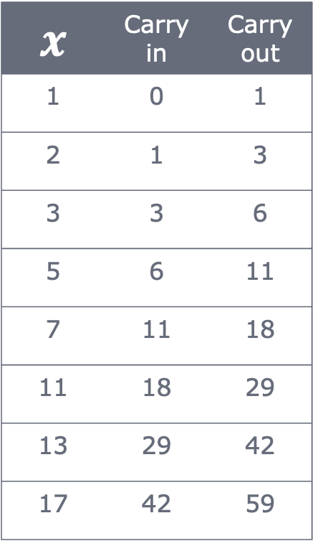
Cumulative Sum with scan
Carry in
x
0
1
$$x$$ | Carry in | Carry out
1 | 0 | 1
2 | 1 | 3
3 | 3 | 6
5 | 6 | 11
7 | 11 | 18
11 | 18 | 29
13 | 29 | 42
17 | 42 | 59
from jax import lax
xs = jnp.array([1, 2, 3, 5, 7, 11, 13, 17])
def cumsum(cumsum, el):
cumsum += el
return cumsum, cumsum # ('carryover', 'accumulated')
init_sum = 0
final, result = lax.scan(cumsum, init_sum, xs)
Carry out
Accumulated
1
[1]

Slide 2
Cumulative Sum with scan
Carry in
x
1
2
$$x$$ | Carry in | Carry out
1 | 0 | 1
2 | 1 | 3
3 | 3 | 6
5 | 6 | 11
7 | 11 | 18
11 | 18 | 29
13 | 29 | 42
17 | 42 | 59
from jax import lax
xs = jnp.array([1, 2, 3, 5, 7, 11, 13, 17])
def cumsum(cumsum, el):
cumsum += el
return cumsum, cumsum # ('carryover', 'accumulated')
init_sum = 0
final, result = lax.scan(cumsum, init_sum, xs)
Carry out
Accumulated
3
[1, 3]

Slide 3
Cumulative Sum with scan
Carry in
x
3
3
$$x$$ | Carry in | Carry out
1 | 0 | 1
2 | 1 | 3
3 | 3 | 6
5 | 6 | 11
7 | 11 | 18
11 | 18 | 29
13 | 29 | 42
17 | 42 | 59
from jax import lax
xs = jnp.array([1, 2, 3, 5, 7, 11, 13, 17])
def cumsum(cumsum, el):
cumsum += el
return cumsum, cumsum # ('carryover', 'accumulated')
init_sum = 0
final, result = lax.scan(cumsum, init_sum, xs)
Carry out
Accumulated
6
[1, 3, 6]

Slide 4
Cumulative Sum with scan
Carry in
x
6
5
$$x$$ | Carry in | Carry out
1 | 0 | 1
2 | 1 | 3
3 | 3 | 6
5 | 6 | 11
7 | 11 | 18
11 | 18 | 29
13 | 29 | 42
17 | 42 | 59
from jax import lax
xs = jnp.array([1, 2, 3, 5, 7, 11, 13, 17])
def cumsum(cumsum, el):
cumsum += el
return cumsum, cumsum # ('carryover', 'accumulated')
init_sum = 0
final, result = lax.scan(cumsum, init_sum, xs)
Carry out
Accumulated
11
[1, 3, 6, 11]

Slide 5
Cumulative Sum with scan
Carry in
x
11
7
$$x$$ | Carry in | Carry out
1 | 0 | 1
2 | 1 | 3
3 | 3 | 6
5 | 6 | 11
7 | 11 | 18
11 | 18 | 29
13 | 29 | 42
17 | 42 | 59
from jax import lax
xs = jnp.array([1, 2, 3, 5, 7, 11, 13, 17])
def cumsum(cumsum, el):
cumsum += el
return cumsum, cumsum # ('carryover', 'accumulated')
init_sum = 0
final, result = lax.scan(cumsum, init_sum, xs)
Carry out
Accumulated
18
[1, 3, 6, 11, 18]

Slide 6
Cumulative Sum with scan
Carry in
x
18
11
$$x$$ | Carry in | Carry out
1 | 0 | 1
2 | 1 | 3
3 | 3 | 6
5 | 6 | 11
7 | 11 | 18
11 | 18 | 29
13 | 29 | 42
17 | 42 | 59
from jax import lax
xs = jnp.array([1, 2, 3, 5, 7, 11, 13, 17])
def cumsum(cumsum, el):
cumsum += el
return cumsum, cumsum # ('carryover', 'accumulated')
init_sum = 0
final, result = lax.scan(cumsum, init_sum, xs)
Carry out
Accumulated
29
[1, 3, 6, 11, 18, 29]

Slide 7
Cumulative Sum with scan
Carry in
x
29
13
$$x$$ | Carry in | Carry out
1 | 0 | 1
2 | 1 | 3
3 | 3 | 6
5 | 6 | 11
7 | 11 | 18
11 | 18 | 29
13 | 29 | 42
17 | 42 | 59
from jax import lax
xs = jnp.array([1, 2, 3, 5, 7, 11, 13, 17])
def cumsum(cumsum, el):
cumsum += el
return cumsum, cumsum # ('carryover', 'accumulated')
init_sum = 0
final, result = lax.scan(cumsum, init_sum, xs)
Carry out
Accumulated
42
[1, 3, 6, 11, 18, 29, 42]

Slide 8
Cumulative Sum with scan
Carry in
x
42
17
$$x$$ | Carry in | Carry out
1 | 0 | 1
2 | 1 | 3
3 | 3 | 6
5 | 6 | 11
7 | 11 | 18
11 | 18 | 29
13 | 29 | 42
17 | 42 | 59
from jax import lax
xs = jnp.array([1, 2, 3, 5, 7, 11, 13, 17])
def cumsum(cumsum, el):
cumsum += el
return cumsum, cumsum # ('carryover', 'accumulated')
init_sum = 0
final, result = lax.scan(cumsum, init_sum, xs)
Carry out
Accumulated
59
[1, 3, 6, 11, 18, 29, 42, 59]

