Slide 1
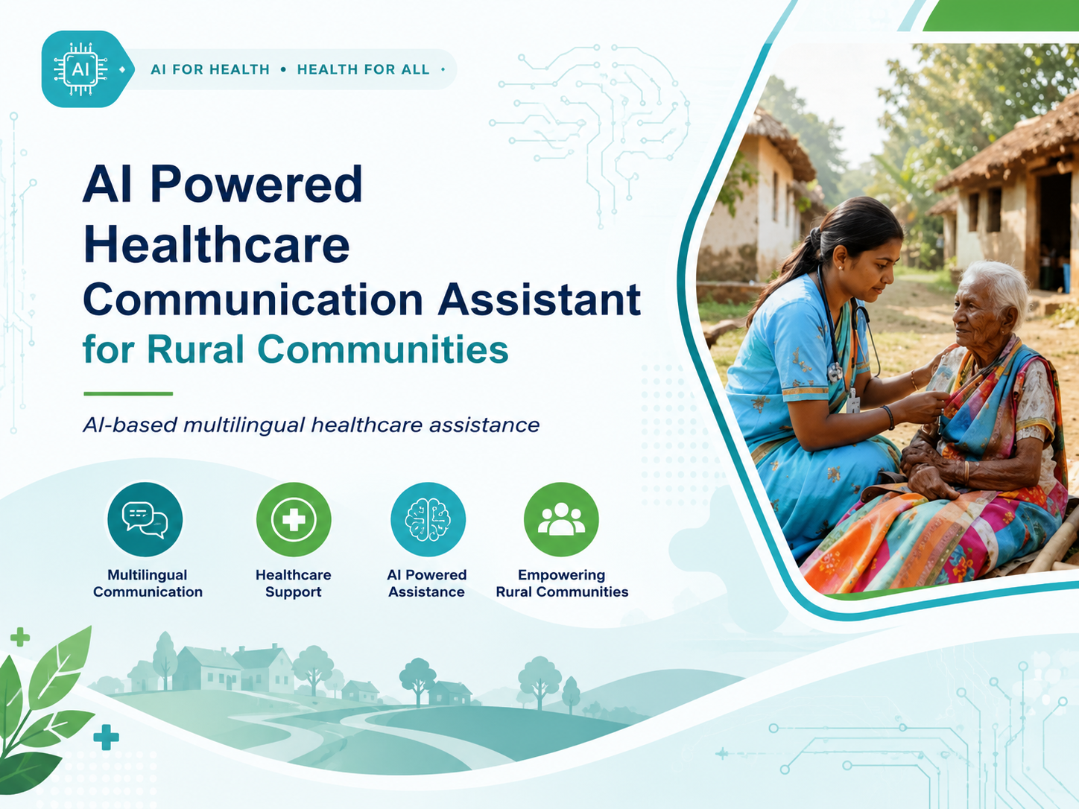
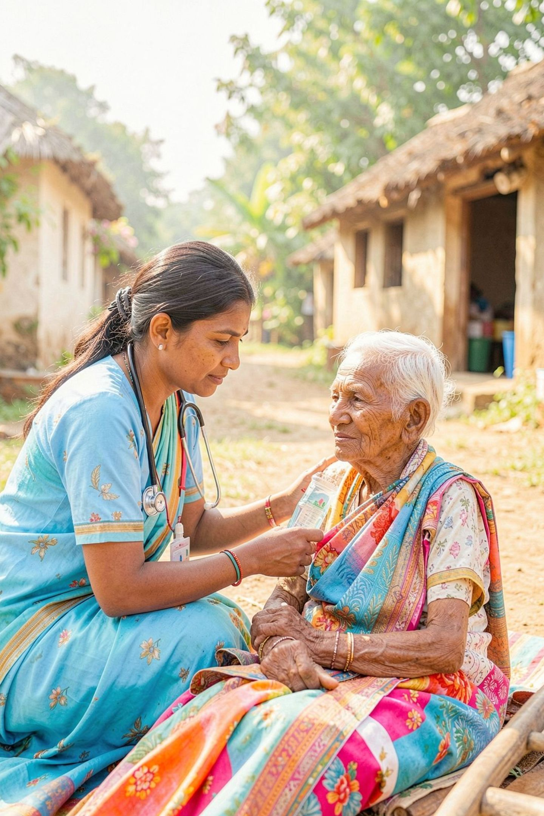
AI Powered Healthcare Communication Assistant for Rural Communities
AI-based multilingual healthcare assistance

Slide 2
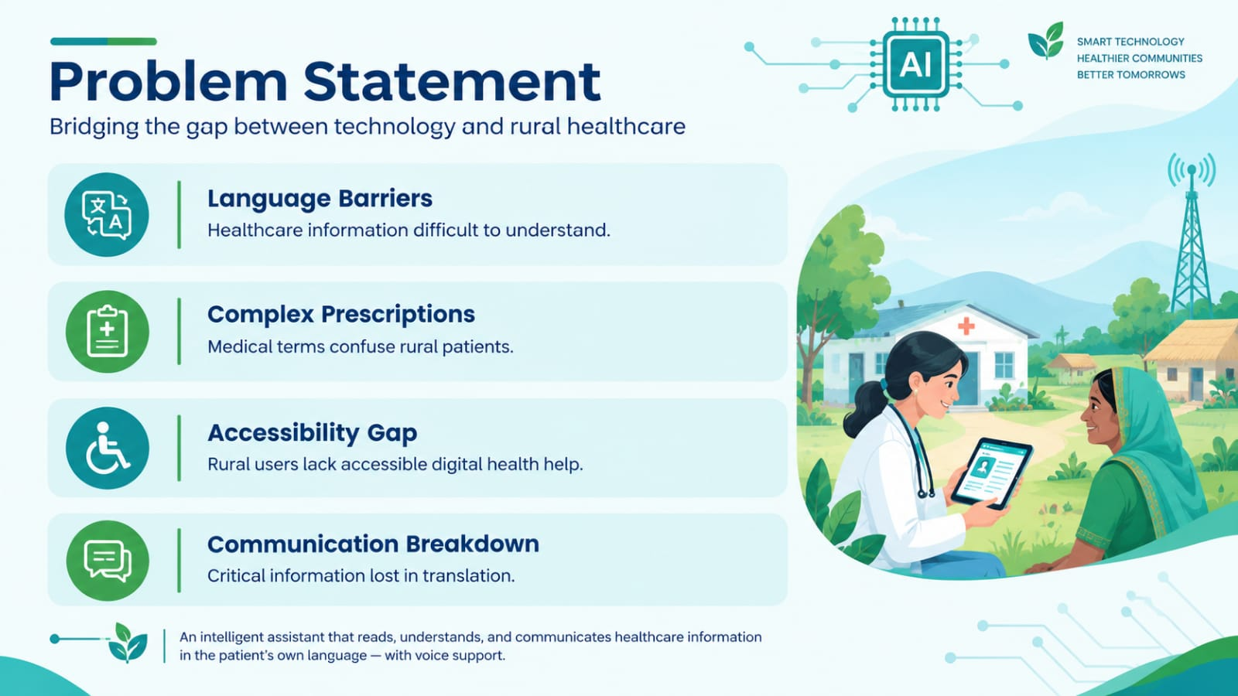
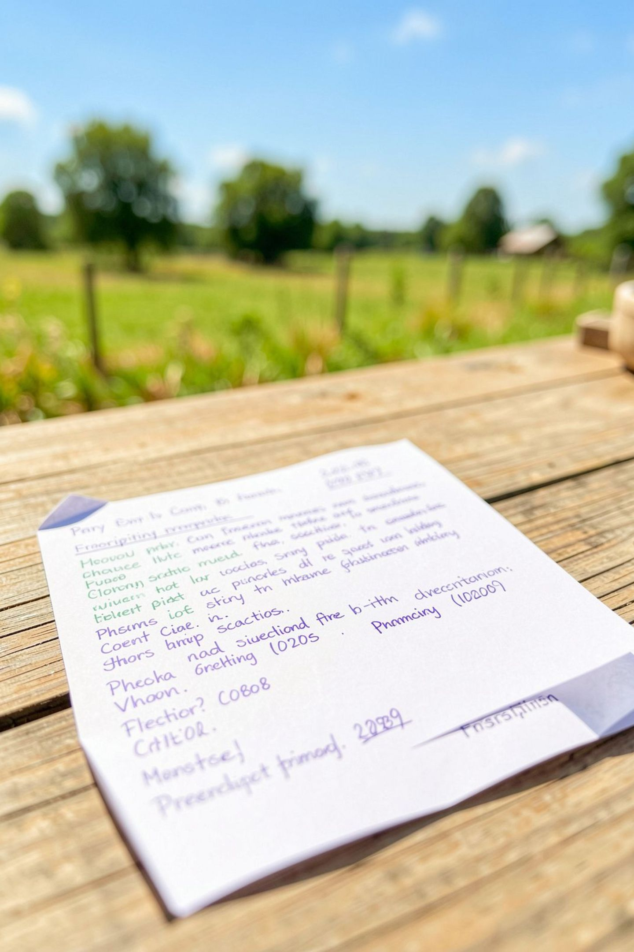
Problem Statement
Language Barriers
Healthcare information difficult to understand
Complex Prescriptions
Medical terms confuse rural patients
Accessibility Gap
Rural users lack accessible digital health help
Communication Breakdown
Critical information lost in translation

Slide 3
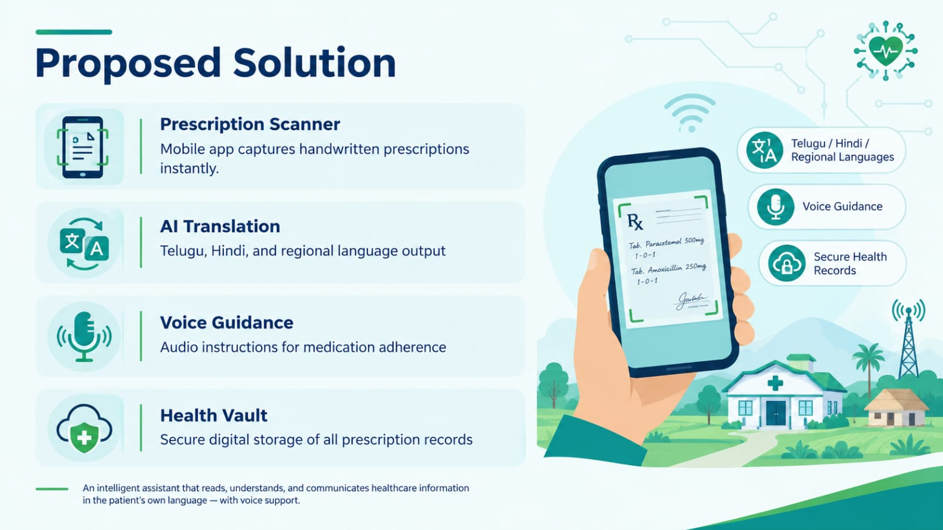
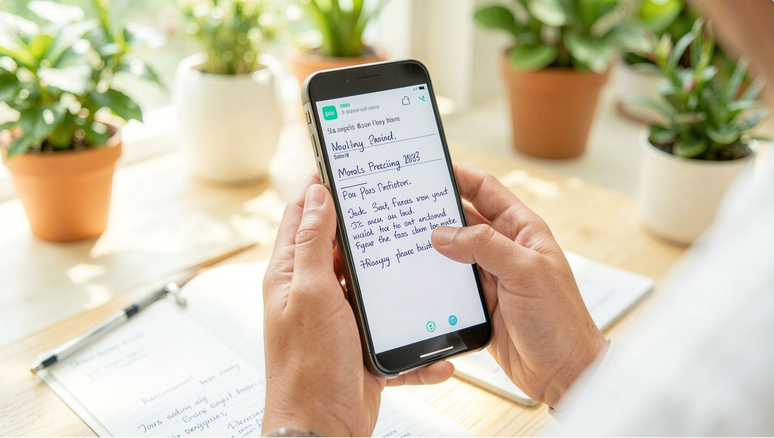
Proposed Solution
Prescription Scanner
Mobile app captures handwritten prescriptions
instantly
AI Translation
Telugu, Hindi, and regional language output
Voice Guidance
Audio instructions for medication adherence
Health Vault
Secure digital storage of all prescription records
Upload Rx
AI Review
Translate
An intelligent assistant that reads, understands, and communicates healthcare information in the patient's own language — with voice support.

Slide 4
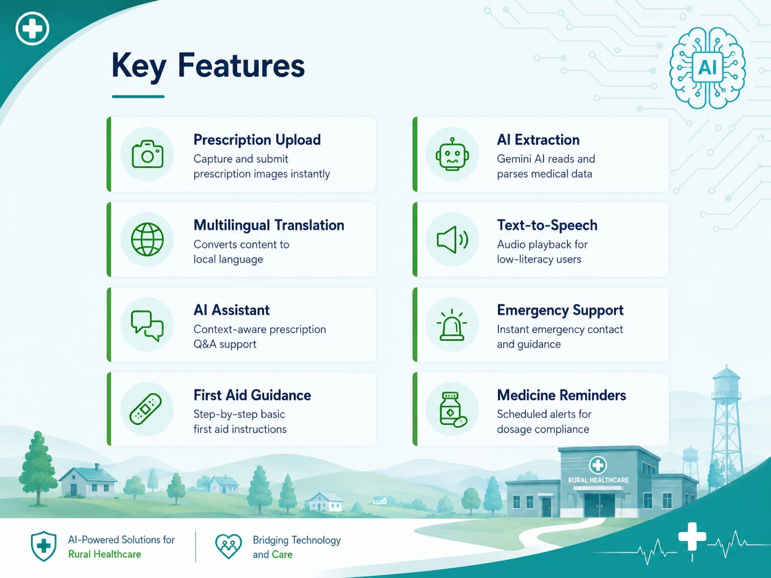
Key Features
Prescription Upload
AI Extraction
Capture and submit prescription images instantly
Gemini AI reads and parses medical data
Multilingual Translation
Text-to-Speech
Converts content to local language
Audio playback for low-literacy users
AI Assistant
Emergency Support
Context-aware prescription Q&A support
Instant emergency contact and guidance
First Aid Guidance
Medicine Reminders
Step-by-step basic first aid instructions
Scheduled alerts for dosage compliance

Slide 5
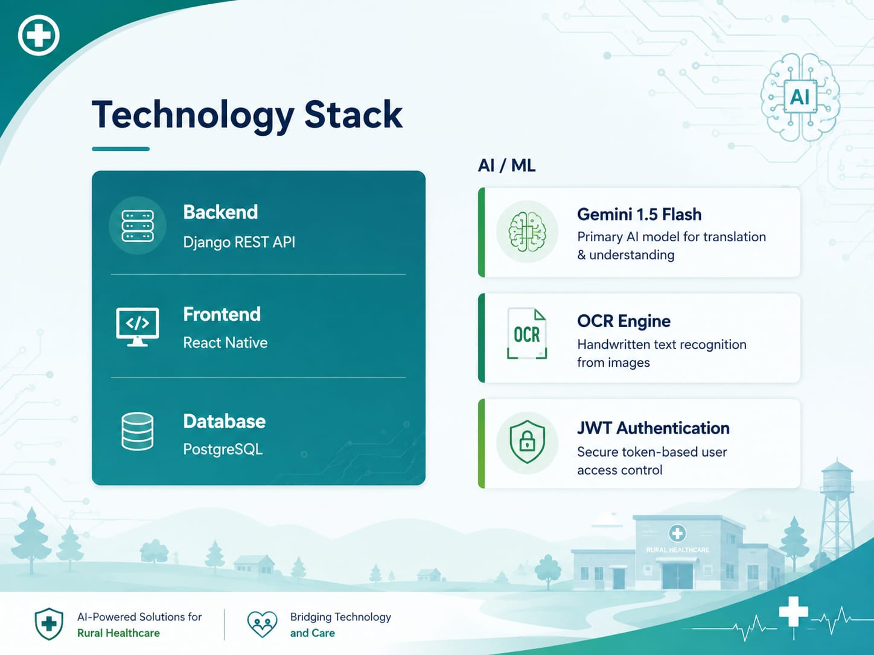
Technology Stack
Backend
AI / ML
Django REST API
Gemini 1.5 Flash
Frontend
Primary AI model for translation & understanding
React Native
OCR Engine
Database
Handwritten text recognition from images
PostgreSQL
JWT Authentication
Secure token-based user access control

Slide 6
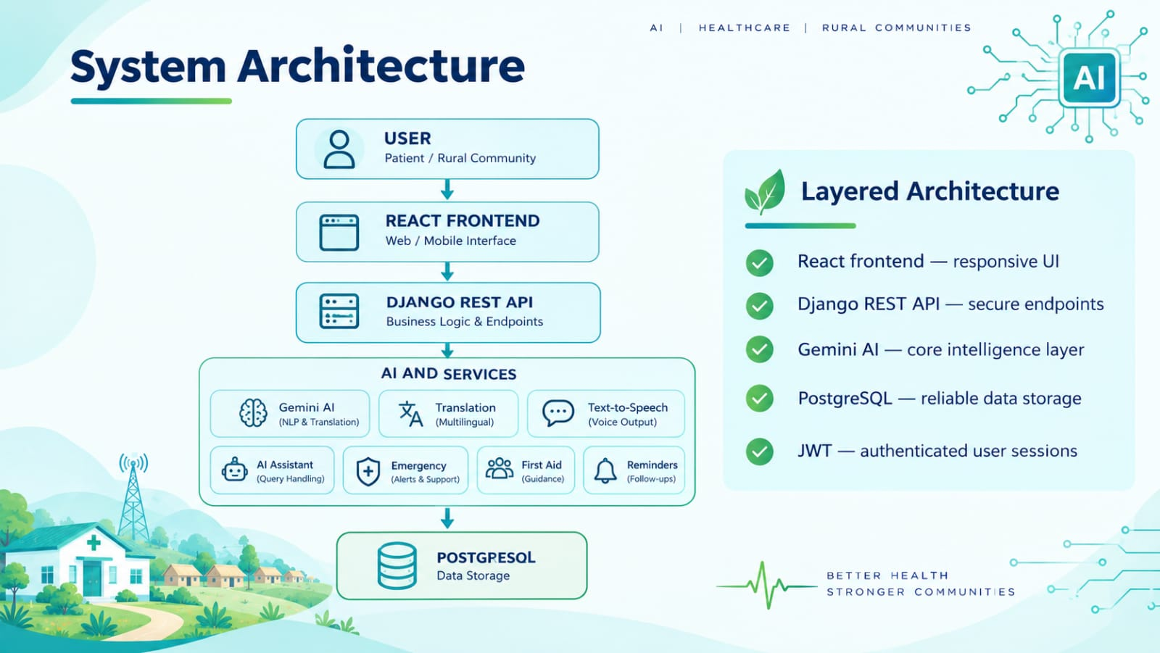
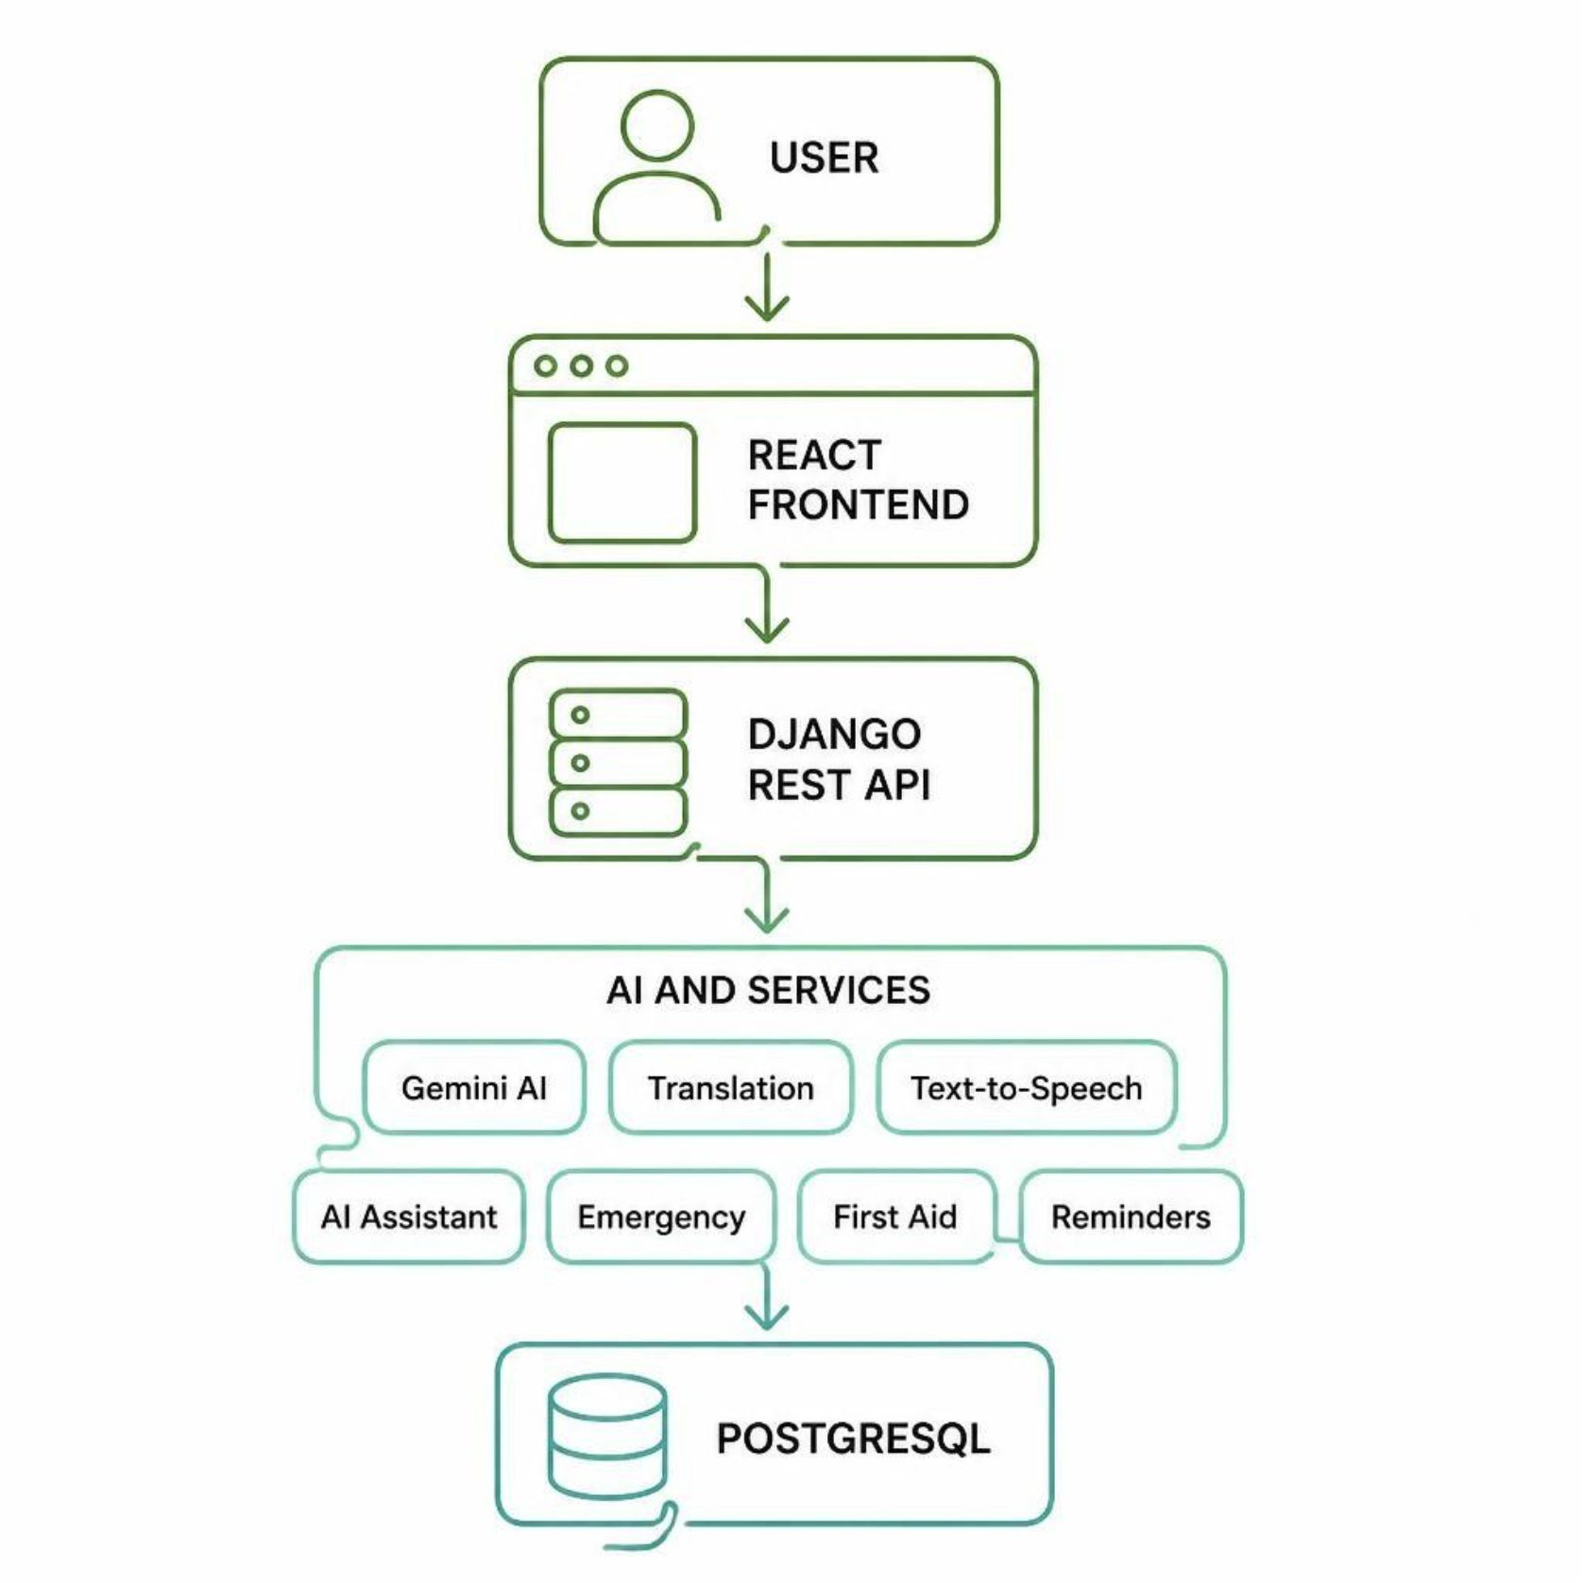
System Architecture
Layered Architecture
React frontend — responsive UI
Django REST API — secure endpoints
Gemini AI — core intelligence layer
PostgreSQL — reliable data storage
JWT — authenticated user sessions

Slide 7
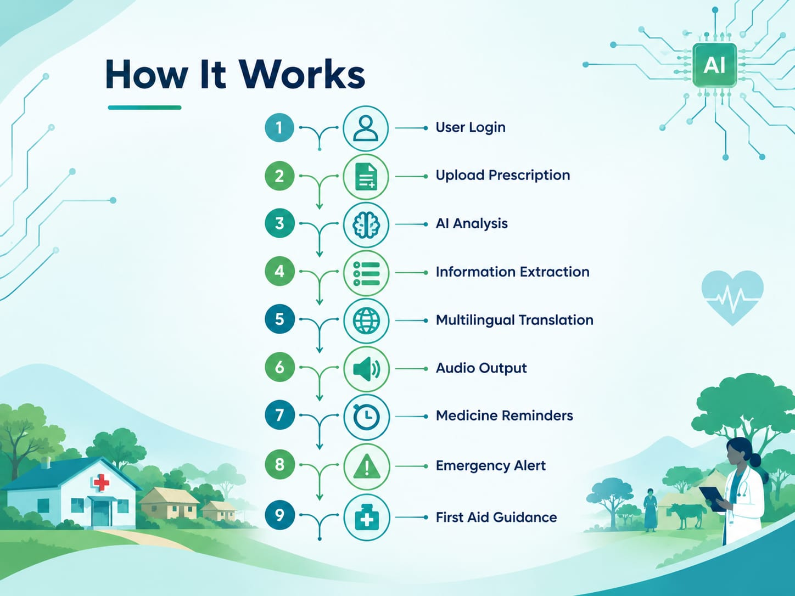
Project Roadmap
01 — Planning
03 — AI Integration
05 — Emergency & First Aid
Requirements gathering & system design
Gemini AI prescription extraction
Safety features & guidance modules
1
2
3
4
5
6
1
2
3
4
5
6
02 — UI & Backend
04 — Translation & Voice
06 — Testing & Deploy
React frontend & Django API setup
QA, Postman validation & launch
Multilingual support & text-to-speech

Slide 8
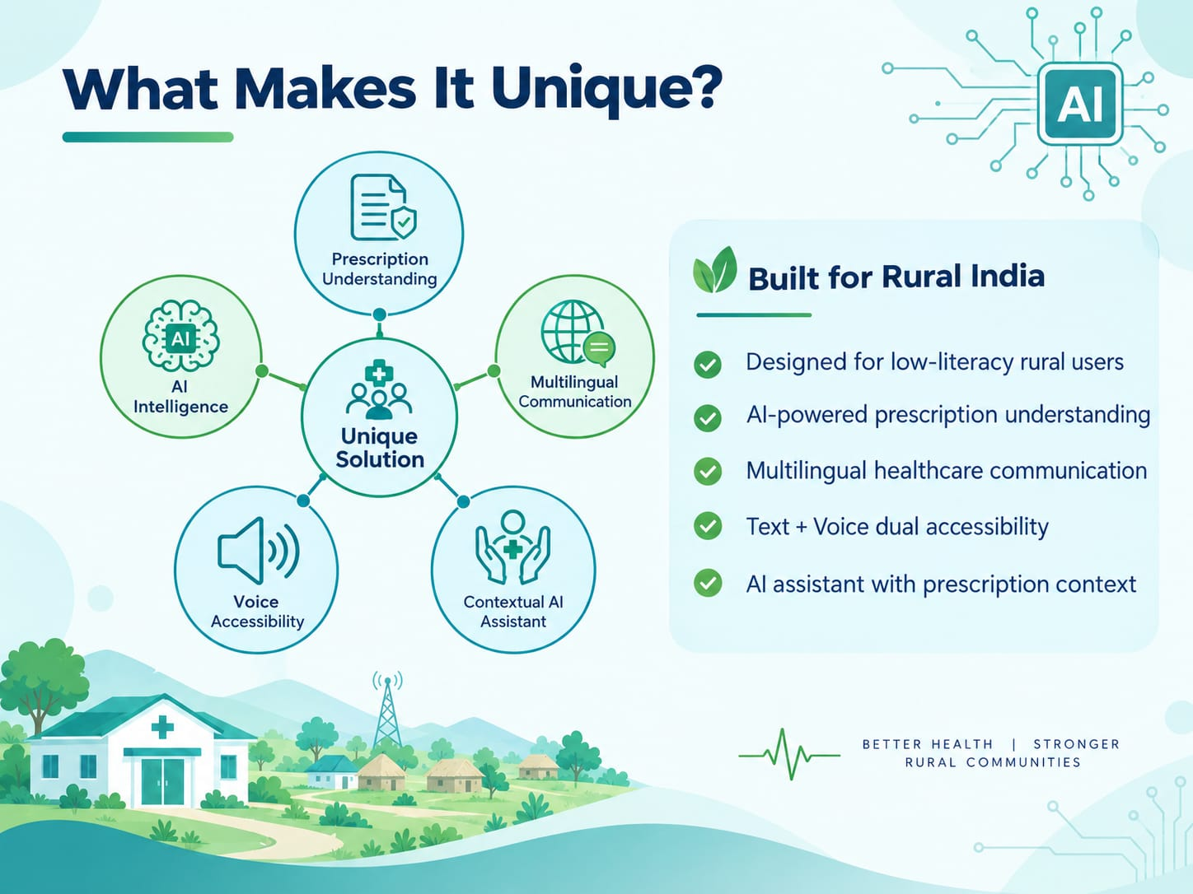
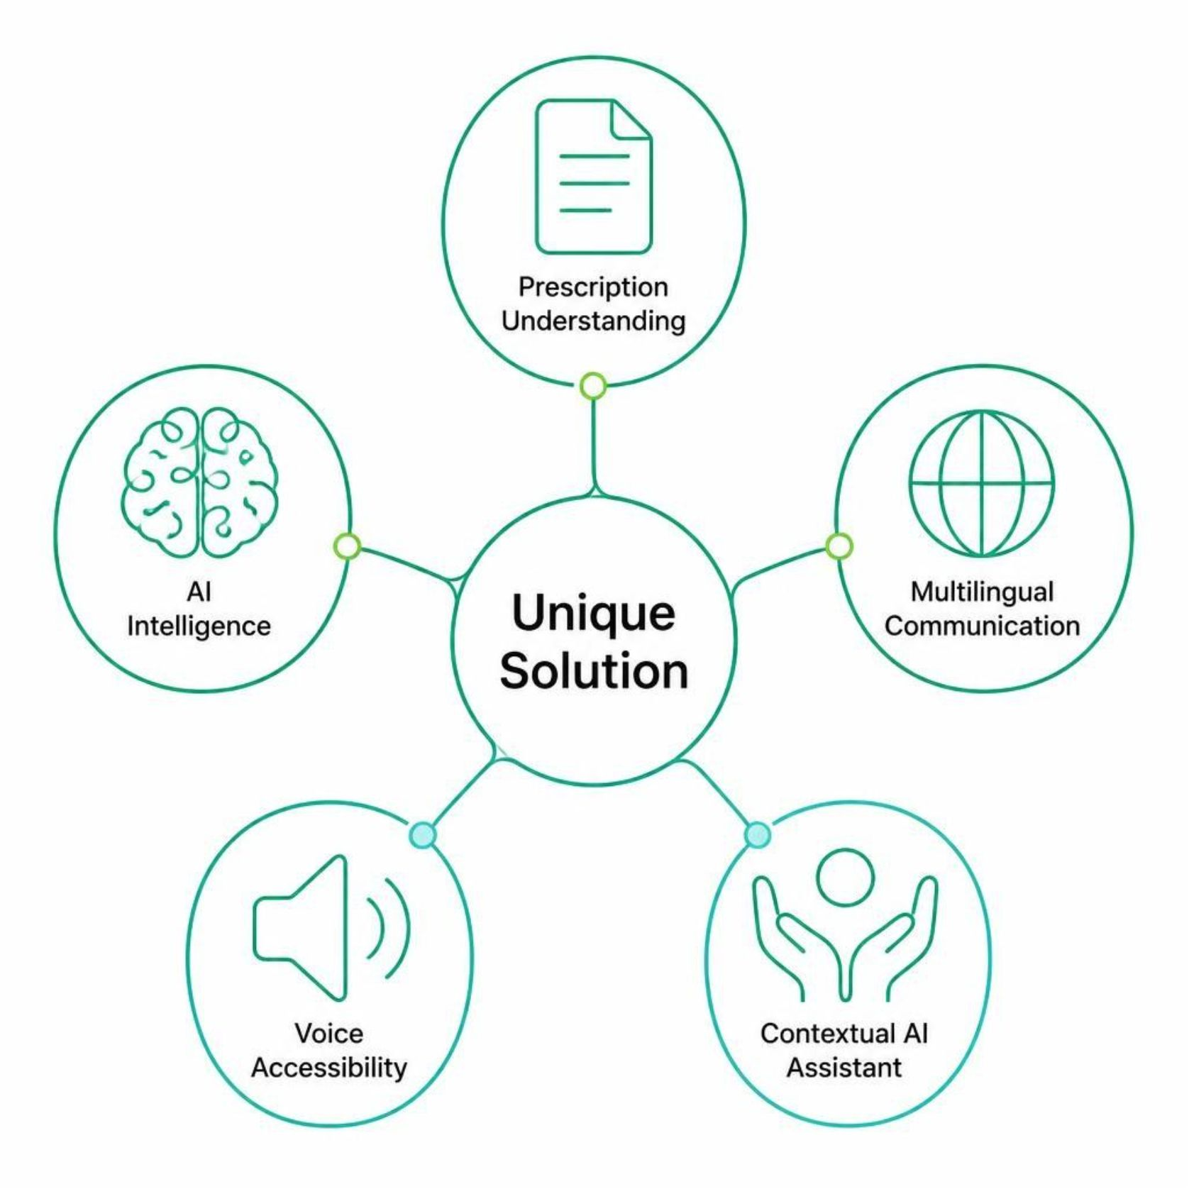
What Makes It Unique?
Built for Rural India
Designed for low-literacy rural users
AI-powered prescription understanding
Multilingual healthcare communication
Text + voice dual accessibility
AI assistant with prescription context

Slide 9
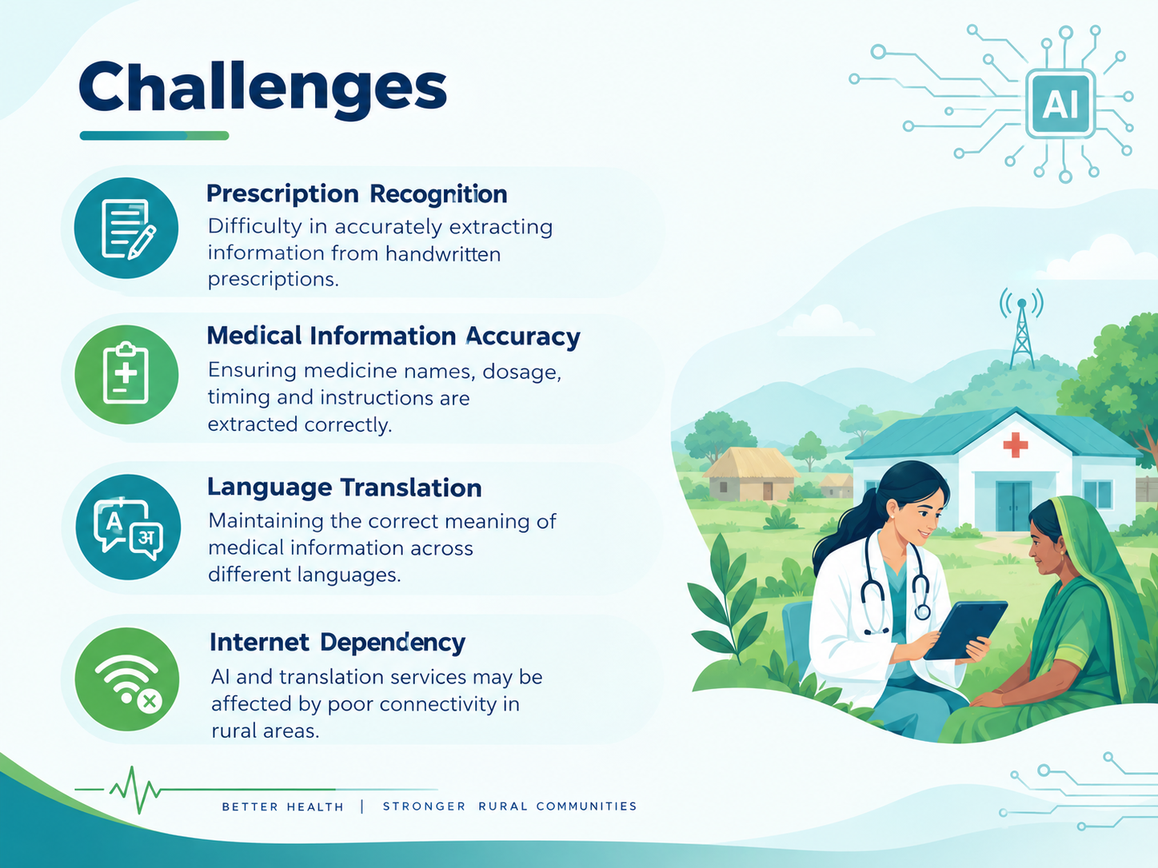

Challenges
Prescription Recognition
Difficulty in accurately extracting information from handwritten prescriptions.
Medical Information Accuracy
Ensuring medicine names, dosage, timing and instructions are extracted correctly.
Language Translation
Maintaining the correct meaning of medical information across different languages.
Internet Dependency
AI and translation services may be affected by poor connectivity in rural areas.

Slide 10
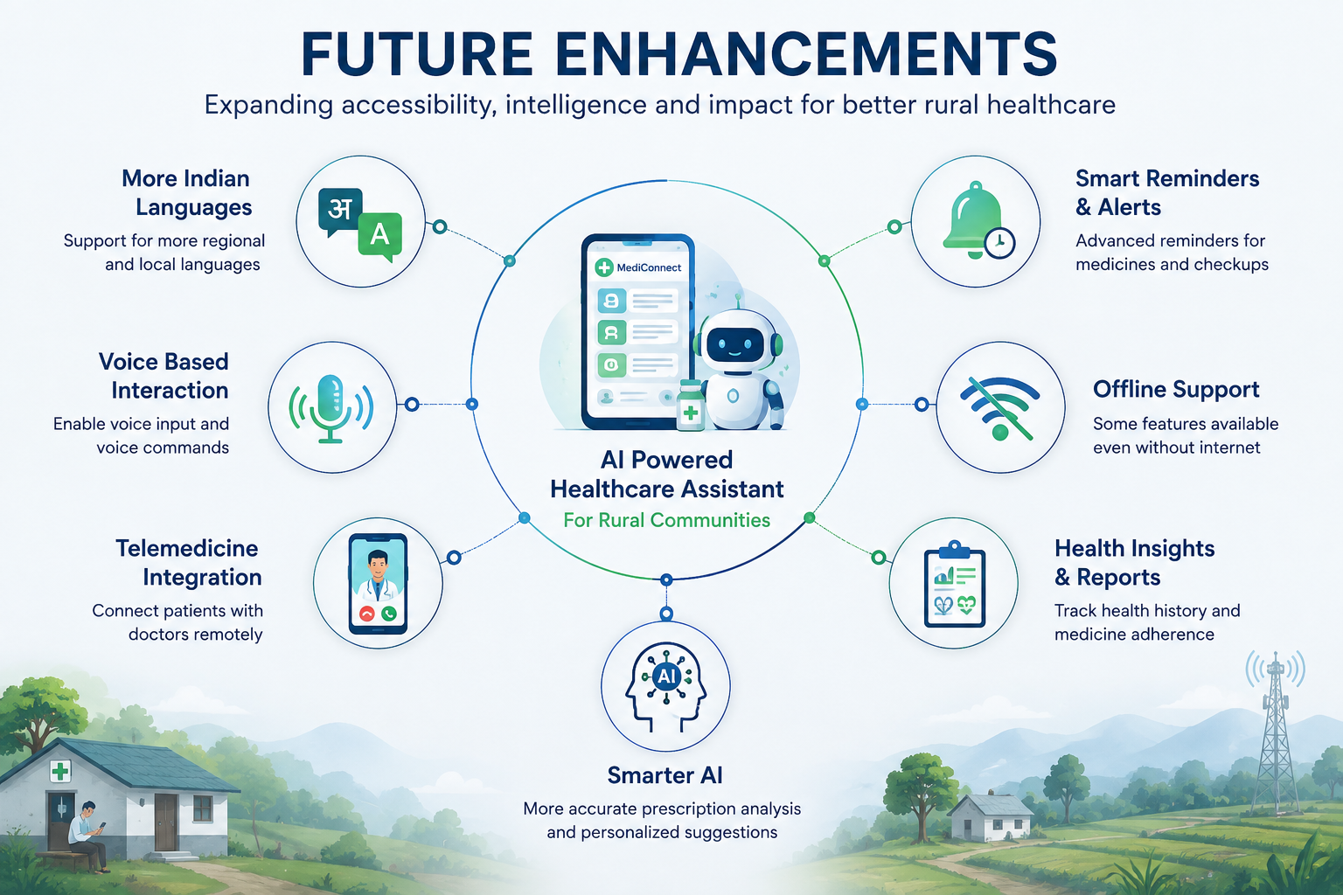
Future Scope
Format Variation
Multiple prescription layouts across regions
Translation Fidelity
Medical accuracy across all languages
AI Safety & Reliability
Ensuring clinically safe AI responses

Slide 11
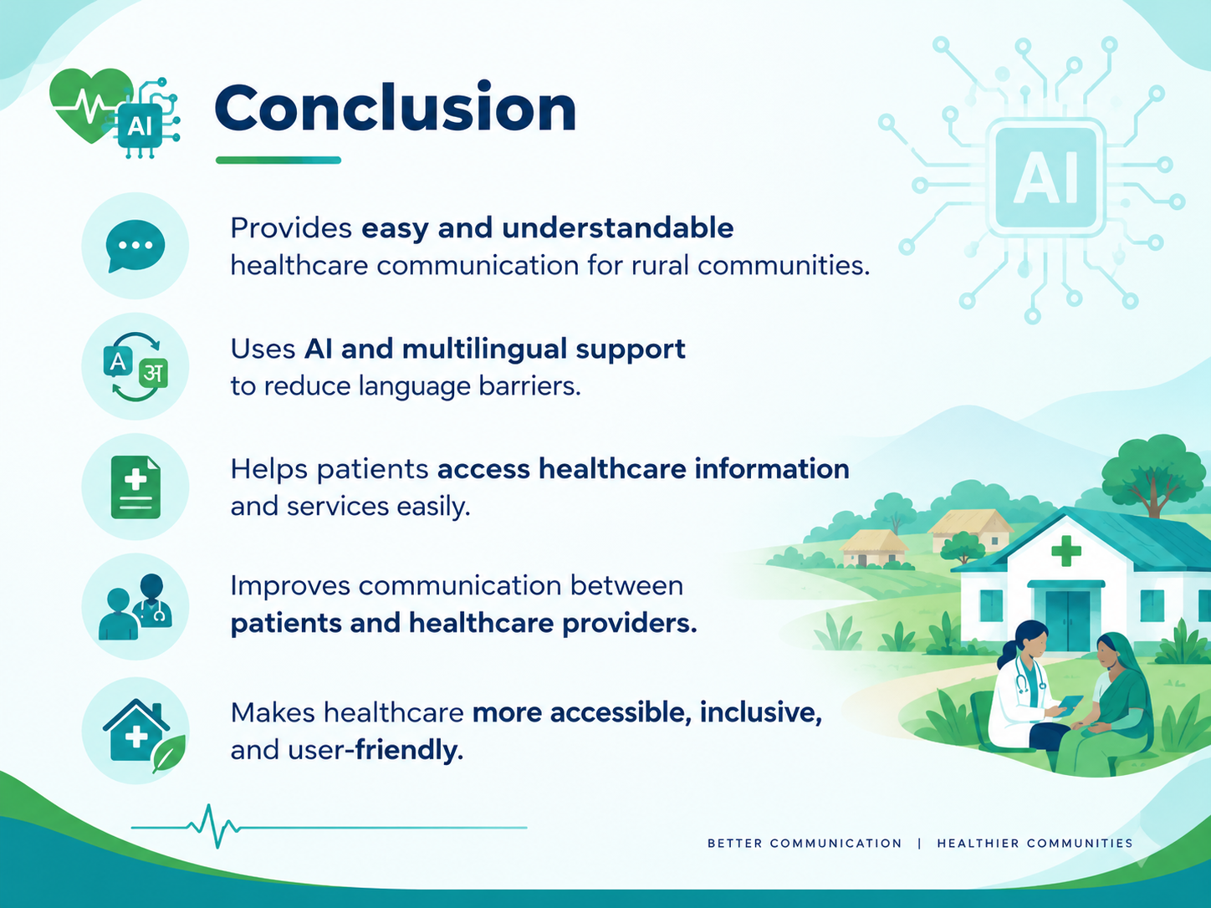
Conclusion
Provides easy and understandable healthcare communication for rural communities.
Uses AI and multilingual support to reduce language barriers.
Helps patients access healthcare information and services easily.
Improves communication between patients and healthcare providers.
Makes healthcare more accessible, inclusive, and user-friendly.

Slide 12

THATHANKANK
TH
AI Powered Healthcare Communication Assistant for Rural Communities
Questions & Discussion

