Slide 1
Analyzing heart disease using patient medical records
Group 1
Jayachandu Bandlamudi,
Augustine Chiu,
Daulet Dyussekenov

Slide 2
Coronary heart disease
Smoking habits – tobacco
Eating habits –adiposity, obesity, LDL, systolic blood pressure
Family history of the disease
Behavior habits – type-A, systolic blood pressure
Drinking habits – alcohol consumption
Aging – age, systolic blood pressure, LDL

Slide 3
Numerical predictors
Predictor | Median | Minimum | Maximum | Units
Age | 42.82 | 15 | 64 | Years
Blood Pressure | 134 | 101 | 218 | mmHg
Tobacco | 2 | 0 | 31.2 | Kg
LDL | 4.34 | 0.98 | 15.33 | mmol/l
Alcohol | 7.51 | 0 | 147.2 | Units/week
Type-A | 53 | 13 | 78 | Points
Adiposity | 26.12 | 6.74 | 42.49 | %
Obesity | 25.8 | 14.7 | 46.58 | Kg/m^2

Slide 4
Logistic Regression model: variable selection
Final model: chd ~ age + Famhist + Tobacco + Type-A + LDL
Variables dropped: adiposity, obesity , blood pressure, alcohol
Summary of Stepwise Selection
Step | Effect |  | DF | Number In | Score Chi-Square | Wald Chi-Square | Pr > ChiSq
 | Entered | Removed
1 | age |  | 1 | 1 | 64.2684 |  | <.0001
2 | Famhist |  | 1 | 2 | 19.0794 |  | <.0001
3 | Tobacco |  | 1 | 3 | 11.0460 |  | 0.0009
4 | Typea |  | 1 | 4 | 10.4263 |  | 0.0012
5 | Ldl |  | 1 | 5 | 9.0922 |  | 0.0026

Slide 5
Logistic Regression model: diagnostics

Slide 6
Logistic Regression model: significance
Model Fit Statistics
Criterion | Intercept Only | Intercept and Covariates
AIC | 598.108 | 487.686
SC | 602.244 | 512.499
-2 Log L | 596.108 | 475.686
Testing Global Null Hypothesis: BETA=0
Test | Chi-Square | DF | Pr > ChiSq
Likelihood Ratio | 120.4228 | 5 | <.0001
Score | 105.5848 | 5 | <.0001
Wald | 82.5120 | 5 | <.0001

Slide 7
Logistic Regression model: lack-of-fit
Hosmer and Lemeshow Goodness-of-Fit Test
Chi-Square | DF | Pr > ChiSq
1.5312 | 8 | 0.9922

Slide 8
Logistic Regression model
Analysis of Maximum Likelihood Estimates
Parameter |  | DF | Estimate | Standard Error | Wald Chi-Square | Pr > ChiSq
Intercept |  | 1 | -5.9923 | 0.9174 | 42.6626 | <.0001
Age |  | 1 | 0.0505 | 0.0102 | 24.4446 | <.0001
Famhist | Absent | 1 | -0.4541 | 0.1129 | 16.1827 | <.0001
Tobacco |  | 1 | 0.0804 | 0.0259 | 9.6456 | 0.0019
Typea |  | 1 | 0.0371 | 0.0122 | 9.3058 | 0.0023
Ldl |  | 1 | 0.1620 | 0.0550 | 8.6846 | 0.0032

Slide 9
Logistic Regression model
Odds Ratio Estimates
Effect | Point Estimate | 95% Wald Confidence Limits
Age | 1.052 | 1.031 | 1.073
famhist Absent vs Present | 0.403 | 0.259 | 0.628
Tobacco | 1.084 | 1.030 | 1.140
Typea | 1.038 | 1.013 | 1.063
Ldl | 1.176 | 1.056 | 1.310

Slide 10
Logistic Regression model: predicting
Table of chd by _INTO_
CHD | _INTO_(Formatted Value of the Predicted Response)
Frequency | 0 | 1 | Total
0 | 256 | 46 | 302
1 | 73 | 87 | 160
Total | 329 | 133 | 462

Slide 11
Clustering and ANOVA
Systolic blood pressure is a big health issue around the world
Are chd (coronary heart disease), famhist (family history), and the new cluster variable good predictors for sbp (systolic blood pressure)?
Cluster to group the continuous variables other than sbp

Slide 12
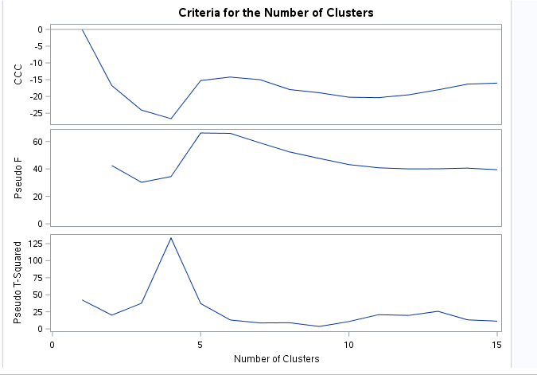
First attempt at clustering

Slide 13
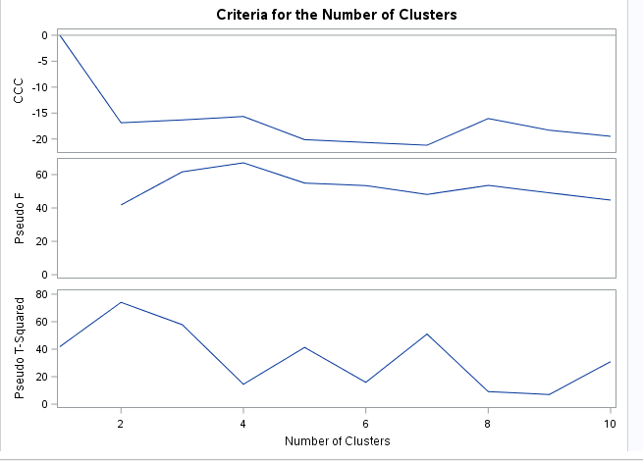
Clustering after removing 2 outliers

Slide 15
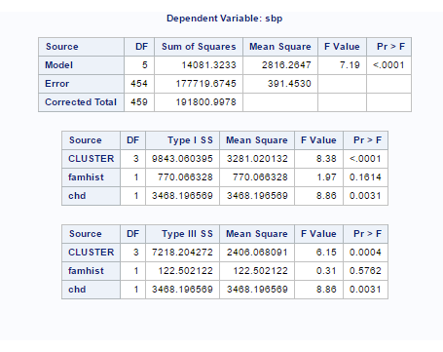
Proc GLM with response variable sbp and predictor variables cluster, famhist, and chd

Slide 16
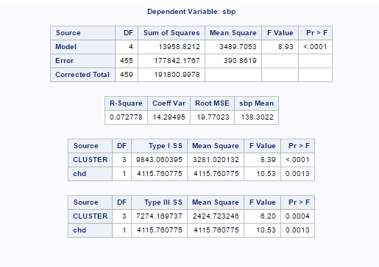
Model after removing insignificant variable famhist

Slide 17
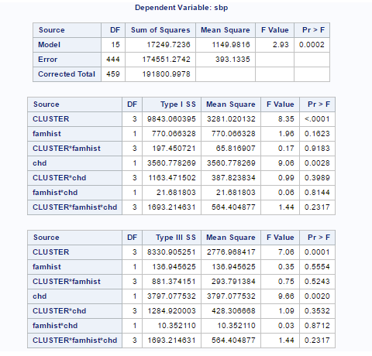
Model with all interactions

Slide 18
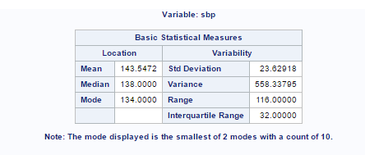
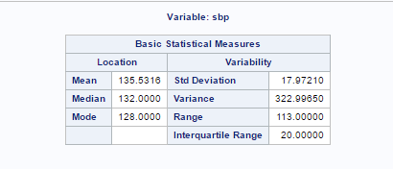
Coronary heart disease is a significant predictor for systolic blood pressure
This makes sense as people with heart disease also tend to have high blood pressure
Has coronary heart disease
No coronary heart disease

Slide 19
Discriminant analysis:
In the dataset we have two categorical variables ‘chd’ (coronary heart disease) indicating if the patient has the heart disease : levels 0/1 , ‘famhist’ (family history) if any family member of the patient has the heart disease : levels present/absent.
My analysis will try to answer the question, what are the significant variables that influence the combination of patient and his family getting the heart disease.
‘Chd’ and ‘famhist’ variables are combined such as below to create response variable for the analysis.
Chd (0/1) | famhist (Present/Absent) | Class (New response)
0 | Present | ClassA
1 | Present | ClassB
0 | Absent | ClassC
1 | Absent | ClassD
Class C is benign/safe
Class B is risky
Class A ,D may be at risk

Slide 20
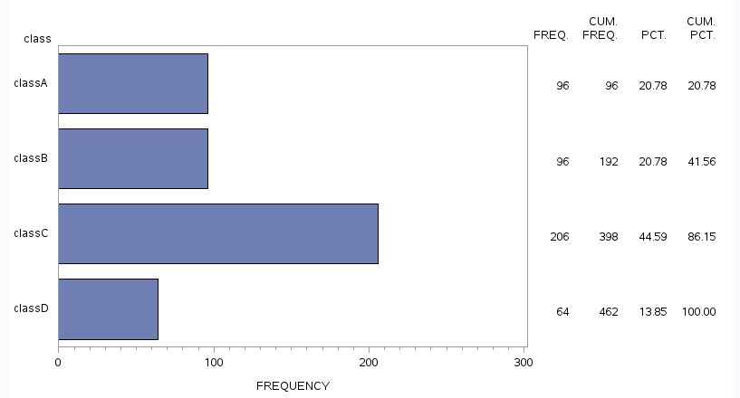
New response variable has 4 levels, so we are dealing with multi-class problem. We use LDA and QDA for the analysis.
Frequency plot for the new response variable(class).
At risk
Risky
Safe
At risk

Slide 21

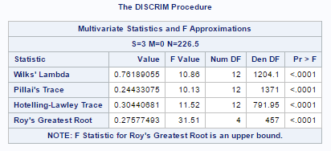
Model(QDA/LDA) with Class as response and 8 continuous variables as predictors.
Class ~ sbp + typea +tobacco+ alcohol+ ldl+ adiposity+ obesity+ age
QDA will be used based on homogeneity for variance test.
MANOVA test results, say possibility of discriminating classes.

Slide 22
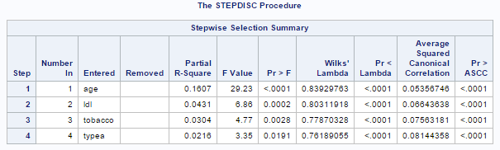
Using stepwise variable selection ,to identify significant variables in the discriminant analysis.

Slide 23
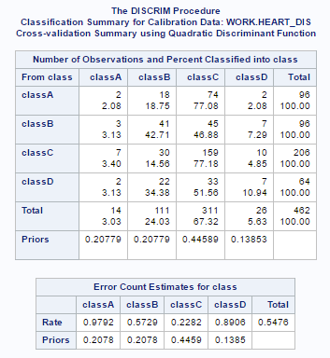
QDA results are not good, we have error rate close to 55 %.
Class C : error- 23 %
Class C ← chd (‘0’), famhist (‘Absent’)
Class A : error - 98 %
Class A← chd(‘0’) , famhist (‘Present’)
* Class A,D are most confused with Class C
QDA cross-validated results

Slide 24
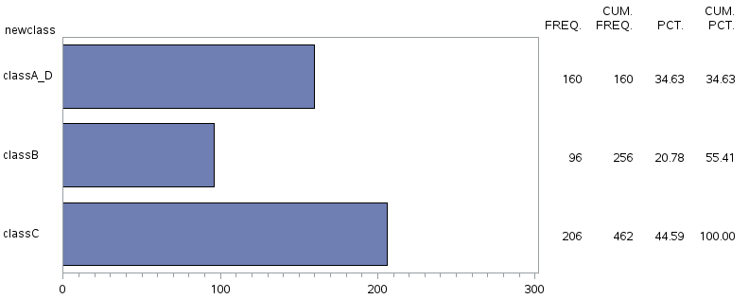
Next step is to merge the Class A,D because we could not effectively discriminate them.
New Class frequency plot with class A,D merged.
Similar to previous step, we did QDA analysis with New class variable as response. (MANOVA results : possibility of discrimination)
At risk
Risky
Safe

Slide 25
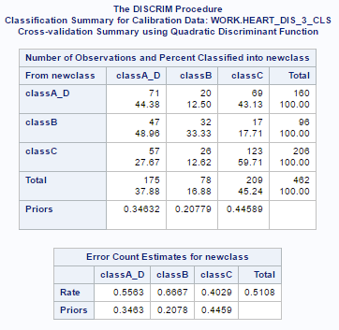
QDA results after merging the class A,D
Variables that significant are ‘ldl’, ‘typea’, ‘age’ (using Stepwise selection).
Cross-validation results.
This model is useful ,despite bad error rate.
Class A_D : Error rate of 56%
Predicting Class A_D correctly is more important. Because either the patient or Family member has heart disease.

Slide 26
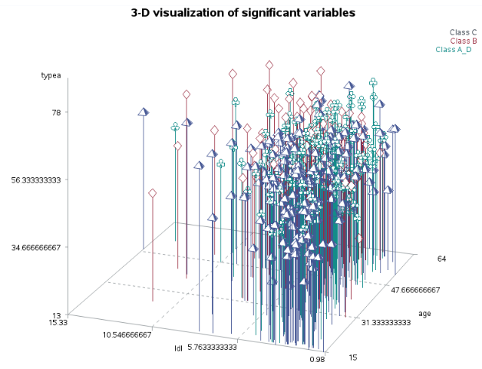
Interpreting the significant variables

Slide 27
Thank you

