Slide 1
Intern-Project SL2-Gene Report Automation Tool Jay Bandlamudi M.S. in Statistics @UIUC

Slide 2
Motivation
Gene report contains information about genetic variants from a subject/patient
Genetic counselors use these reports while counseling subjects
Information comes from several sources such as multiple catalog files and web
Manually preparing a report is cumbersome
Genetic counselors spend approx. 3 hours/per report.

Slide 3
Need for AUTOMATION
Project goal is to automate gene report generation (pptx format).
Report can be generated in less than a minute by running couple of commands.
With this tool , genetic counselors can spend more time analyzing data than preparing reports manually.

Slide 4
Gene report contents
Gene symbol ,Transcript, Protein
Zygosity (Homo/Hetero) traits for Subject, Dad, Mom
ExAC, gnomAD statistics
In silico predictions
Clinvar and HGMD
Inheritance
Phenotype list
Entrez Gene summary.
ExAC table and Source URL references

Slide 5
Sources of Information
Bior Annotate is used for annotating the variants using several catalog files
Catalog files:
ClinVar_20170208_GRCh37
ExAC_r031_GRCh37
HGMD_2016Q4_GRCh37
dbSNP_142_GRCh37p13
omim_20170405_GRCh37p13_EnsemblGTF_75
hgnc_37_20151224
dbNSFP_v3a_GRCh37
gnomAD_r20_GRCh37
HPO_Build_1241_GRCh37
Websites:
http://exac.broadinstitute.org
https://www.ncbi.nlm.nih.gov/
http://www.uniprot.org/
http://www.genecards.org/
etc.,

Slide 6
Variants in Genes Related to Phenotype
FANCD2 , HET , c.78A>C , p.Gln26His , Dad is : HET , Mom is : Neg
Disease => Fanconi anemia complementation group D2, MIM: 227646
ExAC => 69/120704 (0 hom ;0.0962% NFE), gnomAD => 223/246258 (0 hom;0.2070% ASJ)
ClinVar => Not reported , HGMD => Not reported
In silico => SIFT : T , Polyphen : B|P|P , Mutation Taster Pred : N , CAVA_IMPACT : MODERATE
Location => Ex3
Entrez Gene Summary / (CAVA_GENE_ID : ENSG00000144554) => The Fanconi anemia complementation group (FANC) currently includes FANCA, FANCB, FANCC, FANCD1 (also called BRCA2), FANCD2, FANCE, FANCF, FANCG, FANCI, FANCJ (also called BRIP1), FANCL, FANCM and FANCN (also called PALB2). The previously defined group FANCH is the same as FANCA. Fanconi anemia is a genetically heterogeneous recessive disorder characterized by cytogenetic instability, hypersensitivity to DNA crosslinking agents, increased chromosomal breakage, and defective DNA repair. The members of the Fanconi anemia complementation group do not share sequence similarity; they are related by their assembly into a common nuclear protein complex. This gene encodes the protein for complementation group D2. This protein is monoubiquinated in response to DNA damage, resulting in its localization to nuclear foci with other proteins (BRCA1 AND BRCA2) involved in homology-directed DNA repair. Alternative splicing results in multiple transcript variants. [provided by RefSeq, Feb 2016]
Uniprot Gene Summary => Required for maintenance of chromosomal stability. Promotes accurate and efficient pairing of homologs during meiosis. Involved in the repair of DNA double-strand breaks, both by homologous recombination and single-strand annealing. May participate in S phase and G2 phase checkpoint activation upon DNA damage. Plays a role in preventing breakage and loss of missegregating chromatin at the end of cell division, particularly after replication stress. Required for the targeting, or stabilization, of BLM to non-centromeric abnormal structures induced by replicative stress. Promotes BRCA2/FANCD1 loading onto damaged chromatin. May also be involved in B-cell immunoglobulin isotype switching.13 Publications
AR
Quick links/Right click
exac
ncbi
uniprot
marrvel
genecards
Constraint from Exac | Expected no. variants | Observed no. variants | Constraint Metric
Synonymous | 182.5 | 163 | z=0.89
Missense | 416.6 | 427 | z=-0.25
LoF | 63.0 | 33 | pLI=0.00
CNV | nan | nan | z=nan

Slide 7
Phenotype List
Esophageal atresia
Tracheoesophageal fistula
Pes planus
Meckel diverticulum
Aplasia/Hypoplasia of the iris
Spina bifida
Choanal atresia
Hip dislocation
Thrombocytopenia
Arteriovenous malformation
Decreased fertility in males
Strabismus
Irregular hyperpigmentation
Reduced bone mineral density
Renal hypoplasia/aplasia
Sloping forehead
Abnormality of the carotid arteries
Abnormal localization of kidney
Cataract
Pyridoxine-responsive sideroblastic anemia
External ear malformation
Abnormality of the liver
Astigmatism
Toe syndactyly
Short stature
Intellectual disability
Cranial nerve paralysis
Facial asymmetry
Aplasia/Hypoplasia of fingers
Umbilical hernia
Anal atresia
Aplasia/Hypoplasia of the uvula
Micrognathia
Ptosis
High palate
Hypertelorism
Hyperreflexia
Abnormality of the aorta
Aplasia/Hypoplasia of the radius
Visual impairment
There are more ... , refer NOTES below
Notes:
Ventriculomegaly , Duodenal stenosis , Leukopenia , Aganglionic megacolon , Short palpebral fissure , Hearing impairment , Hypopigmented skin patches , Myelodysplasia , Multiple cafe-au-lait spots , Upslanted palpebral fissure , Abnormality of femur morphology , Cryptorchidism , Absent testis , Hypoplasia of the ulna , Hypertrophic cardiomyopathy , Abnormality of the aortic valve , Microcephaly , Bicornuate uterus , Azoospermia , Weight loss , Dolichocephaly , Scoliosis , Almond-shaped palpebral fissure , Abnormality of the preputium , Nystagmus , Oligohydramnios , Finger syndactyly , Recurrent urinary tract infections , Global developmental delay , Atrial septal defect , Abnormality of chromosome stability , Proptosis , Hypospadias , Triphalangeal thumb , Hydroureter , Cleft palate , Renal insufficiency , Hypogonadism , Intrauterine growth retardation , Clubbing of toes , Hydrocephalus , Patent ductus arteriosus , Microphthalmia , Abnormality of the hypothalamus-pituitary axis , Clinodactyly of the 5th finger , Epicanthus , Frontal bossing , Tetralogy of Fallot , Small for gestational age , Cafe-au-lait spot , Short thumb , Abnormal heart morphology , Pancytopenia , Absent thumb , Renal agenesis , Chromosomal breakage induced by crosslinking agents , Deficient excision of UV-induced pyrimidine dimers in DNA , Horseshoe kidney , Duplicated collecting system , Bruising susceptibility , Prolonged G2 phase of cell cycle , Absent radius , Leukemia , Anemic pallor , Hypergonadotropic hypogonadism , Reticulocytopenia , Neutropenia , Ectopic kidney , Anemia , Complete duplication of thumb phalanx , Abnormality of skin pigmentation

Slide 8
Tool capabilities
Tool developed in python
Report can be generated in less than a minute.
It does web scraping ( to get gene summaries, tables etc from web)
Stores web scraped gene details to a database(sqlite) for future reference.
Capable of capturing screenshots using selenium browser automation(not in use)

Slide 9
DEMO
Command to generate annotated vcf
python ~/flash_ppt/src/annotate_variants.py -i ~/flash_ppt/variants/SL2-377_reportedvcf.txt -n SL2-377-new -o ~/flash_ppt/sample_vcfs/
Command to generate report
python ~/flash_ppt/src/run_tool.py -i ~/flash_ppt/sample_vcfs/SL2-377.vcf.gz -n SL2-377 -o ~/flash_ppt -d ~/flash_ppt

Slide 10
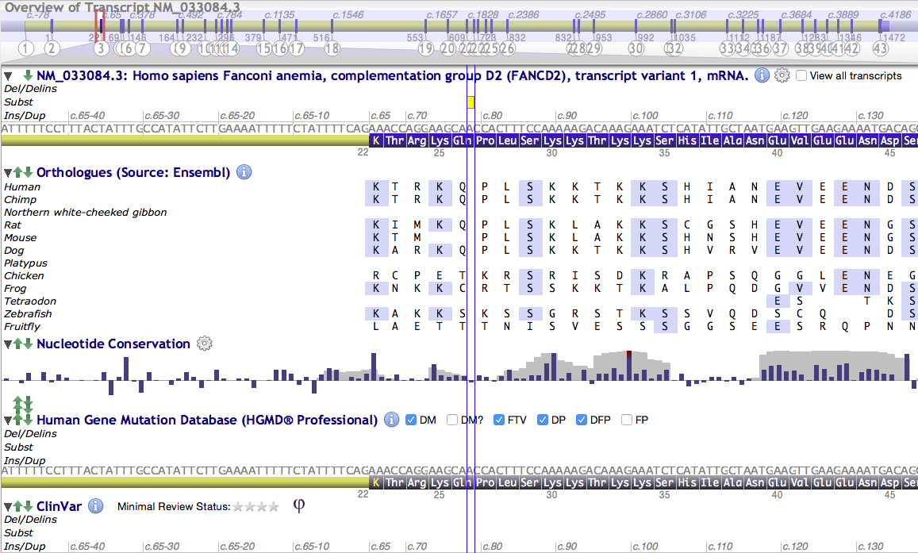
Enhancements:

Slide 11
Learning experience
Exposure to Bioinformatics (No previous experience)
Gained experience in software development, improved python programming skills
Learned web-scraping, browser automation using selenium
Did couple of side projects
i) Metabolic modelling project (Mike Mundy)
ii)Catalogs documentation (Raymond Moore)

