Slide 1

Capstone Project T.A.I.G.A
TEXT-BASED ARTIFICIALLY INTELLIGENT GAMING ADVENTURE
CPG 66
Mentor :
Dr. Shivendra Shivani
Assistant Professor
CSED
Team Members :
Harsh Thakur 101916052
Shrey Bandlish 101916017
Harshit Rai 101916069
Navneet Kaur 101916030

Slide 2
Problem Definition And Scope
Conventional Ways of storytelling fail to captivate the younger audience and the gaming market finds it difficult to tell a compelling plot.
Most games have little to no replay-ability and reading books fails to be an interactive activity for the user.
Text-based Artificially Intelligent Gaming Adventure is a NLP based web application that offers to remedy these problems and more with the help of machine learning.
TAIGA takes user input in the form of sentences which with the help of GPT-3 gives an output creating an input output loop and in this process builds a unique story.
Not only building a captivating and personalised story but also being a truly ‘open world’ video game that is infinitely explorable and replay able.
Acting as a bridge between the gaming and reading society providing for a better means of storytelling.

Slide 3
Methodology
A web application made using the help of Django will be hosted to the public on internet providing ease of access
Individual user profiles will be created for access to start different topics within the web application.
Created topics will ask for input in the form of a sentence which will be used for obtaining output.
A specifically tuned GPT-3 model will run on the backend, used to fetch the output.
Input will be forwarded to the model and the respective output returned will be displayed to the user.
An appropriate dataset will be chosen to tune the model and parameters like temperature are set to get the desired result.

Slide 4
Project Analysis And Design (Literature Survey)
Sr. No. | Paper Title | Findings
1 | Attention Is All You Need | Attention based transformer architecture helps train with unsupervised data effectively.
2 | Language Models Are Unsupervised Multitask Learners | Language Models like BERT and GPT-3 can do a number of tasks trained on unsupervised data.
3 | GPT-3 What Is It Good For | GPT-3 can do an array of NLP tasks and can be finely tuned to perform a single one with better results
4 | AI Dungeon A Brief Overview | A text based RPG with its shortcomings and approach using GPT-2

Slide 5
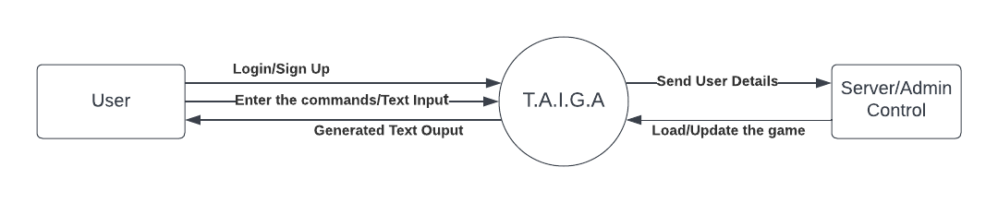
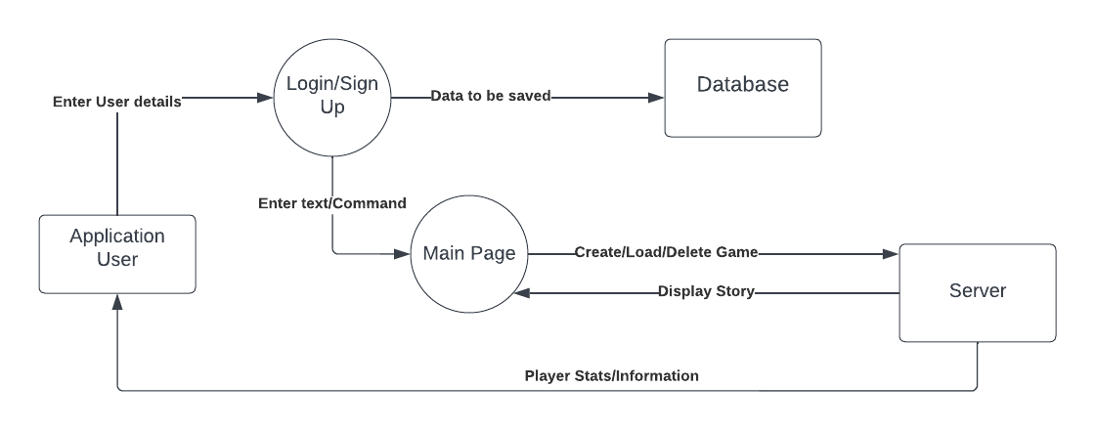
Data Flow Diagrams
LEVEL 0
LEVEL 1

Slide 6
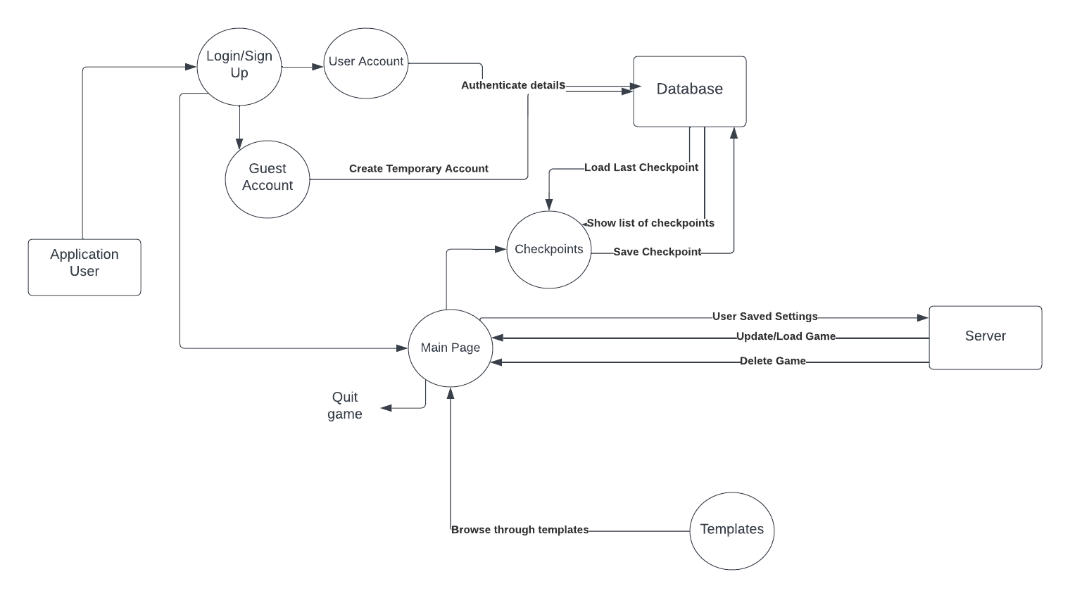
LEVEL 2

Slide 7
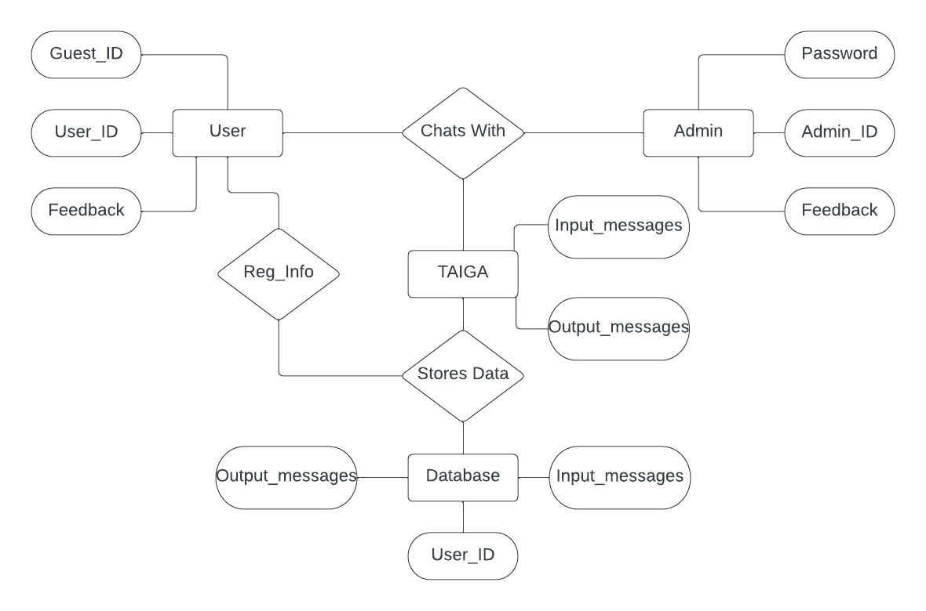
Entity Relationship

Slide 8
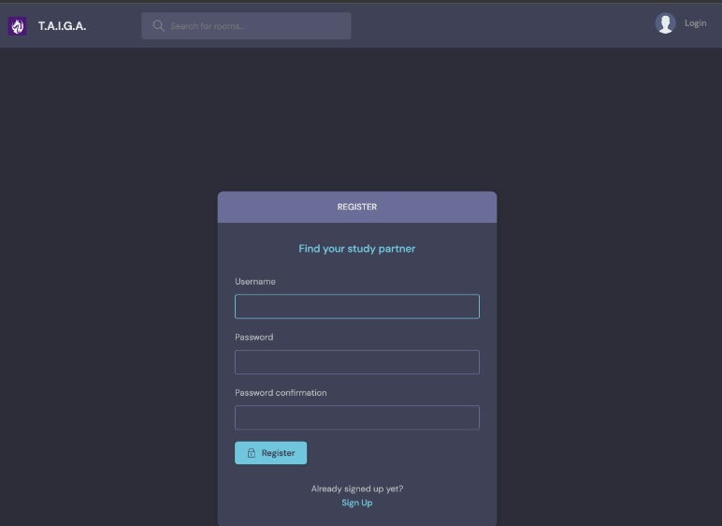
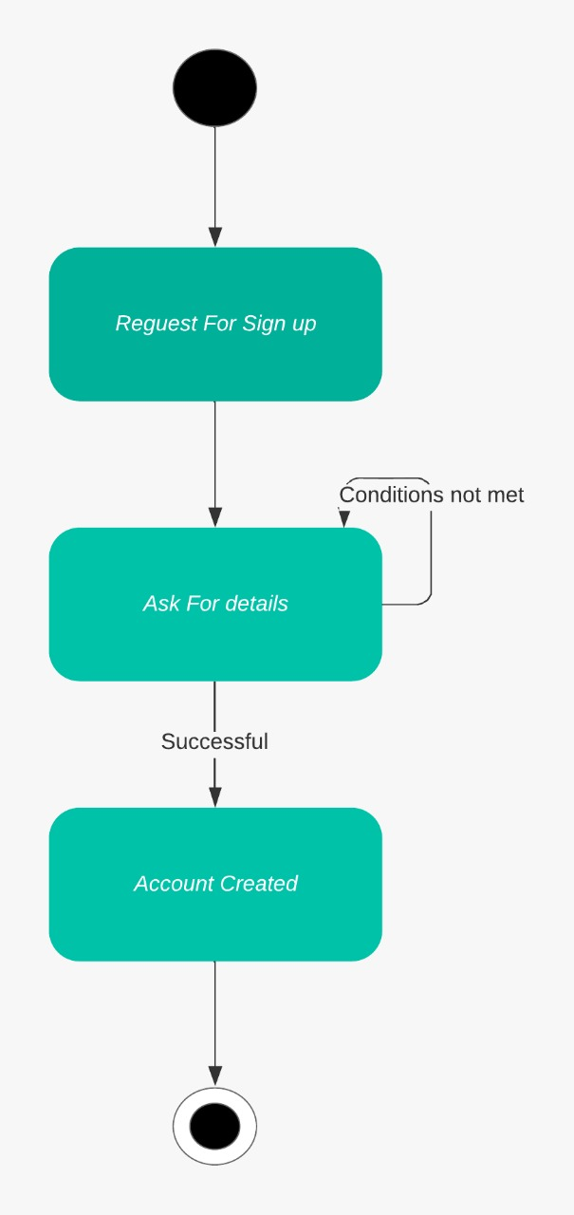
Snapshots With Activity Diagrams

Slide 9
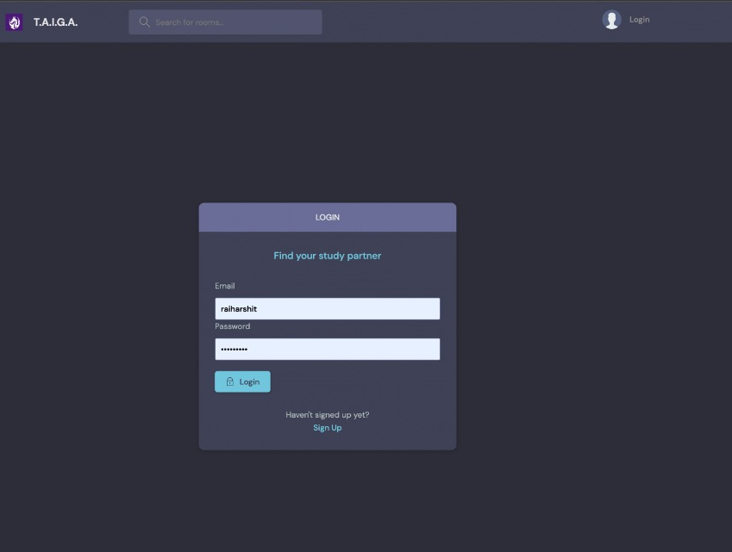
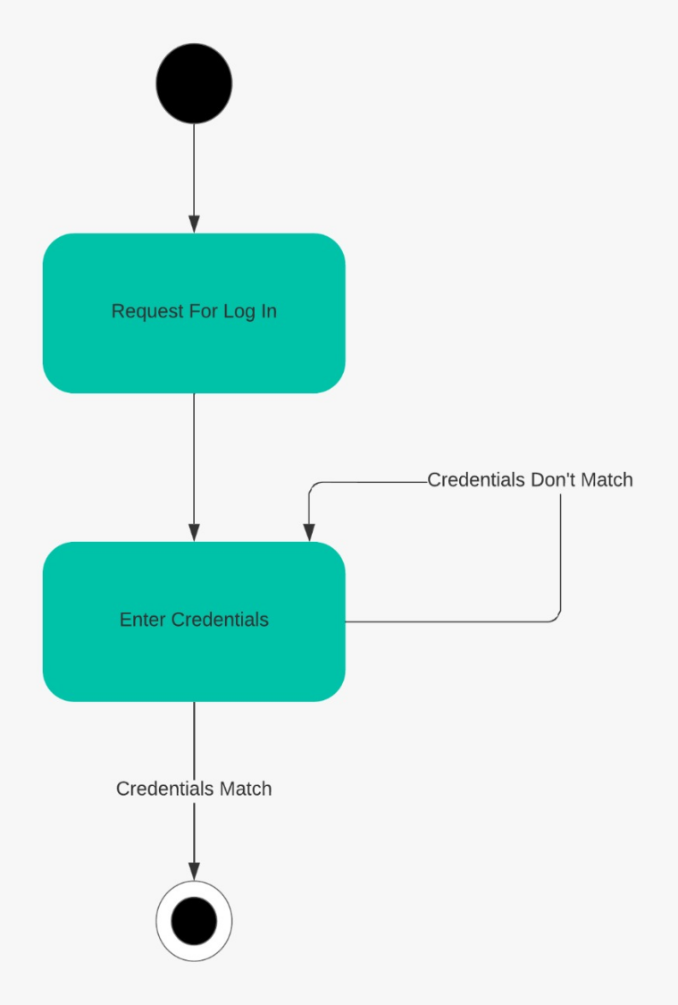

Slide 10
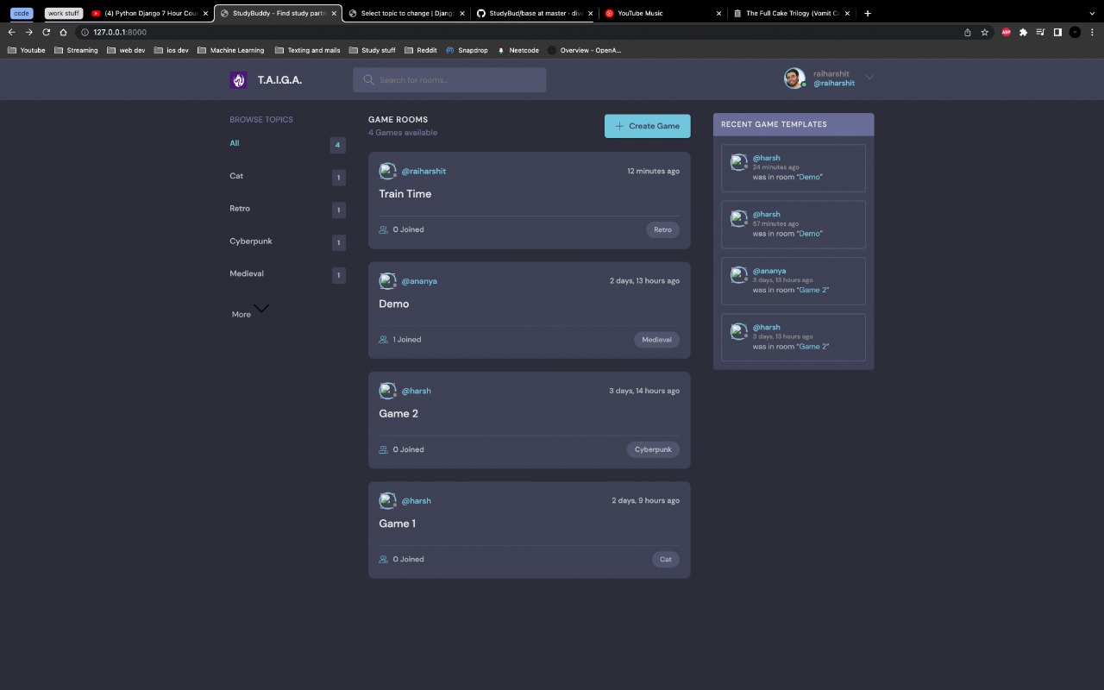
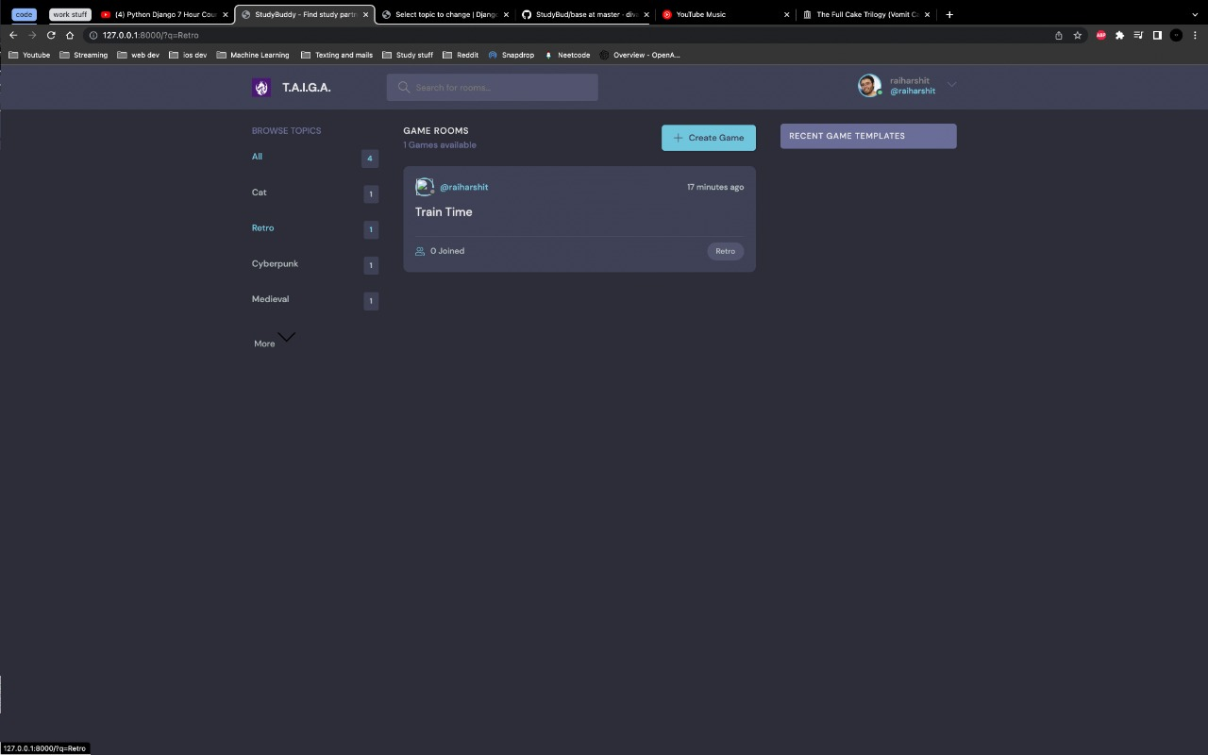

Slide 11
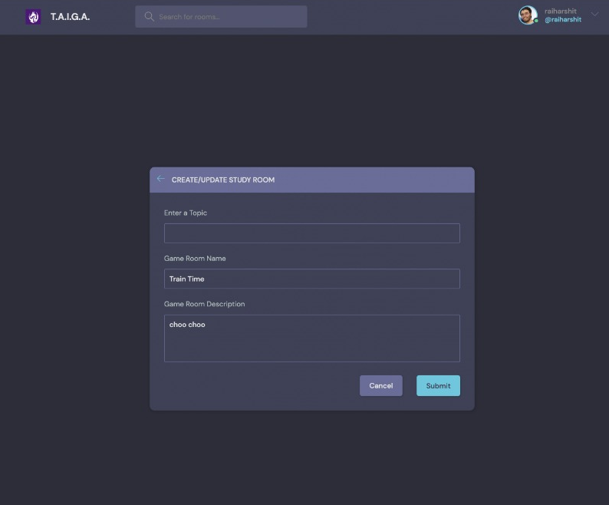
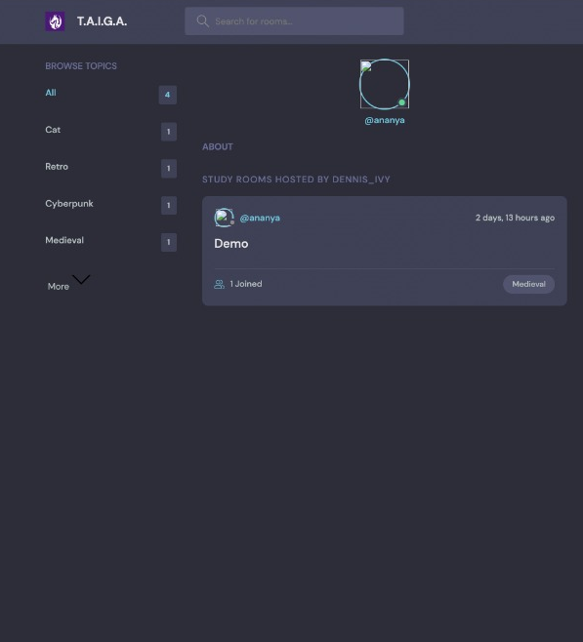

Slide 12
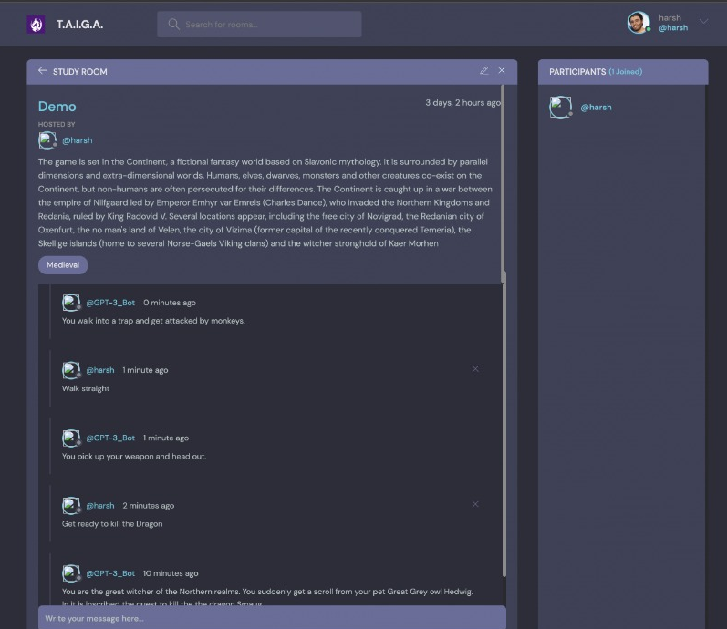
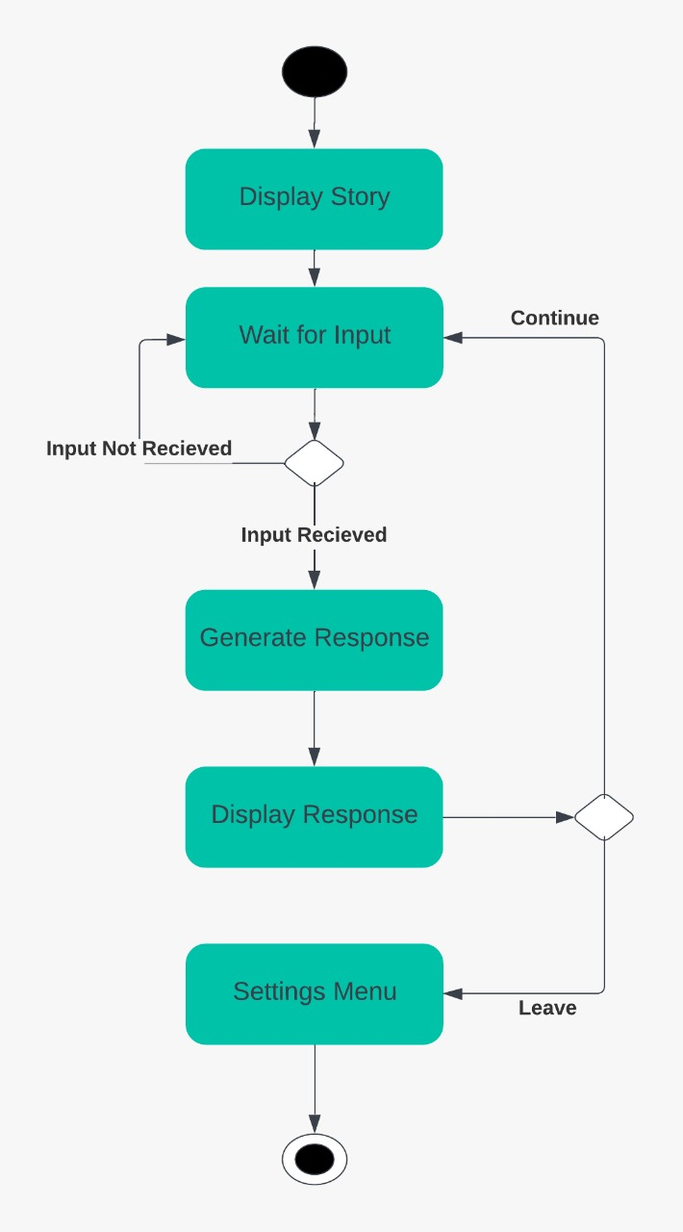

Slide 13
Role/Contribution Of Each Member
Project Conceptualization | Shrey, Harsh , Navneet, Harshit
Literature Survey needed for project | Shrey, Harsh, Navneet, Harshit
Project Analysis and UML Diagrams | Shrey, Harsh, Navneet, Harshit
Technical Report | Shrey, Harsh , Navneet, Harshit
Front-end Development | Harshit
Back-end Development | Harsh, Navneet
GPT-3 Research | Navneet, Shrey
Project Integration | Shrey, Harsh

