Slide 1
Acoustic Battleship
Team 5 MDR
12/11/2019
Evaluated by:
Professor Maciej Ciesielski
Professor Yeonsik Noh
Professor Baird Soules

Slide 2


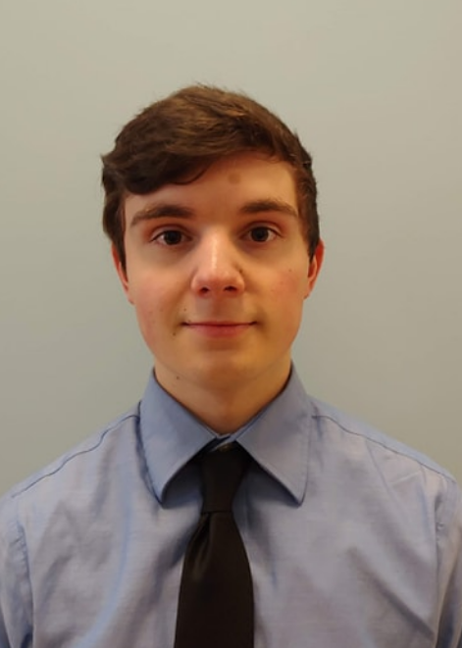

Team Members
Liam Weston
(Group Manager)
Adrian Sanmiguel
Justin Forgue
Xinyu Cao

Slide 3
Problem Statement
Board games have failed to adapt to the technological advances of today’s market. Traditional board games have fallen out of favor. Implementing embedded systems could help to provide a jolt to the industry.
How do we plan to do this?
Notes:
Note for bullet 1
Even games that do implement electronics, do so in a way that make them in accessible (often found only in arcades)
Note for bullet 2
Games are based entirely on the users’ eyes, ears, and brain to determine points and keep track of score

Slide 4
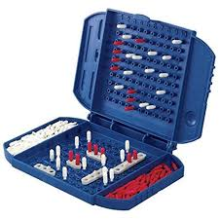
Problem Statement
Provide an aesthetically pleasing, functional, scalable, and robust interface
Applying these characteristics to Battleship
Notes:
Note Bullet 2
We would like to provide localization solution to the classic game Battleship

Slide 5
Problem Statement
Our solution will put an interactive spin on a classic game
Accuracy based game using a ping pong ball to provide low-latency, responsive feedback
Will follow an adapted set of guidelines to Battleship
Using localization from a network of microphones to detect if a target is hit

Slide 6
Game Rules
Two team game (1+ player per team), alternate turns
1m x 2m playing surface
projectile is a ping pong ball
Each team is attempting to hit multi-coordinate, line of sight platform, where a coordinate may contain a target
A winner is declared when all targets on either team have been struck by the opposing teams projectile
Liam Weston

Slide 7
System Requirements & Specifications
Table of Requirements and Specifications
Requirement | Specifications | Value
Accuracy | Distance Error | <= 5 cm
Responsiveness | Response Time | <= 500 ms
Components:
Microphone, LED, ADC, Microcontroller, Ping-Pong Ball, transparent playing surface/Display

Slide 8
Block Diagram (PDR)
Processing Unit
UI
Clock
Microcontroller
LED
Input
Display
Ping Pong Ball
Acoustic Sensors
ADC
Sound Effect
Start Button

Slide 9
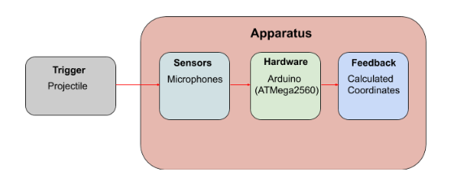
Block Diagram (MDR)

Slide 10
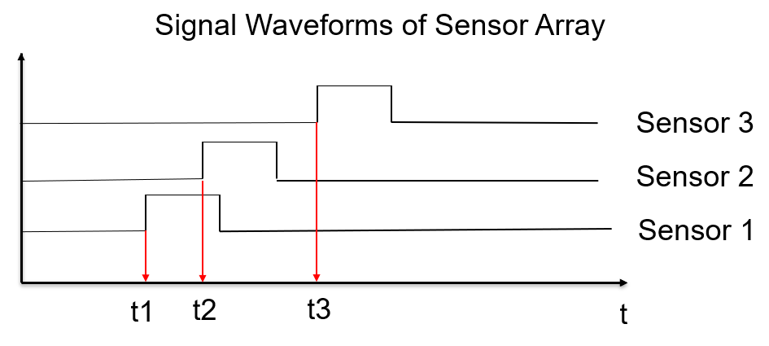
Time of Arrival

Slide 11
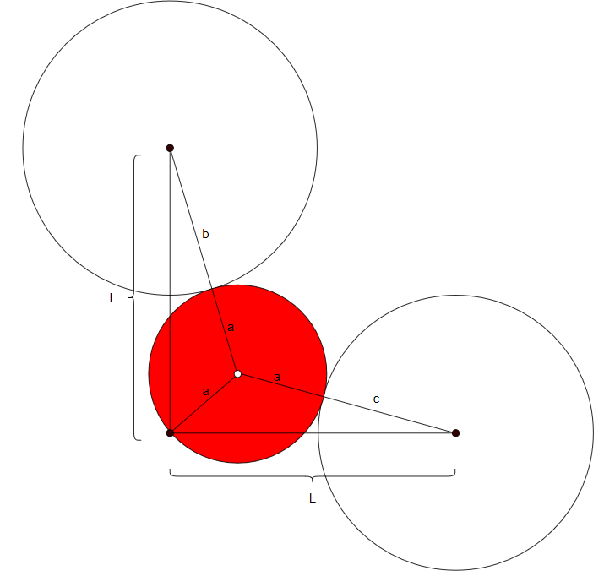
Algorithm
Liam Weston

Slide 12
Known Values
b = Δt_{b} × 343 ^{m}/_{sec}
c = Δt_{c} × 343 ^{m}/_{sec}
We must calculate the distance of a based on b and c
Liam Weston

Slide 13
Steps for Analytical Solution
Send distance a to zero
Create new circle with radius d
Increase d, simultaneously increase radii b and c by d
When the three circles intersect at a unique point, we have determined the source of the sound.
Liam Weston

Slide 14
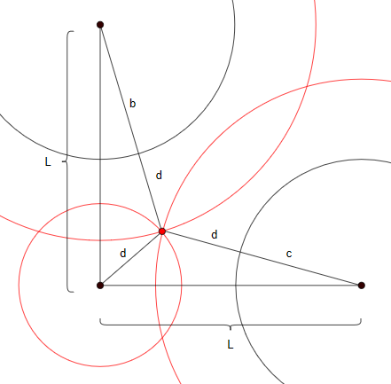
Algorithm Continued...
Liam Weston

Slide 15
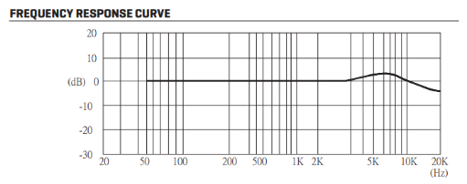
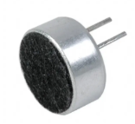
Microphone Sensors
Implement 8 electret omnidirectional condenser microphones (CMA-4544PF) to optimize source localization in 2-Dimensional space
Operating frequency: 20Hz – 20kHz
Frequency of human conversation: 85Hz - 255 Hz
Frequency of Ping Pong hitting a surface: 5.9kHz - 7.3kHz
CMA-4544PF
Adrian Sanmiguel

Slide 16
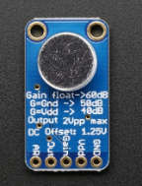
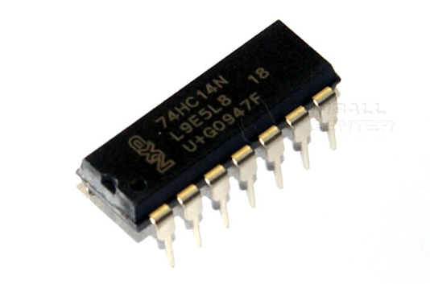
Sensor Hardware (MDR)
Electret Condenser Microphone
Automatic Gain Control
Low - noise microphone bias
Variable gain: 40,50,60 dB
DC offset: 1.25 volts
Schmitt Trigger Inverter
Comparator with Hysteresis
Two threshold voltages
Used to provide a digital high-to-low output from each microphone sensor
Adafruit AGC Electret Microphone - MAX9814
74HC14N IC
Adrian Sanmiguel

Slide 17
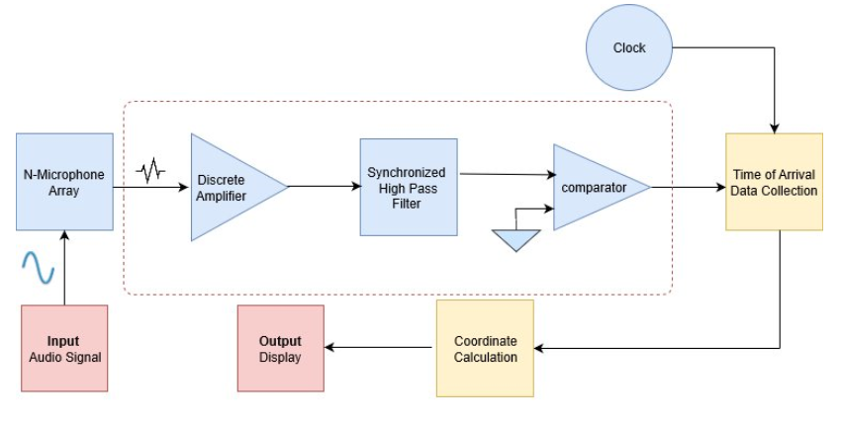
Analog Digital Converter (ADC)

Slide 18
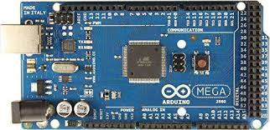
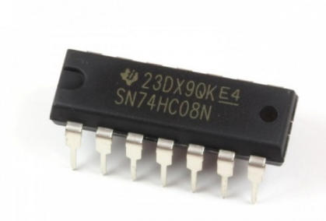
Microcontroller
Arduino Atmega2560
16 MHz clocked prescaled at 250 kHZ
~ 2mm resolution
Four 16-bit synchronous timers
74HC08
Four AND gates/sensor used as delay

Slide 19
Microcontroller Function
Takes input from the ADCs and clock
Once the input of an ADC goes from high-to-low the system time is stored
The 8 time stamps are compared to calculate a location on the board
The location is matched to a LED
The relevant LED is switched through the output of a PWM signal

Slide 20
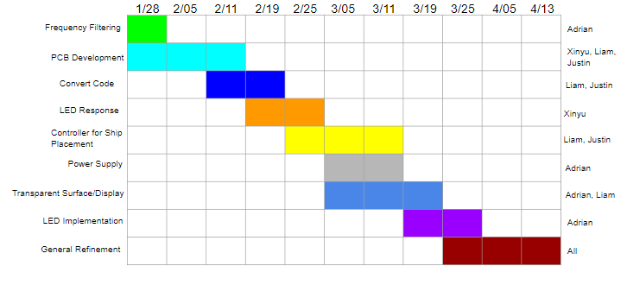
Gantt Chart

Slide 21
MDR Prototype (Original)
System on a single board for one player
Using Arduino as microcontroller
Calculate coordinates and light up LED accordingly
Error distance less than 8 cm.
Response time less than 1 s

Slide 22
MDR Prototype (Actual)
System on a single playing surface for one player
Use an Arduino Mega2560
Response time less than 500ms
Error distance less than 8 cm.

Slide 23
CDR Game Rules
Players choose the positions for their battleship through certain type of controller; positions are displayed on the LEDs board visible to each player themselves
Players attack their opponent in turn by throwing ping pong ball at their opponent’s surface
Players score when they hit the battleship, as indicated by the LEDs on the surface
The one who hits all the battleships first wins

Slide 24
CDR Interfaces & Specifications
Two transparent square surfaces for players
LEDs under the surface show and register hit or miss
10 * 10 block on each surface
1 meter * 1 meter on each surface
Four sensors placed one at each corner
A button for each player to push to indicate turns
Sub LED Displays
controller to select battleship position individually
small display of LEDs displaying battleship positions
Specifications
Response time less than 500ms
Distance error less than 5 cm
User friendly game experience

Slide 25
Questions?

