Slide 1


2021
Gameland
A GameFi NFT rent protocol

Slide 2
Abstract
Game
Users
DAO
Gameland
Gameland as a Gamefi platform aims to help users experience high-end games at the lowest price, provide users a rental platform with integrating experience and revenue, and lower the boundary between players and games

Slide 3
Gameland Features
Account ownership lending
Gaming NFT trading
A
B
C
Gaming NFT lending：
NFT pet
NFT tools
DAO：
Governance
Organization
Gaming
Borrowers can use the rented NFTs to profit or gain the gaming experience by paying low interest.
Lenders can profit by lending out the gaming tools which don’t got used very often.

Slide 4
Different Roles
Lenders
Lend out the gaming NFTs
01
Gameland Dao
Borrowers
Evaluate the value of the NFTs
06
02
Rent the gaming NFTs
Gameland
05
03
Players
Community DAO
Game players
Help to manage the community
04
Gaming DAO
Share gaming experience

Slide 5
Main Users
Lenders
Can lend out 1+ NFT items
The NFT items will be listed on Gameland for public to rent
Can decide：
The daily price
The collateral amount
The maximum renting days）
Borrowers
Need to accept the set renting days
Need to pay total amount = collateral + daily price * days
Will get the collateral back after returning the NFT items
Will lose the collateral if fail to return the NFT items before the due day, but can possess the items themselve

Slide 6
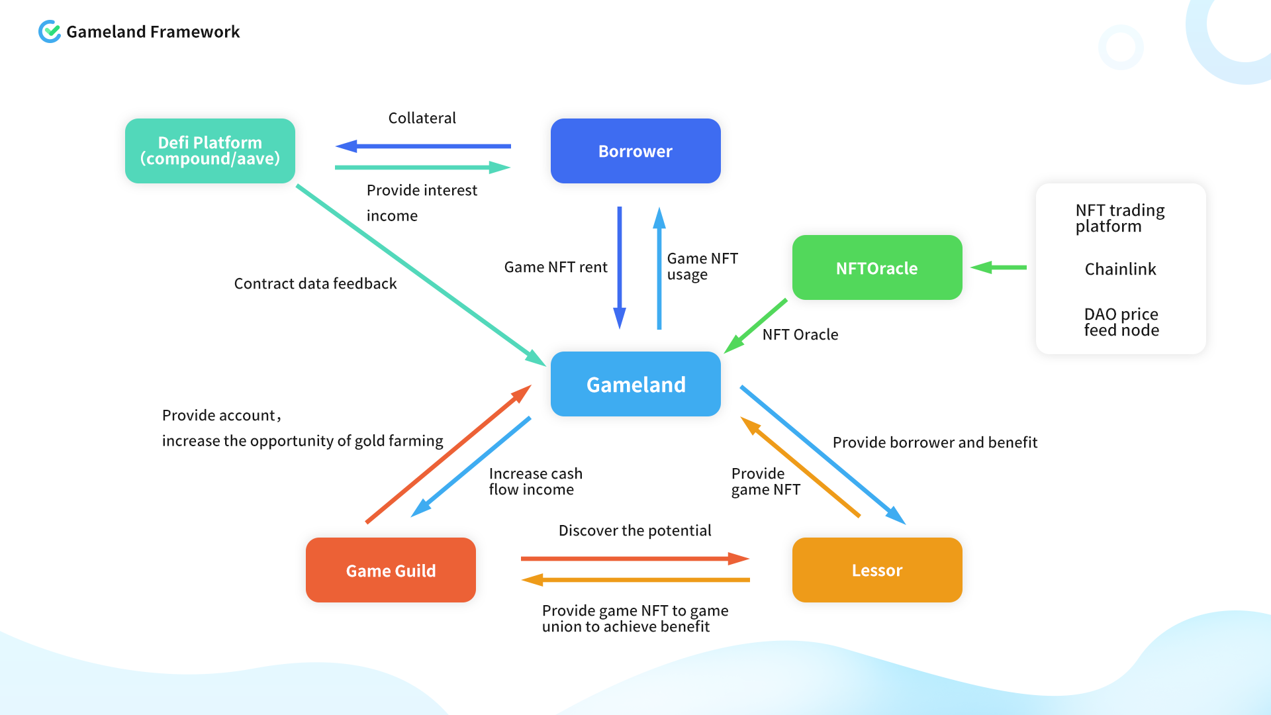

Slide 7
Roadmap
Q3 2021
Testnet launch : including lending, borrowing, withdraw and liquidation etc.
Q4 2021
Bugs fixing and function optimizations: imposing a fine as penalty instead of confiscating the collaterals
Collateral Free Rentals: direct project integrations with NFT games/projects enabling collateral free renting
L2 Solutions Support: Polygon
DAO Launch/Rollout : including Game Guild DAO and Gameland Governance DAO
Further blockchains/defi integrations (e.g: Aave and Compound): according to market demands/activity
Full Rental Statistics Dashboard
Live leaderboard showing top renters and lenders (With special NFT rewards to gamify experience)

Slide 8


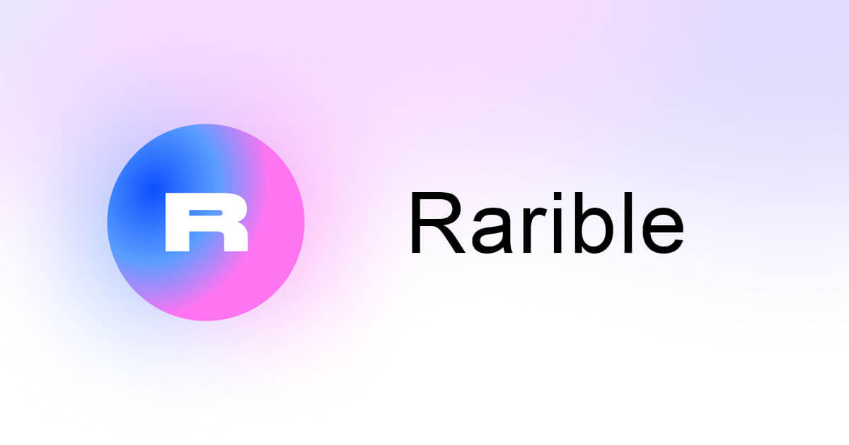

Gaming NFT Price Oracle
External Data
Discover NFT Price
DAO Validate Data
Gameland
Feed price
Validate Data
Normalized Data
Gameland
Feed price
Feed price

Slide 9




Our Team
Ben Li
Vincent Chen
Shaoting Lin
Leo Li
core developer
Founder
core developer
Front-End Development
5 years in Blockchain industry
2021 became the official technical Ambassador for Polkadot
2 years of Blockchain community operation
Established a community of about 5000 people
5 years in Blockchain industry
Bandot core developer
6 years on front-end develpment
familiar with the mainstream front-end development framework

Slide 10



David Li
Cora Chen
celestia
developer
CMO
Media
PhD in software development
4 years in Blockchain
5 years in Blockchain oversea community
Marketing operations manager
In charge of all the media operation
Media manager

Slide 11
2021
THANK YOU

