Slide 1

Hack the Planet:
Peter Unrein, Hung Giang, Tongyu Yang and Adrian Berg

Slide 2
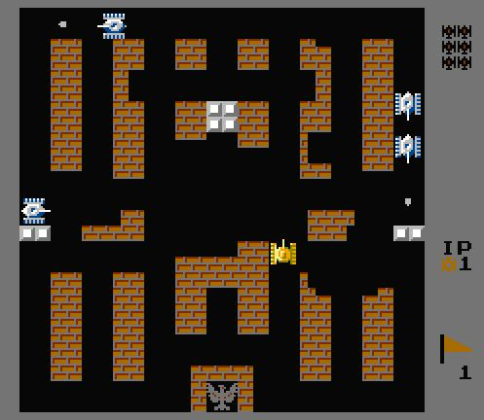
Project Description / Background
Released in 1985
Namco game
Destroy tanks, protect base
Special blocks
Brick, tree, steel, river
Special tanks (4 types of enemies)
Basic, fast, power, armor
Upgrades with powerUps
Timer, grenade, shield, star, tank
We added some own features by ourselves

Slide 3


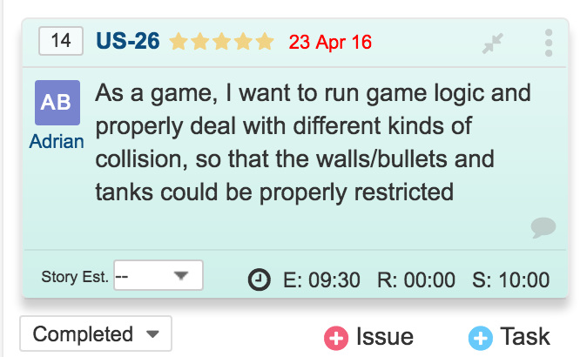
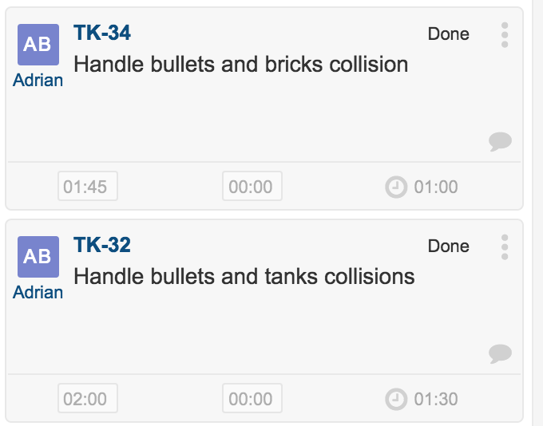
Scrum
Frequent meeting/ contact very useful
Used class time to meet
Used slack to communicate
Kept a task board on Yodiz
Perhaps overly formal and structured for this project
Difficult to manage rigorously with a student schedule

Slide 4
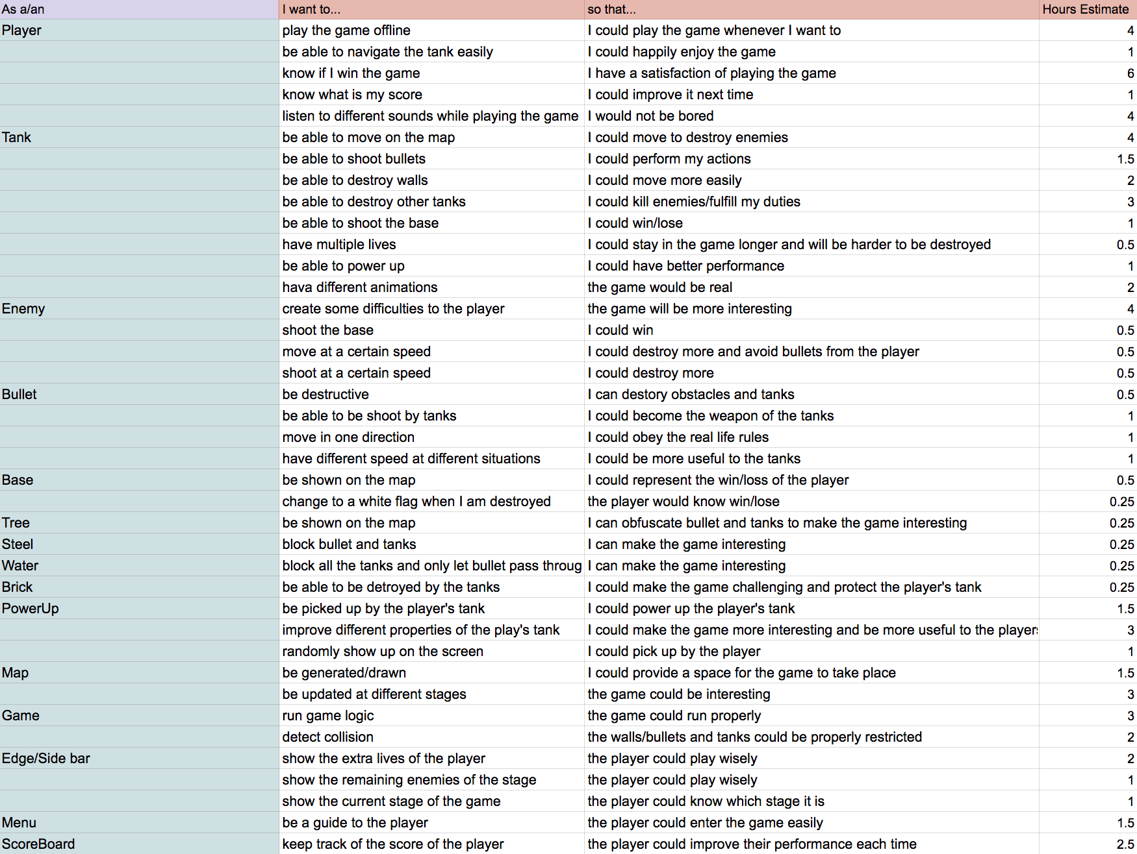
Product Backlog

Slide 5
Design and Implementation
Two Major Packages
GameMain
SpriteClasses
PowerUps

Slide 6
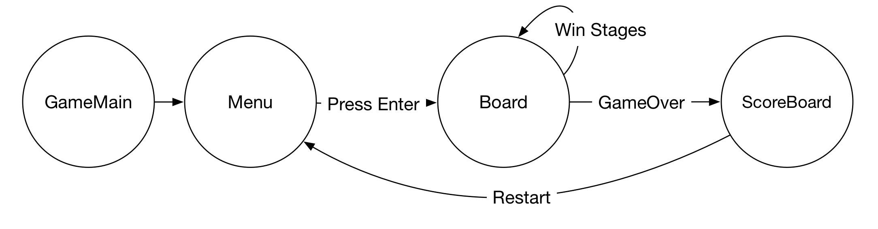
Main Structure of the Game
GameMain (GameView)
Menu
Board
ScoreBoard

Slide 7
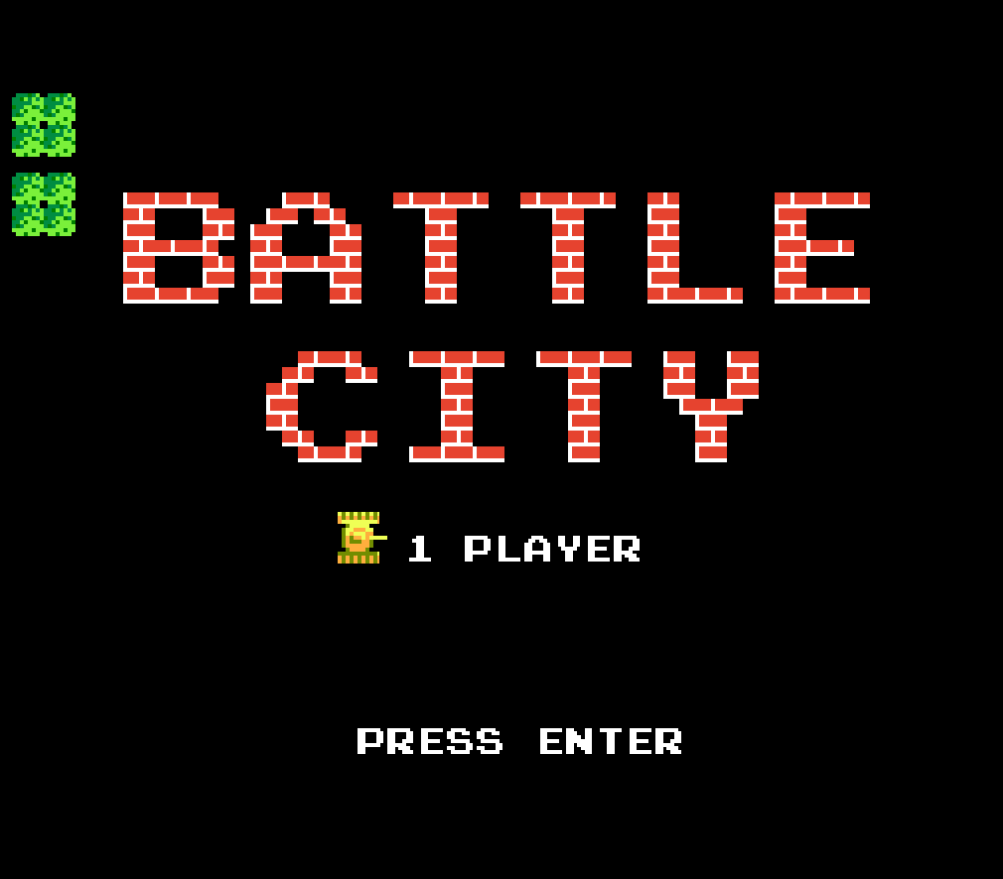
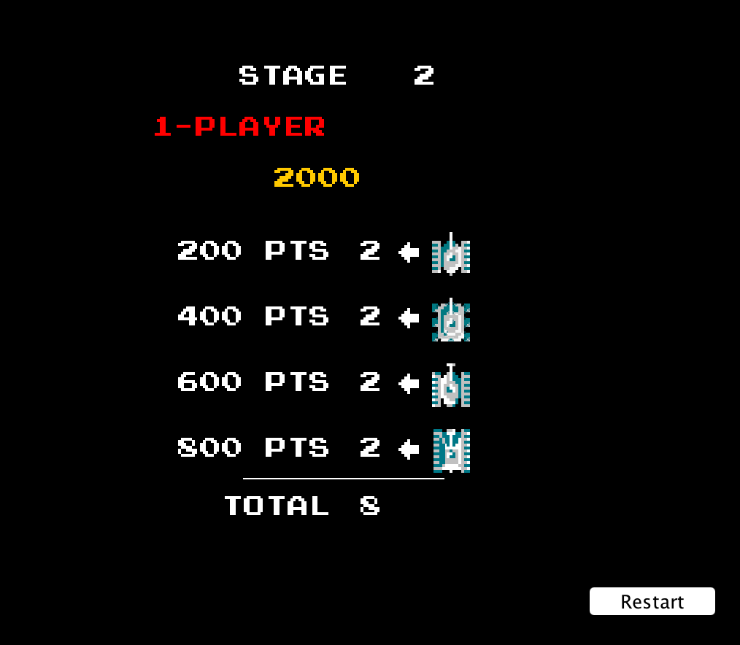
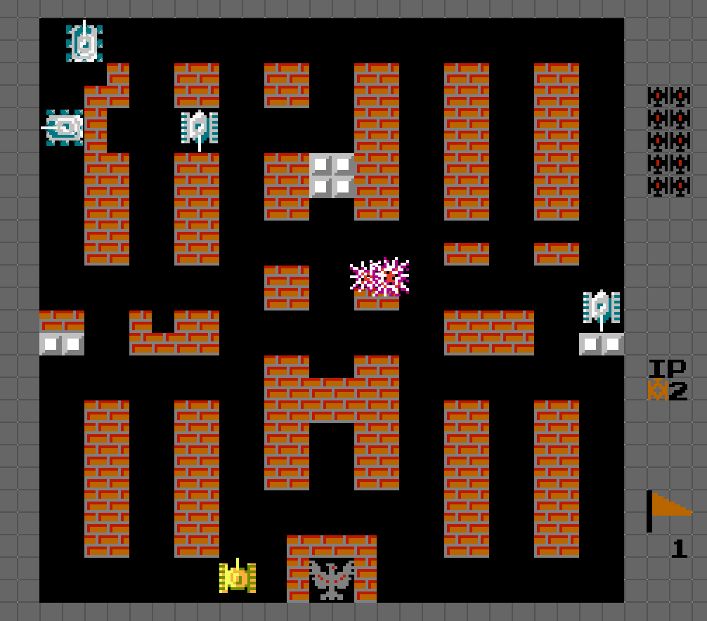
User Interface

Slide 8
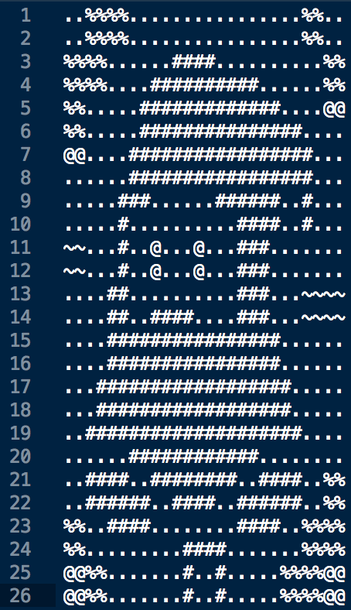
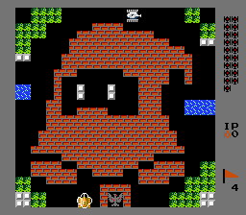
How the map for each stage works
35 stages in total (2D Arrays)

Slide 9
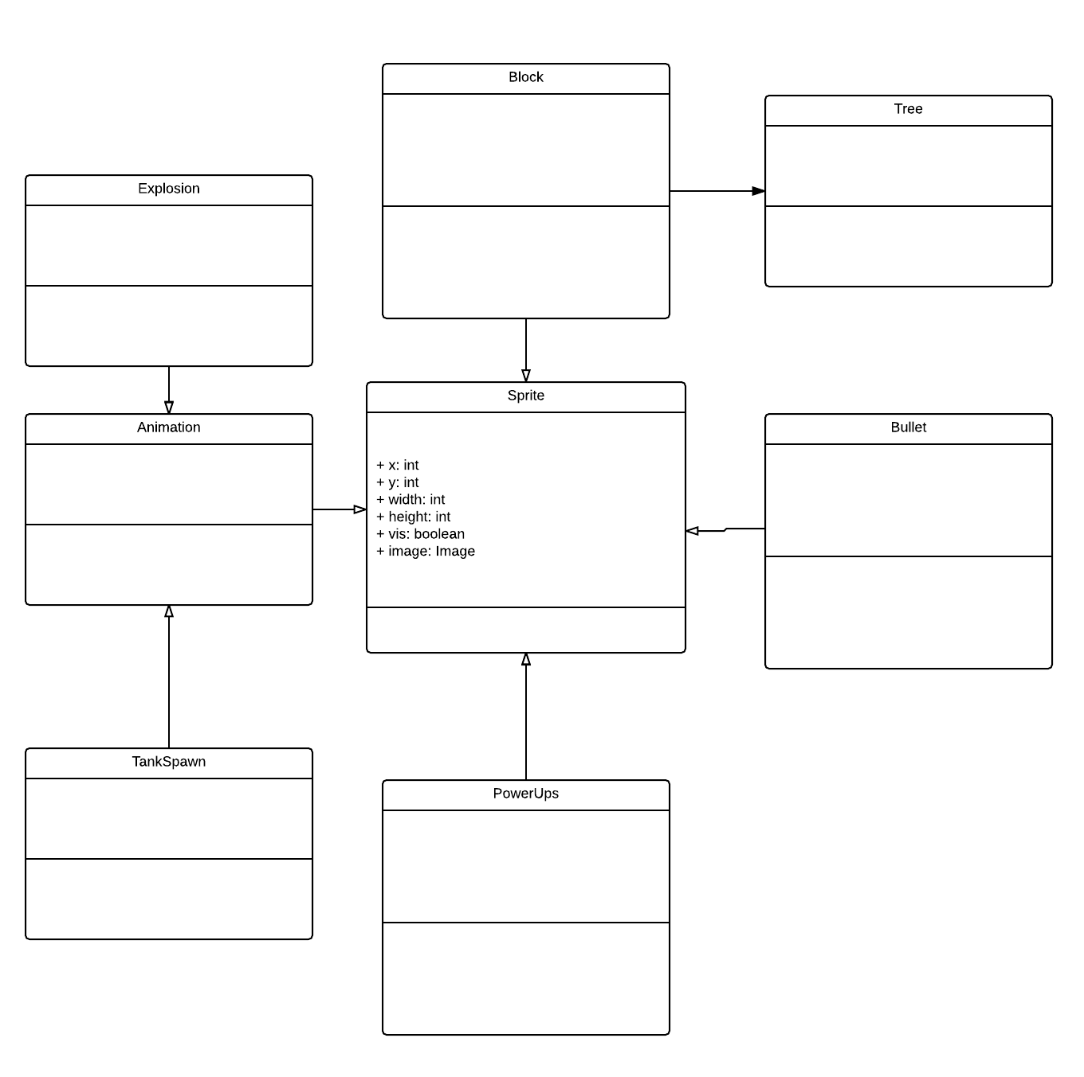
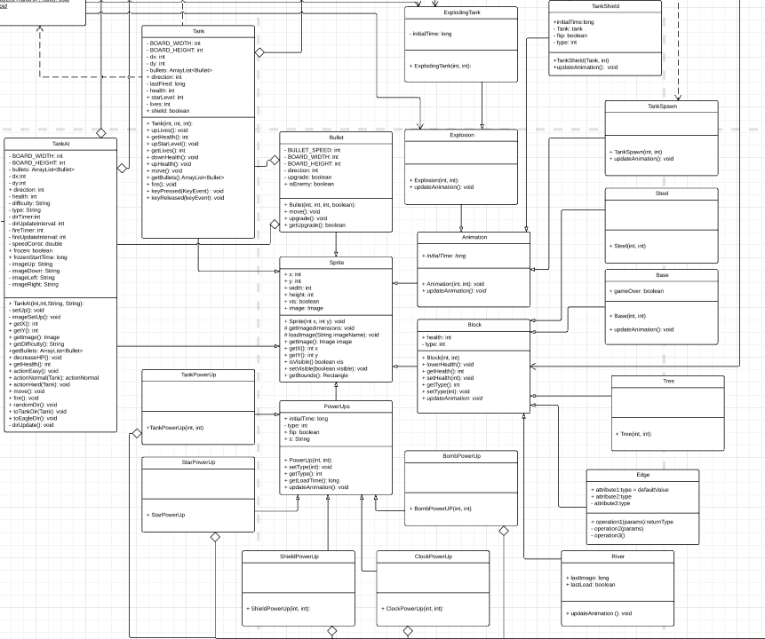
Everything is a Sprite!!!
Information which all Sprites contain
X&Y position (int representing pixel position on the board)
A boolean representing whether or not the object should be visible on the board
An ImageIcon of the desired sprite
The bounds of the sprite drawn represented as a Rectangle object

Slide 10
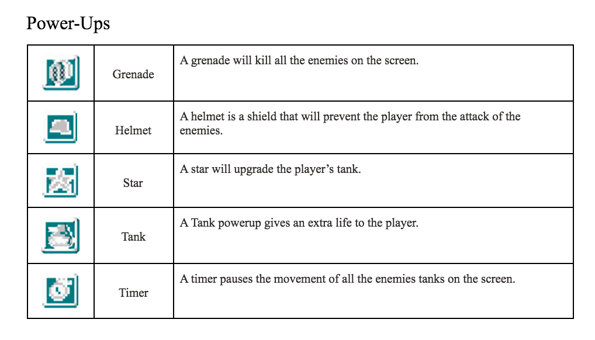
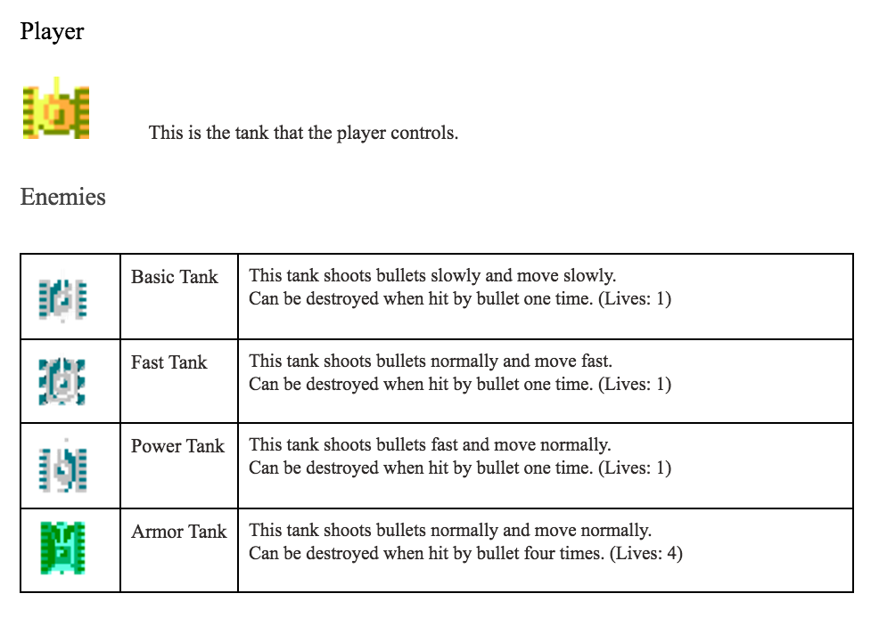
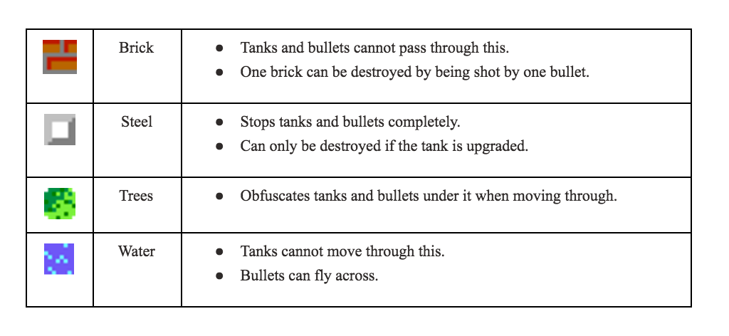

Slide 11

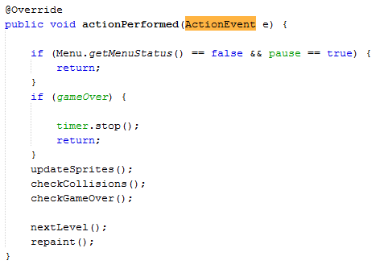
Logic of the Game
Board class is a JPanel which handles the logic
All the sprites are held in private ArrayLists
Uses a Timer (javax.swing.Timer) set to hand ActionEvents to Board class which implements ActionListener
Each ActionEvent causes updates/redraws
Update events and Collisions are handled in Utility classes in order to cut down on the size of the Board class
Drawing is handled with paintComponent/drawObjects

Slide 12
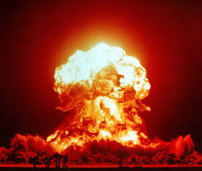
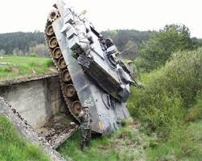
Explosions and Crashes
Collisions depend on Rectangles drawn by the image of each sprite.
CollisionUtility takes ArrayLists of Bullets, Blocks, Enemy Tanks, and the player Tank and checks intersections
When a collision is detected, the objects have their health and vis modified according to the rules of the game
Sprites with vis = false are removed when the board updates and necessary animations are added

Slide 13

Sound
Used sound from the original game
Sound Utility Class used to load, open and loop clips
Already Familiar with Java Sound API

Slide 14

TankAI
AI difficulties: easy, normal, hard - actively seek out the player.
AI types: basic, power, fast, armor - has different kind of “power up” for enemy.
Spawning AI: Board will spawn AI until a certain number of AI for a level is reached (goal).
Some AI will carry power up for the player tank.

Slide 15
Demo

Slide 16
What we learned
Plan (How to break down a relatively large project)
How to split up work
Communication is very important!
Collaborate
Write small parts each time and update often

Slide 17
Future Challenges (Version 2.0)
Short term goals:
2-player mode
Load / Save
New Game Modes
Online Play
Smooth out transitions between levels (show current score)
Non-Coding gameplay balances
Far term goals:
Get game on app market (acquire capital)
Use excess capital to defend against Bandai Namco Entertainment lawsuits (use capital)
Purchase or steal an island (retire young)

Slide 18
Image credits
Nuts and Bolts, http://fabfest.london/brief/materials/
Explosion, https://en.wikipedia.org/wiki/Nuclear_explosion
Tank Crash, http://boombob.ru/picture.php?id=36851
I will find you, http://www.quickmeme.com/meme/3vgbf1

