Slide 1
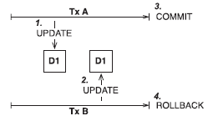
Lost update

Slide 2
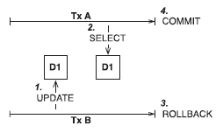
Dirty read

Slide 3
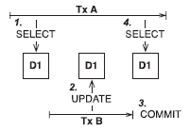
Unrepeatable read

Slide 4
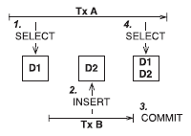
Phantom read

Slide 5
Nivo izolacije transakcija
connection.setTransactionIsolation(...);
Nivo izolacije | Eliminiše problem
READ_UNCOMMITTED | lost update
READ_COMMITTED | dirty read
REPEATABLE_READ | unrepeatable read
SERIALIZABLE | phantom read

Slide 6
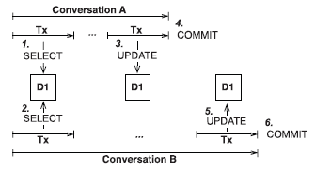
Optimističko zaključavanje

