Slide 1
Selective “Missingness”
Rhea Banerjee

Slide 2
Introduction
Many datasets are incomplete
Random error – forgot to fill out a question in a questionnaire
Systematic bias – certain types of people preferred not to answer a question
Different ways to address missing data
Remove the data point
Use some statistic to “complete” the data point
Poisoning attacks can introduce “missingness” to skew results
Previous works have
Tested packages that address missing data (mean, KNN, etc.) TODO: Cite paper
Conducted analyses on maximum likelihood and multiple imputation [1]
Consider the ethical implications of missing data due to systematic bias [2]
[1] Baraldi, Amanda N., and Craig K. Enders. “An Introduction to Modern Missing Data Analyses.” Journal of School Psychology, vol. 48, no. 1, 2010, pp. 5–37.
[2] Podsakoff, Philip M., et al. “Sources of Method Bias in Social Science Research and Recommendations on How to Control It.” Annual Review of Psychology, vol. 63, no. 1, 2012, pp. 539–569.

Slide 3
Problem Statement
Target model: Logistic regression (frequently used in healthcare)
Goal: Design a poisoning attack on the dataset that reduces out of sample performance versus a complete dataset

Slide 4
Algorithm
Used stroke prediction and heart failure prediction datasets
*Mean or KNN to complete dataset
Look at correlations between target and features
Select top 3 most correlated features
Remove 1, 5, or 10% of the values in each selected feature
Compare results vs baseline

Slide 5
Methodology
Used stroke prediction and heart disease datasets
Baseline:
Remove all rows with any missing values
Split into train/test (80%/20%)
Create baseline model on training data – examine results on test
Run algorithm on training data
Train model on poisoned training data
Evaluate on full test data

Slide 6
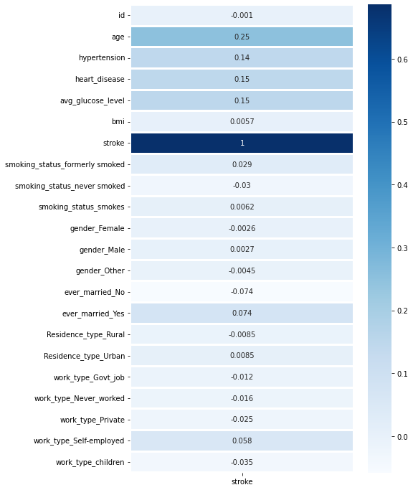
Experimental Results
Baseline:
Fit model on full training data
Test on full test data
Training accuracy: 0.9464
Test accuracy: 0.9504
True positive rate: 0
True negative rate: 1.0
Most correlated
age, avg_glucose_level, heart_disease

Slide 7

Experiment 1
Remove data points with missing data
True positive rate: 0
True negative rate: 1.0
Most correlated
age, avg_glucose_level, heart_disease

Slide 8
Class imbalance
Full dataset stroke count:
0 – 3246
1 – 180
Far more people in the dataset have had strokes than not
Upsampled to reach 3246/2000 stroke/no stroke

Slide 9
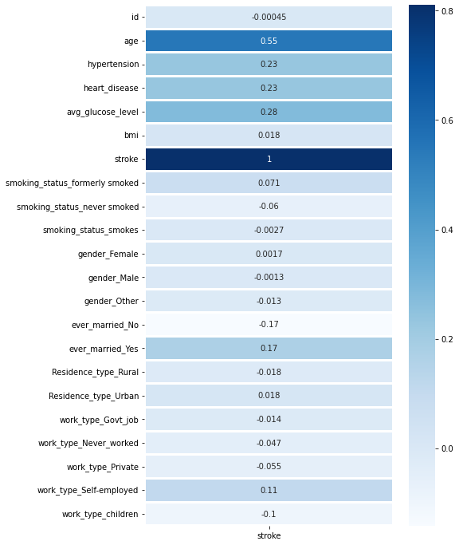
New Baseline
3246/2000 stroke to no stroke
Fit model on balanced training data
Test on full test data
Training accuracy: 0.7618
Test accuracy: 0.74344
True positive rate: 0.11413
True negative rate: 0.75
Most correlated features
age, avg_glucose_level, heart_disease

Slide 10

Experiment 2
Replace missing values with mean
True positive rate: 0.11640
True negative rate: 0.74386
Most correlated
age, avg_glucose_level, hypertension

Slide 11

Experiment 3
Replace missing values with k-nn
k=3 [3]
True positive rate: 0.1117
True negative rate: 0.7438
Most correlated
age, avg_glucose_level, heart_disease
[3] D. M. P. Murti, U. Pujianto, A. P. Wibawa and M. I. Akbar, "K-Nearest Neighbor (K-NN) based Missing Data Imputation," 2019 5th International Conference on Science in Information Technology (ICSITech), 2019, pp. 83-88, doi: 10.1109/ICSITech46713.2019.8987530.

Slide 12
Conclusions
K-nn is a good way to handle missing data
Unbalanced datasets make poisoning attacks more complicated
Future work
Remove the top, middle, bottom % of correlated data
Find different methods for removing data
Test on different models besides logistic regression

Slide 13
Citations
Lin, WC., Tsai, CF. Missing value imputation: a review and analysis of the literature (2006–2017). Artif Intell Rev 53, 1487–1509 (2020). https://doi.org/10.1007/s10462-019-09709-4
D. M. P. Murti, U. Pujianto, A. P. Wibawa and M. I. Akbar, "K-Nearest Neighbor (K-NN) based Missing Data Imputation," 2019 5th International Conference on Science in Information Technology (ICSITech), 2019, pp. 83-88, doi: 10.1109/ICSITech46713.2019.8987530
Baraldi, Amanda, and Craig Enders. “An Introduction to Modern Missing Data Analyses.” Journal of School Psychology, vol. 48, no. 1, 2010, pp. 5–37., https://doi.org/10.1016/j.jsp.2009.10.001.
Podsakoff, Philip M., et al. “Sources of Method Bias in Social Science Research and Recommendations on How to Control It.” Annual Review of Psychology, vol. 63, no. 1, 2012, pp. 539–569., https://doi.org/10.1146/annurev-psych-120710-100452.
Lakshminarayan, Kamakshi, et al. “Imputation of Missing Data in Industrial Databases.” Applied Intelligence, vol. 11, no. 3, 1999, pp. 259–275., https://doi.org/10.1023/a:1008334909089.
Raghunathan, Trivellore E. “What Do We Do with Missing Data? Some Options for Analysis of Incomplete Data.” Annual Review of Public Health, vol. 25, no. 1, 2004, pp. 99–117., https://doi.org/10.1146/annurev.publhealth.25.102802.124410.
Marston L, Carpenter JR, Walters KR, Morris RW, Nazareth I, Petersen I. Issues in multiple imputation of missing data for large general practice clinical databases. Pharmacoepidemiol Drug Saf. 2010;19(6):618–626.

