Slide 1




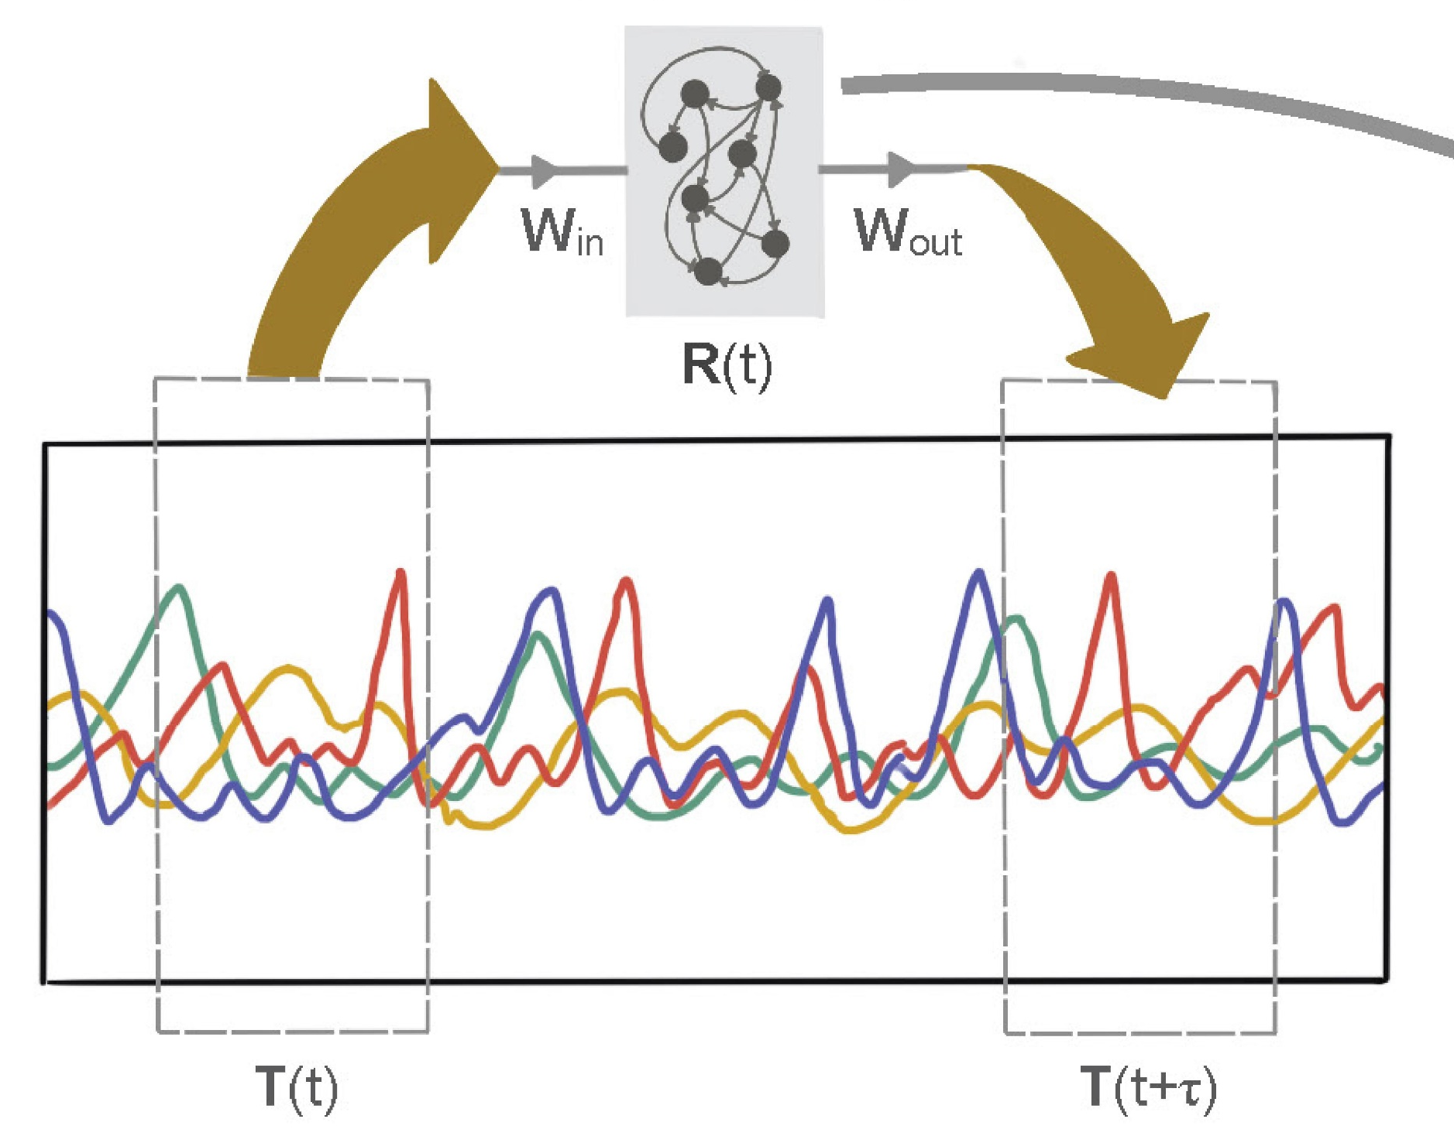

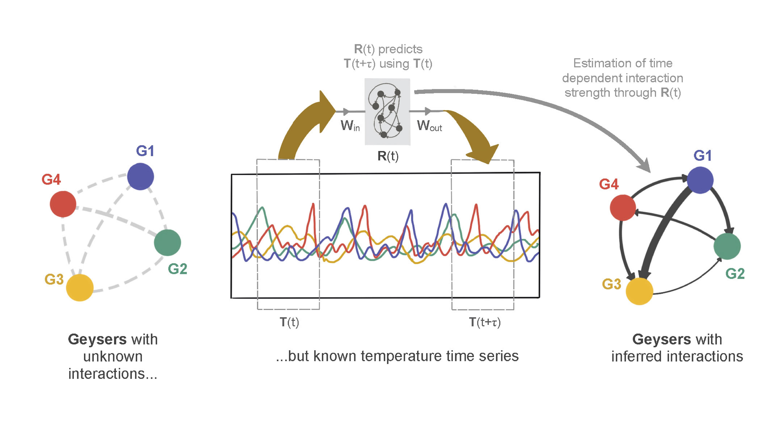




2.To investigate geyser interactions, we recorded temperatures of 10 geysers continuously over 18 months. The geysers are hydraulically connected underground. But from outside, inferring those connections is difficult because the geyser interactions are delayed in time, and we lack a detailed understanding of the complex geophysics of the system. To make matters worse, geysers are very different from one another, some erupted only tens of times, while others erupted tens of thousands of times during recording!
G1
erupts
G4
erupts
??
Temperature
Time
4. When we dug into the computer model of the geyser system, we could decode how temperatures from different geysers are related with each other in that model. Voila! That gives the geyser interaction network now!
1. The Yellowstone National Park (Wy, USA) has the greatest concentration of geysers worldwide. Eruption of one geyser usually causes eruptions of others, but we don’t know how. So how to get that perfectly-timed instagram shot?
3. Solution: Use the temperature data to train a neural network to give a computer model predicting future geyser temperatures from current ones!

Slide 2
2.To investigate geyser interactions, we recorded temperatures of 10 geysers continuously over 18 months. But from outside, inferring those connections is difficult because the geyser interactions are delayed in time, and we lack a detailed understanding of the complex geophysics of the system. To make matters worse, geysers are very different from one another, some erupted only tens of times, while others erupted tens of thousands of times during recording!
G4
erupts
G1
erupts
G4
erupts
G1
erupts
??
Temperature
Temperature
Time
4. When we dug into the computer model of the geyser system, we could decode how temperatures from different geysers are related with each other in that model. Voila! That gives the geyser interaction network now!
Time
1. The Yellowstone National Park (Wy, USA) has the greatest concentration of geysers worldwide. Eruption of one geyser usually causes eruptions of others, but we don’t know how. So how to get that perfectly-timed instagram shot?
3. Solution: Use the temperature data to train a neural network to give a computer model predicting future geyser temperatures from current ones!

Slide 3
The Yellowstone National Park in the state of Wyoming in US has the greatest concentration of geysers worldwide.
They attract millions of visitors each year and their eruption dynamics have been the subject of extensive research for nearly two centuries.

Slide 4
Eruption of one geyser usually influences eruptions of others, but in a complicated way. Research shows that individual geysers are not isolated but rather are hydraulically connected in the subsurface with other geysers and thermal springs.
??

Slide 5
Understanding of such connections between geysers is not only critical for managing tourism and infrastructure around Yellowstone National Park’s geysers, but also insightful in exploring patterns of interdependence that may exist among other episodic geological phenomena, like volcanic eruptions.
But from outside, inferring those connections is difficult because the geyser interactions are delayed in time, and we lack a detailed understanding of the complex geophysics of the system.

Slide 6


To investigate geyser interactions, we recorded temperature profiles of 10 geysers continuously for 18 months. Most previous works focus only on eruption timings, but we looked into full temperature records during and between eruptions.
G4
erupts
G1
G1
erupts
G4
erupts
G3
G1
erupts
Temperature
Temperature
G2
G4
Time
Time
Some geysers erupted only tens of times, while others erupted tens of thousands of times during recording: another complication in understanding their mutual interactions!
We used the temperature data to train a neural network to give a computer model predicting future geyser temperatures from current ones!

Slide 7
When we dug into the computer model of the geyser system, we could decode how temperatures from different geysers are related with each other in that model.
That gives the geyser interaction network!
Our model showed that when we combined data from multiple geysers, we could predict a geyser’s outflow temperature a lot better, upto 15 times more accurately in some cases!

Slide 8







Our analyses highlight the existence of quantifiable geyser-to-geyser interactions influencing their eruptions. These interactions can be inferred by studying the geyser system as a complex network.
Similar network-level approaches can now be applied for exploring patterns of interdependence that may underlie other episodic geological and ecological phenomena, like volcanic eruptions, mass extinctions, and tremors and slips in tectonic plates leading to earthquakes.

Slide 10




This is one of the earliest works we did. We developed a brand-new AI tool that can look at the dynamics of a complicated system with many moving components (think of multiple stock prices rising and crashing together as an example) and tell us how those components are interacting and influencing one another.
The bonus?: Our method was explicitly designed to detect time-delayed interactions: the ones that take a long time to reveal themselves, like domino effects in economy.

Slide 11
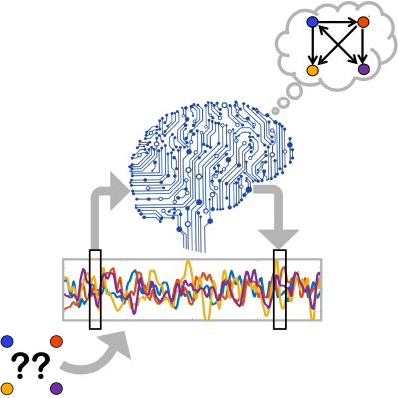
So here is how it works, broadly…
3. Suppose we train an AI system to predict the dynamics of the four nodes at a much later time, just by looking at the present and past dynamics (like, will this stock crash next week?)…
4. Now this trained AI better have an idea of the network model of how the nodes influence one another, if it wants to predict their future dynamics accurately…
That gives us the unknown network we were looking for!
1. We have four nodes connected by an unknown network (think of prices of four stocks)…
2. We have no clue how the nodes are linked, but we do have their dynamics recorded (again, think of a record of daily stock prices)…

Slide 12
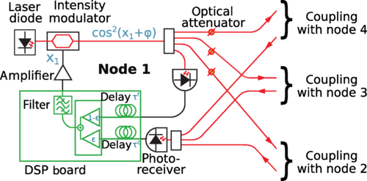
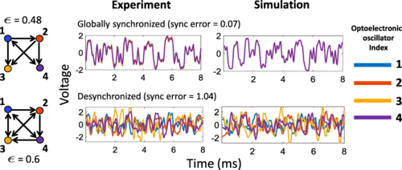
To test whether our method is working on real data, we tried it on voltage recordings from 4 coupled optoelectronic oscillator circuits in our lab. These circuits switch between light signals and voltage signals. They can also be programmed to produce chaotic but synchronized outputs when coupled together – making them a really nice playground for nonlinear dynamics experiments!
Schematic of one optoelectronic oscillator circuit. We got 4 of these connected, but with some time-delay!
Time (ms)
Different networks produce different kinds of dynamics

Slide 13


Our results showed that we got perfect network inference when there were no synchrony among the 4 oscillators. Thus, anything that destroyed synchrony – noise, differences in circuit specifications for the four oscillators, even strong coupling – actually helped us infer the underlying network!
This approach can be used to infer interactions in systems involving time-delays, like weather patterns and stock market fluctuations.

Slide 16
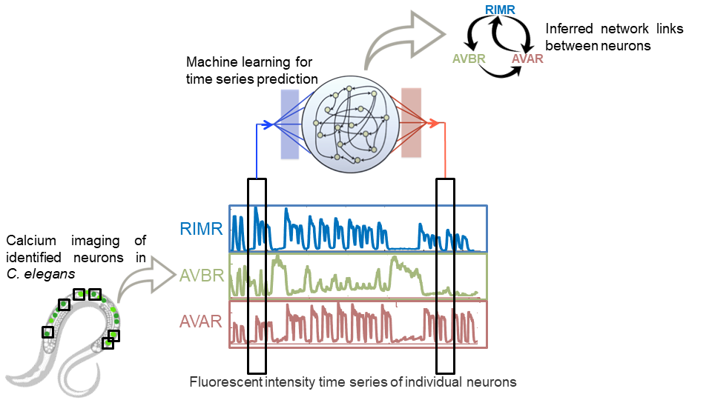

Slide 17
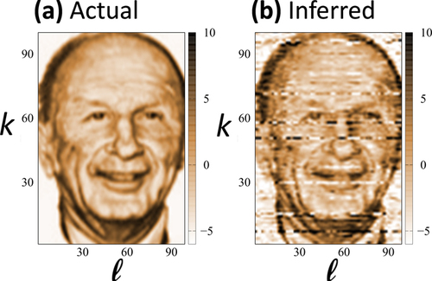
True Connection Strengths
Inferred Connection Strengths
To Oscillator #
To Oscillator #
Connection Strength
Connection Strength
From Oscillator #
From Oscillator #

