Slide 1
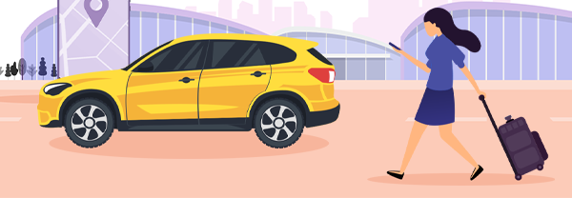
CAB BOOKING SYSTEM -MyCab-
Presented by:
- Deeksha Maurya
- Madhurita Skekhawat
- Soubhik Banerjee
- Sandeep Kumar
- Ankit Kumar
- Prama Sahu
Guided by: Shailaja Patil

Slide 2
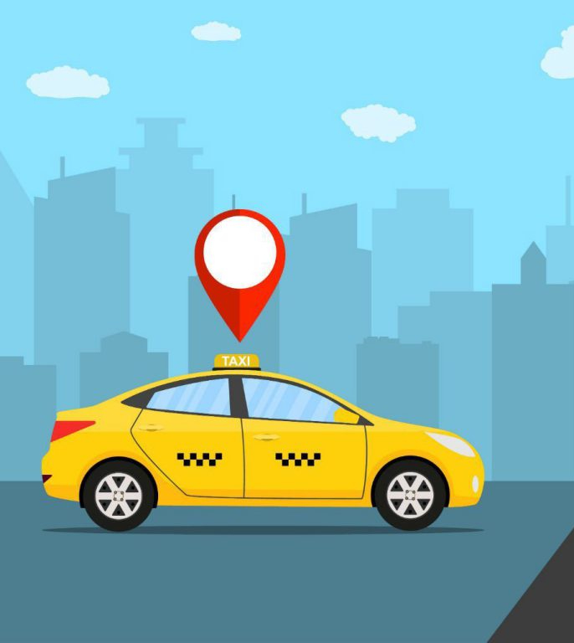
Index:
Aim of the project
Introduction
Objectives
Software Requirements
Storyboard
Data Flow Diagrams
Flowchart
Implementation
Advantages and Disadvantages
Future Scope Of This Project
Conclusion

Slide 3
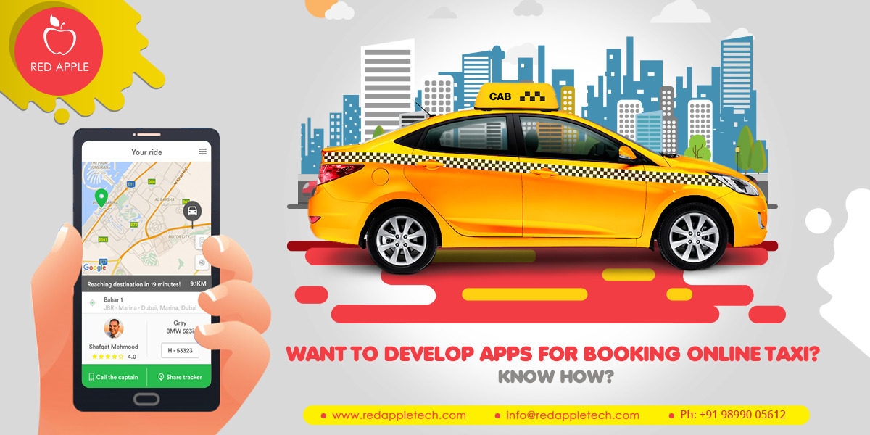
Aim Of The Project:
To develop a Cab Booking System called MyCab using C programming language in Linux environment.
Intended User :-
1) Cab Driver
2) User
Since this a general-purpose software thus any one can access it.

Slide 4
Introduction:
Transport is an integral part of our social living. The modern society cannot run without transport facilities. There are many companies who give transport services to the individual and corporate clients.
In the current system, the client first contacts with the transport company for getting transport service but MyCab will solve this and a person can book a cab directly without contacting anybody.
MyCab booking system is the online service which will automate the process of booking acab and will facilitate both the user and the driver with reduced time and efforts.
First the company will register his information and the vehicles to the system. Then the user can book or schedule the cab on his required date and time, providing all necessary information. The fare will be calculated and user should confirm it. Then the driver will serve the client on the specific date and time.

Slide 5
Objectives:
To provide a convenient and easy way for customers to book cabs.
To allow Cab Drivers to manage their bookings and dispatch taxis efficiently.
To provide customers to enter their desired pick-up and drop location.

Slide 6

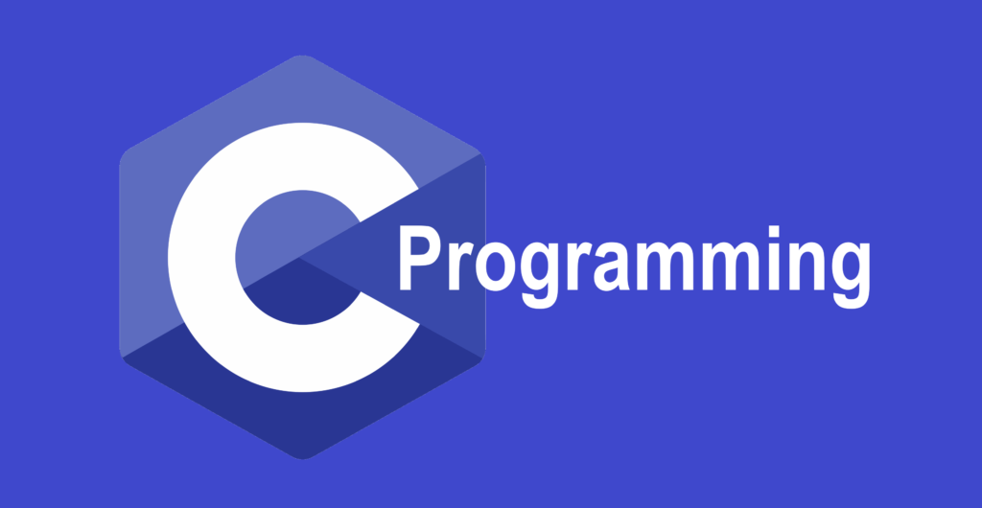

Software Requirements:
This cab booking system called MyCab is designed using Draw.io and Smart Draw.
This project is coded and made using the following:
Operating system: Linux
Software : Ubuntu 20.04.5 and Cygwin 3.4.0
Back-end: C programming

Slide 7
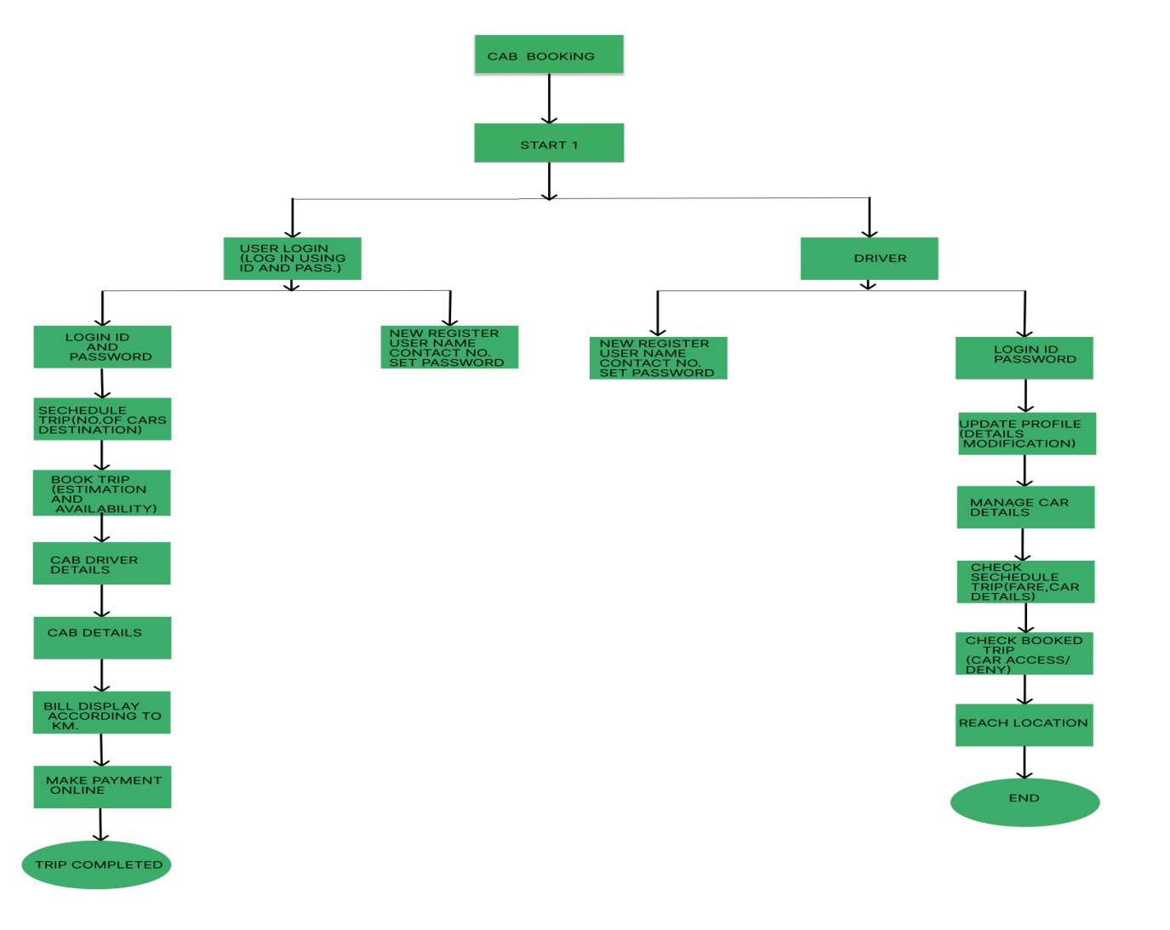
Story board of MyCab

Slide 8
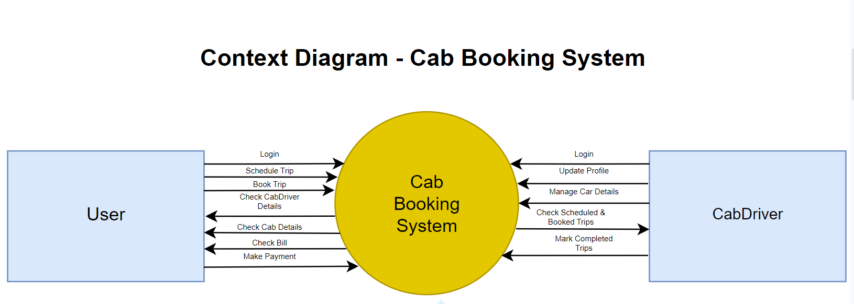
Context Diagram

Slide 9
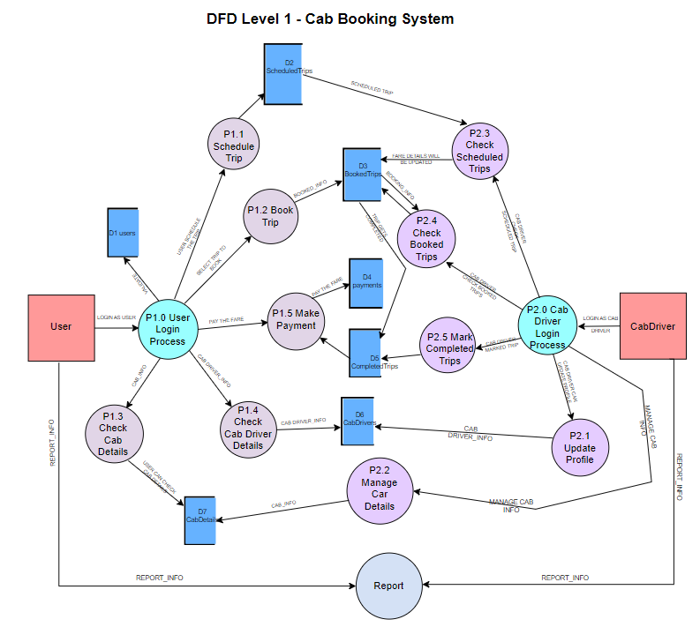
DFD – Level 1

Slide 10
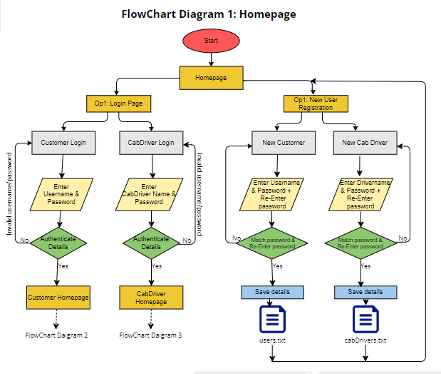
Flowchart

Slide 11
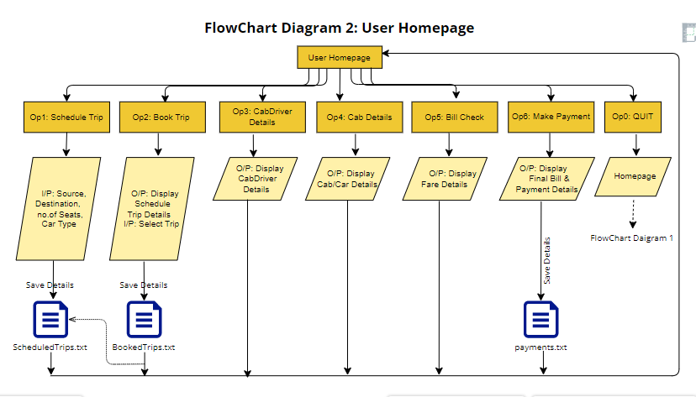
Flowchart

Slide 12
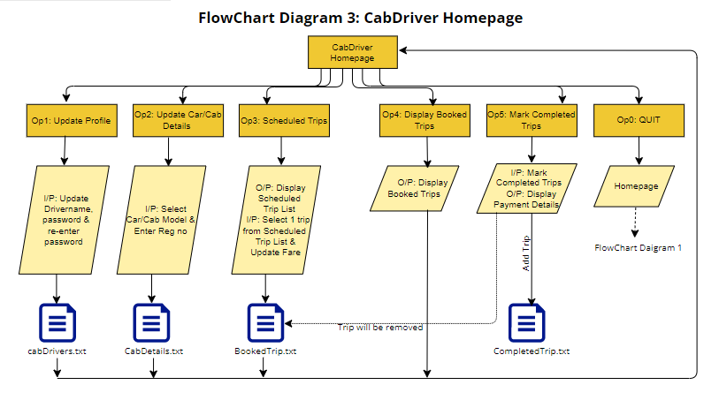
Flowchart

Slide 13
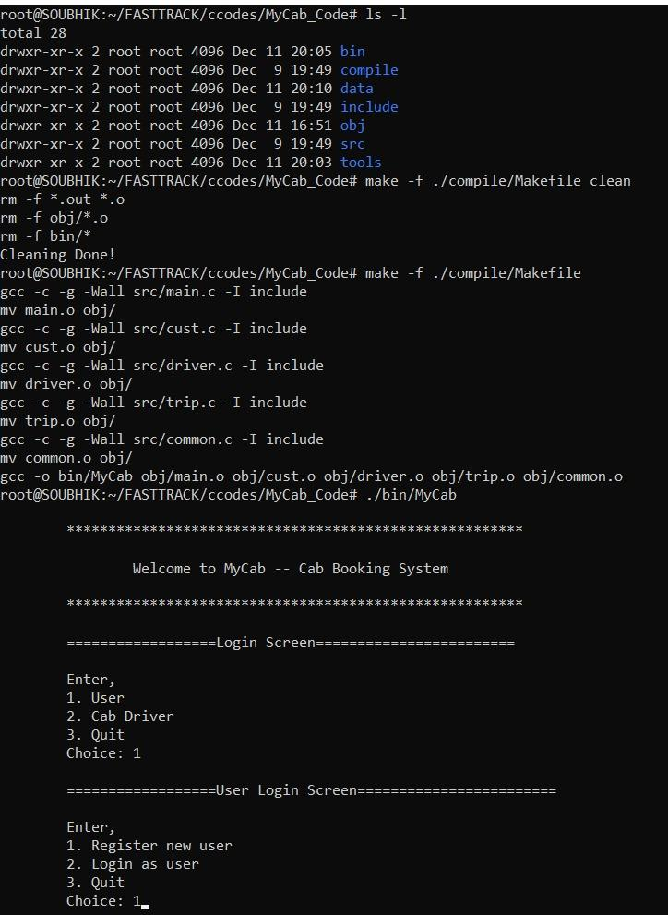
IMPLEMENTATION
1) Makefile cleaning and compilation:

Slide 14
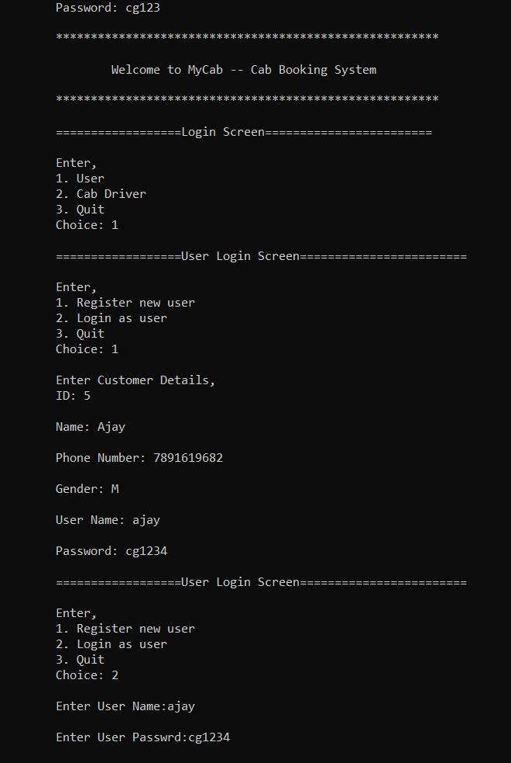
IMPLEMENTATION - User screen
2) After Execution the screen appears like this:
The user has to enter a Choice from above options 1 or 2.

Slide 15
IMPLEMENTATION – User Screen
When choice is Entered as 1

Slide 16
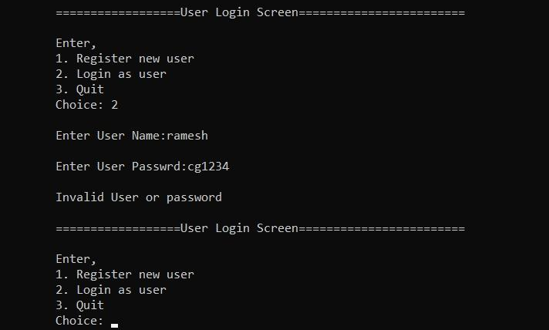
IMPLEMENTATION – User Screen
When choice is Entered as 2
When Entered Registered username or password is wrong

Slide 17
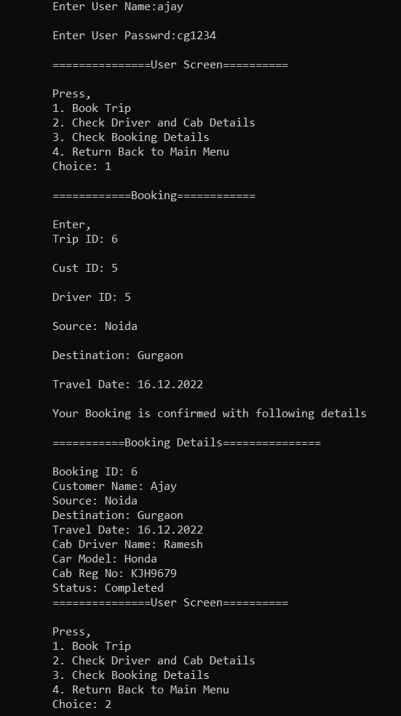
IMPLEMENTATION – User Screen
After Entering the User Menu

Slide 18
IMPLEMENTATION – User Screen
If choice is 1

Slide 19
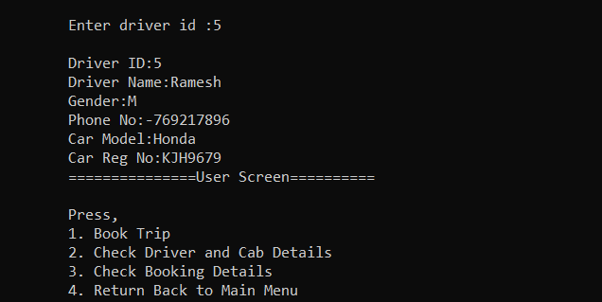
IMPLEMENTATION – User Screen
If choice is 2

Slide 20
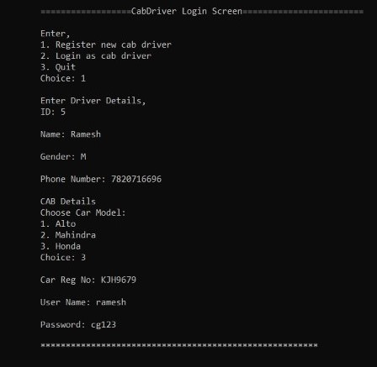
IMPLEMENTATION – Cab Driver
Cab Driver Screen if choice is 1, Register CabDriver.

Slide 21
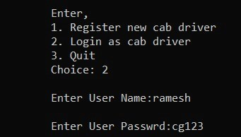
IMPLEMENTATION – Cab Driver
Cab Driver Login with registered name and password if choice is 2

Slide 22
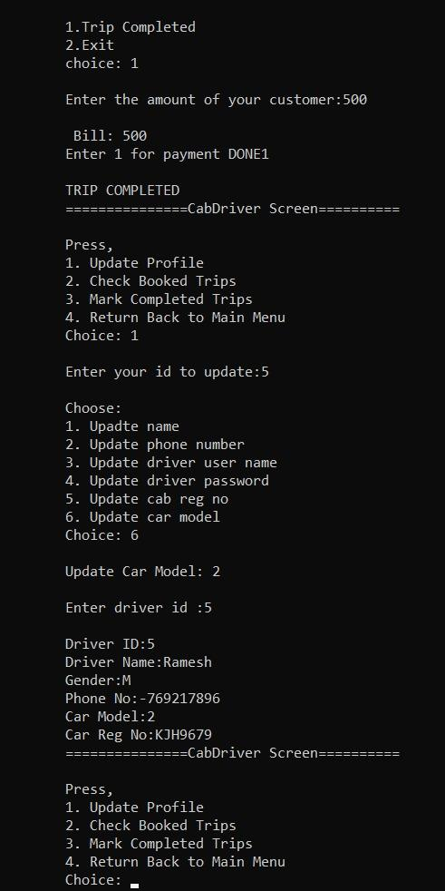
IMPLEMENTATION – Cab Driver
Option1: Update profile

Slide 23
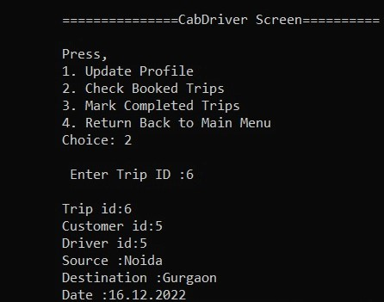
IMPLEMENTATION – Cab Driver
Driver Screen after Login
Option 2 for Checked booked trips

Slide 24
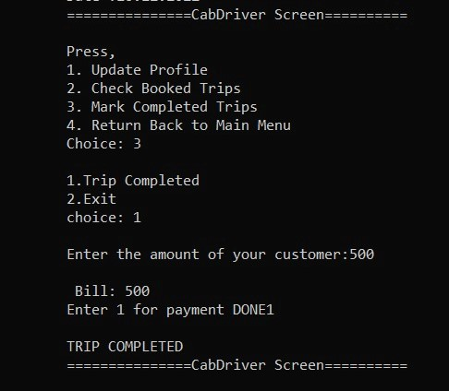
IMPLEMENTATION – Cab Driver
Driver Trip Completed if choice is 3

Slide 25
Advantages :
Drivers do not need to drive around searching for passengers.
Passengers/Users can find it convenient to book cabs without waiting on the road.
Exact location of the passenger helps the driver to reach and pick up the passenger on time without any delay.

Slide 26
Disadvantages:
This project has no Database Connectivity so the details are not permanently stored.
Its not an online project yet.
The is no Admin to manage and check upon the CabDriver and User.

Slide 27
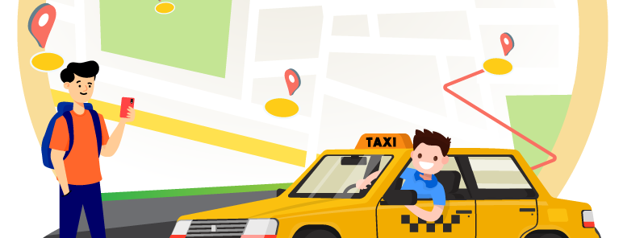
FUTURE SCOPE OF THIS PROJECT
As this project is not a fully developed system, thus it requires a lot of developments.
There is a great scope of making this project more user friendly by making it an online project .
Database integration is also an essential part for making any project store data more effectively and efficiently so, this project will be connected to a DB in the future.
An admin module will be added to supervise the Cabdriver and User.

Slide 28
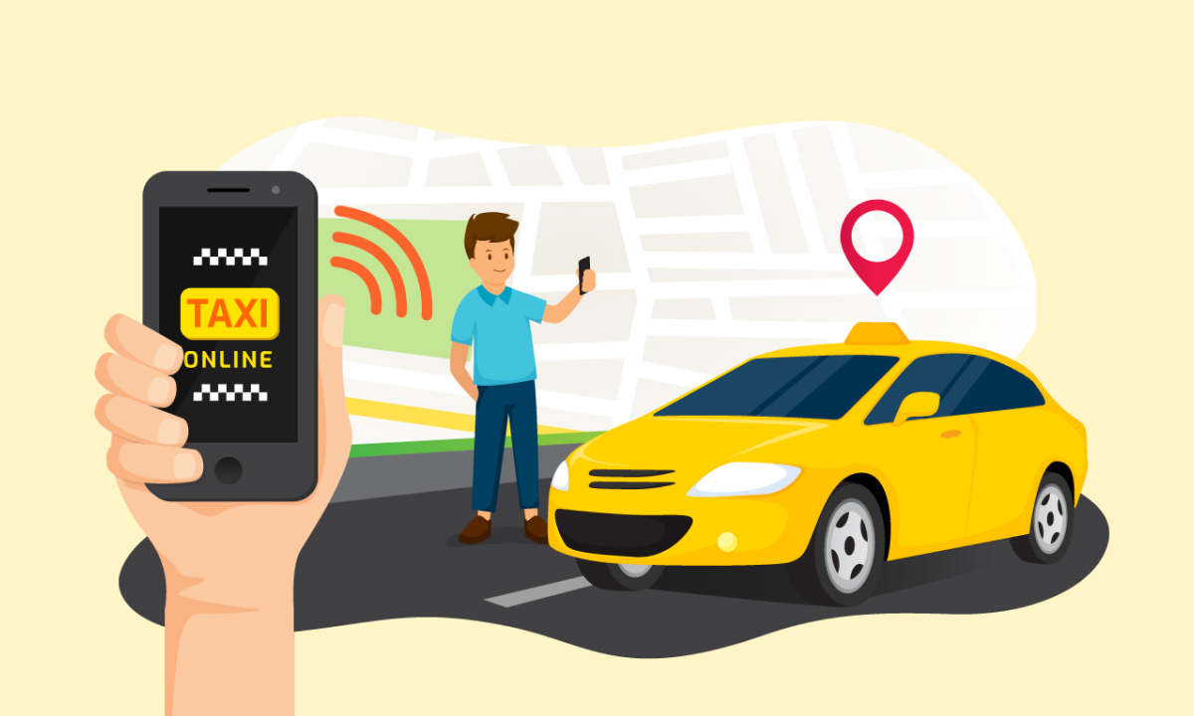
CONCLUSION
We were able to develop a project where the passenger/customer/user is able to book a Cab ,can check the driver ,cab details and all the booking details.
The Cab Driver can also Update profile, check and mark booked trips.

Slide 29


