Slide 1
Machine Learning Introduction
GPGN535
Ge Jin, Geophysics Department

Slide 2
Acknowledgement
Géron, A., 2019. Hands-On Machine Learning with Scikit-Learn, Keras, and TensorFlow: Concepts, Tools, and Techniques to Build Intelligent Systems. O'Reilly Media.
Nadima Dwihusna, Master Thesis

Slide 3
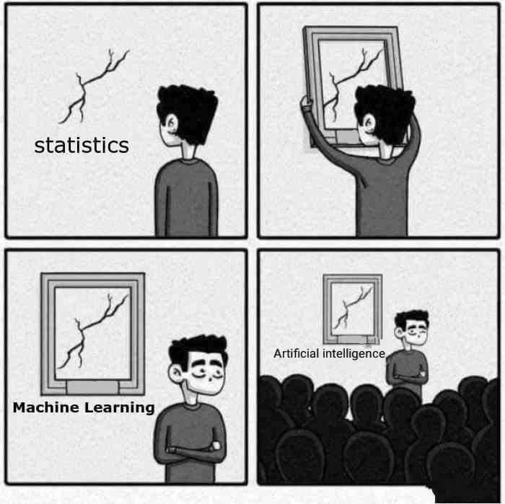
Machine learning and statistics
[Machine Learning is the] field of study that gives computers the ability to learn without being explicitly programmed.
--- Arthur Samuel, 1959

Slide 4
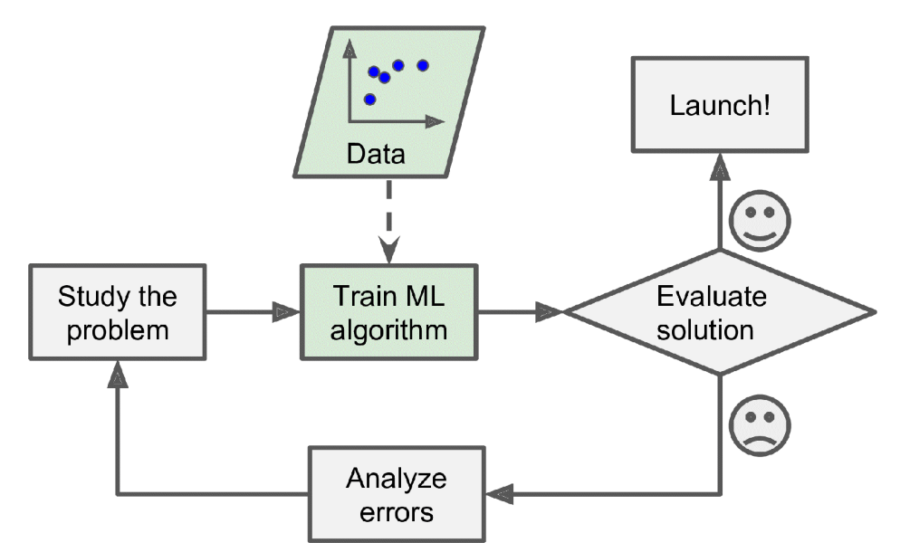
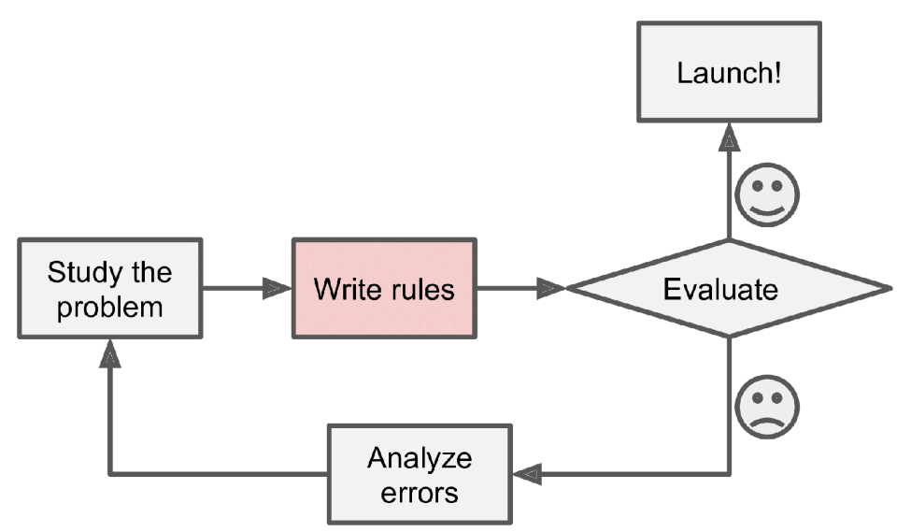
Traditional approach VS machine learning

Slide 5
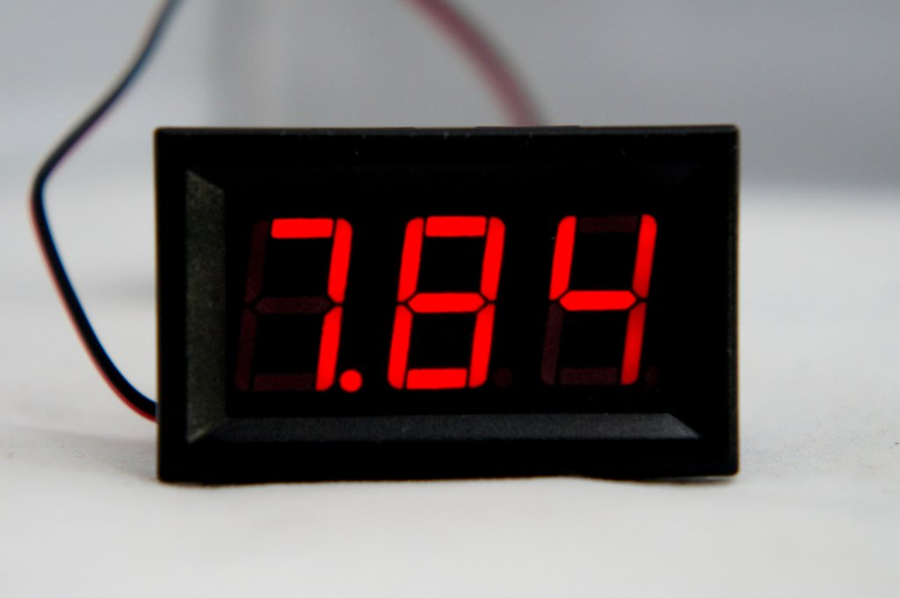
A simple problem
7.84

Slide 6
Traditional approach
1
6
2
4
7
0110011
5
3
4

Slide 7
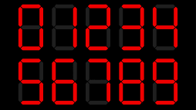
Machine learning approach
Training
Machine Learning Model
4

Slide 8
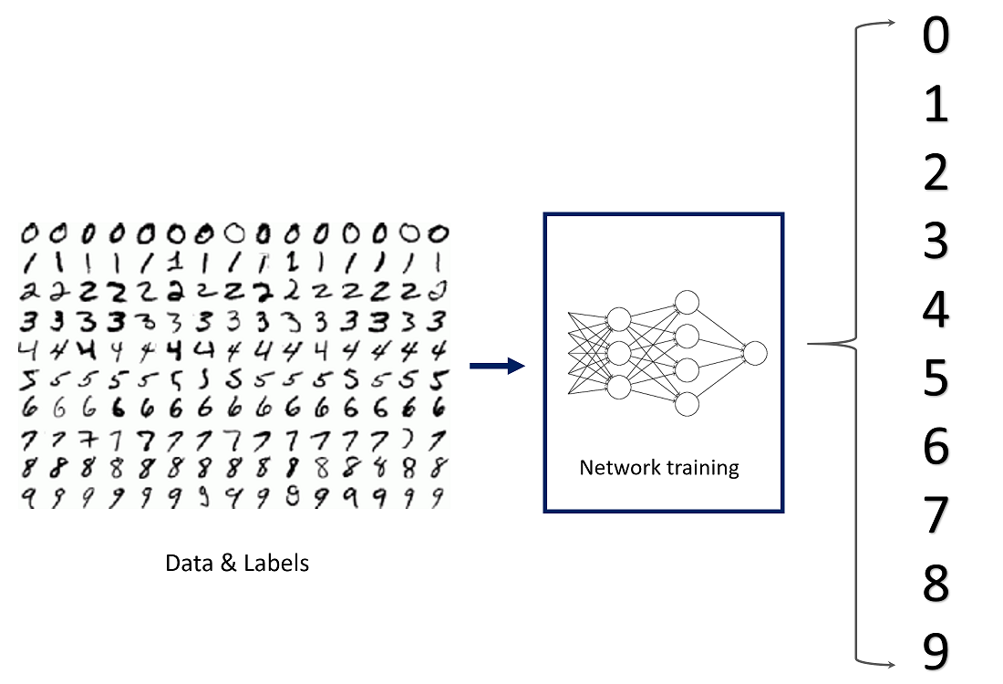
Handwriting recognization

