Slide 1
BANF
Comprehensive Budget Analysis & Financial Report
📅 February 12, 2026

Slide 2
📋 Agenda
1
Financial Overview
Current position, KPI dashboard & IRS 509(a)(2) compliance
2
Proposed Budget FY2026-27
Membership tiers & fees, event access matrix, income/expense projections
3
Strategic Vision
Digital transformation, membership engagement & community outreach
4
BOT
Open discussion, motions & voting
5
Q&A & Closing
Questions, answers & next steps

Slide 3
Current Financial Position (Snapshot)
End of 2024-26 EC Term | Assets & Fund Allocation
📊 Total Assets
💰 Fund Allocation
Asset | Amount
Bank Account Balance | $3,600
Prepaid – Website Hosting (2 yrs) | $504
Prepaid – Holi 2026 Venue Deposit | $215
Receivable – Sponsorship | $500
TOTAL ASSETS | $4,819
Fund | Amount | Status
Operating Fund | $3,022 | Available for operations
Thakur Bahini Fund | $1,797 | Designated
TOTAL | $4,819
Zero Liabilities
$3,022 Operating
$1,797 Designated
No outstanding obligations
Available for immediate use
Thakur Bahini designated fund
BANF | FY 2026-27 | Financial Analysis

Slide 4
Section 1
📊 Financial Overview
3 EC Terms at a Glance • Assets $4,819 • Equity 3.68× • Fee Drivers
BANF Budget Presentation | FY 2026-27 | February 2026

Slide 5
Financial Health & KPI Dashboard — FY 2020 to 2026
6-Year Performance Trends | BANF Financial Analysis | Sources: Financial Summary PPTs + SaraswatiPuja2026.xlsx
BANF | FY 2026-27 | Financial Health KPI Dashboard | Note: Volunteer concentration data not available in financial records

Slide 6
⚖️ IRS 509(a)(2) Public Charity Compliance
501(c)(3) Section 509(a)(2) | EIN: 45-0591164 | Effective: April 7, 2008 | Public Support >33.33% ✅
📜 Historical Events → 509(a)(2) Compliance Mapping
📊 509(a)(2) Public Support Test (FY 2024-25)
Event (Since 2008)
Category
Revenue
509(a)(2)
SOURCE
AMOUNT
%
COUNTS?
Durga Puja (2008-Present)
Religious/Cultural
Program Revenue
✅
Membership Dues
$23,885
39%
✅ Yes
Kali Puja (2008-Present)
Religious/Cultural
Program Revenue
✅
Sponsorships
$25,986
42%
✅ Yes
Saraswati Puja (2008-Present)
Religious/Educational
Program Revenue
✅
Event Ticket Sales
$10,892
18%
✅ Yes
Spandan (Youth Cultural)
Educational/Youth
Program Revenue
✅
Other Program
$1,000
1%
✅ Yes
Sports Day/Picnic
Community Building
Program Revenue
✅
─────────────
─────
───
─────
Nabo Borsho (New Year)
Cultural Preservation
Program Revenue
✅
PUBLIC SUPPORT
$61,763
100%
✅ PASS
Winter Picnic
Community Building
Program Revenue
✅
Investment Income
$0
0%
✅ <33%
🎯 509(a)(2) Qualifying Activity Categories — BANF Historical Events Mapped
🛕 Religious (Exempt)
• Durga Puja ✅
• Kali Puja ✅
• Saraswati Puja ✅
• Lakshmi Puja ✅
• Mahalaya ✅
🎭 Cultural (Exempt)
• Nabo Borsho ✅
• Spandan ✅
• Rabindra Jayanti ✅
• Cultural Workshop ✅
📚 Educational (Exempt)
• Bengali Classes ✅
• Youth Programs ✅
• Heritage Camp ✅
• Art/Music ✅
🤝 Community (Exempt)
• Sports Day ✅
• Winter Picnic ✅
• Beach Clean✅
✅ BANF 509(a)(2) Compliance Status — 17 Years Continuous (2008-2025)
✅ Public Support >33.33%: PASS
✅ Investment Income <33.33%: PASS
✅ Form 990 Filed Annually
✅ Religious Purpose: Active
✅ Educational Purpose: Active
✅ Cultural Purpose: Active
✅ No Private Inurement
✅ Public Accessibility: Yes
✅ State Registration: Current

Slide 7
Section 2
💰 Proposed Budget FY 2026-27
7 Membership Categories • EB Tier Avg ~7% • Every Tier >1.5× Value
BANF Budget Presentation | FY 2026-27 | February 2026

Slide 8
3 membership categories
3 New special passes
17 Total events
MEMBERSHIP FEES
Early Bird premium (Previously mentioned as M2 premium Earlybird) - Covers all 17 events, only available until May 31st.
Premium (Previously named as M2 premium): Covers all 17 events, available anytime.
Regular (Previously named as M1): Covers 11 core events only, pay discounted fees for other events.
SPECIAL PASSES
Culture Special Pass (Previously mentioned as Culture Special) - Covers cultural events only.
Durga Puja Celebration Pass (Previously named as DP Special 1): Covers Durga Puja core events and artist performances for both days.
Durga Puja Core Pass (Previously named as DP Special 2): Covers Durga Puja core events only (No artist)
**** Please double-tap the excel link for detailed information, if you are interested

Slide 9
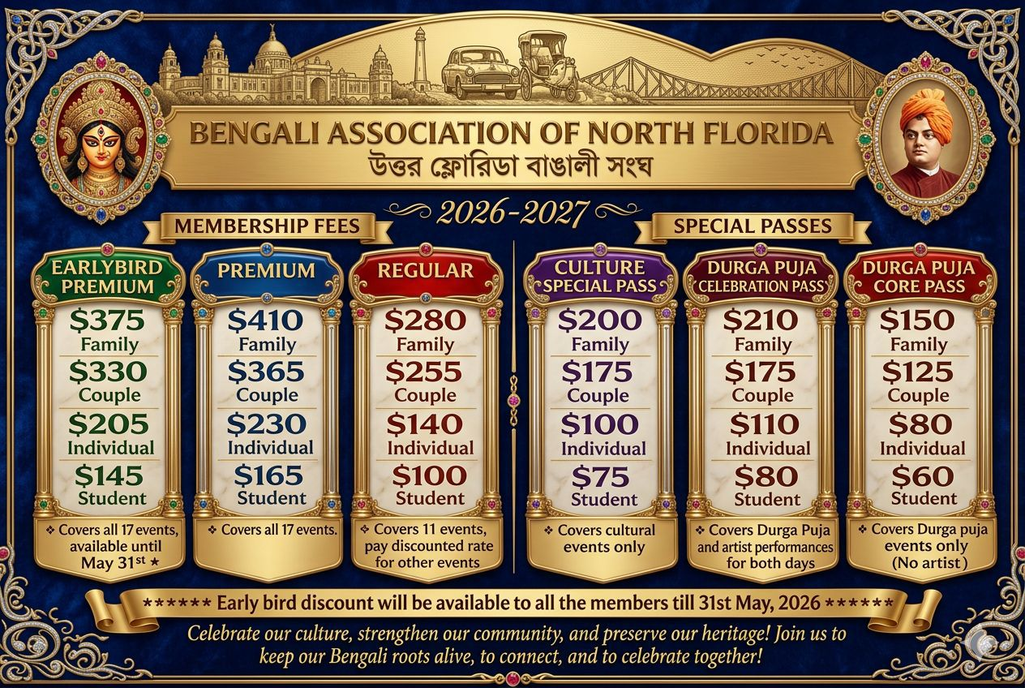

Slide 10
Event Access by Membership Category
FY 2026-27 | ✓ = Included • $ = Add-on price • — = Not available
Event | Date | Type | M2 🏆 | M1 📋 | Cultural 🎭 | DP-1 🙏 | DP-2 🙏
Bosonto Utsob | Mar 7 | Cult | ✓ | ✓ | ✓ | — | —
Noboborsho | Apr 25 | Cult | ✓ | $30 | ✓ | — | —
Kids Summer Sports Training | Jun–Jul | Educ | ✓ | $45 | $50 | — | —
Summer Workshops – Kids | Jun–Jul | Educ | ✓ | $35 | $40 | — | —
Summer Workshops – General | Jun–Jul | Educ | ✓ | $35 | $40 | — | —
Sports Day | Jul | Soci | ✓ | ✓ | $20 | — | —
Spondon | Aug | Cult | ✓ | ✓ | ✓ | — | —
Mohaloya | Oct 17 | Reli | ✓ | ✓ | — | ✓ | ✓
Durga Puja Day 1&2 + Lunch | Oct 24–25 | Reli | ✓ | ✓ | — | ✓ | ✓
Lakshmi Puja | Oct 24 | Reli | ✓ | ✓ | — | ✓ | ✓
Bijoya Sonmiloni | Oct 25 | Soci | ✓ | ✓ | — | ✓ | ✓
Artist Program – Day 1 + Din… | Oct 24 | Cult | ✓ | $35 | — | ✓ | —
Artist Program – Day 2 + Din… | Oct 25 | Cult | ✓ | $35 | — | ✓ | —
Kali Puja + Lunch | Nov 7 | Reli | ✓ | ✓ | — | — | —
Natok (Drama) + Dinner | Nov 7 | Cult | ✓ | ✓ | ✓ | — | —
Winter Picnic | Jan 11/27 | Soci | ✓ | ✓ | ✓ | — | —
Saraswati Puja | Feb 27 | Reli | ✓ | ✓ | — | — | —
💡 M2 Premium includes ALL 17 events. Cultural Special covers 12 events at 3.50× value. DP Specials offer focused Durga Puja access from $150.
Event Count → M2 Premium: 17 | M1 Regular: 11 | Cultural Special: 5 | DP Special-1: 6 | DP Special-2: 4

Slide 11
Projected Income — FY 2026-27
Category Revenue Breakdown | Sponsorship & Events | 112 Units | ▲ +16.1% vs FY25-26
Category | Units | Revenue | vs FY25-26
M2 Early Bird | 27 | $10,070 | ▲ +16.4%
M2 Premium | 6 | $2,490 | ▲ +16.9%
M1 Regular | 21 | $6,065 | ▲ +16.2%
Cultural Special | 10 | $1,825 | ▲ +17.0%
DP Special-1 | 10 | $2,195 | ▲ +16.8%
DP Special-2 | 8 | $1,240 | ▲ +16.4%
Subtotal (Existing 82) | 82 | $23,885 | ▲ +16.5%
Cultural (New) | 15 | $1,800 | 🆕 NEW
DP w/Artist (New) | 10 | $2,250 | 🆕 NEW
DP w/o Artist (New) | 5 | $1,500 | 🆕 NEW
TOTAL MEMBERSHIP | 112 | $29,435 | ▲ +23.2%
Membership
Sponsorship
Events
TOTAL INCOME
112 units · 9 categories (▲ +23.2%)
Platinum/Gold/Silver/Bronze (▲ +6.1%)
Guest tickets + M3 (▲ +22.7%)
All streams (▲ +16.1%)
$29,435
$25,986
$13,500
$68,921
FY25-26 baseline: Membership $23,885 | Sponsorship $24,500 | Events $11,000 | Total $59,385. 82 existing renewed + 30 new members (+$5,550). Overall ▲ +16.1% year-over-year.
BANF | FY 2026-27 | Projected Income | Section 2.4

Slide 12
Projected Expenses — FY 2026-27
11 Events | 6 Categories | ▲ +13.1% vs FY25-26 | Inflation + Tariff + 2 New Programs
Category Subtotals
🕉️ Religious
4 events ▲ +5.1%
$47,690 (75%)
🎭 Cultural
2 events ▲ +5.0%
$6,319 (10%)
🎉 Social
2 events ▲ +5.0%
$2,506 (4%)
📚 Educational + 🤝 Community
🆕 Workshops $2,500 + Charity $2,000
$4,500 (7%)
⚙️ Admin/Overhead
Storage ▲ +5.0%
$2,470 (4%)
Total Projected Income
Total Projected Expense
Projected Surplus
$68,921
$63,485
$5,436
BANF | FY 2026-27 | Projected Expenses | Section 2.4

Slide 13
Strategic Vision — FY 2026-27 and Beyond
Three Strategic Pillars for Organizational Growth and Community Impact
🖥️
PILLAR 1
🤝
PILLAR 2
🌍
PILLAR 3
Digital Transformation & Process Automation
Diversifying Membership Engagement
Expanding Social & Cultural Outreach
• Digitize organizational archives — historical records, financial documents, and cultural artifacts
• Automate membership management with online enrollment, renewals, and tier selection
• Implement digital event registration and ticketing system with QR-based check-in
• Streamline financial reporting and treasury management with automated dashboards
• Build a centralized knowledge base for institutional memory and succession planning
• Youth engagement — targeted programs, mentorship, and leadership roles for next-generation Bengalis
• Senior & parent outreach — culturally relevant social, wellness, and community-health programs
• Non-Bengali Hindu families — welcoming broader South Asian community with shared cultural values
• Bangladeshi Bengali community — inclusive cultural bridge-building through shared language and heritage
• Cross-club collaboration — partnerships with Bengali associations in Orlando, Tampa, and across Central Florida
• Establish BANF as a recognized cultural anchor and civic partner in Greater Orlando
• Pursue interfaith and multicultural partnerships to foster cross-community dialogue and understanding
• Develop community service initiatives — from food drives to cultural education — that extend impact beyond the Bengali diaspora
• Collaborate with local arts councils, schools, libraries, and civic organizations to amplify cultural programming
• Build a sustainable outreach model that celebrates heritage while engaging diverse audiences and sponsors
"Preserving heritage, building bridges, and fostering a more connected and inclusive community"
BANF | FY 2026-27 | Strategic Vision | Three Pillars for Growth

Slide 14
🏛️
BOT Time
Board of Trustees Discussion & Q‍&‍A
▸ Budget approval for FY 2026-27
▸ Membership tier & pricing ratification
▸ Strategic vision alignment
▸ Open floor — questions & feedback

Slide 15
🙏
Thank You
Bengali Association of North Florida
FY 2026-27 Budget Presentation
Prepared for the General Body Meeting
"Preserving heritage · Building bridges · Fostering community"

