Slide 1

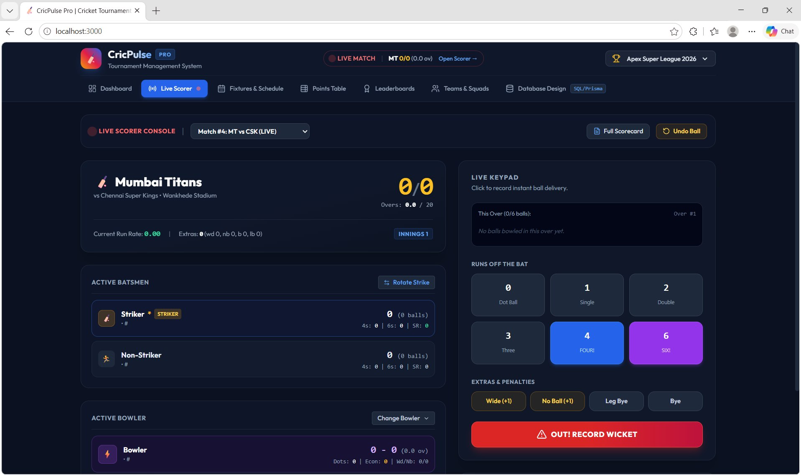
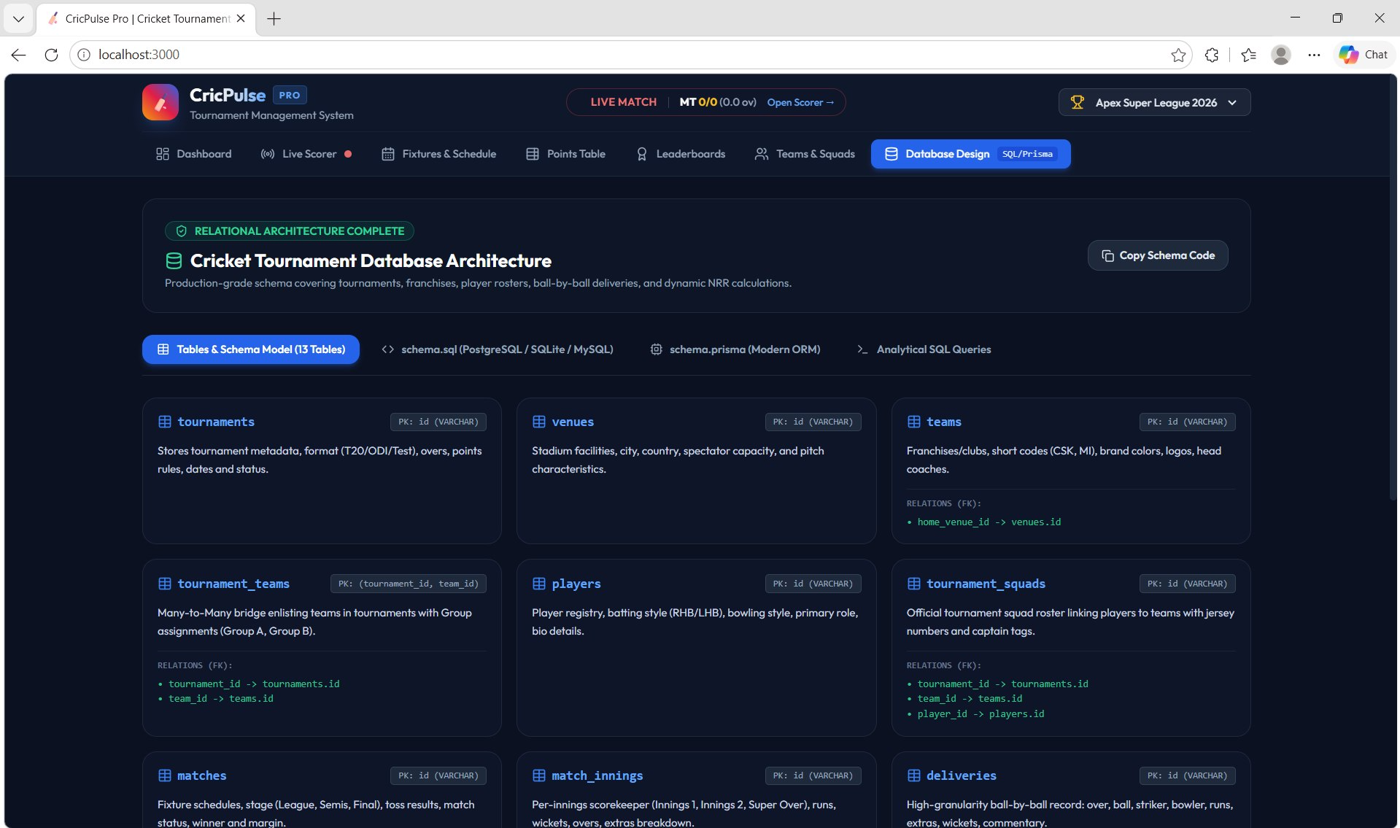

Cricket Tournament Management System
Members: D. Satvarsh, P. Laxman Raj Teja, B. Shashank | II Year B.Tech, CS-IT (AIML)
Guide: Dr. M. Gayatri, Associate Professor
Database Systems Engineering and Distributed Backend Development (25CS1302E) | KLH Bachupally Campus, CSE | PBL 2026-27
Abstract
Tools & Technologies
A web-based system that replaces paper and spreadsheet records with a centralized relational database for teams, players, matches, venues and scores.
It automatically calculates results, points, wins, losses, NRR and rankings, so admins manage tournaments faster and users can view fixtures, scores and standings.
Front-End: Web-based UI for Admin & Users
Back-End: Python / Java / C++ with API-based communication
Database: MySQL / SQLite (relational model)
Platform: Windows / Linux
Tools: VS Code / Eclipse, Web Browser
Problem Statement & Objectives
Problem: Manual paper and spreadsheet records cause duplicate data, calculation errors and lost records.
Objective 1: Centralize teams, players, matches and scores in one database.
Objective 2: Automate results, points, NRR and rankings.
Objective 3: Let admins manage records and users view fixtures and standings.
Scope: Admin and user modules for teams, players, scheduling, scores and points table.
System Architecture
Users
Presentation Layer
Application Logic Layer
Database Layer
Admin: manages tournament data
User: views fixtures & standings
Web user interface for Admin & Users to interact with the system
Manages teams, matches, scores, results & points
Validates data, calculates NRR & rankings
Stores teams, players, matches, scores & tournament data
MySQL / SQLite
Existing vs Proposed System
Flow: User → User Interface → Application Logic → Database
Benefits: efficient data management, security and easy maintenance
Feature | Existing System | Proposed System
Data Storage | Paper, notebooks and separate files | Centralized relational database
Calculations | Manual points, wins and NRR | Automatic results, points and NRR
Updates & Search | Slow; records hard to find | Fast CRUD operations and search
Standings | Hard to produce accurately | Auto-generated points table and rankings
Limitation / Gap | Duplication, errors, lost records | Validated, organized, consistent data
ER Diagram & Database Design
Player
Team
Match
Score
PK player_id
FK team_id
name
role
N
1
PK team_id
team_name
captain
N
M
PK match_id
FK tournament_id
FK venue_id
FK team1/team2_id
match_date, result
1
N
PK score_id
FK match_id
runs, wickets
overs, innings
1
N
N
Notation
PK primary key
FK foreign key
1 : N one-to-many
N : M many-to-many
N
1
1
Points Table
Tournament
Venue
FK tournament_id
FK team_id
played, won, lost
points, NRR
N
1
PK tournament_id
name
season
format
PK venue_id
venue_name
location
Feasibility Study
Implementation Screenshots
Technical: Python / Java / C++ with MySQL / SQLite on a standard laptop (4 GB RAM, 10 GB storage).
Economic: Open-source stack (Python / Java, MySQL / SQLite, VS Code / Eclipse) keeps cost minimal.
Operational: User-friendly for admins and users; easy to maintain and scale.
Schedule: Planned for completion within the semester timeline.
Live scorer: ball-by-ball score entry
Database design: 13-table schema
Results & Testing
Conclusion
Future Scope
Results, points, wins, losses & NRR calculated automatically
CRUD operations with validation on teams, players, matches & scores
Simple, efficient management of teams, players, matches and scores
Reduces manual work and errors; improves accuracy and accessibility
Live score updates and match notifications
Player statistics and performance analytics
Mobile app for fans and team managers
References: [1] MySQL 8.0 Reference Manual, dev.mysql.com/doc [2] SQLite Documentation, sqlite.org/docs.html [3] Python Documentation, docs.python.org

