Slide 1
MACHINE LEARNING PROJECT
Wine Quality Classification
Using Logistic Regression and
Multinomial Logistic Regression
S. Venugopal | 2520090185
Shashank Bangale | 2520090086
Guide: I V Sai Lakshmi Haritha
Department of CSIT • KLH • A.Y. 2026–27

Slide 2
2. Introduction
• Wine quality assessment supports product consistency and customer satisfaction.
• Traditionally, expert tasters evaluate sensory properties such as taste, aroma and appearance.
• Machine learning can estimate quality classes from measurable physicochemical properties.
• This project compares binary Logistic Regression with multinomial Logistic Regression.
02

Slide 3
3. Problem Statement
• Manual wine-quality assessment can be subjective and may vary between evaluators.
• Expert evaluation takes time and may be costly when repeated at scale.
• Chemical measurements need to be translated into consistent quality categories.
• The project investigates whether interpretable classification models can support quality screening.
• Affected stakeholders include wine producers, laboratory teams and quality-control staff.
03

Slide 4
4. Motivation
• Explore a practical application of supervised machine learning.
• Use measured chemical properties instead of relying only on manual evaluation.
• Compare a binary decision task with prediction across multiple quality scores.
• Create a reproducible baseline that can later be compared with more advanced algorithms.
04

Slide 5
5. Objectives
• Load and inspect the provided WineQT.csv dataset.
• Prepare numeric features using missing-value imputation and feature scaling.
• Train Logistic Regression to group wines as Good or Poor.
• Train multinomial-capable Logistic Regression to predict the original quality classes.
• Evaluate both models using accuracy, precision, recall and F1-score.
05

Slide 6
6. Existing System
• Current approach: human experts assess sensory qualities of wine.
• Existing supporting tools may include laboratory chemical measurements and statistical analysis.
• Limitations: subjectivity, need for specialist time, and difficulty of fully automating sensory judgement.
• A model based only on chemical properties also cannot represent every aspect of taste, aroma or appearance.
06

Slide 7
7. Proposed System
• Use the uploaded WineQT.csv as the data source.
• Use 11 physicochemical measurements as input features; keep quality as the target and exclude Id.
• Apply preprocessing and split the dataset into training and test sets.
• Train binary and multiclass Logistic Regression pipelines.
• Compare test-set metrics and use the predictions as decision-support estimates.
07

Slide 8
8. System Architecture / Block Diagram
End-to-end pipeline from CSV input to evaluated prediction
INPUT
PREPROCESS
MODELS
OUTPUT
WineQT.csv
11 chemical features
→
Impute missing values
Scale features
→
Binary Logistic
Multiclass Logistic
→
Quality class
Metrics and report
Data input → preprocessing → model training → prediction → evaluation
08

Slide 9
9. Methodology / Workflow
• 1. Read WineQT.csv and inspect records, columns and target labels.
• 2. Select the 11 chemical properties as X; select quality as y; exclude the Id field.
• 3. Split into 80% training and 20% test data using stratification and random_state = 42.
• 4. Build a pipeline with median imputation, StandardScaler and Logistic Regression.
• 5. Binary task: quality ≥ 6 is Good; quality < 6 is Poor.
• 6. Multiclass task: predict the quality labels present in the dataset; calculate test metrics.
09

Slide 10
10. Technology Stack
• Programming language: Python 3.10 or later.
• Development environment: Google Colab, Jupyter Notebook or Visual Studio Code.
• Data handling: Pandas and NumPy.
• Machine learning: Scikit-learn (SimpleImputer, StandardScaler, Pipeline, LogisticRegression).
• Evaluation and visualization: scikit-learn metrics, Matplotlib and Seaborn.
• Dataset format: CSV; operating system: Windows, Linux or macOS. No separate database or hardware is required.
10

Slide 11
11. System Modules / Components
• Dataset module: imports the CSV and checks feature columns and target distribution.
• Preprocessing module: handles missing numeric values and scales the inputs.
• Binary classification module: maps quality scores to Good and Poor classes.
• Multiclass classification module: predicts the original discrete quality labels.
• Evaluation module: computes accuracy, precision, recall and F1-score.
• Reporting module: presents metrics, observations and limitations.
11

Slide 12
12. Implementation
• Load the CSV using pandas.read_csv("WineQT.csv").
• Set X to the 11 chemical features and y to the quality column; exclude Id from model inputs.
• Use train_test_split with test_size = 0.2, random_state = 42 and stratification.
• Fit preprocessing and Logistic Regression together in a scikit-learn Pipeline.
• Predict labels for the held-out test data and calculate evaluation metrics.
• The numerical results in the following slides are computed from the uploaded CSV with this split.
12

Slide 13
13. Dataset / Input Data
• Dataset: WineQT.csv; total records: 1,143; total columns: 13.
• Model inputs: 11 physicochemical features; target column: quality; Id is excluded.
• Features: fixed acidity, volatile acidity, citric acid, residual sugar, chlorides, free sulfur dioxide, total sulfur dioxide, density, pH, sulphates and alcohol.
• Observed quality counts: 3: 6, 4: 33, 5: 483, 6: 462, 7: 143, 8: 16.
• Quality scores in this uploaded file range from 3 to 8; the dataset does not contain labels 1, 2, 9 or 10.
• Preprocessing: median imputation, standard scaling and stratified 80/20 split.
13

Slide 14
14. Algorithm / Model
• Logistic Regression estimates the probability of a sample belonging to a class from its input features.
• Binary model: quality ≥ 6 is Good (1); quality < 6 is Poor (0).
• Multiclass model: predicts the original quality classes using Logistic Regression in multiclass mode.
• Pipeline: SimpleImputer(strategy="median") → StandardScaler() → LogisticRegression(max_iter=3000).
• The algorithms are selected as interpretable baseline classifiers and are straightforward to compare.
14

Slide 15
15. Results: Binary Classification
Held-out test set • Good = quality ≥ 6 • Poor = quality < 6
Accuracy
Precision
Recall
F1-score
0.777
0.802
0.782
0.792
Interpretation: these metrics provide a baseline for the chosen threshold and test split. Performance can change if the quality threshold or dataset split changes.
15

Slide 16
16. Results: Multiclass Classification
Original quality labels • precision, recall and F1-score are weighted averages
Accuracy
Weighted precision
Weighted recall
Weighted F1-score
0.624
0.588
0.624
0.604
The dataset is imbalanced: quality scores 5 and 6 are most common, while scores 3 and 8 are rare. Overall metrics may hide weaker performance for uncommon classes. A confusion matrix and per-class report can provide more detail.
16

Slide 17
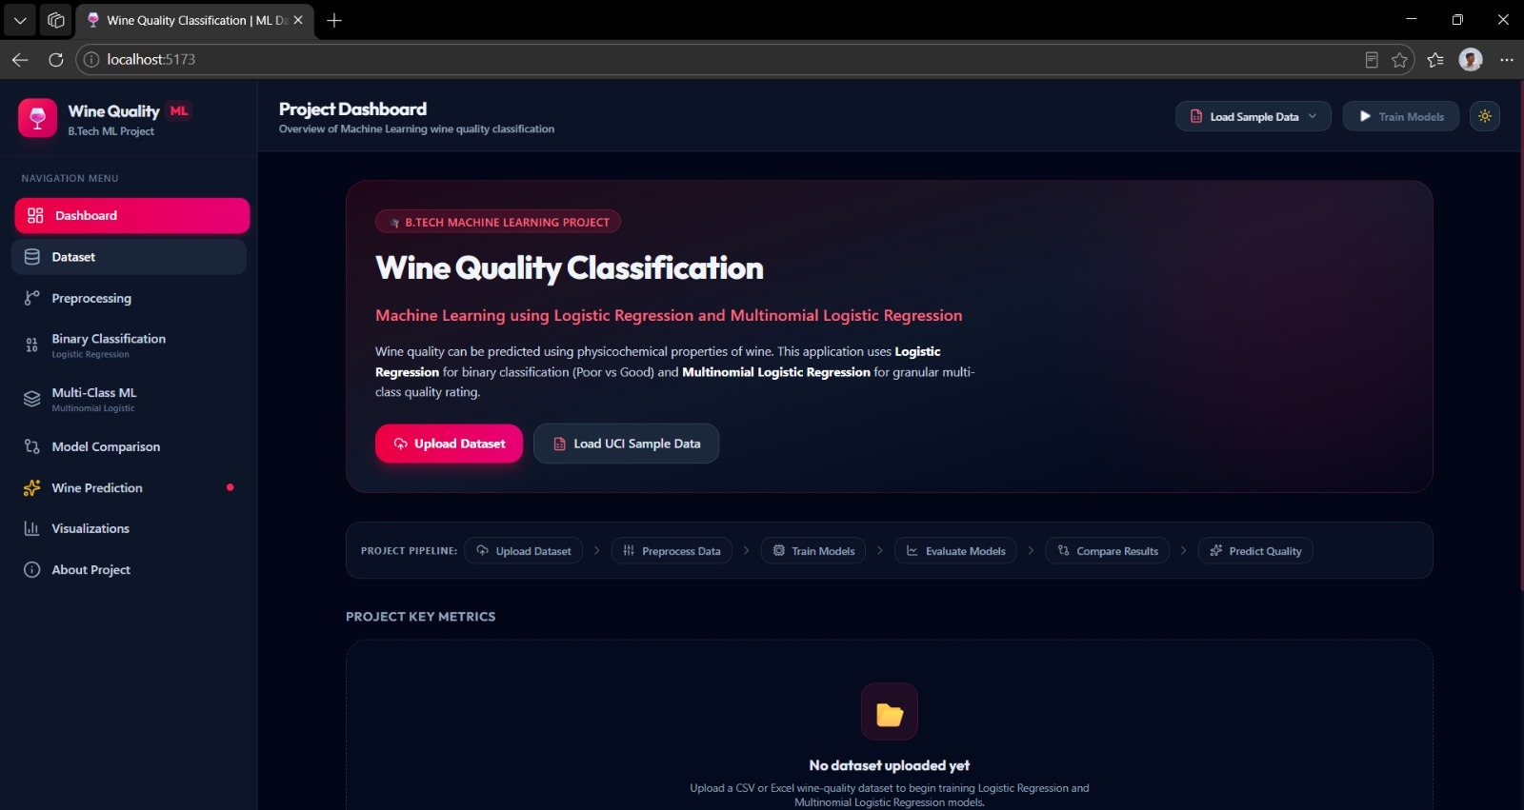
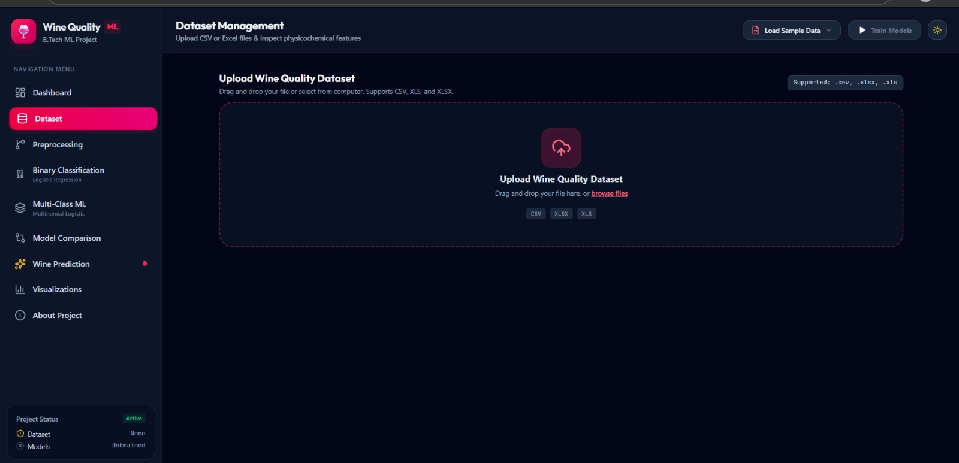
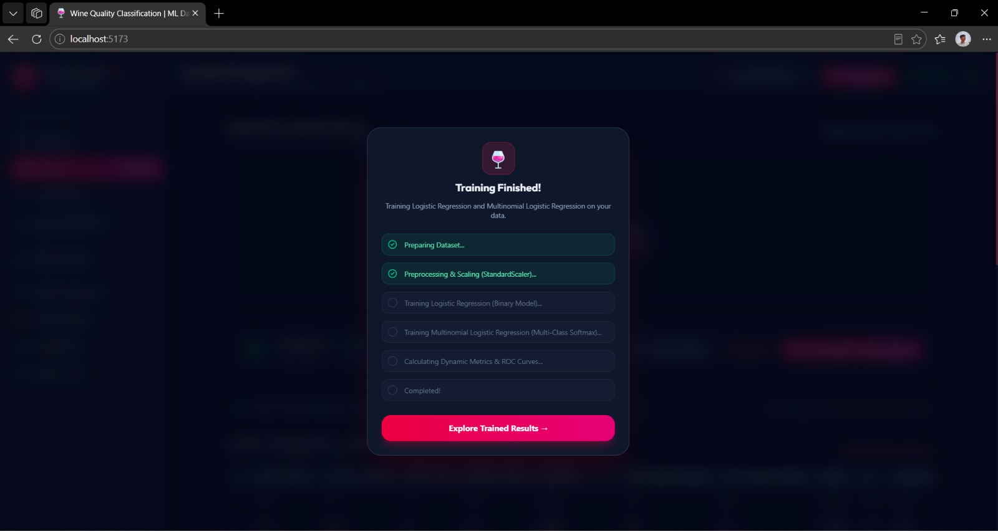
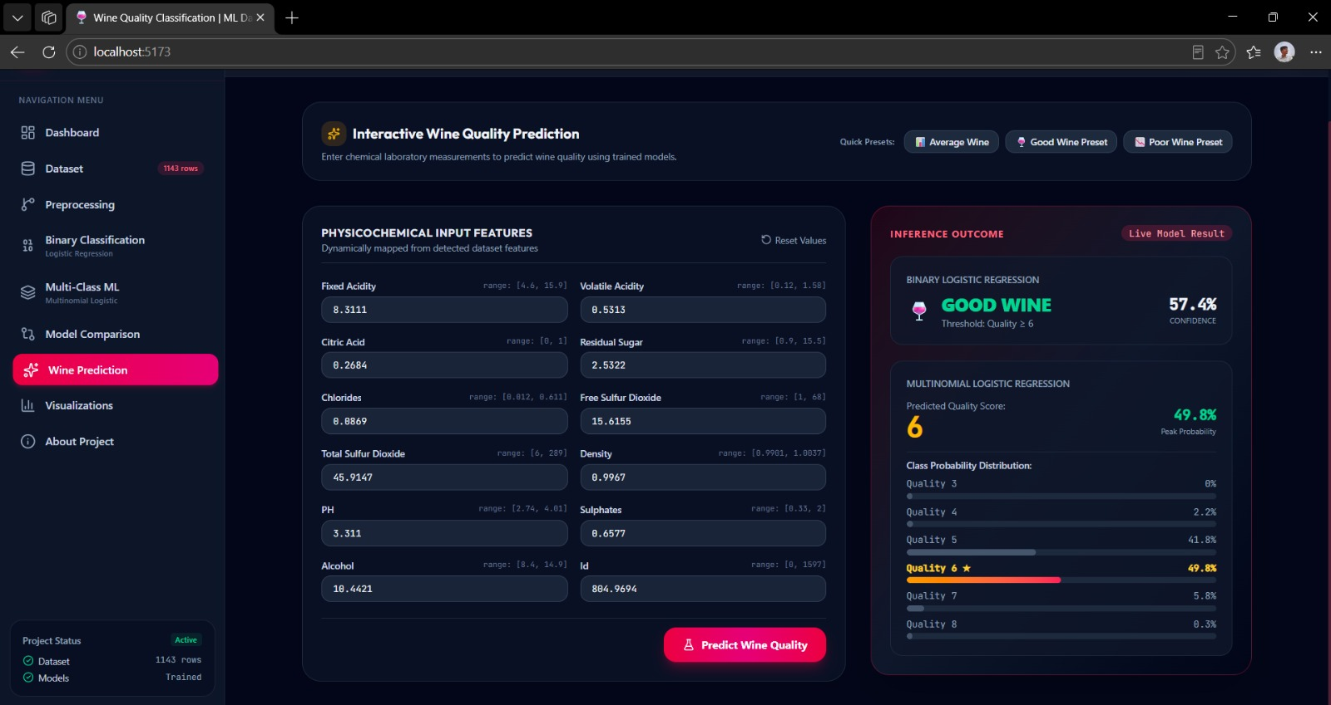
17. Screenshots / Demo
HOME / DATA
INPUT DATA
PROCESSING
RESULT
Wine Quality
Classification
Dataset: WineQT.csv
Enter / load
chemical features
from CSV
Imputation
Scaling
Model prediction
Predicted class
Metrics report
These are conceptual mock-ups, not screenshots of a completed user interface. The current project workflow can be demonstrated in Google Colab or VS Code.
17

Slide 18
18. Advantages
• Repeatable predictions from the same input measurements and trained model.
• Fast scoring can help prioritize samples for further expert inspection.
• Interpretable baseline algorithms are suitable for learning and comparison.
• Automates part of the classification workflow and supports consistent record keeping.
• The model is a support tool; it does not replace laboratory tests or sensory experts.
18

Slide 19
19. Applications
• Quality-control support for wine producers and bottling operations.
• Preliminary screening of wine samples using physicochemical measurements.
• Comparative analysis for laboratory and food-science teams.
• Machine-learning education and demonstration of preprocessing and classification.
• Potential integration into a quality dashboard after additional validation.
19

Slide 20
20. Limitations
• The dataset contains 1,143 rows and quality labels from 3 through 8 only.
• Class imbalance means rare quality levels have fewer training examples.
• Input features do not directly describe all sensory properties such as aroma and taste.
• The binary threshold quality ≥ 6 is a project choice rather than a universal definition.
• Results depend on the chosen split and may not generalize to other wine types or production sources.
20

Slide 21
21. Future Scope
• Compare Logistic Regression with Random Forest, Support Vector Machine and XGBoost.
• Use cross-validation and hyperparameter tuning for more robust estimates.
• Add a confusion matrix, per-class metrics and ROC-AUC for binary classification.
• Test on external datasets and different wine varieties to assess generalization.
• Build a web interface for entering chemical measurements and viewing predicted classes.
21

Slide 22
22. Conclusion
• The project uses the uploaded WineQT.csv to build a wine-quality classification workflow.
• Binary Logistic Regression and multiclass Logistic Regression are evaluated on held-out data.
• Accuracy, precision, recall and F1-score provide a quantitative comparison of the models.
• The workflow demonstrates how chemical measurements can support preliminary quality screening.
• Predictions should be validated before use in real production decisions.
22

Slide 23
Thank You
Wine Quality Classification • CSIT • A.Y. 2026–27

