Slide 1


Slide 2

Object Oriented Programming

Slide 3

What is NLP?
Natural Language Processing, or NLP, is an area of computer science that focuses on developing techniques to produce machine-driven analyses of text.
“It is hard from the standpoint of the child, who must spend many years acquiring a language … it is hard for the adult language learner, it is hard for the scientist who attempts to model the relevant phenomena, and it is hard for the engineer who attempts to build systems that deal with natural language input or output. These tasks are so hard that Turing could rightly make fluent conversation in natural language the centerpiece of his test for intelligence.”

Slide 4
Why is NLP a “hard” problem?
Language is inherently ambiguous. Once person's interpretation of a sentence may very well differ from another person's interpretation. Because of this inability to consistently be clear, it's hard to have an NLP technique that works perfectly.
E.g “I hate visiting aunts.”

Slide 5
Current application of NLP
Machine Translation
Sentiment Analysis
Question & Answering (Chat-bots)
Topic Modelling

Slide 6
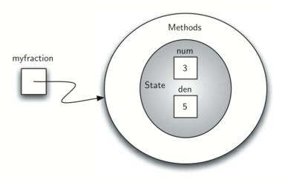
Our class so far

Slide 7
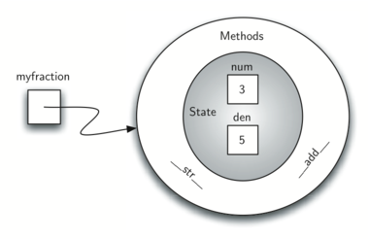
Our class so far

Slide 8
Inheritance
Inheritance is the ability for one class to be related to another class in much the same way that people can be related to one another. Children inherit characteristics from their parents. Similarly, Python child classes can inherit characteristic data and behavior from a parent class. These classes are often referred to as subclasses and superclasses.
By organizing classes in this hierarchical fashion, object-oriented programming languages allow previously written code to be extended to meet the needs of new situations.

Slide 9
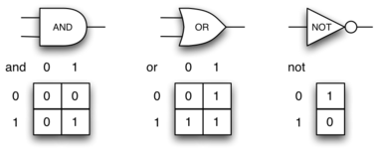
Example: Logic Gates

Slide 10
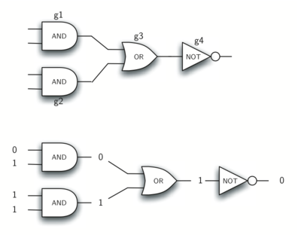
Example: Logic Gates

Slide 11
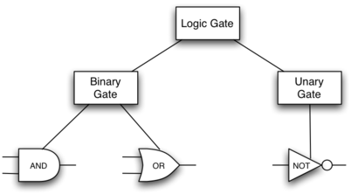
Desired Inheritance Structure

Slide 12


