Slide 1
Django

Slide 2
Agenda
Introduction
Features
Installation
Django Architecture
Project Structure

Slide 3
Introduction - Why Django?
Developed by Adrian Holovaty
Named after famous Guitarist Django Reinhardt
Creation of complex data driven websites
Reusability and plugin ability of components
Rapid Application Development
Ridiculously Fast in taking web applications from concept to launch.

Slide 4
Famous Websites Use Django
Mozilla
Washington Times
Disqus
BitBucket
Nextdoor

Slide 5
Features
Fully loaded with common web related tasks like
User authentication
Content administration
Site Maps
RSS Feeds
Tagging
AJAX Enhancements
Searching
Building networks
Deploying to servers

Slide 6
Django Core Framework Capabilities
MVC Pattern – MVT Pattern
ORM – Mediates between data models and relational databases (models)
System for processing http requests through web templating system (views)
Regular expression based URL dispatcher (controller)
Lightweight standalone server for development and testing
Form serialization and validation that can translate between HTML form and values suitable for storing in database

Slide 7
Django Core Framework Contd..
Template system that utilizes the concept of inheritance
Caching framework for caching html, image and documents on both server side and the client side
Middleware classes that can intervene at various stages of request processing and carry out custom functions.
Internationalization system to handle different languages
Serialization system that can produce XML and JSON representations of Django model instances
Interface to python unit test framework

Slide 8
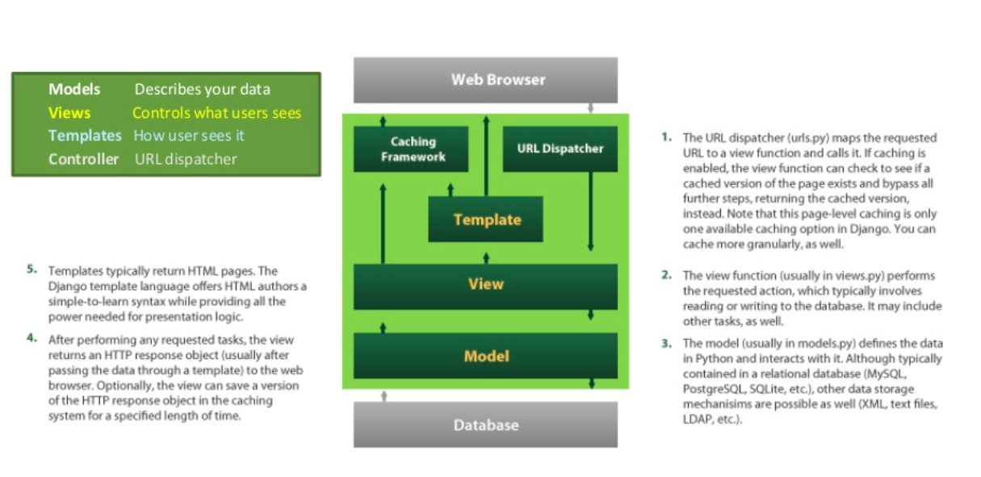
How the framework works?

Slide 9
Bundled Applications
Tools for generating RSS and Atom Syndication feeds
Tools for generating google sitemaps
Multiple applications in one application with different websites
Built in mitigation for sql injections, password cracking, cross-site scripting
Framework for creating GIS applications

Slide 10
Extensible
More than 2500 packages are available to extend the framework of the original behavior providing solutions to issues the original tool didn’t tackle.

Slide 11
Server Support System
Nginx
Gunicorn
WSGI
FastCGI server
Database support
PostgreSQL, MySQL
SQLite, Oracle,
NoSQL, MongoDB

Slide 12
References
https://docs.djangoproject.com/en/1.11/

Slide 13
Web Frameworks
A piece of software containing all the basic functionalities of a web development built in
Server – client (Sockets)
HTML Templates
HTTP Verbs Request / Response Framework

