Slide 1
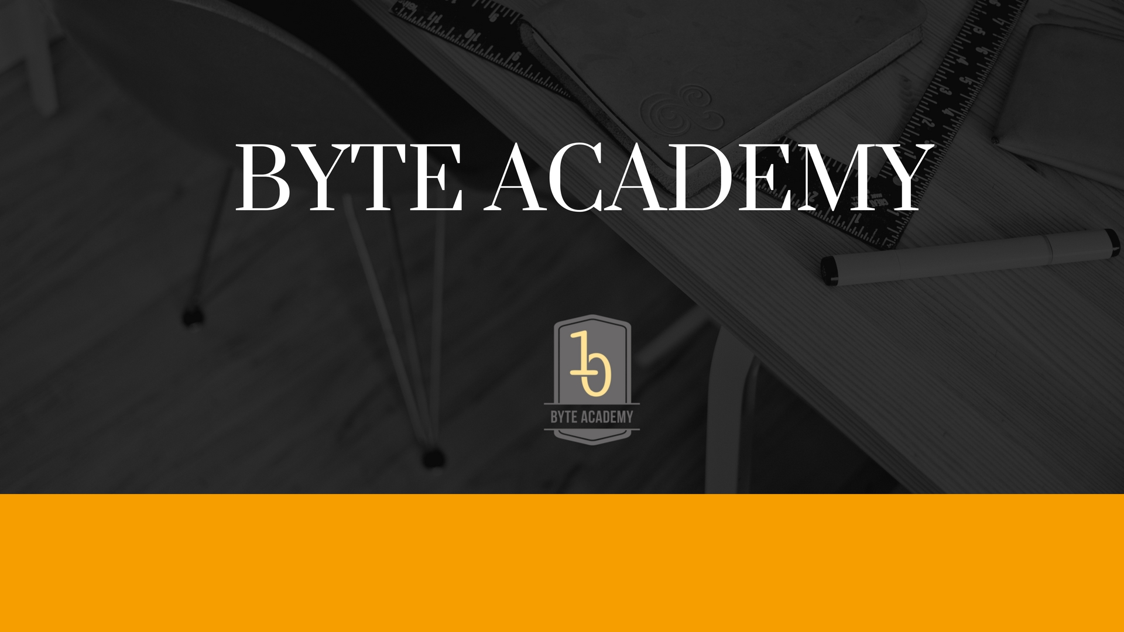

Slide 2
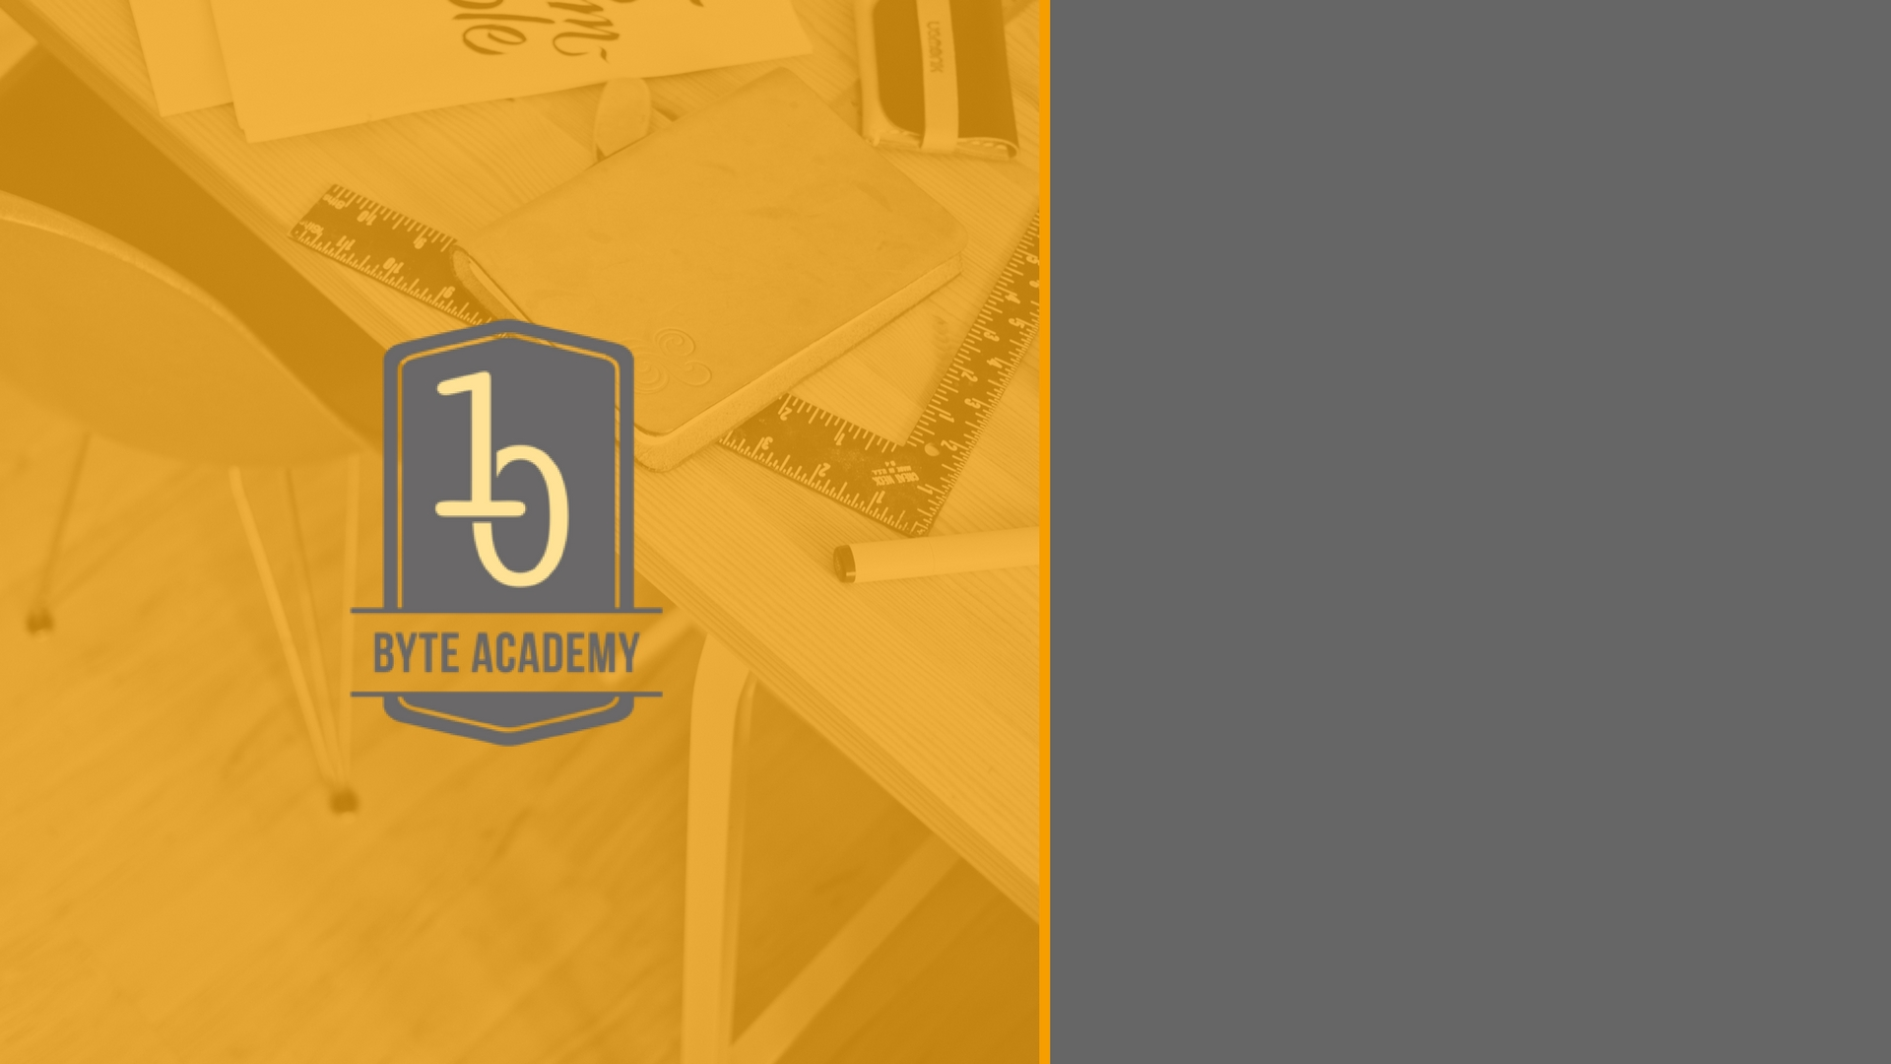
Flask

Slide 3

Introduction to Flask
Flask is a Python based web application framework
Web Frameworks are set of libraries, and packages that enables developers to write applications without having to bother about low level details such as protocols, thread management, socket interactions etc.,
Flask developed by Armin Ronacher and leader of International group of Python Enthusiasts (Pocco)

Slide 4
Introduction to Flask (Contd..)
Flask is based on Werkzeug WSGI Toolkit
Jinja 2 Template Engine
Both are Pocco Projects
WSGI – Web Server Gateway Interface
  (Universal Interface between the web server and web clients/applications)
WSGI Toolkit implements requests, response

Slide 5
Flask Hands On

Slide 6


