Slide 1


Slide 2

Django

Slide 3

Agenda
Introduction
Features
Installation
Django Architecture
Project Architecture

Slide 4
Introduction to Django
Developed by Adrian Holovaty
Named after famous Guitarist Django Reinhardt
Creation of complex data driven websites
Reusability and plugin ability of components
Rapid Application Development
Ridiculously Fast in taking web applications from concept to launch.

Slide 5
Django Features
Fully loaded with common web related tasks like
User authentication
Content administration
Site Maps
RSS Feeds
Tagging
AJAX Enhancements
Searching
Building networks
Deploying to servers

Slide 6
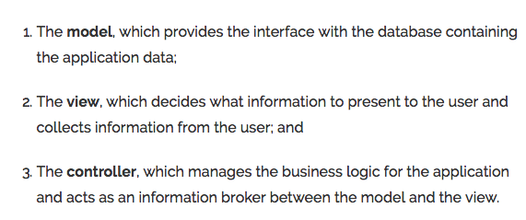
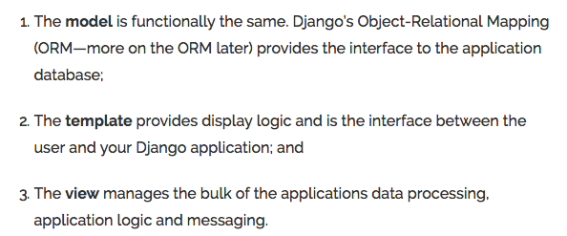
Django Architecture [ MVC – MVT]

Slide 7
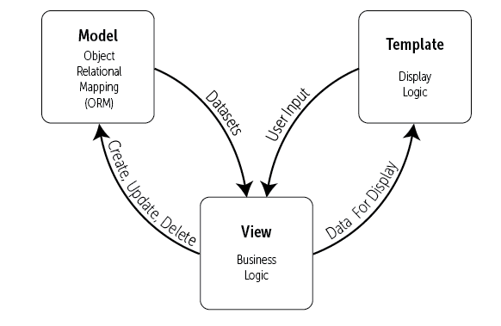
Django Architecture MVT

Slide 8
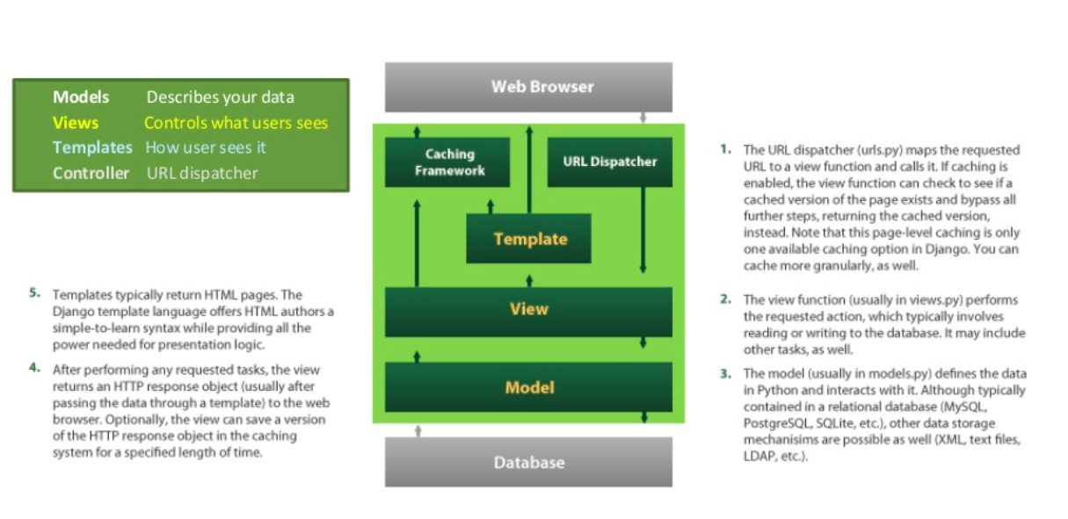
Django Framework

Slide 9
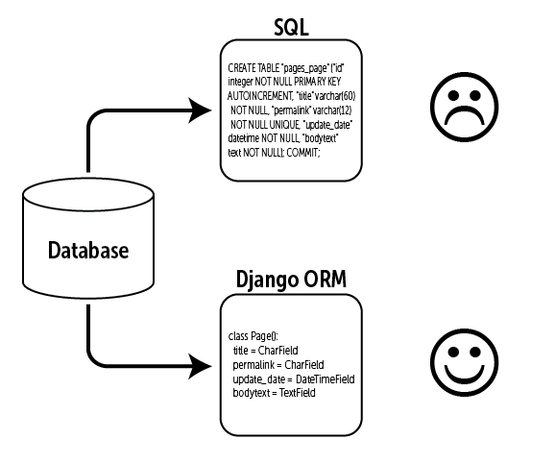
Django ORM
ORM – Mediates between data models and relational databases (models)

Slide 10
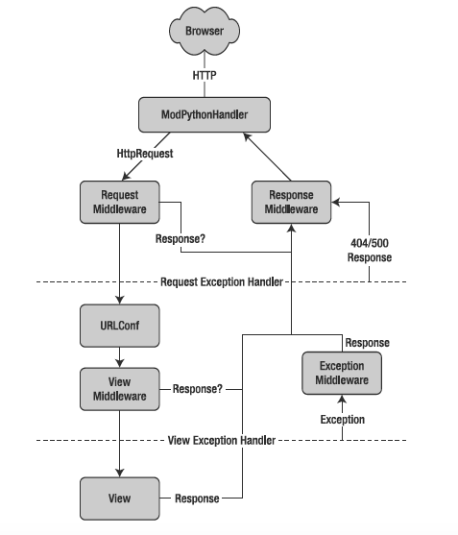
Django Control
Flow

Slide 11
Django Functions
System for processing http requests through web templating system (views)
Regular expression based URL dispatcher (controller)
Lightweight standalone server for development and testing
Form serialization and validation that can translate between HTML form and values suitable for storing in database
Template system that utilizes the concept of inheritance

Slide 12
Django Functions Contd..
Caching framework for caching html, image and documents on both server side and the client side
Middleware classes that can intervene at various stages of request processing and carry out custom functions.
Internationalization system to handle different languages

Slide 13
Django Functions Contd..
Serialization system that can produce XML and JSON representations of Django model instances
Interface to python unit test framework

Slide 14
Famous Websites Use Django
Mozilla
Washington Times
Disqus
BitBucket
Nextdoor

Slide 15


