Slide 1
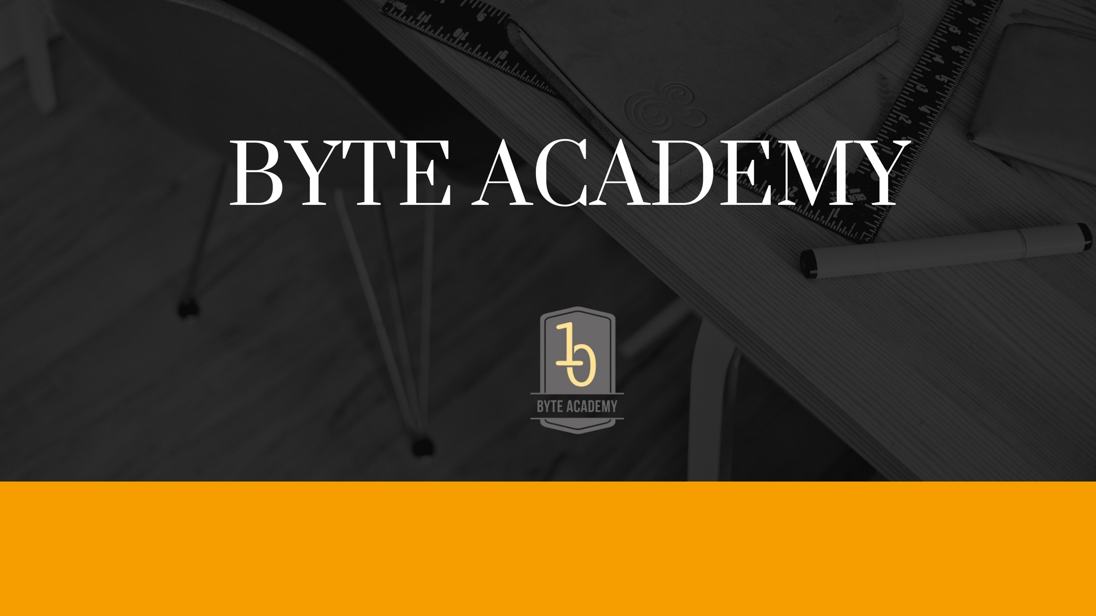

Slide 2
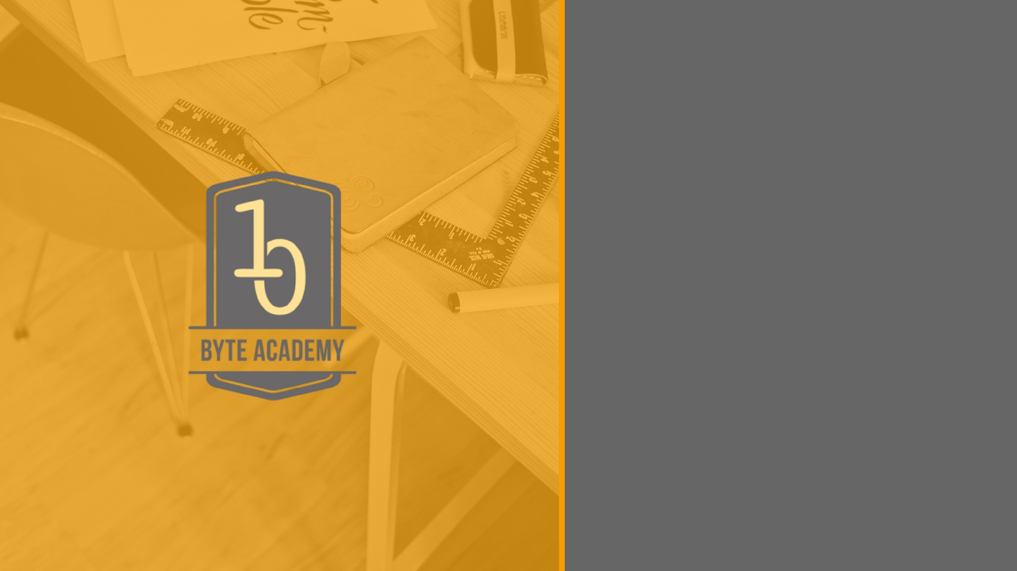
PostgreSQL

Slide 3

PostgreSQL Architecture Fundamentals
Uses a Client / Server Model
PostgreSQL session consists of following co-operative processes
A server process
Client Application
As a typical client / server model it can run on different hosts, in which case they communicate over TCP/IP network connection.

Slide 4
PostgreSQL Server Process
Manages the database files
Accepts connections to databases from client application
Performs database actions on behalf of client
The server program is called postgreSQL
Server can handle multiple connections from clients, by doing ‘fork’ a new process of each connection.
Master process keep running to accept a new client connection, forked process serves the accepted client connections

Slide 5
PostgreSQL Client Application
Client is the front end application that wants to perform database operations
Client applications can be diverse in nature
Could be text oriented tool
A graphical application
A web server accesses the database to display web pages
Or a specialized database maintenance tool

Slide 6
PostgreSQL Client Application
Client is the front end application that wants to perform database operations
Client applications can be diverse in nature
Could be text oriented tool
A graphical application
A web server accesses the database to display web pages
Or a specialized database maintenance tool

Slide 7
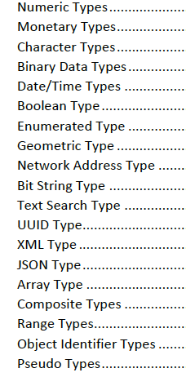
PostgreSQL
Data Types

Slide 8
PostgreSQL Operators
Arithmetic Operators
Comparison Operators
Logical Operators
Bitwise Operators

Slide 9
Basic Commands and hands on
Install psql
createdb testdb
psql testdb

Slide 10
Python API for PostgreSQL (psycopg2)

Slide 11


