Slide 1


Slide 2

MongoDB

Slide 3

Agenda
No SQL Introduction
No SQL Example – MongoDB
MongoDB Architecture
MongoDB Features
Installation – MongoDB Python Library
MongoDB - Handson

Slide 4
Introduction to No - SQL
Non Relational DBMS
Designed for distributed data stores
Data Storing may not require fixed schema
Avoid Join Operations
Scale horizontally
Exponential data increase in following cases
Google
Facebook
Personal User Information
Social Graphs
Geo Location Data
User generated content
Machine Logs

Slide 5
RDBMS vs No-SQL
RDBMS (ACID Rules)
Structured and Organized Data
SQL
Data and Relationships are stored in separate tables
Data manipulation language, Data definition language
Tight Consistency
ACID – Atomicity, Consistency, Isolated, Durability
No SQL
Not only SQL
No declarative query language
No predefined schema
Categories : Key-Value pair storage, Column storage, Document store and Graph database
Eventual consistency rather than ACID property
Unstructured and unpredictable data
CAP (Consistency, Availability and Partitioning) theorem
Prioritizes high performance, high availability and scalability

Slide 6
CAP Theorem

Slide 7
NO SQL Categories
Key value stores
Most Commonly Used
Designed to handle huge amount of data
Based on Amazon Dynamo’s Paper
Schema Less Data
Key – strings, lists, sets
Work well for shopping cart contents
Eg: Redis, Dynamo
Column Oriented
Primarily work on columns , every column treated individually
Values of single column stored contiguously
Query processors work on columns only
Works good on data warehouses, business intelligence, CRMs
Eg: BigTable, Cassandra, SimpleDB
Graph Databases
Document Oriented

Slide 8
NO SQL Categories Contd..
Graph Databases
Stores data in graphs
Graphs contains edges and vertices
Collection of nodes and edges
Node – Entity, Edge – Relationship
(Node, Edge) defined by unique identifier
Each node knows its adjacent nodes
Eg: OrientDB
Document Oriented
Relational model | Graph model
Tables | Vertices and Edges set
Rows | Vertices
Columns | Key/value pairs
Joins | Edges

Slide 9
NO SQL Categories Contd..
Document Oriented Databases
Collection of documents
Document is Key-Value Collection
No schema in documents
Eg: MongoDB
Relational model | Document model
Tables | Collections
Rows | Documents
Columns | Key/value pairs
Joins | not available

Slide 10
MongoDB
Mongo from ‘Humongous’
Free and Open Source written using C++
Document Oriented Database
Classified as NO SQL
Users JSON like documents called BSON
Developed by MongoDB Incorporation in C++, but some drivers are libraries are in C

Slide 11
MongoDB Fundamental Elements
Database – Physical container of collections
Collections – Group of Mongo DB Documents
Document – key-value pair
RDBMS – Mongo DB (Comparison)
Database – Database
Table – Collections
Record (Row) - Document

Slide 12
Use cases, Pros and Cons of No-SQL
Schema Less
Ease of scaling out
Why to Use MongoDB?
Document storage in the form of JSON
Index any attribute
Auto Sharding
Professional Support
When to use MongoDB?
Big Data
Content Management
Mobile and Social Infrastructure
Data Hubs

Slide 13
Features
Adhoc Queries
Indexing
Replication
Keep data safe
Disaster Recovery
Aggregation (sum, avg, min, max)
Sharding

Slide 14
Replication
Keep the data safe
Disaster Recovery
No downtime maintenance (like backups, index rebuilds)
Replica set is transparent to the application
How does replication works?
Replica set is a group of 2 or more nodes
One node is primary, others are secondary
Data replicates from primary to secondary
At the time of failure, election establishes for primary and a new primary node is elected.

Slide 15
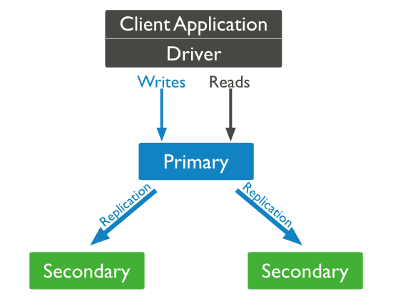
Replication

Slide 16
Sharding
Sharding is a process of storing data records across multiple machines and it is mongodb’s approach to meet the demands of the data growth.
As the size of the data increases, sharding solves the problem of horizontal scaling
With sharding you add more machines to support data growth and the demands of read and write operations
Shards – used to store data
Config servers – stores the cluster’s metadata. This data contains the mapping of cluster’s data set to the shards
Query routers – they are mongo client instances which will interface with the client applications and direct operations to the appropriate shard.

Slide 17
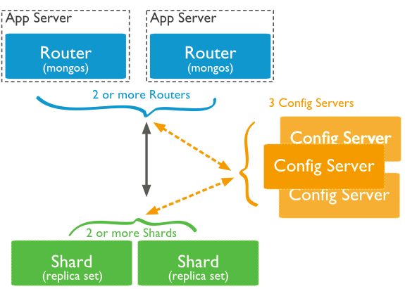
Sharding

Slide 18
Mongo DB Installation
For Ubuntu
sudo apt-get install mongodb
sudo mongod
If mongod terminates
sudo mkdir /data
sudo mkdir /data/db
Open another terminal and enter mongo
You will see one connection has been made message in the mongod daemon
For MacOS
brew install mongodb
sudo mongod
Open another terminal and enter mongo
You will see one connection has been made message in the mongod daemon
Link
https://docs.mongodb.com/manual/tutorial/install-mongodb-on-ubuntu/

Slide 19
Data Modeling with Website Blog
Every post has a unique title
Every post can have one or more tags
Every post has the name of the publisher and total number of likes
Every post has comments given by users
RDBMS Schema
Comments
Posts
Taglist

Slide 20
MongoDB Schema
{ _id: POST_ID
title: TITLE_OF_POST,
description: POST_DESCRIPTION,
by: POST_BY,
url: URL_OF_POST,
tags: [TAG1, TAG2, TAG3],
likes: TOTAL_LIKES,
comments: [ { user:'COMMENT_BY',
message: TEXT,
dateCreated: DATE_TIME,
like: LIKES },
{ user:'COMMENT_BY', message: TEXT, dateCreated: DATE_TIME, like: LIKES } ] }

