Slide 1

Present ….

Slide 2
Making LOOK IT! Studio & Photography as a provider of professional services and creative photography in jakarta.
“Lookit! Studio & Photography”

Slide 3
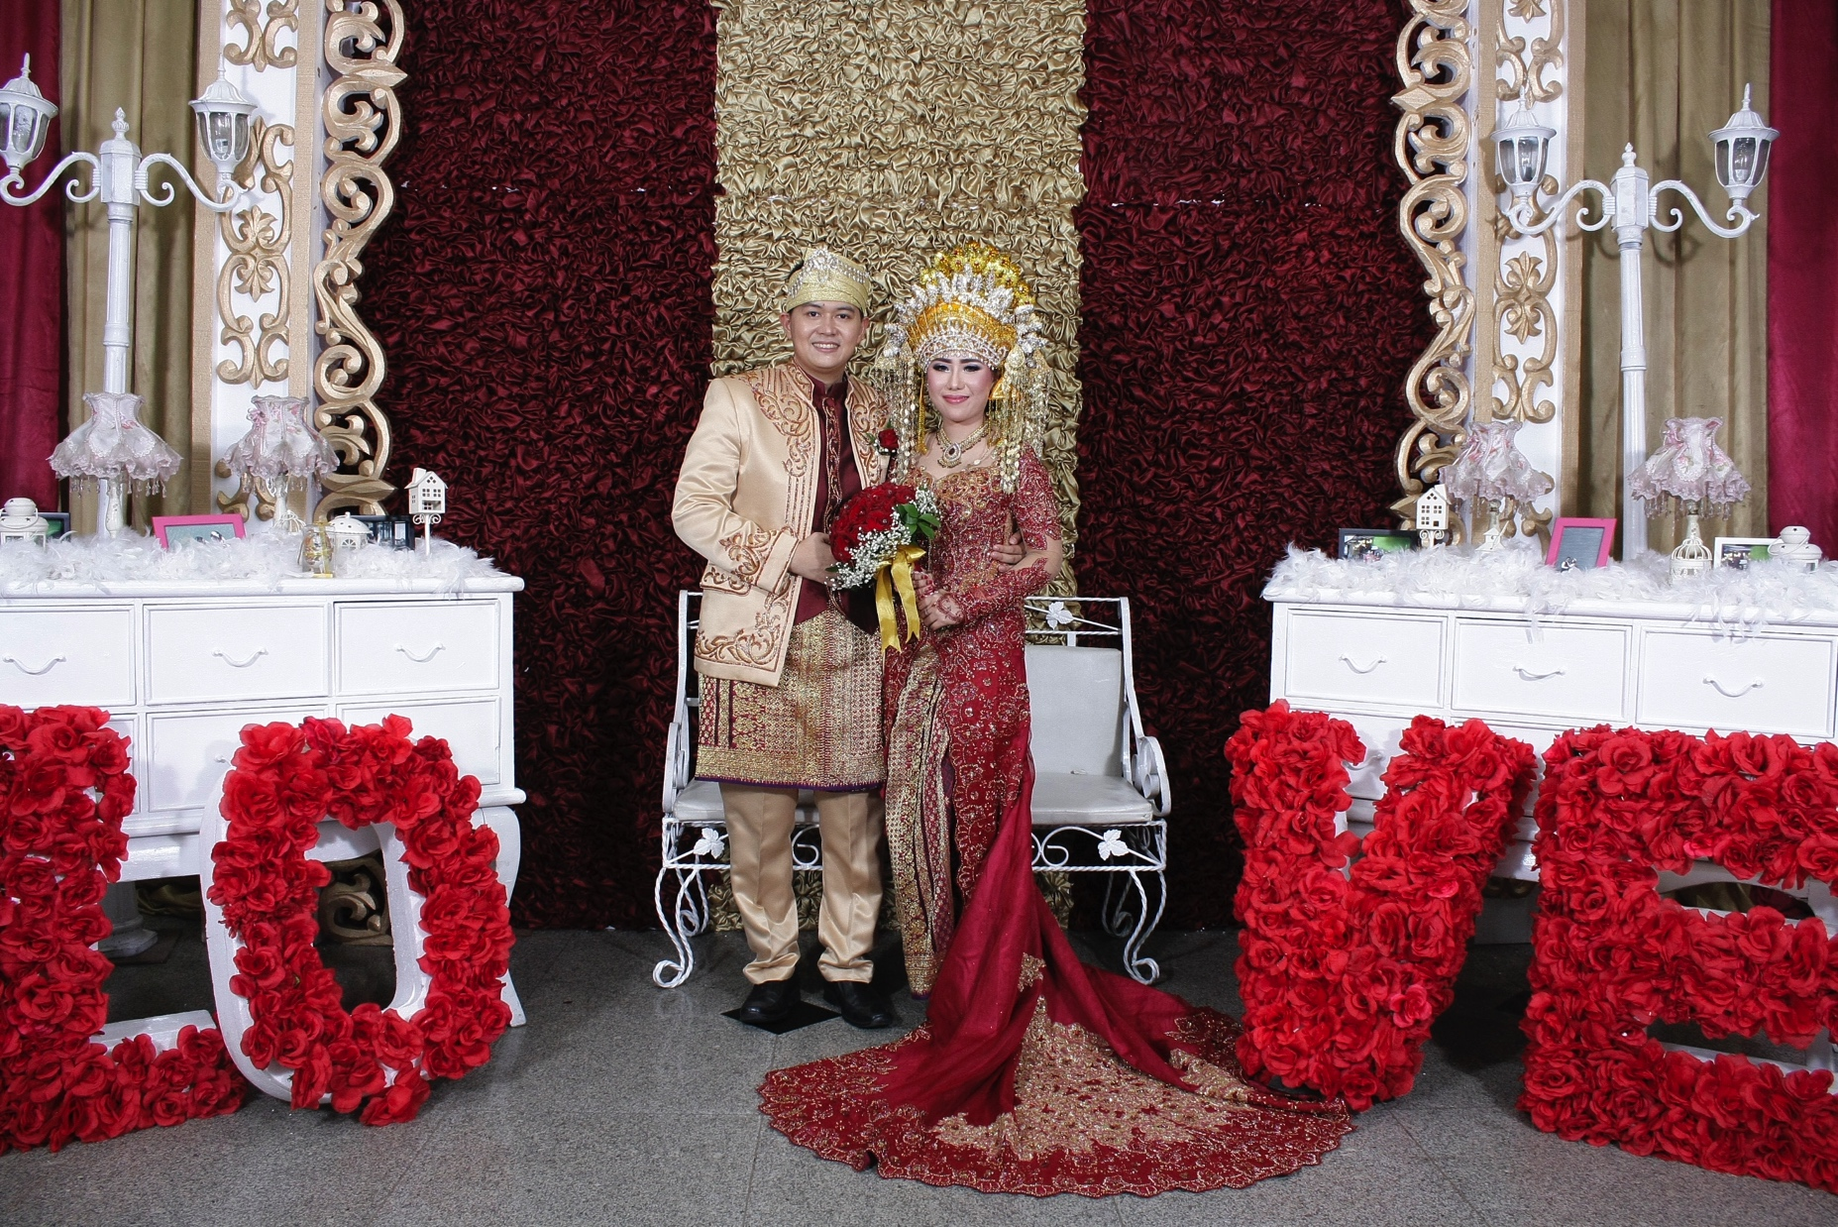
Photo Booth

Slide 4
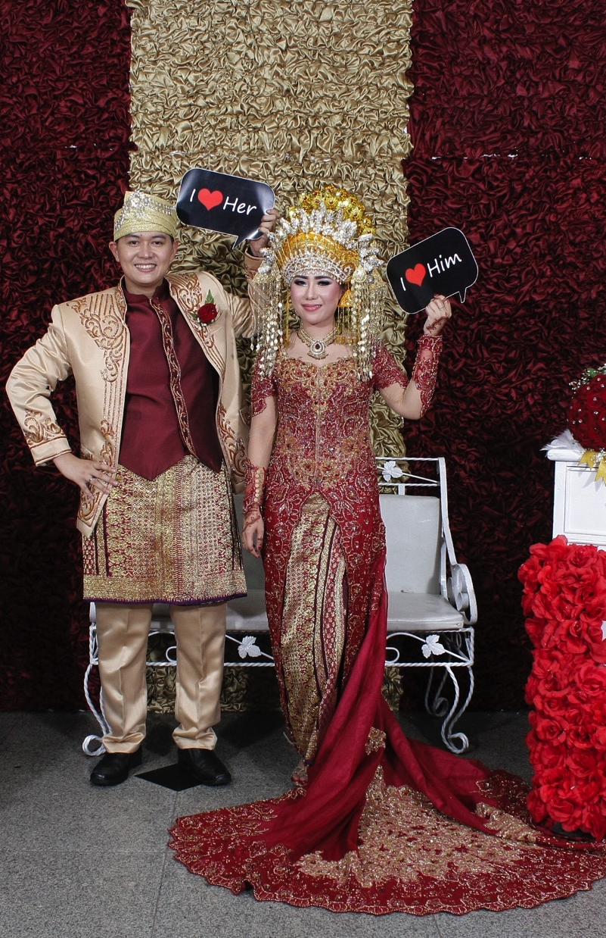
Photo Booth
IDR 4.000.000
For 3 Office Hour
Print Size 5R + Frame
Unlimited Result Photo
Delivery All File CD

