Slide 1
People Counting and Zone Management System

Slide 2
Objective
In many crowded places like shopping malls, airports, railway stations, offices, or events, it’s often difficult to keep track of how many people are present in a specific area. Usually, this is done manually by security staff or through guesswork, which can be slow and inaccurate.
For example, during busy hours in a mall, it’s hard to know if a particular zone like the food court or entrance area is becoming overcrowded. This can lead to safety problems, long waiting lines, or poor management decisions.

Slide 3
Objective
To solve this, the People Count and Zone Management System uses live camera feeds and AI technology to automatically detect and count people in real time. The system divides a place into different zones — like Zone A for entry, Zone B for shopping, and Zone C for exits — and tracks how many people are in each one. The results are shown instantly on a live dashboard with easy-to-read charts and visuals. This helps managers or security teams to see crowd movement, identify busy areas, and take action quickly if a zone gets too full.
This project makes crowd monitoring faster, safer, and more accurate, saving both time and human effort while improving the overall management of public spaces.

Slide 4
Outcomes
Real-time People Counting:
The system can count how many people are present at any moment using a CCTV or webcam feed. For example, if 50 people are walking in a mall entrance, the system will instantly show “50” on the screen and update as people move in or out.
Live Dashboard with Visuals:
There will be an interactive dashboard that shows real-time information such as current people count, movement patterns, and area-wise statistics. It will also include heatmaps, which use colors to show which zones are crowded (for example, red for busy areas, green for less crowded ones). This makes it very easy to understand what’s happening at a glance.

Slide 5
Outcomes
Zone-wise Management:
The system can divide the place into different zones — for example, Zone A (Entrance), Zone B (Shopping Area), Zone C (Food Court) — and display the number of people in each zone separately. This helps in monitoring which area is busier and which one is free.
Alerts for Overcrowding:
The system can send automatic alerts when a particular zone becomes too crowded. For example, if Zone B allows only 100 people and the count crosses 100, the system can flash a warning message or send a notification to staff to control the crowd.

Slide 6
Outcomes
Exportable Reports:
The system can generate and export detailed reports that include daily or weekly people count, busiest time periods, and crowd trends. These reports can be saved as PDF or Excel files for record-keeping and analysis.
Time-based Analysis:
The dashboard will also show how the crowd changes throughout the day — for example, showing that the morning hours are less crowded but evenings are the busiest. This helps managers plan staff and resources better.
User-friendly Interface:
The system will be designed in a simple, easy-to-use format, so even people without technical knowledge (like mall managers or security staff) can use it comfortably.

Slide 7
Tools and Technologies Used
This project helps detect people in crowded places like malls, airports, and train stations in real time using:
Django: Handles the backend, video processing, and YOLO model integration.
Redis: Stores and updates live detection data instantly.
React: Displays real-time results through charts, dashboards, and alerts.

Slide 8
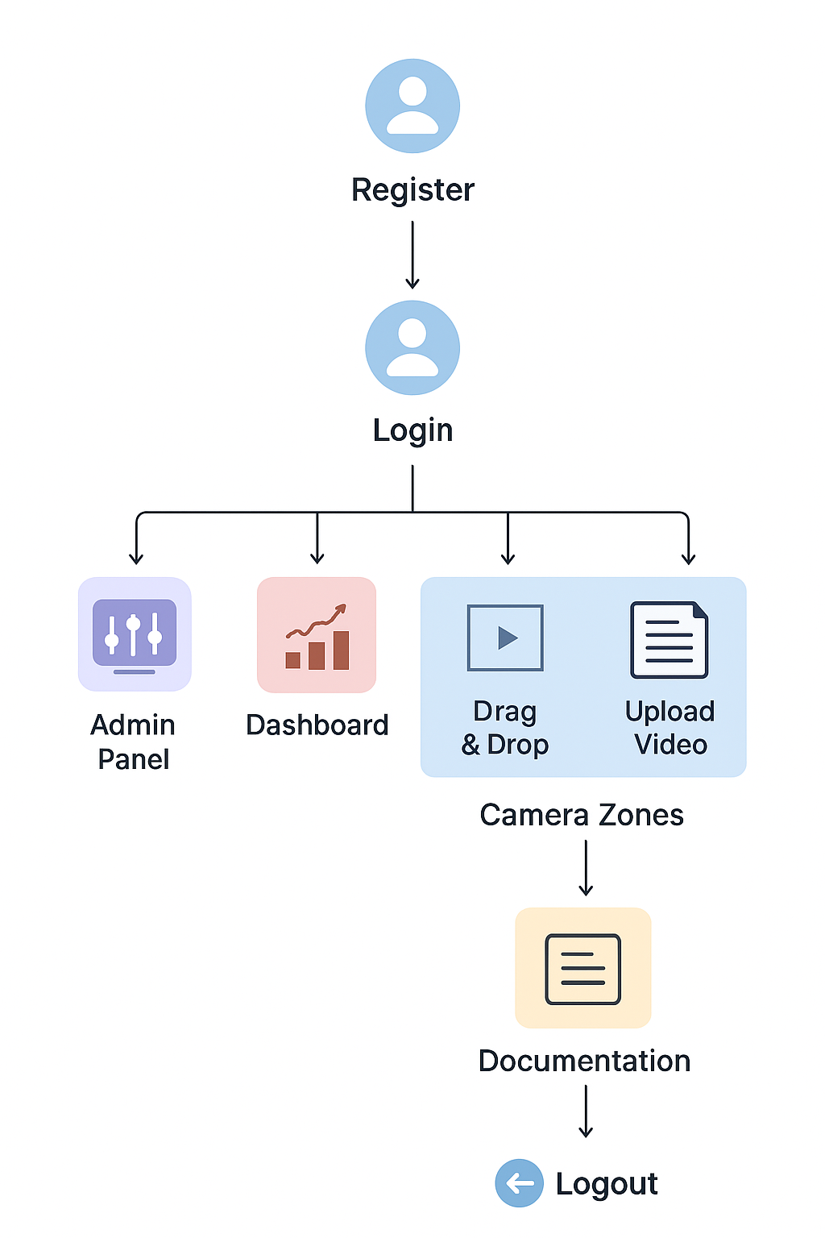
Flow Diagram

Slide 9
How Project Solves the Problem
Our project uses AI and computer vision to automatically detect and count people in real time using a CCTV or webcam feed. The system divides the area into different zones and tracks how many people are present in each one. This data is updated live and shown on an interactive dashboard built with React, where users can see charts, alerts, and zone statistics.
If any zone becomes overcrowded, the system sends an instant alert, helping security or management teams take quick action. By using Django for backend processing, Redis for fast data storage, and React for real-time display, our project makes crowd monitoring automatic, accurate, and efficient, removing the need for manual counting.

Slide 10
Future Enhancements
In the future, this system can be improved by adding more smart and advanced features. For example, it can include face recognition to identify regular visitors or detect suspicious activity. The system can also be linked with IoT sensors and security alarms to automatically control entry gates when a zone becomes too crowded. Adding mobile app support will allow managers to monitor live crowd data anytime and anywhere. It can also be enhanced with cloud storage for saving historical data and AI-based predictions to forecast crowd levels during peak hours or special events.
These improvements will make the system smarter, faster, and more useful for real-world crowd management.

