Slide 1


Azure Networking Brown Bag - VNet Peering and Hub-Spoke Network Topology
Yanbing Shi

Slide 2
Outline
Azure virtual network (VNet) fundamentals
VNet boundaries
Address ranges
Subnets
VNet peering deep dive
Benefits and constraints
Introduction of hub-spoke network topology
VNet hub
VWAN

Slide 3

Azure virtual network fundamentals
Subscription
Region
VNet
Subnet 1
Subnet 2
AZ 1
AZ 2
AZ 3

Slide 4
Azure virtual network fundamentals
An Azure virtual network is an isolated private network within Azure public cloud and provides Azure compute instances networking functionality.
Comparative solution on AWS: Amazon virtual private cloud (VPC).
Comparative solution on GCP: Google virtual private cloud (VPC)
A virtual network consists of one or more IP ranges typically from RFC 1918 but not exclusively (e.g., shared address space in RFC 6598)
10.0.0.0 - 10.255.255.255 (10/8 prefix)
172.16.0.0 - 172.31.255.255 (172.16/12 prefix)
192.168.0.0 - 192.168.255.255 (192.168/16 prefix)
The address space is broken into subnets
Azure reserves 5 IP addresses within each subnet: x.x.x.0 – x.x.x.3 and the last address (e.g., x.x.x.255 for /25 and larger).
Smallest supported subnet IPv4 address space: /29 with 3 usable Ips
Largest supported subnet IPv4 address space: /2
IPv6 subnet: must be exactly /64

Slide 5
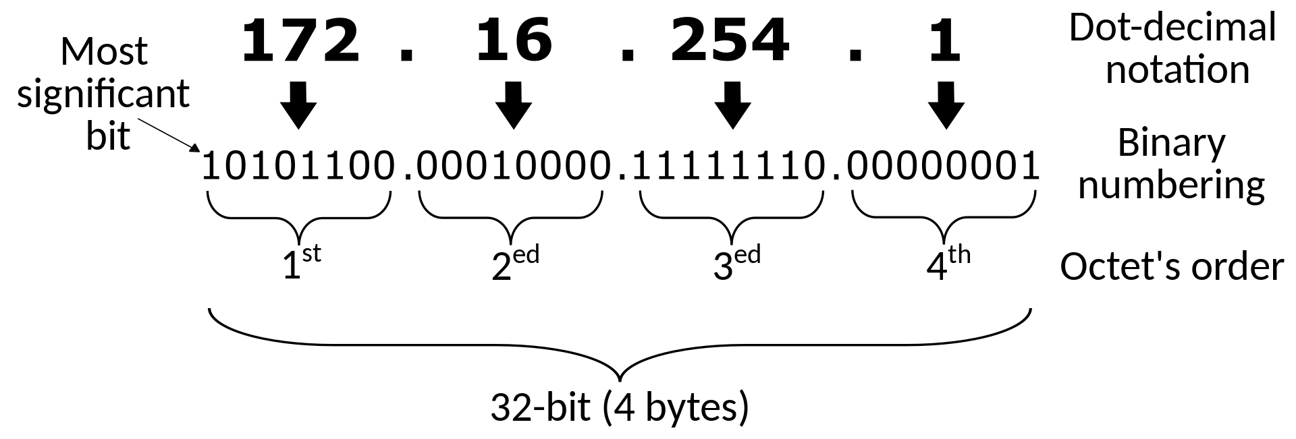
Classless Inter-Domain Routing (CIDR) notation
10.0.0.0/24
24-bit prefix: 10.0.0.x
The last 8 bits vary: 00000000 ~ 11111111
256 available addresses: 10.0.0.0 – 10.0.0.255
10.0.0.0/N
The last (32-N) bits vary with 2^(32-N) available addresses.

Slide 6


Private and secure connectivity across VNets
VNet-to-VNet connections using VPN gateways
IPsec VPN tunnel
Subscription 1
Subscription 2
Region 1
Region 2
VNet 1
Internet
VNet 2
VPN gateway
VPN gateway
Performance
Latency is not guaranteed as the data is transferred through public internet.
Bandwidth is constraint by the gateway performance.
Varies based on type of Gateway from 100 Mbps to 1.25Gps.
Billing
Gateway and egress traffic are charged at both ends.
Public IP addresses are required and charged.
The connected VNets cannot have overlapping IP address ranges.

Slide 7
VNet peering
Tenant 1
Tenant 2
Subscription 1
Subscription 2
Region 1
Region 2
VNet 1
Peering
VNet 2
10.1.0.0/16
Microsoft backbone network
The traffic between VMs in the peered VNets is routed through the Microsoft backbone network without going through public internet.
Low latency and high bandwidth
Private
Working across tenants, subscriptions and regions

Slide 8


VNet peering – no overlapping IP address ranges
VNet 1
Peering
VNet 2
10.1.0.0/16
10.2.0.0/24
VNet 1
Peering
VNet 2
10.1.0.0/16
10.1.5.0/24

Slide 9
VNet peering - non-transitive connectivity
VNet 2
Peering
Peering
VNet 1
VNet 3
VNet 1 connects with VNet 2 through peering.
VNet 2 connects with VNet 3 through peering.
VNet 1 and VNet 3 are not connected.

Slide 10
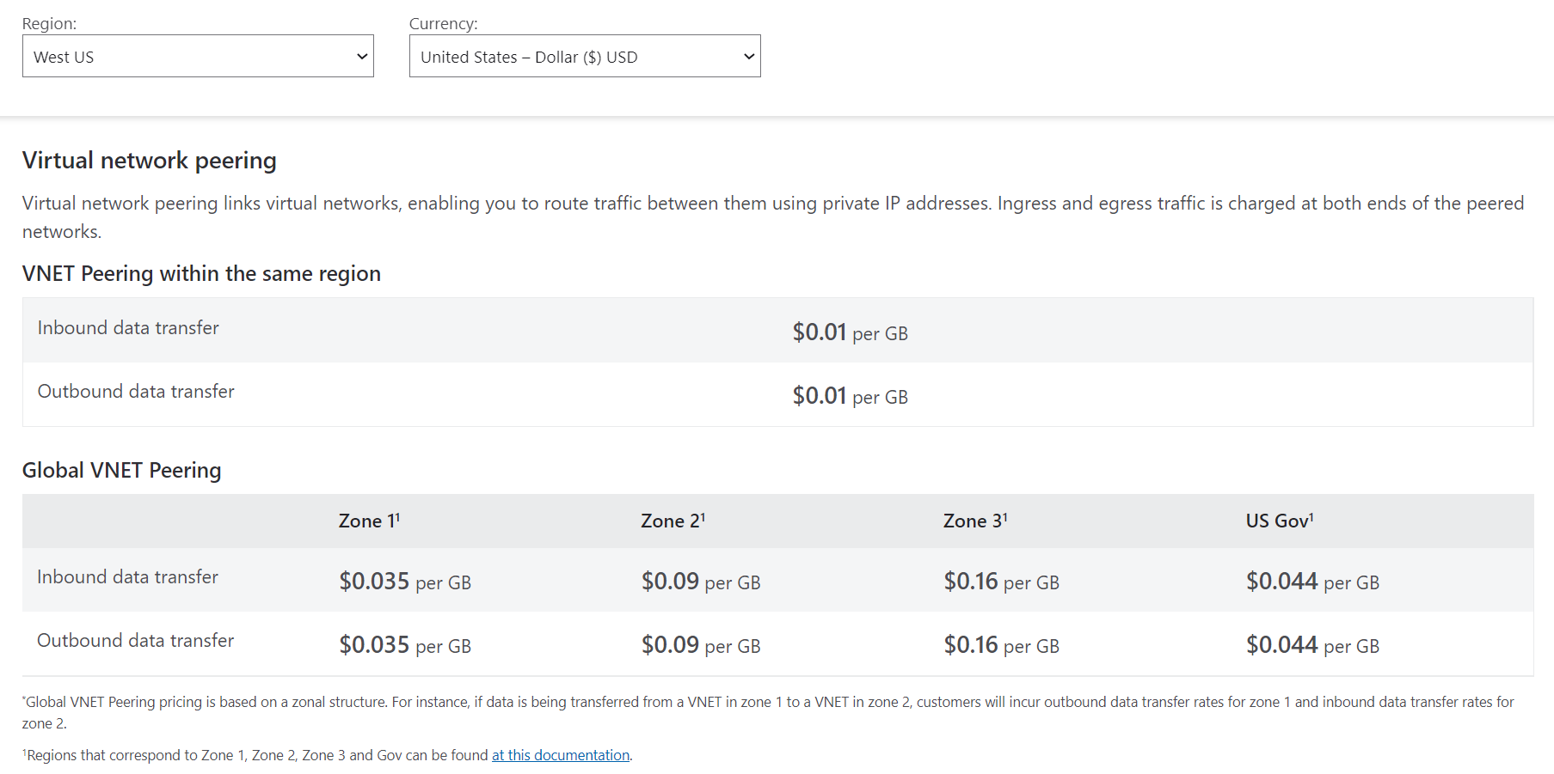
VNet peering - billing
Data transfer
Within a VNet: free.
Across peered Vnets: ingress and egress traffic is charged at both ends.

Slide 11

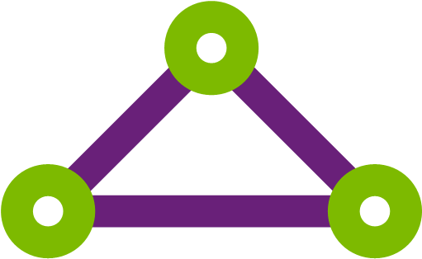

Hub-spoke network topology
Hub VNet
ExpressRoute
On-premises
Peering
Peering
Network virtual appliance (NVA)
Spoke VNet 1
Spoke VNet 2
The hub VNet acts as a central point of connectivity.
Transitive VNet-to-VNet connectivity with minimal peering management.
Centralize access to Azure from on-premises network.
Save cost by deploying shared services, such as firewall, into the hub VNet.
Consolidate network management and security control.

Slide 12

Azure Virtual WAN (VWAN)
VWAN
Hub-to-hub connection
Virtual hub 1
Region 1
Virtual hub 2
Region 2
ExpressRoute
Peering
Peering
Peering
Spoke VNet 1
Spoke VNet 2
Spoke VNet 3
On-premises
Network as service - Microsoft managed hub VNets with virtual network appliances
Simplify and unify the management of many Azure networking functionalities with a single operational interface.
Connectivity (using VHub gateway): hub-to-hub, VPNs (site-to-site, point-to-site), ExpressRoute, transitive VNet-to-VNet.
Security: Azure Firewall
3rd party network virtual appliances: firewalls, routers, gateways, load balancers, etc.

