Slide 1
Pattern-growth Methods for Sequential Pattern Mining: Principles and Extensions
Jiawei Han (UIUC)
Jian Pei (Simon Fraser Univ.)

Slide 2
Outline
Sequential pattern mining
Pattern-growth methods
Performance study
Mining sequential patterns with regular expression constraints

Slide 3
Why Sequential Pattern Mining?
Sequential pattern mining: Finding time-related frequent patterns (frequent subsequences)
Most data and applications are time-related
  Customer shopping patterns, telephone calling patterns
    E.g., first buy computer, then CD-ROMS, software, within 3 mos.
  Natural disasters (e.g., earthquake, hurricane)
  Disease and treatment
  Stock market fluctuation
  Weblog click stream analysis
  DNA sequence analysis

Slide 4
Sequential Pattern Mining
Given a set of sequences, find the complete set of frequent subsequences
A sequence : < (ef) (ab) (df) c b >
A sequence database
SID | sequence
10 | <a(abc)(ac)d(cf)>
20 | <(ad)c(bc)(ae)>
30 | <(ef)(ab)(df)cb>
40 | <eg(af)cbc>
Elements items within an
element are listed alphabetically
<a(bc)dc> is a subsequence of <a(abc)(ac)d(cf)>
Given support threshold min_sup =2, <(ab)c> is a sequential pattern

Slide 5
Sequential Pattern: Basics
A sequence : <(bd) c b (ac)>
A sequence database
Seq. ID
Sequence
Elements
10
<(bd)cb(ac)>
<ad(ae)> is a subsequence of <a(bd)bcb(ade)>
20
<(bf)(ce)b(fg)>
30
<(ah)(bf)abf>
40
<(be)(ce)d>
Given support threshold min_sup =2, <(bd)cb> is a sequential pattern
50
<a(bd)bcb(ade)>

Slide 6
Apriori Property
If a sequence S is not frequent → every super-sequence of S is not frequent
  E.g, <hb> is infrequent→ so do <hab>, <(ah)b>
Seq. ID
Sequence
Given support threshold min_sup =2
10
<(bd)cb(ac)>
20
<(bf)(ce)b(fg)>
30
<(ah)(bf)abf>
40
<(be)(ce)d>
50
<a(bd)bcb(ade)>

Slide 7
Apriori-like Sequential Pattern Mining Methods
Proposed by Agrawal and Srikant, ICDE’95 & EDBT’96
  GSP (Generalized Sequential Pattern) algorithm
Outline of the method
  Level-by-level do
    Generate candidate sequences
    Scan database to collect support counts
  Use Apriori property to prune candidates
    Only generate candidates satisfying Apriori property
Advantages
  Candidate pruning, scalable

Slide 8
The GSP Mining Process
5th scan: 1 cand. 1 length-5 seq. pat.
<(bd)cba>
Cand. cannot pass sup. threshold
4th scan: 8 cand. 6 length-4 seq. pat.
<abba> <(bd)bc> …
Cand. not in DB at all
3rd scan: 46 cand. 19 length-3 seq. pat. 20 cand. not in DB at all
<abb> <aab> <aba> <baa> <bab> …
2nd scan: 51 cand. 19 length-2 seq. pat. 10 cand. not in DB at all
<aa> <ab> … <af> <ba> <bb> … <ff> <(ab)> … <(ef)>
1st scan: 8 cand. 6 length-1 seq. pat.
<a> <b> <c> <d> <e> <f> <g> <h>
Seq. ID
Sequence
min_sup =2
10
<(bd)cb(ac)>
20
<(bf)(ce)b(fg)>
30
<(ah)(bf)abf>
40
<(be)(ce)d>
50
<a(bd)bcb(ade)>

Slide 9
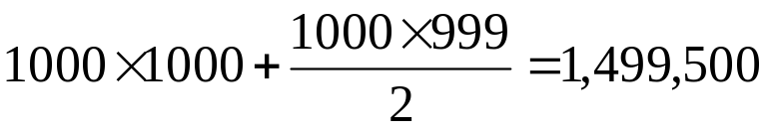
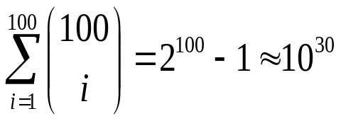
Bottlenecks of Apriori–Like Methods
A huge set of candidates could be generated
  1,000 frequent length-1 sequences generate length-2 candidates!
Many scans of database in mining
Encounter difficulty when mining long sequential patterns
  Exponential number of short candidates
  A length-100 sequential pattern needs candidate sequences!

Slide 10
Mine Sequential Patterns by Prefix Projections
Step 1: find length-1 sequential patterns
  <a>, <b>, <c>, <d>, <e>, <f>
Step 2: divide search space. The complete set of seq. pat. can be partitioned into 6 subsets:
  The ones having prefix <a>;
  The ones having prefix <b>;
  …
  The ones having prefix <f>
SID | sequence
10 | <a(abc)(ac)d(cf)>
20 | <(ad)c(bc)(ae)>
30 | <(ef)(ab)(df)cb>
40 | <eg(af)cbc>

Slide 11
Find Seq. Patterns with Prefix <a>
Only need to consider projections w.r.t. <a>
  <a>-projected database: <(abc)(ac)d(cf)>, <(_d)c(bc)(ae)>, <(_b)(df)cb>, <(_f)cbc>
Find all the length-2 seq. pat. Having prefix <a>: <aa>, <ab>, <(ab)>, <ac>, <ad>, <af>
  Further partition into 6 subsets
    Having prefix <aa>;
    …
    Having prefix <af>
SID | sequence
10 | <a(abc)(ac)d(cf)>
20 | <(ad)c(bc)(ae)>
30 | <(ef)(ab)(df)cb>
40 | <eg(af)cbc>

Slide 12
Completeness of PrefixSpan
SDB
SID | sequence
10 | <a(abc)(ac)d(cf)>
20 | <(ad)c(bc)(ae)>
30 | <(ef)(ab)(df)cb>
40 | <eg(af)cbc>
Length-1 sequential patterns
<a>, <b>, <c>, <d>, <e>, <f>
Having prefix <a>
Having prefix <c>, …, <f>
Having prefix <b>
<a>-projected database
<(abc)(ac)d(cf)>
<(_d)c(bc)(ae)>
<(_b)(df)cb>
<(_f)cbc>
<b>-projected database
…
Length-2 sequential
patterns
<aa>, <ab>, <(ab)>,
<ac>, <ad>, <af>
… …
Having prefix <aa>
Having prefix <af>
<aa>-proj. db
…
<af>-proj. db

Slide 13
Efficiency of PrefixSpan
No candidate sequence needs to be generated
Projected databases keep shrinking
Major cost of PrefixSpan: constructing projected databases
  Can be improved by bi-level projections

Slide 14
Pair-wise Checking Using S-matrix
SDB
SID | sequence
10 | <a(abc)(ac)d(cf)>
20 | <(ad)c(bc)(ae)>
30 | <(ef)(ab)(df)cb>
40 | <eg(af)cbc>
Length-1 sequential patterns
<a>, <b>, <c>, <d>, <e>, <f>
<aa> happens twice
<(ac)> happens twice
a | 2
b | (4, 2, 2) | 1
c | (4, 2, 1) | (3, 3, 2) | 3
d | (2, 1, 1) | (2, 2, 0) | (1, 3, 0) | 0
e | (1, 2, 1) | (1, 2, 0) | (1, 2, 0) | (1, 1, 0) | 0
f | (2, 1, 1) | (2, 2, 0) | (1, 2, 1) | (1, 1, 1) | (2, 0, 1) | 1
 | a | b | c | d | e | f
<ac> happens 4 times
S-matrix
<ca> happens twice
All length-2 sequential patterns are found in S-matrix

Slide 15
Scaling-up by Bi-level Projection
Partition search space based on length-2 sequential patterns
Only form projected databases and pursue recursive mining over bi-level projected databases

Slide 16
Mining <ab>-projected Database
SDB
Length-1 sequential patterns
<a>, <b>, <c>, <d>, <e>, <f>
SID | sequence
10 | <a(abc)(ac)d(cf)>
20 | <(ad)c(bc)(ae)>
30 | <(ef)(ab)(df)cb>
40 | <eg(af)cbc>
a | 2
b | (4, 2, 2) | 1
c | (4, 2, 1) | (3, 3, 2) | 3
d | (2, 1, 1) | (2, 2, 0) | (1, 3, 0) | 0
e | (1, 2, 1) | (1, 2, 0) | (1, 2, 0) | (1, 1, 0) | 0
f | (2, 1, 1) | (2, 2, 0) | (1, 2, 1) | (1, 1, 1) | (2, 0, 1) | 1
 | a | b | c | d | e | f
S-matrix
<ab>-projected database
<(_c)(ac(cf)>
<(_c)a>
<c>
No hope to form (_ac), so no need to count it.
Lead to pattern <a(bc)a>
S-matrix
a | 0
c | (1, 0, 1) | 1
(_c) | (∅, 2, ∅) | (∅, 1, ∅) | ∅
 | a | c | (_c)
Local length-1
sequential patterns:
<a>, <c>, <(_c)>

Slide 17
Benefits of Bi-level Projection
More patterns are found in each shoot
Much less projections
  In the example, there are 53 patterns.
  53 level-by-level projections
  22 bi-level projections

Slide 18
3-way Apriori Checking
Using Apriori heuristic to prune items in projected databases
  Absorb goodness of Apriori-like algorithms
<acd> cannot be a pattern!
Exclude d from <ac>-projected database
a | 2
b | (4, 2, 2) | 1
c | (4, 2, 1) | (3, 3, 2) | 3
d | (2, 1, 1) | (2, 2, 0) | (1, 3, 0) | 0
e | (1, 2, 1) | (1, 2, 0) | (1, 2, 0) | (1, 1, 0) | 0
f | (2, 1, 1) | (2, 2, 0) | (1, 2, 1) | (1, 1, 1) | (2, 0, 1) | 1
 | a | b | c | d | e | f

Slide 19
Speed-up by Pseudo-projection
Major cost of PrefixSpan: projection
  Postfixes of sequences often appear repeatedly in recursive projected databases
When the (projected) database fit in memory, use pointers to form projections
  Pointer to the sequence
  Offset of the postfix
s=<a(abc)(ac)d(cf)>
<a>
s|<a>: ( , 2)
<(abc)(ac)d(cf)>
<ab>
s|<ab>: ( , 4)
<(_c)(ac)d(cf)>

Slide 20
Pseudo-Projection vs. Physical Projection
Pseudo-projection avoids physically copying postfixes
  Efficient when database fits in main memory
  Not efficient when database cannot fit in main memory
    Disk-based random accessing is very costly
Suggested Approach:
  Integration of physical and pseudo-projection
  Swapping to pseudo-projection when the data set fits in memory

Slide 21
Seeing is Believing: Experiments and Performance Analysis
Comparing PrefixSpan with GSP and FreeSpan in large databases
  GSP (IBM Almaden, Srikant & Agrawal EDBT’96)
  FreeSpan (J. Han J. Pei, B. Mortazavi-Asi, Q. Chen, U. Dayal, M.C. Hsu, KDD’00)
  Prefix-Span-1 (single-level projection)
  Prefix-Scan-2 (bi-level projection)
Comparing effects of pseudo-projection
Comparing I/O cost and scalability

Slide 22
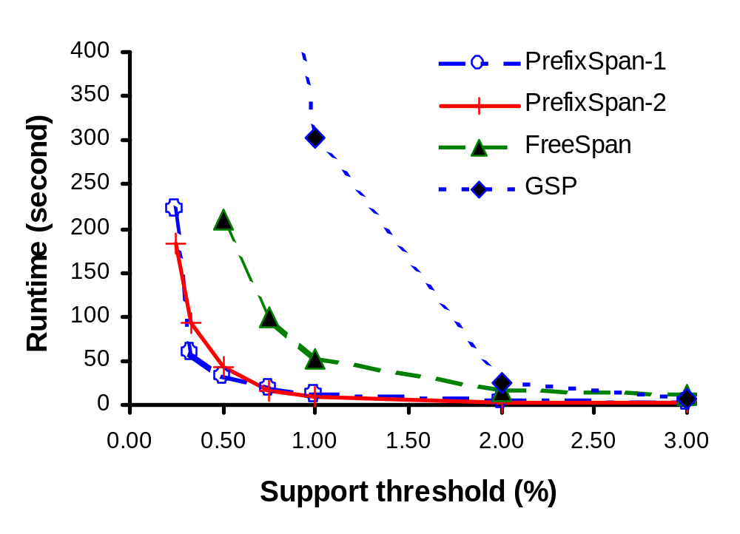
PrefixSpan Is Faster Than GSP and FreeSpan

Slide 23
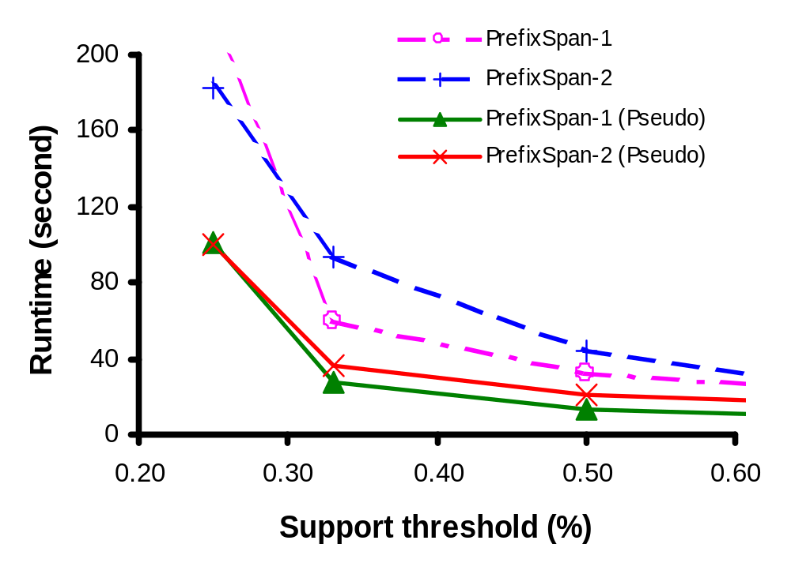
Effect of Pseudo-Projection

Slide 24
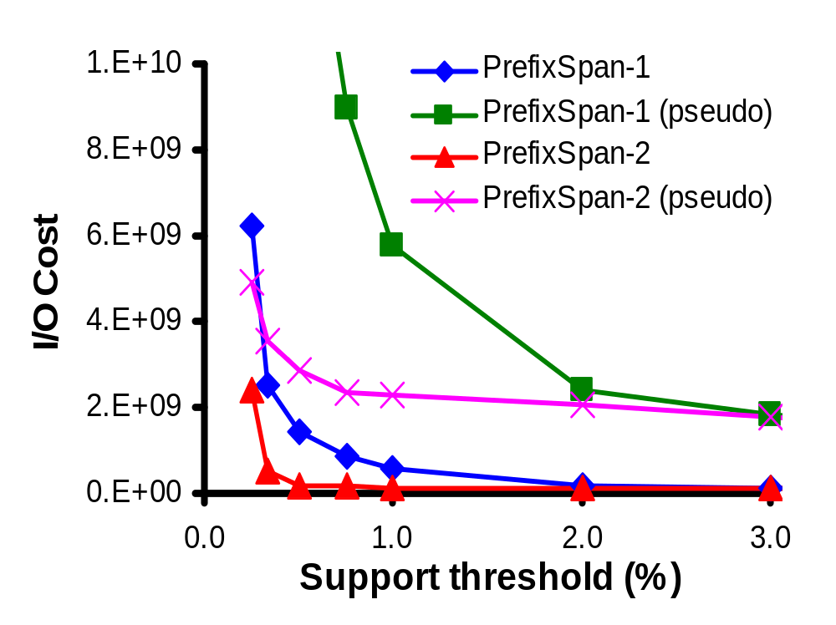
I/O Cost: When It Cannot Fit in Memory

Slide 25
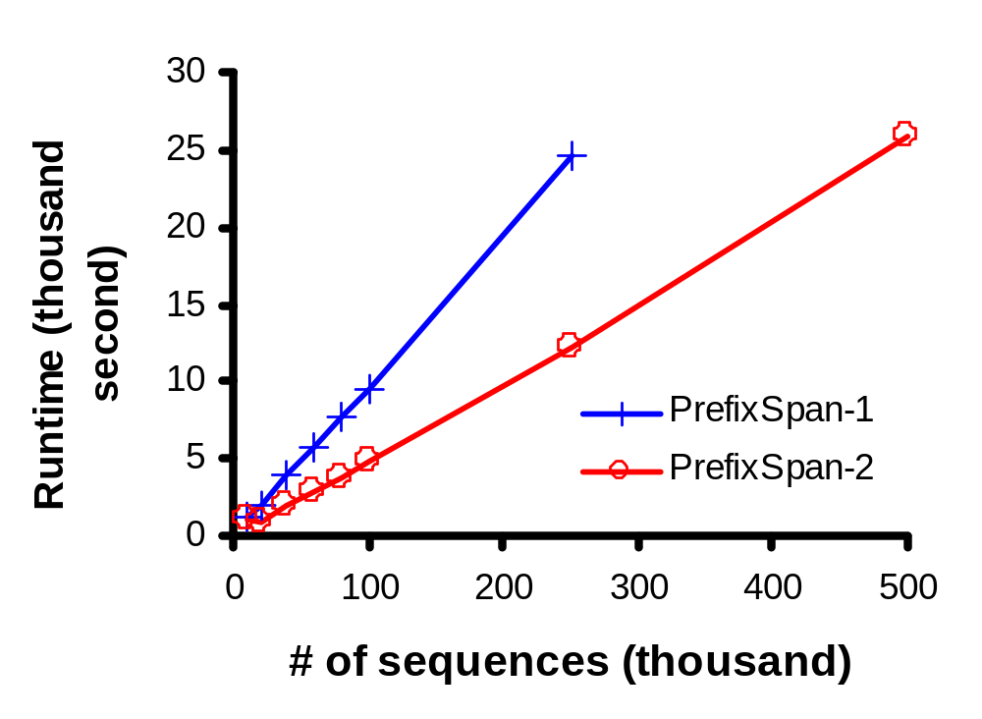
Scalability (When DB Is Large)

Slide 26
Major Features of PrefixSpan
Both PrefixSpan and FreeSpan are pattern-growth methods
  Searches are more focused and thus efficient
Prefix-projected pattern growth (PrefixSpan) is more elegant than frequent pattern-guided projection (FreeSpan)
Apriori heuristic is integrated into bi-level projection PrefixSpan
Pseudo-projection substantially enhances the performance of the memory-based processing

Slide 27
Regular Expression Constraints
Constraints in the form of an automaton
  Deterministic finite automaton for regular expression a*(bb|bcd|dd)
a
b
b
c
d
1
2
3
4
d

Slide 28
PrefixSpan for Constrained Mining
Any prefix failing an RE-constraint cannot lead to a valid pattern
Prune invalid patterns immediately
Only grow prefix satisfying a RE-constraint
Only project items in the remaining of the RE

Slide 29
Conclusions
PrefixSpan: an efficient sequential pattern mining method
  General idea: examine only the prefixes and project only their corresponding postfixes
  Two kinds of projections: level-by-level & bi-level
  Pseudo-projection
Extending PrefixSpan to mine with RE-constraints
  Prune invalid prefix immediately

Slide 30
References (1)
R. Agrawal and R. Srikant. Fast algorithms for mining association rules. VLDB'94, pages 487-499.
R. Agrawal and R. Srikant. Mining sequential patterns. ICDE'95, pages 3-14.
C. Bettini, X. S. Wang, and S. Jajodia. Mining temporal relationships with multiple granularities in time sequences. Data Engineering Bulletin, 21:32-38, 1998.
M. Garofalakis, R. Rastogi, and K. Shim. Spirit: Sequential pattern mining with regular expression constraints. VLDB'99, pages 223-234.
J. Han, G. Dong, and Y. Yin. Efficient mining of partial periodic patterns in time series database. ICDE'99, pages 106-115.
J. Han, J. Pei, B. Mortazavi-Asl, Q. Chen, U. Dayal, and M.-C. Hsu. FreeSpan: Frequent pattern-projected sequential pattern mining. KDD'00, pages 355-359.

Slide 31
References (2)
J. Han, J. Pei, and Y. Yin. Mining frequent patterns without candidate generation. SIGMOD'00, pages 1-12.
H. Lu, J. Han, and L. Feng. Stock movement and n-dimensional intertransaction association rules. DMKD'98, pages 12:1-12:7.
H. Mannila, H. Toivonen, and A. I. Verkamo. Discovery of frequent episodes in event sequences. Data Mining and Knowledge Discovery, 1:259-289, 1997.
B. "Ozden, S. Ramaswamy, and A. Silberschatz. Cyclic association rules. ICDE'98, pages 412-421.
J. Pei, J. Han, B. Mortazavi-Asl, H. Pinto, Q. Chen, U. Dayal, and M.-C. Hsu. PrefixSpan: Mining sequential patterns efficiently by prefix-projected pattern growth. ICDE'01, pages 215-224.
R. Srikant and R. Agrawal. Mining sequential patterns: Generalizations and performance improvements. EDBT'96, pages 3-17.

