Slide 1



Welcome to
Leadership Training
In
VOLVO Battery
Facilitated by
Md. Kaiser Hamid
Management Consultant & Trainer
Cell: 01672420600, kaiser.hr00@yahoo.com
Sunday 25 Feb 2017

Slide 2
iNTRODUCTION

Slide 3
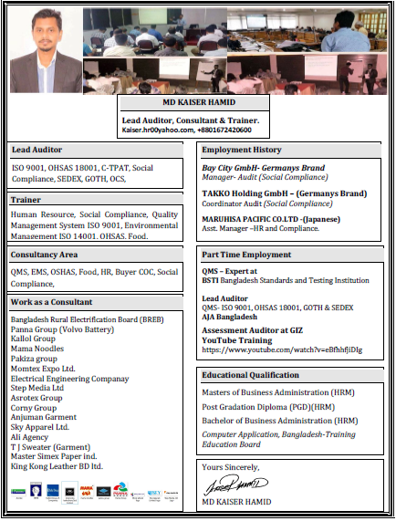

Slide 4
Agenda Items
What is Leadership?
Are Leaders Born or Made?
How to be a Good Leaders
Leadership Principles
Compliment
Some important word
Important qualities of a leader
What do Good leaders do?
Setting Goals
Problem Solving
Leader Vs Boss
Experience Share

Slide 5
What is leadership?
Leading people
Influencing people
Commanding people
Guiding people

Slide 6
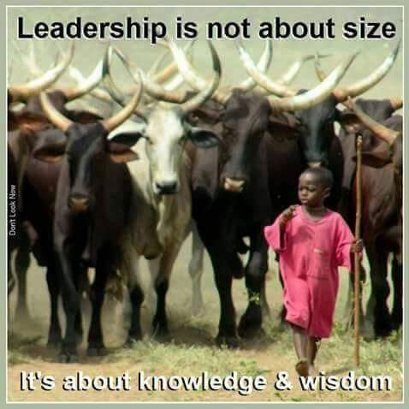

Slide 7
Are Leaders Born or Made?
Good leaders are made not born. If you have the desire and willpower, you can become an effective leader. Good leaders develop through a never ending process of self-study, education, training, and experience.
Notes:
GM
Welcome
Get RAC off to rousing start.

Slide 8
How to be a Good Leader
· Care for your team
· Meet your team
· Train your team
· Grow your team
· Inspire your team
· Celebrate with your team
· Socialize with your team
· Set objectives for each team member
· Review the performance of each team
· Thank constantly
· Be on time
· Accept honest
· Plan your succession
Notes:
GM
Welcome
Get RAC off to rousing start.

Slide 9
Leadership Principles
1 - Show Interest
2 - Positive Approach
3 - Promises
4 - Get the Facts
5 - Explain Why
6 - Admit Mistakes
7- Compliment
Notes:
We will review a dozen or so basics
Principles-
“A Tested Form Of Action”
Can Be Many Different Ones
We Have Listed Several
Need To Practice Them
As a leader-you will have a need to act/re-act to every situation
These are some that will happen and a surveyed method of dealing with them that has a track record of success

Slide 10
The Most Important Words
The six most important words: "I admit I made a mistake."
The five most important words: "You did a good job."
The four most important words: "What is your opinion."
The three most important words: "If you please."
The two most important words: "Thank you,"
The one most important word: "We"
The least most important word: "I"
- Author unknown
Notes:
Information On “Quality Of Leaders Is In The Form Of A Hand Out For You To Read Later.

Slide 11
Important qualities of a leader:
Honesty
integrity
Responsibility
Effective leaders are also inspirational, hard-working, self-aware, confident and service-oriented.
They also have the ability to communicate well.

Slide 12
What do good leaders do?
Help others
Ask for help
Motivate other people
Guide those who need guidance
Establish goals and begin to work toward them
Hold themselves accountable for their group’s actions
Listen to those they are leading

Slide 13
How do leaders improve their leadership skills?
Communication Skill
Team Work
Goals Setting
Problem Solving

Slide 14

Communication Skill

Slide 15
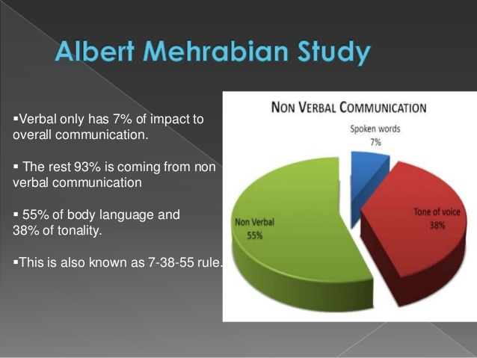
Communication Skill

Slide 16
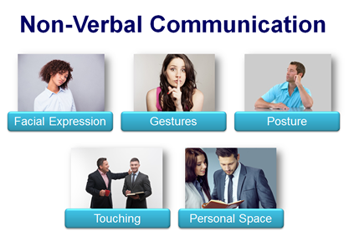
Communication Skill

Slide 17
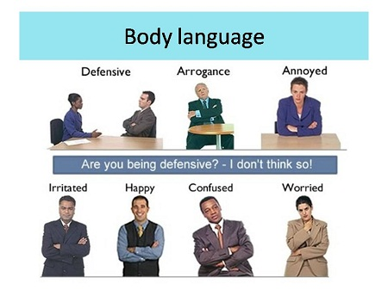
Communication Skill

Slide 18
Game Show
Writing
Jump In Jump Out
Knee Tag

Slide 19
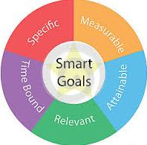
Setting Goals:
Should be SMART

Slide 20
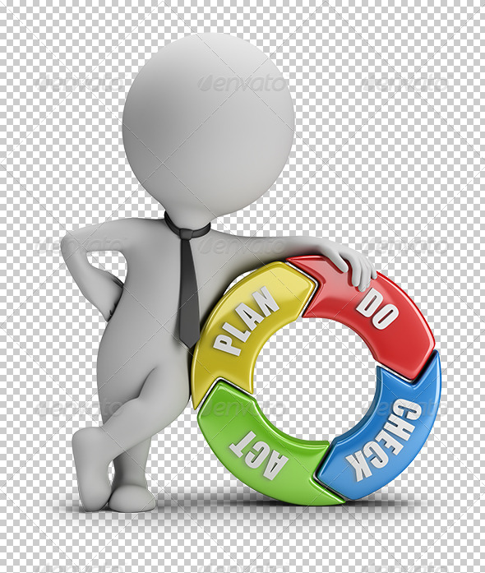
Setting Goals:

Slide 21
Problem solving:
First, create a comfortable environment.
Determine and make clear the problem and issues.
Make sure everyone is aware of the problem.
Plan a solution as a group.
Have everyone agree on the solution
Implement the plan as a group.
Evaluate the solution as a group.
Determine how to avoid new conflict in the future.

Slide 22

Are you Leader or Boss?
YOU ARE!

Slide 23
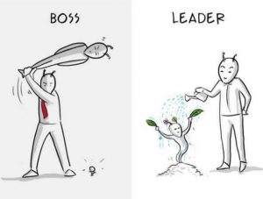
Are you Leader or Boss?

Slide 24
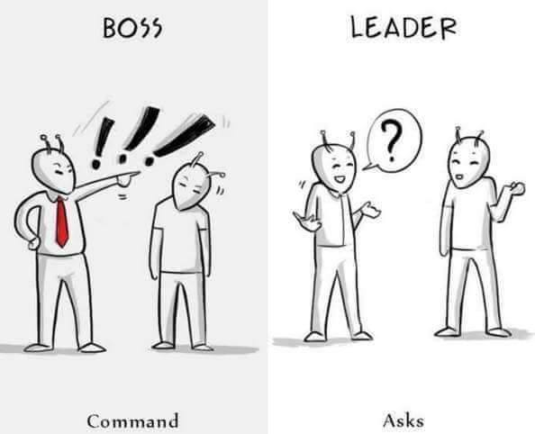
Are you Leader or Boss?

Slide 25
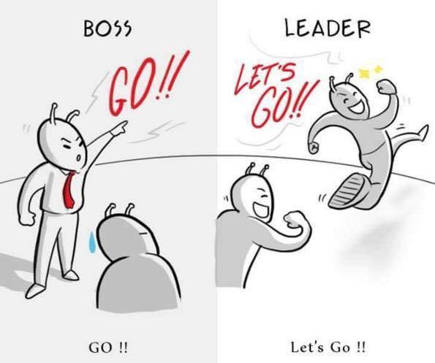
Are you Leader or Boss?

Slide 26
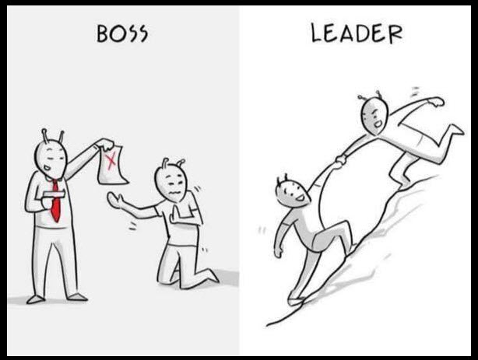
Are you Leader or Boss?

Slide 27
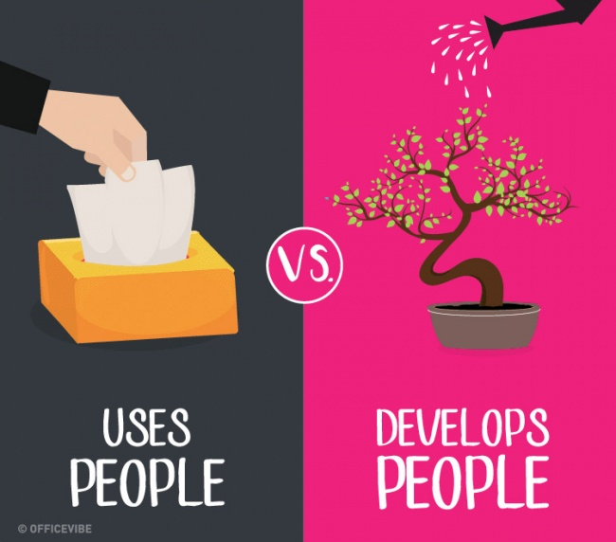
Are you Leader or Boss?

Slide 28
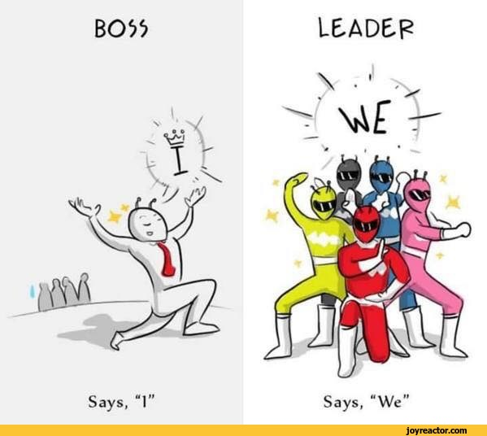
Are you Leader or Boss?

Slide 29
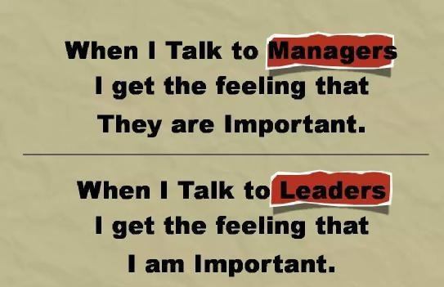
Are you Leader or Boss?

Slide 30
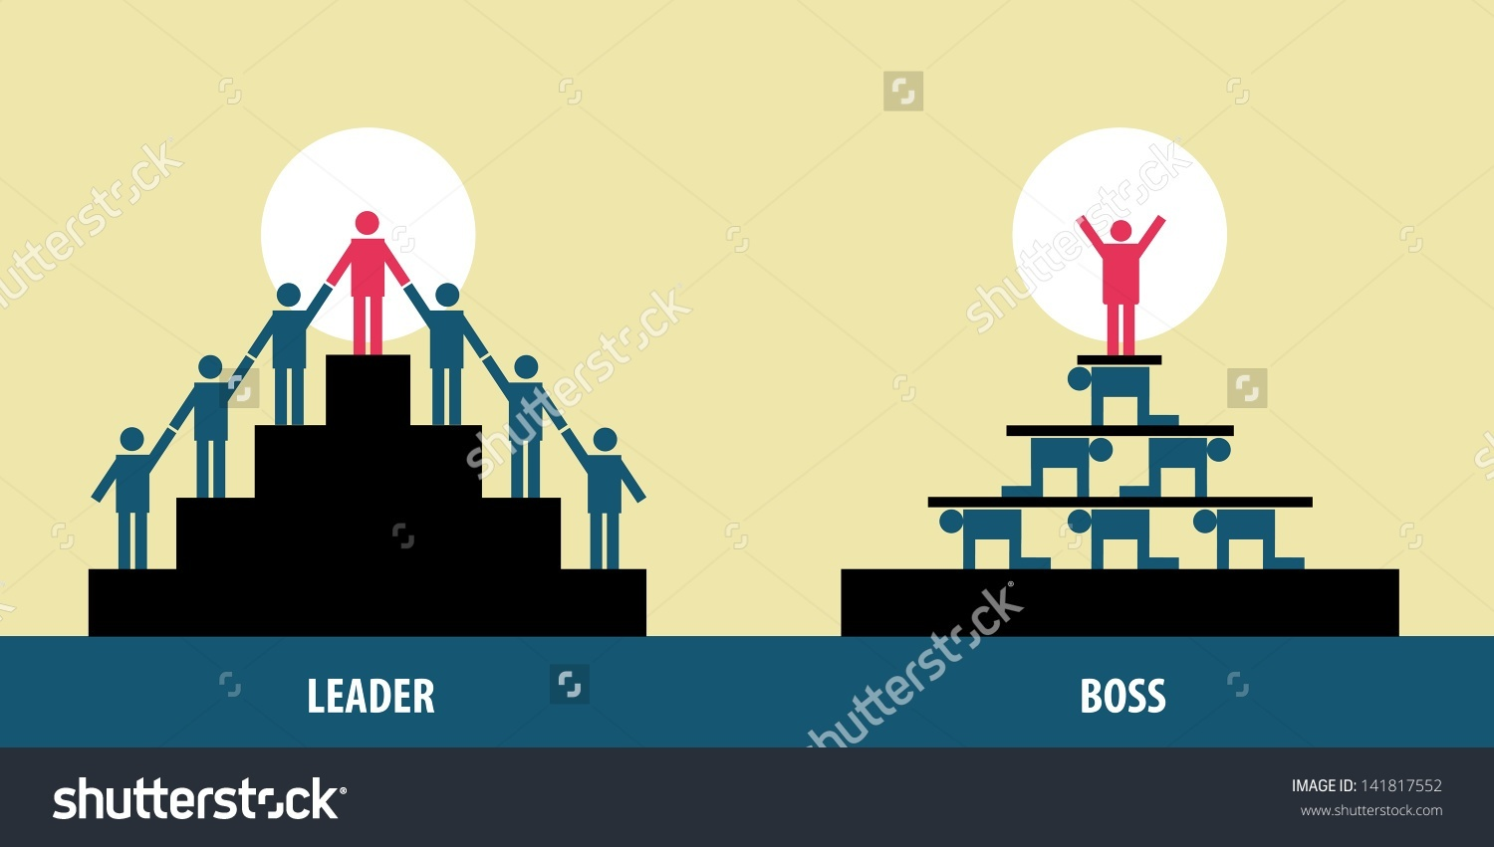
Are you Leader or Boss?

Slide 31
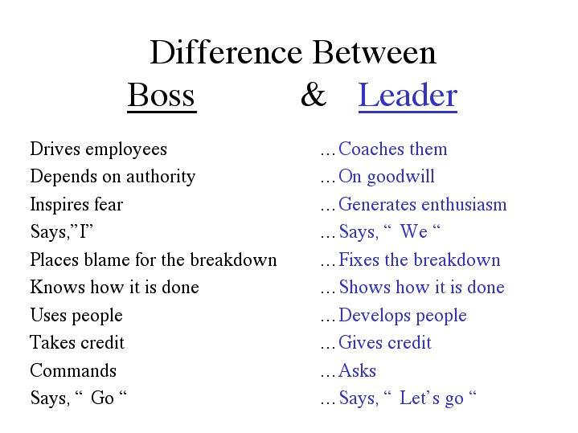
Are you Leader or Boss?

Slide 32
Share Experience

Slide 33


Slide 34


