Slide 1
Systems Analysis & Design
CS183 Spring Semester 2008
Dr. Jonathan Y. Clark
Email: j.y.clark@surrey.ac.uk
Course Website: www.computing.surrey.ac.uk/personal
/st/J.Y.Clark/teaching/sad/cs183.html
Slide <number>

Slide 2
Course Textbook:
Systems Analysis and Design With UML 2.0
An Object-Oriented Approach, Second Edition
Chapter 1:
Introduction to Systems Analysis and Design
Alan Dennis, Barbara Wixom, and David Tegarden
© 2005
John Wiley & Sons, Inc.
Slide <number>

Slide 3
Adapted from slides Copyright © 2005
John Wiley & Sons, Inc.
Slide <number>

Slide 4
INTRODUCTION
Chapter 1
Slide <number>

Slide 5

Key Ideas
Many failed systems were abandoned because analysts tried to build wonderful systems without understanding the organization.
The primarily goal is to create value for the organization.
Quality is satisfaction of requirements, not ‘goodness’
Slide <number>

Slide 6
Key Ideas
The systems analyst is a key person analyzing the business, identifying opportunities for improvement, and designing information systems to implement these ideas.
It is important to understand and develop through practice the skills needed to successfully design and implement new information systems.
Slide <number>

Slide 7
THE SYSTEMS DEVELOPMENT LIFE CYCLE (SDLC)
Slide <number>

Slide 8


Major Attributes of the Lifecycle
The project
  Moves systematically through phases where each phase has a standard set of outputs
  Produces project deliverables
  Uses deliverables in implementation
  Results in actual information system
  Uses gradual refinement
Slide <number>

Slide 9


4 Main Project Phases
Planning
  Why build the system?
Analysis
  What, when, where will the system be?
Design
  How will the system work?
Implementation
  System construction & delivery
Slide <number>

Slide 10
Planning
Identifying business value (is it worth doing?)
Analyze feasibility (is it possible?)
Develop work plan (when?)
Staff the project (who?)
Control and direct project
Slide <number>

Slide 11
Analysis
Analysis (what do we want? Who will use the system?)
Information gathering
Process modelling (what happens?)
Data modelling (… and to what?)
Slide <number>

Slide 12
Design
Design strategy
Architectural design
Interface design (HCI)
Database and file design
Program design (what will the programs do?)
Slide <number>

Slide 13
Implementation
Construction (Programming, testing, validation etc)
Installation (including migration, change management)
Slide <number>

Slide 14
Processes and Deliverables
Process
Product
Project Plan
System Proposal
System
Specification
New System and
Maintenance Plan
Planning
Analysis
Design
Implementation
Slide <number>

Slide 15
SYSTEM DEVELOPMENT Methodologies
Slide <number>

Slide 16
What Is a Methodology?
A formalized approach or series of steps
Writing code without a well-thought-out system request may work for small programs, but rarely works for large ones.
Slide <number>

Slide 17
System Development Methodologies
Structured Design
Rapid Application Development
Agile Development
Slide <number>

Slide 18
1. STRUCTURED DESIGN
Projects move methodically from one to the next step
Generally, a step is finished before the next one begins
Slide <number>

Slide 19
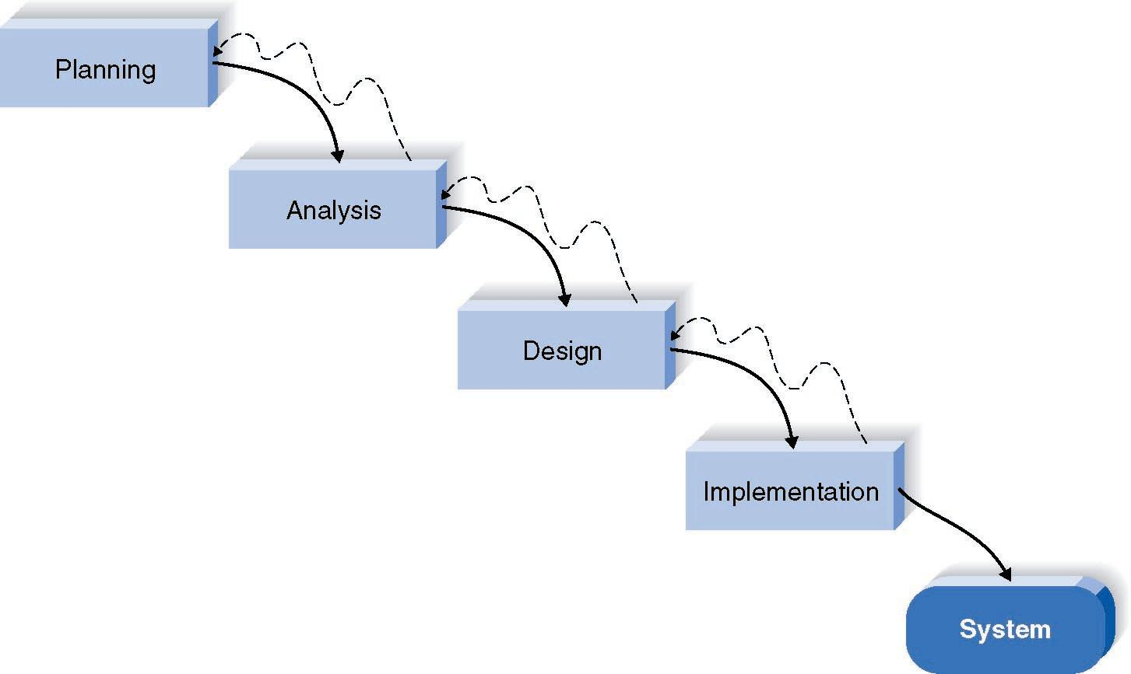
Waterfall Development Method
Slide <number>

Slide 20
Pros and Cons of the Waterfall Method
Pros
Cons
Identifies systems
requirements long
before programming
begins
Design must be
specified on paper
before programming
begins
Long time between
system proposal and
delivery of new
system
Slide <number>

Slide 21
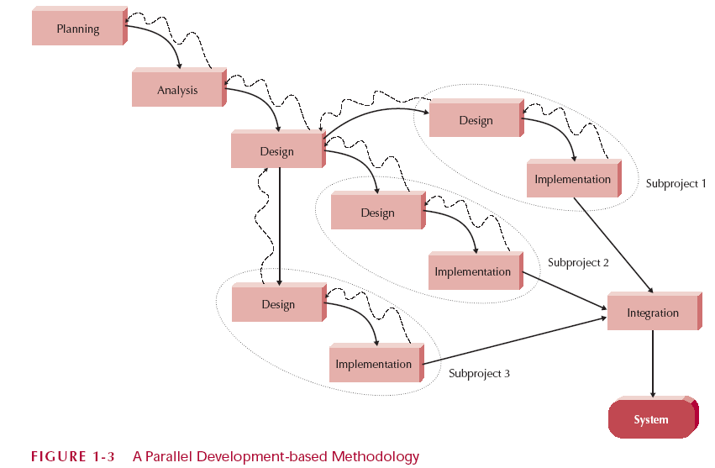
Parallel Development
Slide <number>

Slide 22
2. RAPID APPLICATION DEVELOPMENT (RAD)
Critical elements
  CASE tools
  JAD sessions
  Fourth generation/visualization programming languages
  Code generators
Slide <number>

Slide 23
Rapid Application Development Categories
Phased development
    a series of versions, later combined
Prototyping
    System prototyping
Throw-away prototyping
    Design prototyping
Slide <number>

Slide 24
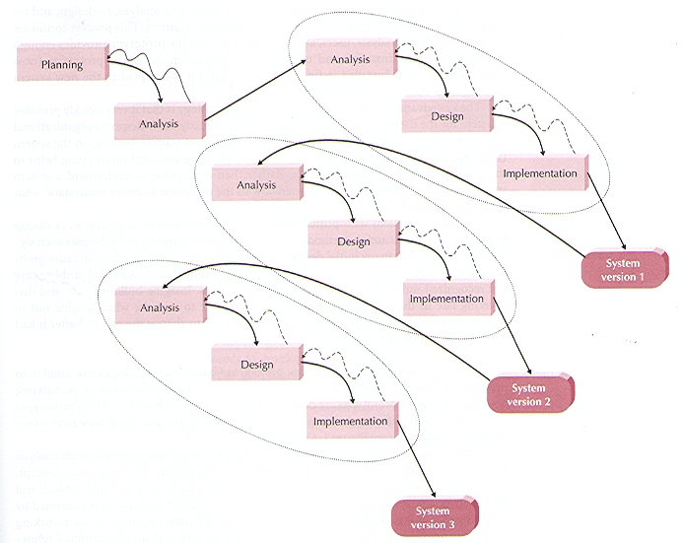
Phased Development
Slide <number>

Slide 25
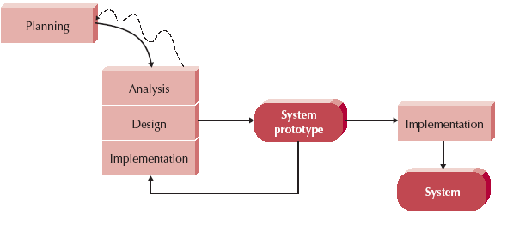
How Prototyping Works
Slide <number>

Slide 26
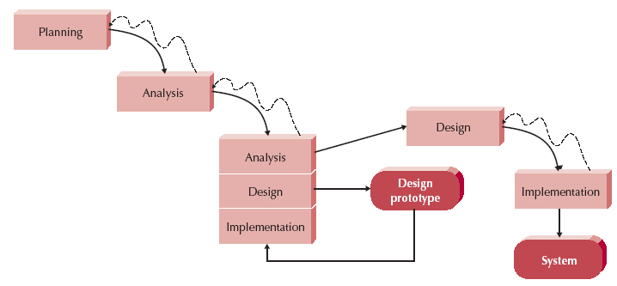
Throwaway Prototyping
Slide <number>

Slide 27
3. AGILE DEVELOPMENT
Simple iterative application development
  Extreme programming (XP)
Slide <number>

Slide 28
Extreme Programming (XP)
Key principles
    Continuous testing
    Simple coding by pairs of developers
    Close interactions with end users
Testing & Efficient Coding Practices
    Integrative testing environment
Requires…
    Stable and experienced teams
    Small groups of developers (<=10)
Slide <number>

Slide 29
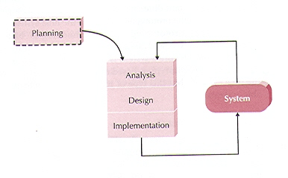
Extreme Programming (XP)
Slide <number>

Slide 30
Selecting the Appropriate Methodology
Clarity of User Requirements
Familiarity with the Technology
System Complexity
System Reliability
Length of Time Schedules
Time Schedule Visibility
Slide <number>

Slide 31
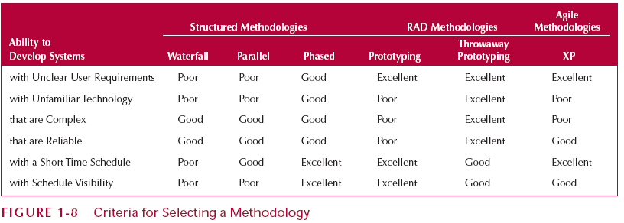
Criteria for Selecting a Methodology
Slide <number>

Slide 32
Project Team Roles and Skills
Slide <number>

Slide 33

Project Team Roles
Business analyst (business value)
Systems analyst (IS issues)
Infrastructure analyst (technical issues – how the system will interact with the organization’s hardware, software, networks, databases)
Change management analyst (people and management issues)
Project manager (budget, time, planning, managing)
Slide <number>

Slide 34



Summary
The Systems Development Life Cycle (SDLC) consists of four stages: Planning, Analysis, Design, and Implementation
The Major Development Methodologies:
  Structured Design
    Waterfall Method
    Parallel Development
  Rapid Application Development (RAD)
    Phased Development
    Prototyping (system prototyping)
    Throwaway Prototyping (design prototyping)
  Agile development
    eXtreme Programming
Project Team Roles
Slide <number>

Slide 35
Summary -- Part 2
There are five major team roles: business analyst
systems analyst
infrastructure analyst
change management analyst
project manager.
Slide <number>

