Slide 1
Chapter 9:
Class and Method Design

Slide 2
Objectives
Become familiar with coupling, cohesion, and connascence.
Be able to specify, restructure, and optimize object designs.
Be able to identify the reuse of predefined classes, libraries, frameworks, and components.
Be able to specify constraints and contracts.
Be able to create a method specification.

Slide 3
BASIC CHARACTERISTICS OF OBJECT ORIENTATION

Slide 4
Elements of OOSAD
Classes
Objects
Attributes
States
Methods
Messages

Slide 5
Encapsulation & Info Hiding
Hiding the content of the object from outside view
Communication only through object’s methods
Key to reusability

Slide 6
Polymorphism & Dynamic Binding
Same message triggers different methods in different objects
Dynamic binding means specific method is selected at run time
Implementation of dynamic binding is language specific
Need to be very careful about run time errors
Need to ensure semantic consistency

Slide 7
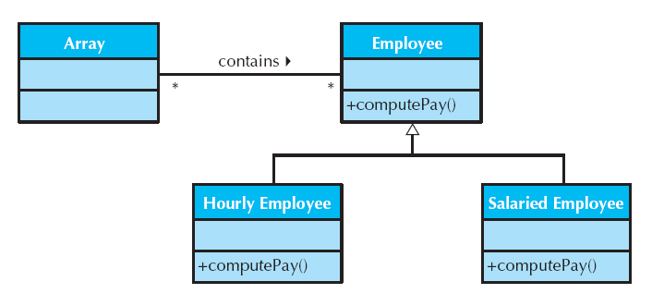
Polymorphism Example

Slide 8
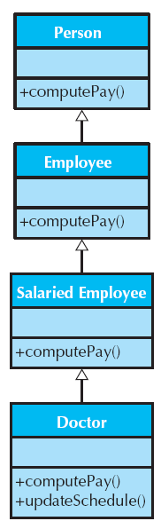
Inheritance
Single inheritance -- one parent class
Multiple inheritance -- multiple parent classes
Redefinition and inheritance conflict
Most inheritance conflicts are due to poor classification

Slide 9
Rumbaugh’s Rules
Query operations should not be redefined
Methods that redefine inherited ones should only restrict the semantics of the inherited ones
The underlying semantics of the inherited method should never be changed
The signature (argument list) of the inherited method should never be changed

Slide 10
DESIGN CRITERIA

Slide 11
Coupling
Interdependency among modules
Interaction coupling through message passing

Slide 12
Law of Demeter
Messages should be sent only by an object:
to itself
to objects contained in attributes of itself or a superclass
to an object that is passed as a parameter to the method
to an object that is created by the method
to an object that is stored in a global variable

Slide 13
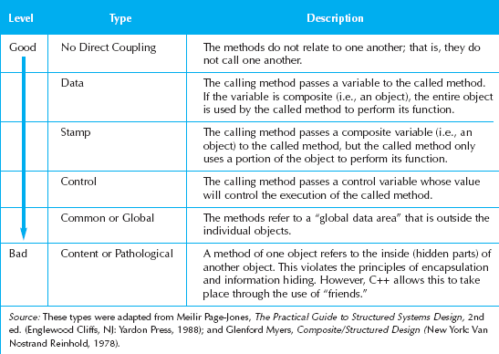
Types of Interactive Coupling

Slide 14
Cohesion
“Single-mindedness of a module”
Method cohesion
Class cohesion

Slide 15
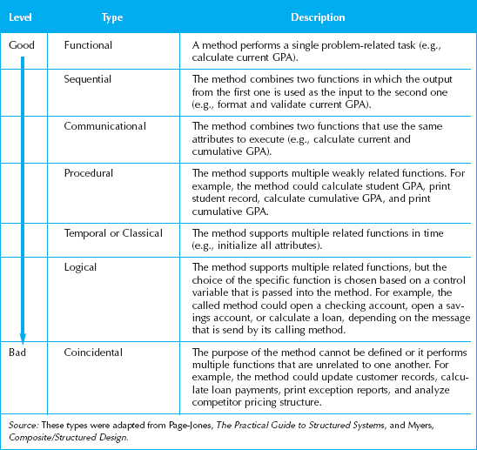
Types of Method Cohesion

Slide 16
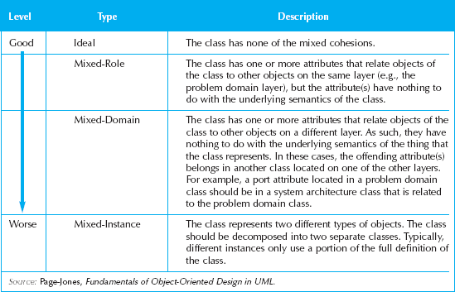
Types of Class Cohesion

Slide 17
Connascence
Creating the need to change another module as a result of changing one
  Minimize overall connascence
  Minimize across encapsulation boundaries
  Maximize within encapsulation boundary

Slide 18
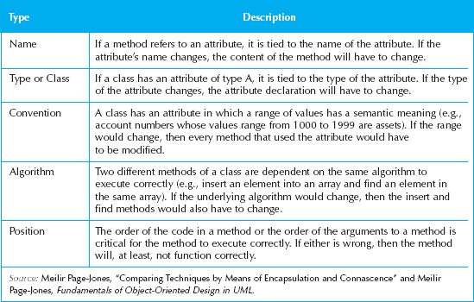
Types of Connascence

Slide 19
OBJECT DESIGN ACTIVITIES

Slide 20
Additional Specification
First review the current set of models
  Sufficient but only necessary classes to solve problem
  No missing attributes or methods
  No extraneous attributes or methods
Examine visibility

Slide 21
Signatures for each method
Name of the method
Parameters or arguments to pass
Type of value the method will return to the calling method

Slide 22
Define constraints
Pre-conditions
Post conditions
Invariants
How to handle violations (exceptions in C++ and Java)?

Slide 23
Identify Opportunities for Reuse
Patterns
Framework
Class libraries
Components

Slide 24
Restructure the Design
Factoring
Map design to current language
Normalization
Assure all inheritance relationships support only generalization/specialization semantics

Slide 25
Optimizing the Design
Review access paths
Review attributes of each class
Review direct and indirect fan-out
Consider execution order of statements in often-used methods
Avoid re-computation by creating derived attributes and triggers

Slide 26
CONSTRAINTS AND CONTRACTS

Slide 27
Types of Constraints
Precondition
  Must be true before the method executes
Post-condition
  Must be true after the method finishes
Invariant
  Must always be true

Slide 28
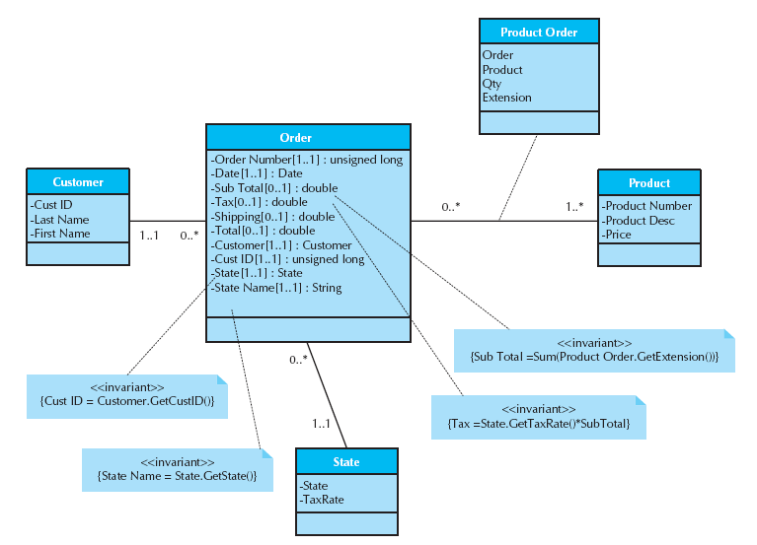
Invariants on a Class Diagram

Slide 29
Contracts
Contracts document message passing between object
A contract is created for each method that is publicly visible in a class
Should contain enough information for the programmer to understand what the method is supposed to do

Slide 30
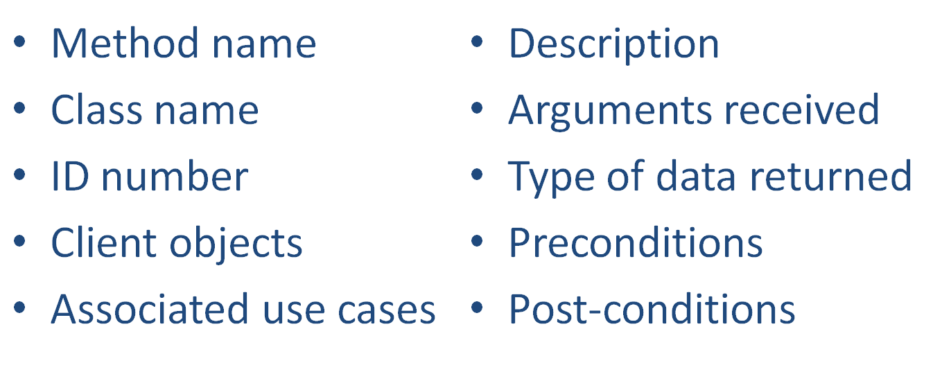
Elements of a Contract

Slide 31
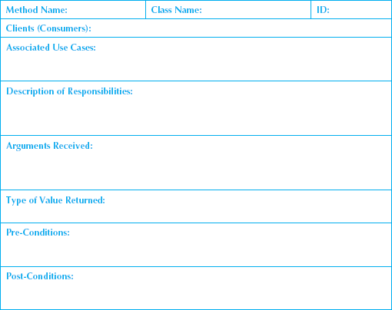
Sample Contract Form

Slide 32
METHOD SPECIFICATION

Slide 33
Method Specification Syntax
No formal syntax specification
General information
Events
Message Passing
Algorithm Specification

Slide 34
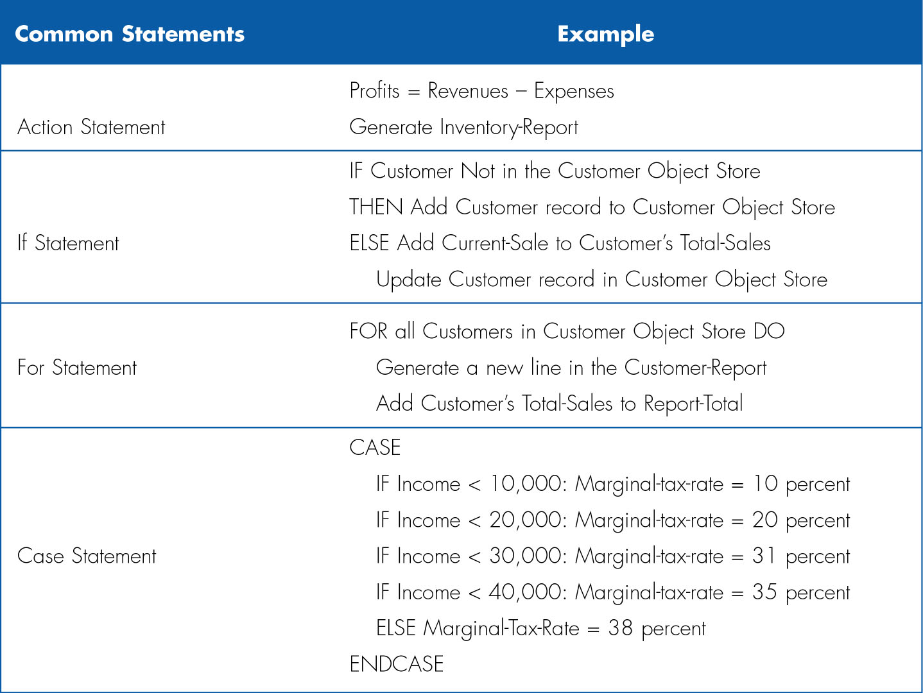
Structured English

Slide 35
Pseudocode Example
(Get CD-info module)
Accept (CD_title) {Required}
Accept (CD_artist) {Required}
Accept (CD_category) {Required}
Accept (CD_length)
Return

Slide 36
Summary
Basic Characteristics of Object Orientation
Design Criteria
Object Design Activities
Constraints and Contracts
Method Specification

