Slide 1
Chapter 10:
Data Management Layer Design

Slide 2
Objectives
Become familiar with several object-persistence formats.
Be able to map problem domain objects to different object-persistence formats.
Be able to apply the steps of normalization to a relational database.
Be able to optimize a relational database for object storage and access.
Become familiar with indexes for relational databases.
Be able to estimate the size of a relational database.
Be able to design the data access and manipulation classes.

Slide 3
The Data Management Layer
Includes both
  data access and manipulation logic, and
  the actual design of the storage
Four-step design approach
  Selecting the format of the storage
  Mapping problem-domain objects to object-persistence format
  optimizing the object-persistence format
  designing the data access & manipulation classes

Slide 4
OBJECT PERSISTENCE FORMATS

Slide 5
Object Persistence Formats
Files (Sequential and Random)
Relational databases
Object-relational databases
Object-oriented databases

Slide 6
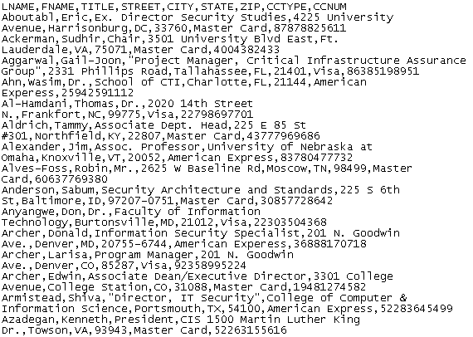
Sample File
Fictitious customer database

Slide 7
Sequential & Random Access Files
Sequential access files allow sequential operations
  Read, write, and search
Efficient for report writing
Searches are not efficient because an average of 50% of records have to be accessed
Two versions
  Ordered
  unordered

Slide 8
Random Access Files
Allow only random or direct file operations
Good for finding and updating a specific object
Inefficient report writing

Slide 9
Application File Types
Master Files
Look-up files
Transaction files
Audit file
History file

Slide 10
Relational Databases
Collection of tables
  Comprised of fields that define entities
  Primary key has unique values in each row of a table
  Foreign key is primary key of another table
Tables related to each other
  Primary key field of a table is a field of another table and called a foreign key
  Relationship established by a foreign key of one table connecting to the primary key of another table

Slide 11
Database Management System
Software that creates and manipulates a database
RDBMS is a DBMS for a relational database
RDBMS usually support Referential Integrity
  the idea of ensuring that values linking the tables together through the primary and foreign keys are valid and correctly synchronized

Slide 12
Referential Integrity Example
The class Customer has an attribute custID
The class Order has an attribute custID that indicates the customer who placed the order
You should not be able to
  create an order for a non-existing customer
  delete a customer who has placed orders, unless there is a policy on what to do with those orders
  change the custID value of a customer, unless you also change the values of his or her orders

Slide 13
The Structured Query Language
Standard language for accessing data in tables
SQL Commands
  Create, edit, and delete tables
  Add, edit, and delete data
  Display data from one or more related tables
  Display data computed from data in one or more related tables
SELECT * FROM customers WHERE custID=77

Slide 14
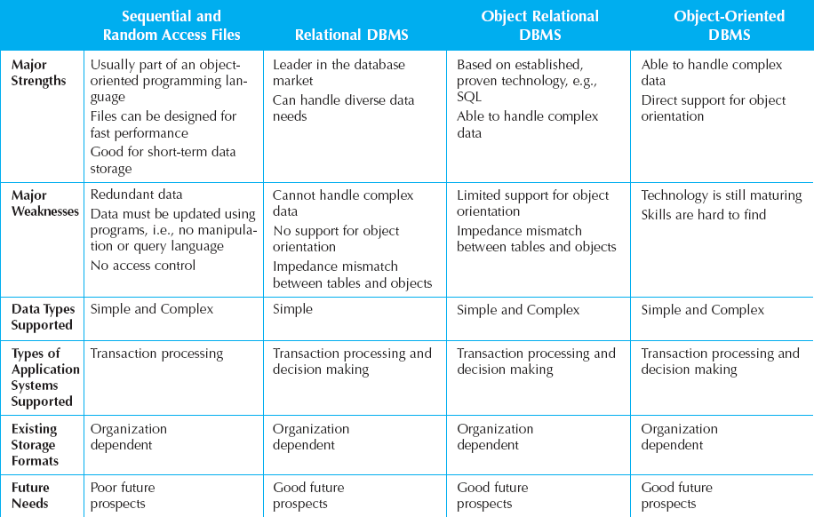
Selecting Persistence Formats

Slide 15
MAPPING PROBLEM-DOMAIN OBJECTS TO OBJECT-PERSISTENCE FORMATS

Slide 16
Mapping PD Classes to RDBMS
Map all concrete problem domain classes to the RDBMS tables.
Map single valued attributes to columns of the tables.
Map methods to stored procedures or to program modules.
Map single-valued aggregation and association relationships to a column that can store the key of the related table
Map multi-valued attributes and repeating groups to new tables and create a one-to-many association from the original table to the new ones.

Slide 17
Mapping PD Classes to RDBMS
Map multi-valued aggregation and association relationships to a new associative table that relates the two original tables together. Copy the primary key from both original tables to the new associative table
For aggregation and association relationships of mixed type, copy the primary key from the single-valued side (1..1 or 0..1) of the relationship to a new column in the table on the multi-valued side (1..* or 0..*) of the relationship that can store the key of the related table
Ensure that the primary key of the subclass instance is the same as the primary key of the superclass..

Slide 18
OPTIMIZING RDBMS-BASED OBJECT STORAGE

Slide 19
Optimizing Storage Efficiency
No redundant data
  Wastes space
  Allows more room for error
Few null values in tables
  Difficult to interpret

Slide 20
Normalization
Tells us how well-formed data is in an RDBMS
Reduces data redundancies
First four levels of normalization are
  0 Normal Form: normalization rules not applied
  1 Normal Form: no multi-valued fields
  2 Normal Form: depend on a whole primary keys
  3 Normal Form: no fields depend on non-primary
  key fields

Slide 21
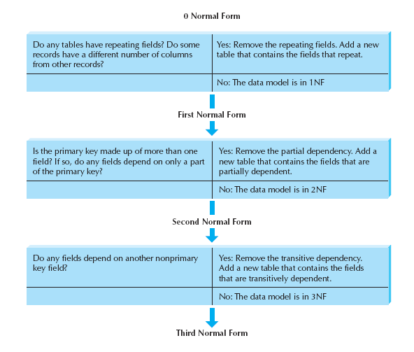
Steps of Normalization

Slide 22
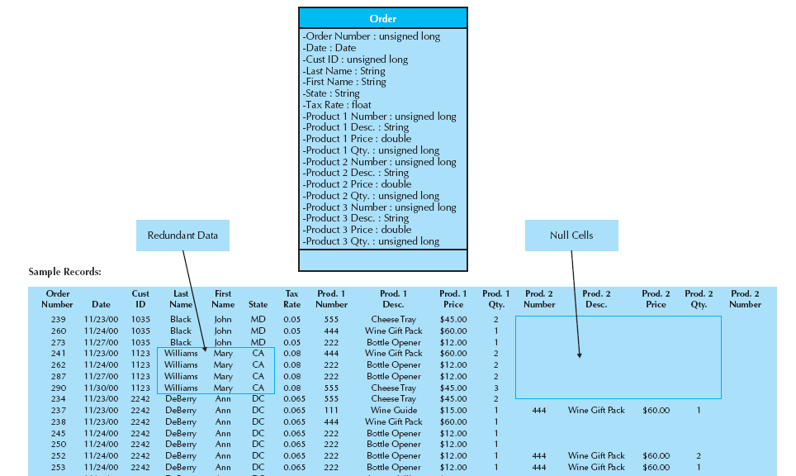
Optimizing Storage Example – 0NF

Slide 23
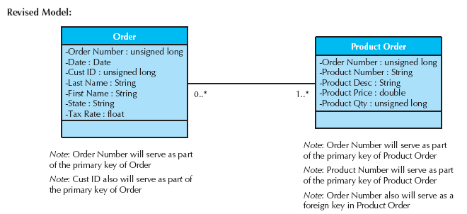
Optimizing Storage Example – 1NF

Slide 24
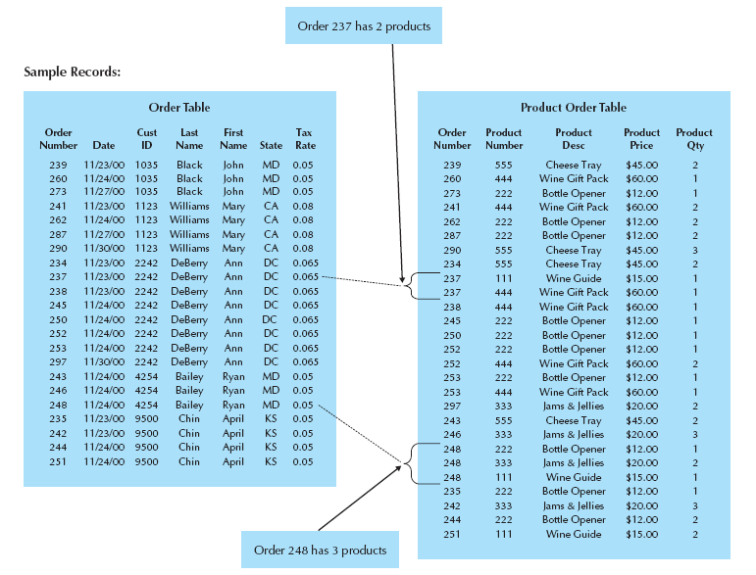
1NF Sample Records

Slide 25
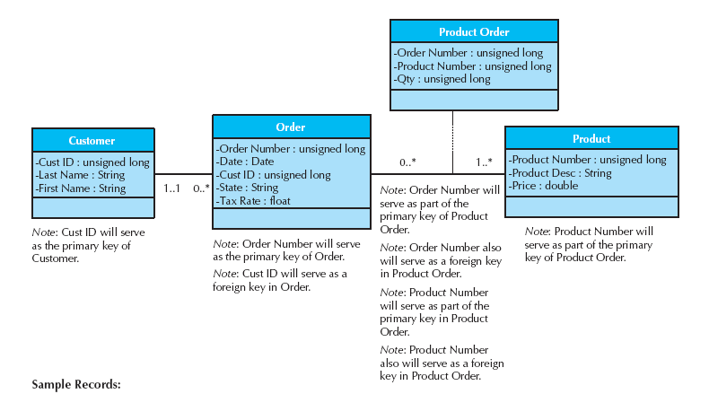
Optimizing Storage Example – 2NF

Slide 26
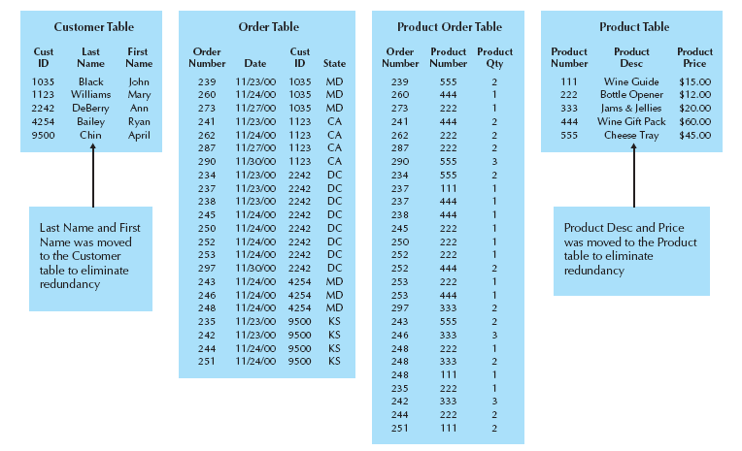
2NF Sample Records

Slide 27
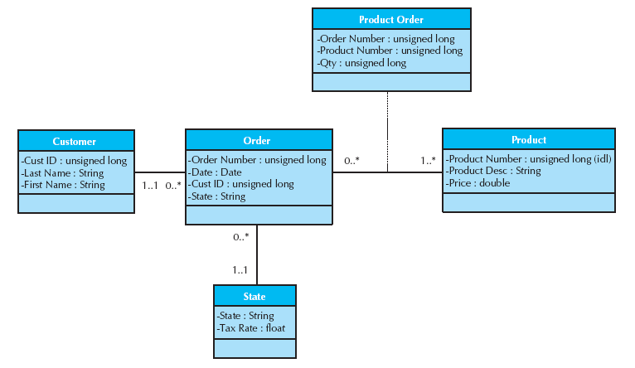
Optimizing Storage Example – 3NF

Slide 28
NONFUNCTIONAL REQUIREMENTS AND DATA MANAGEMENT LAYER DESIGN

Slide 29
Non-Functional Requirements
Operational Requirements
  DAM layer technologies that must be used
Performance Requirements
  DAM layer speed and capacity
Security Requirements
  Access controls, encryption, and backup
Political & Cultural Requirements
  Date formats, currency conversions

Slide 30
DESIGNING DATA ACCESS AND MANIPULATION CLASSES

Slide 31
Data Access & Manipulation
Data access & manipulation (DAM) classes act as a translator between the object-persistence and the problem domain objects
There should be one DAM class for each concrete problem domain class

Slide 32
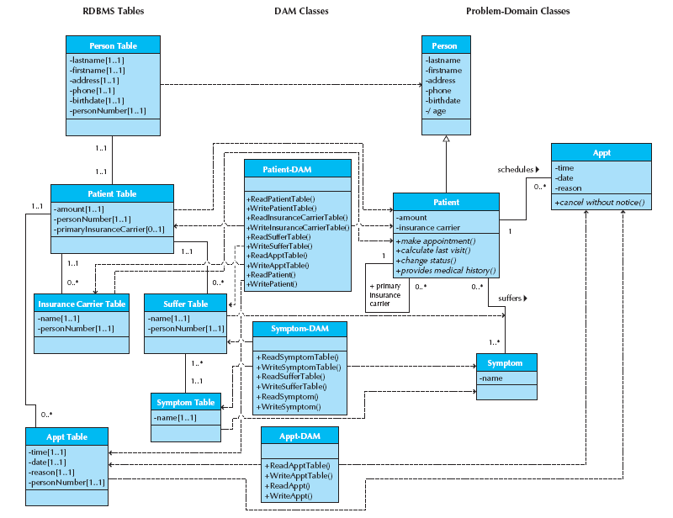
Example DAM Classes

Slide 33
Summary
Object Persistence Formats
Mapping Problem-Domain Objects to Object-Persistence Formats
Optimizing RDBMS-Based Object Storage
Nonfunctional Requirements and Data Management Layer Design
Designing Data Access and Manipulation Classes

