Slide 1
Chapter 6:
Structural Modeling

Slide 2
Objectives
Understand the rules and style guidelines for creating CRC cards, class diagrams, and object diagrams.
Understand the processes used to create CRC cards, class diagrams, and object diagrams.
Be able to create CRC cards, class diagrams, and object diagrams.
Understand the relationship between the structural and use case models.

Slide 3
Structural Model
A formal way of representing the objects that are used and created by a business system
  People
  Places
  Things
Drawn using an iterative process
  First drawn in a conceptual, business-centric way
  Then refined in a technology-centric way describing the actual databases and files

Slide 4
STRUCTURAL MODELS

Slide 5

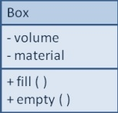
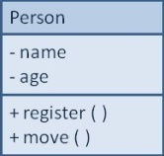
Structural Models
Main goal: to discover the key data contained in the problem domain and to build a structural model of the objects
Structural
Modeling
Solution Domain
Problem Domain

Slide 6
A Common Language
Structural models create a well-defined vocabulary shared by users and analysts
  Classes created during analysis are not the classes that programmers develop during implementation
  This refinement comes later
Typical structural models:
  CRC cards
  Class (and Object) diagrams

Slide 7
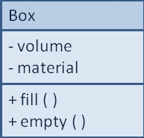
Classes, Attributes, & Operations
Classes
  Templates for instances of people, places, or things
Attributes
  Properties that describe the state of an instance of a class (an object)
Operations
  Actions or functions that a class can perform

Slide 8
Relationships
Describe how classes relate to one another
Three basic types in UML
  Generalization
    Enables inheritance of attributes and operations
  Aggregation
    Relates parts to wholes
  Association
    Miscellaneous relationships between classes

Slide 9
CRC CARDS

Slide 10
Responsibilities & Collaborations
Responsibilities
  Knowing
  Doing
Collaboration
  Objects working together to service a request

Slide 11
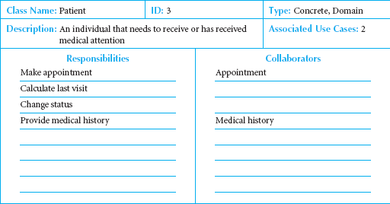
Front-Side of a CRC Card

Slide 12
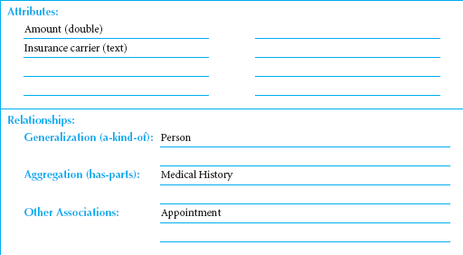
Back-Side of a CRC Card

Slide 13
CLASS DIAGRAMS

Slide 14
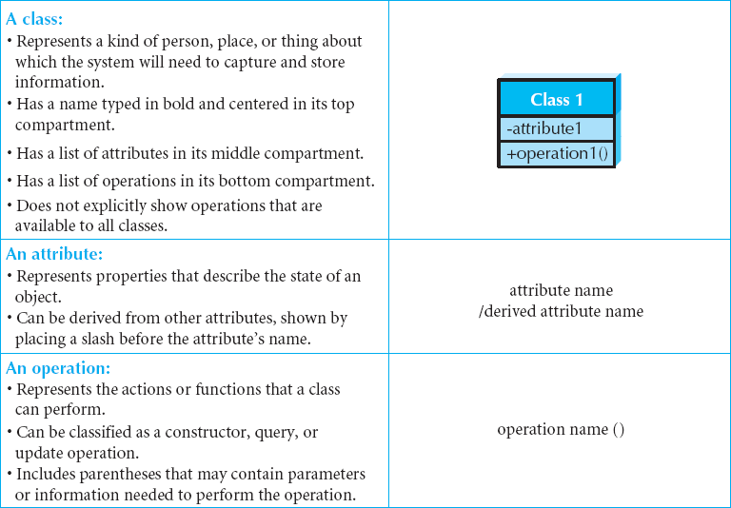
Elements of a Class Diagram

Slide 15
Attribute Visibility
Attribute visibility can be specified in the class diagram
  Public attributes (+) are visible to all classes
  Private attributes (-) are visible only to an instance of the class in which they are defined
  Protected attributes (#) are like private attributes, but are also visible to descendant classes
Visibility helps restrict access to the attributes and thus ensure consistency and integrity

Slide 16
Operations
Constructor
  Creates object
Query
  Makes information about state available
Update
  Changes values of some or all attributes

Slide 17
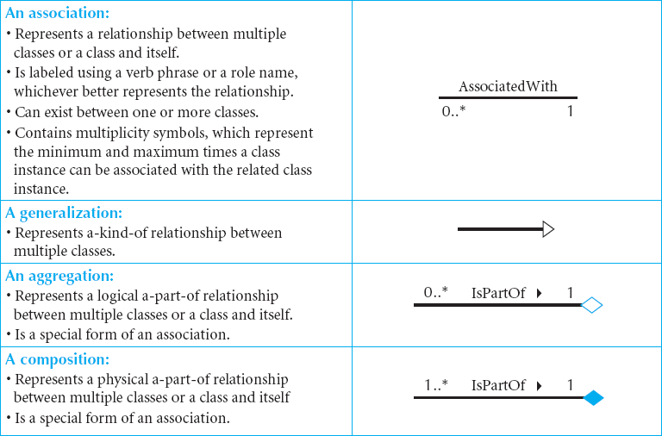
More Elements of Class Diagrams

Slide 18
Multiplicities
Department
Boss
Exactly one:
A department has one and only one boss
1
1
Employee
Child
Zero or more:
An employee has zero to many children
1
0..*
Boss
Employee
One or more:
A boss is responsible for one or more employees
1
1..*

Slide 19
More Multiplicities
Employee
Spouse
Zero or one:
An employee can be married to 0 or 1 spouse
1
0..1
Employee
Vacation
Specified range:
An employee can take 2 to 4 vacations each year
1
2..4
Employee
Committee
Multiple disjoint ranges:
An employee can be in 1 to 3 or 5 committees
1
1..3, 5

Slide 20
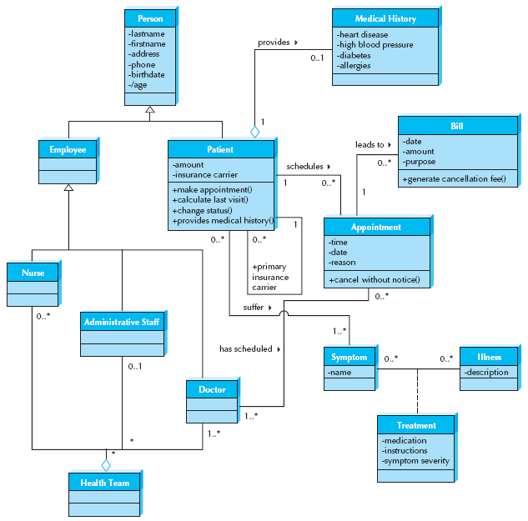
Sample Class Diagram

Slide 21
Simplifying Class Diagrams
Fully populated class diagrams of real-world system can be difficult to understand
Common ways of simplifying class diagrams:
  Show only concrete classes
  The view mechanism shows a subset of classes
  Packages show aggregations of classes (or any elements in UML)

Slide 22
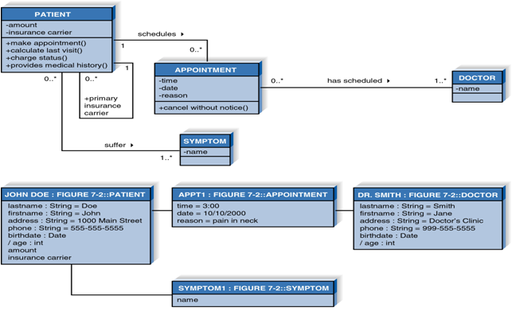
Object Diagrams

Slide 23
CREATING CRC CARDS AND CLASS DIAGRAMS

Slide 24
Object Identification
Textual analysis of use-case information
  Nouns suggest classes
  Verbs suggest operations
Creates a rough first cut
Common object list
Incidents
Roles

Slide 25
Patterns
Useful groupings of classes that recur in various situations
Transactions
  Transaction class
  Transaction line item class
  Item class
  Location class
  Participant class

Slide 26
7 Steps to Structural Models
Create CRC Cards
Examine common object lists
Role-play the CRC cards
Create the class diagram
Review the class diagram
Incorporate patterns
Review the model

Slide 27
Summary
Structural Models
CRC Cards
Class Diagrams
Creating CRC Cards and Class Diagrams

