Slide 1
Systems Analysis & Design
CS183 Spring Semester 2008
Dr. Jonathan Y. Clark
Email: j.y.clark@surrey.ac.uk
Course Website: www.computing.surrey.ac.uk/personal
/st/J.Y.Clark/teaching/sad/cs183.html
Slide <number>

Slide 2
Course Textbook:
Systems Analysis and Design With UML 2.0
An Object-Oriented Approach, Second Edition
Chapter 6:
Functional Modelling
Slide <number>

Slide 3
Adapted from slides © 2005
John Wiley & Sons, Inc.
Slide <number>

Slide 4
Objectives
■ Understand the rules and style guidelines for use cases and use case diagrams.
■ Understand the process used to create use cases and use case diagrams.
Slide <number>

Slide 5
USE-CASE DESCRIPTIONS
Slide <number>

Slide 6

Key Ideas
A use case illustrates the activities that are performed by users of a system.
Use cases are logical models -- they describe the activities of a system without specifying how the activities are implemented.
Slide <number>

Slide 7


What are Use-Case Descriptions?
Describe basic functions of the system
  What the user can do
  How the system responds
Use cases are building blocks for continued design activities.
Slide <number>

Slide 8


How Are Use-Cases Created?
Two steps:
  1. Write text-based use case
  descriptions
  2. Translate descriptions into
  use case diagrams
Describes one and only one function, but may have multiple paths.
Developed by working with users for content.
Slide <number>

Slide 9
Types of Use-Cases
Overview versus detail
  ■ The use case represents an important business process.
  ■ The use case supports revenue generation or cost reduction.
  ■ Technology needed to support the use case is new or risky and therefore will require considerable research.
Essential versus real
Slide <number>

Slide 10
Elements of a Use-Case Description
Use Case Name: ID: Importance Level:
Primary Actor: Use Case Type:
Stakeholders and Interests:
Brief Description:
Trigger:
Relationships: (Association, Include, Extend, Generalization)
Normal Flow of Events:
Subflows:
Alternate/Exceptional Flows:
Slide <number>

Slide 11
USE-CASE DIAGRAMS
Slide <number>

Slide 12
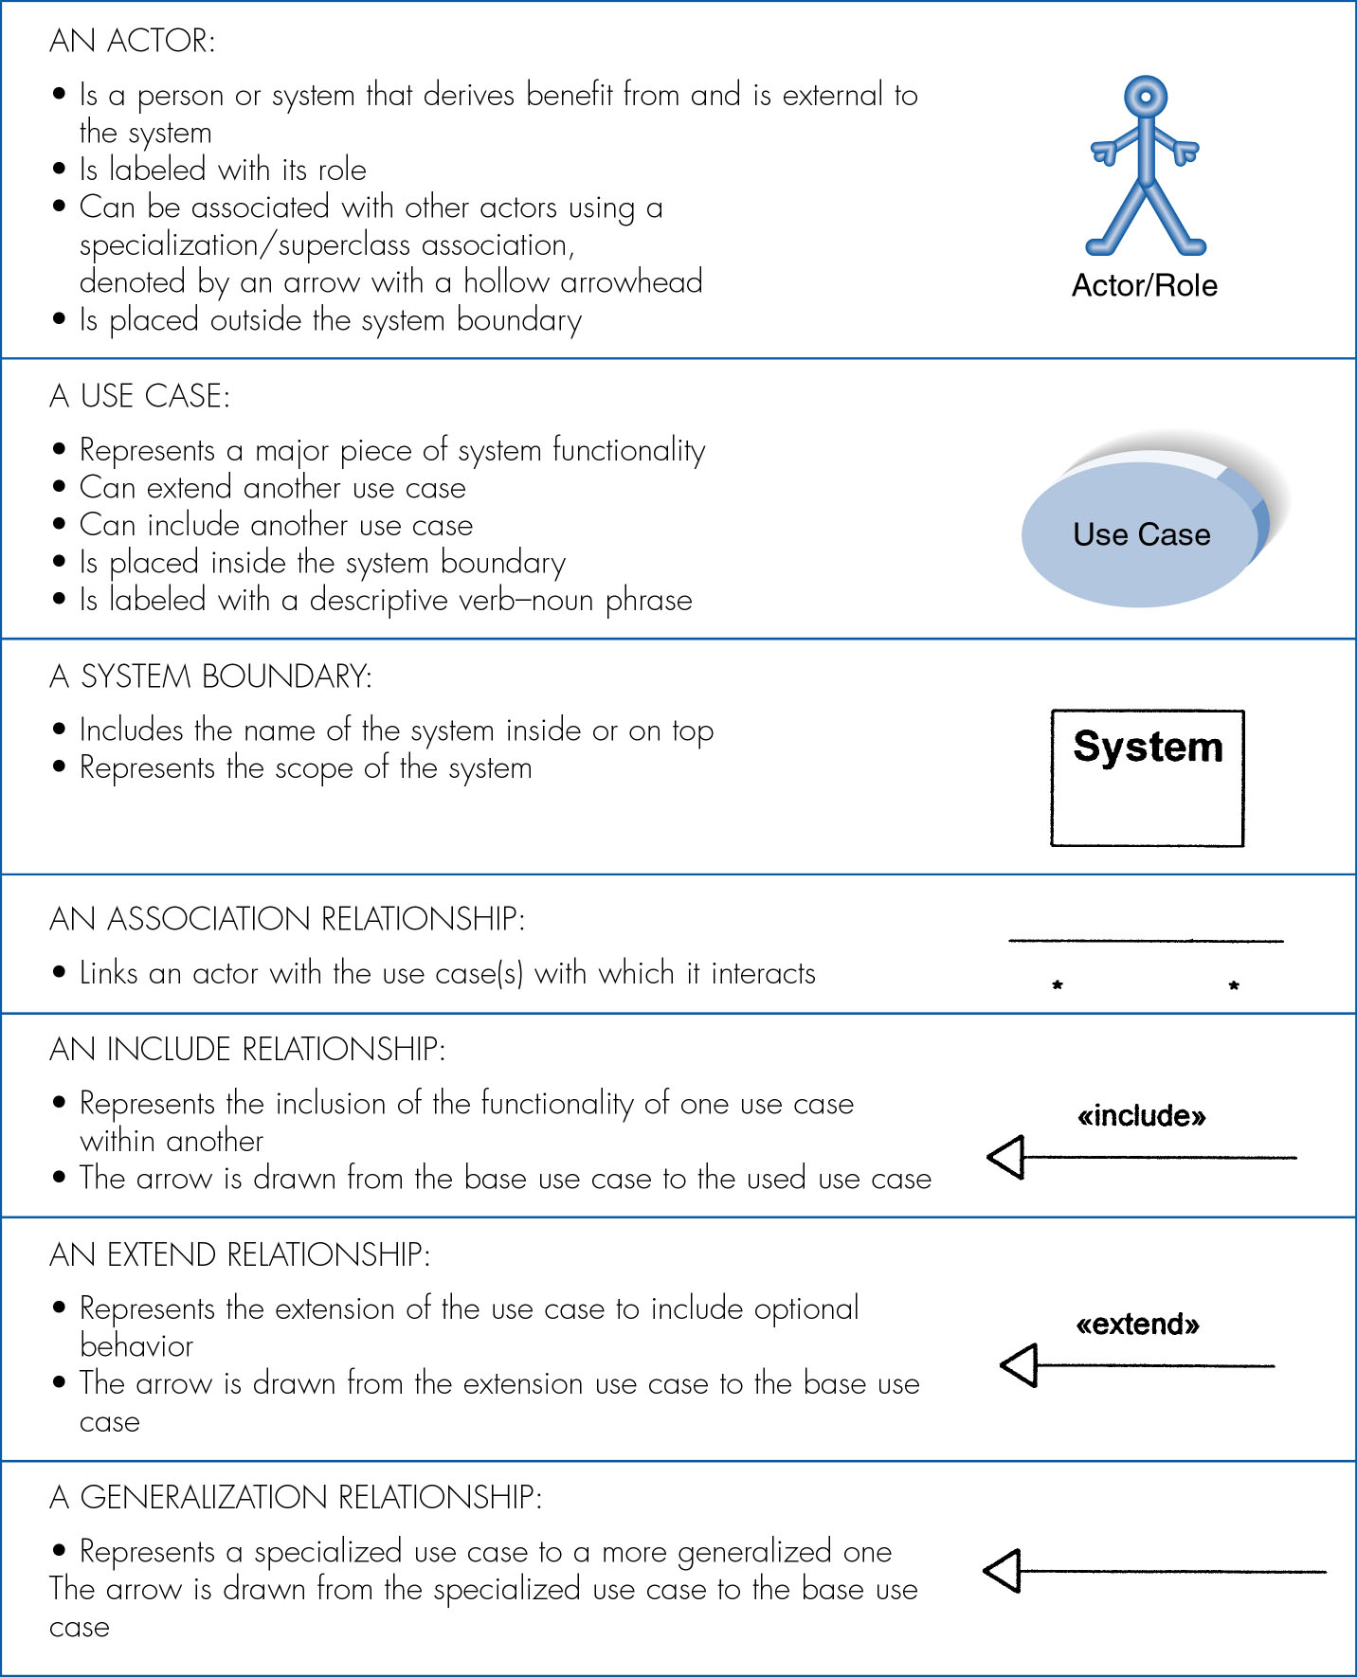
Use-Case Diagram Syntax
Slide <number>

Slide 13
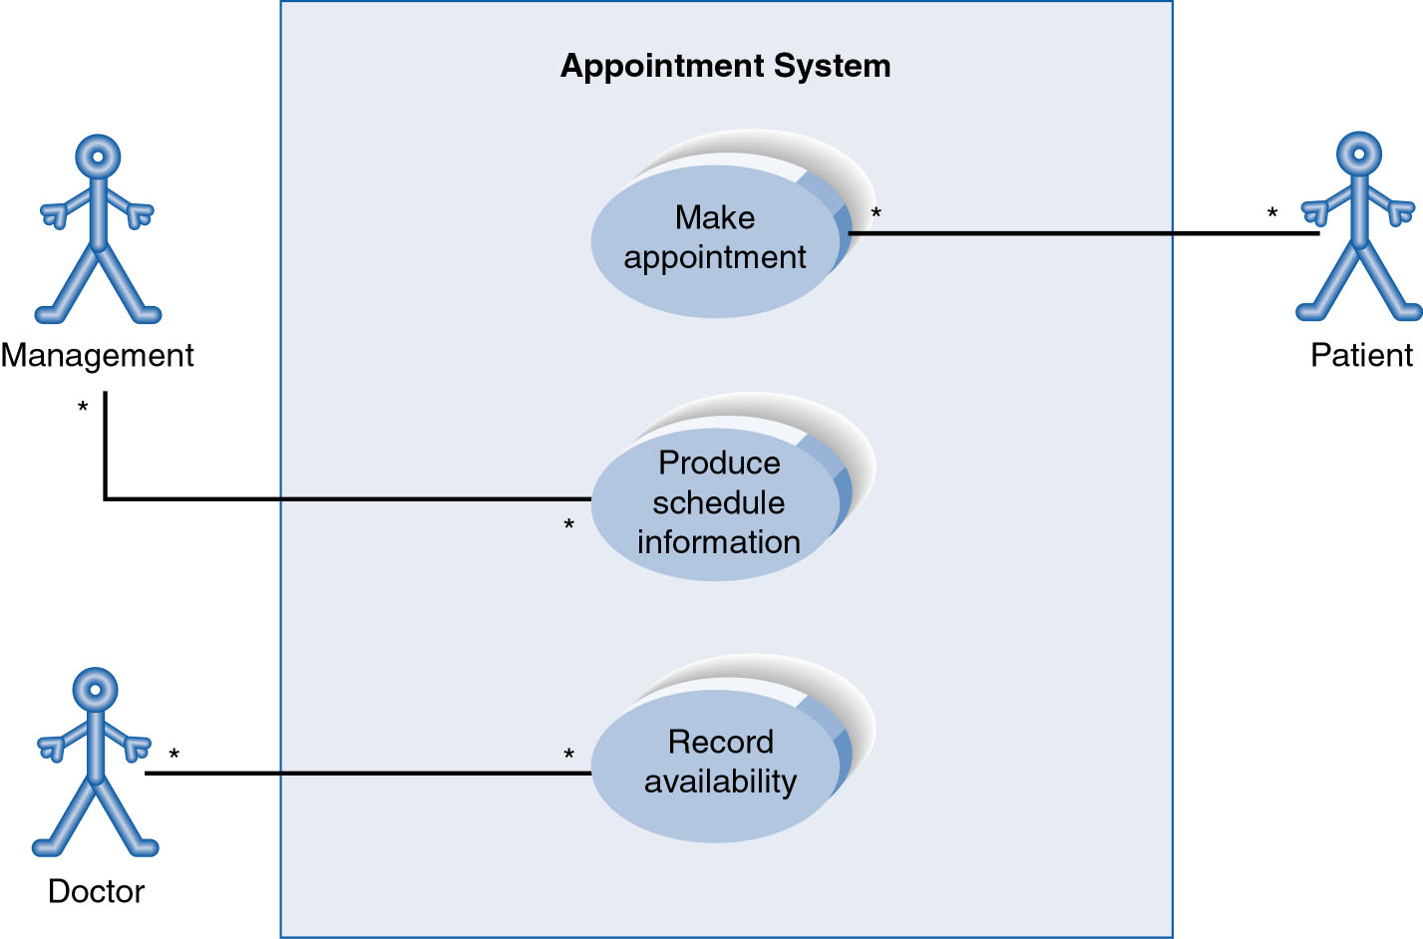
The Use-Case Diagram for Appointment System
Slide <number>

Slide 14
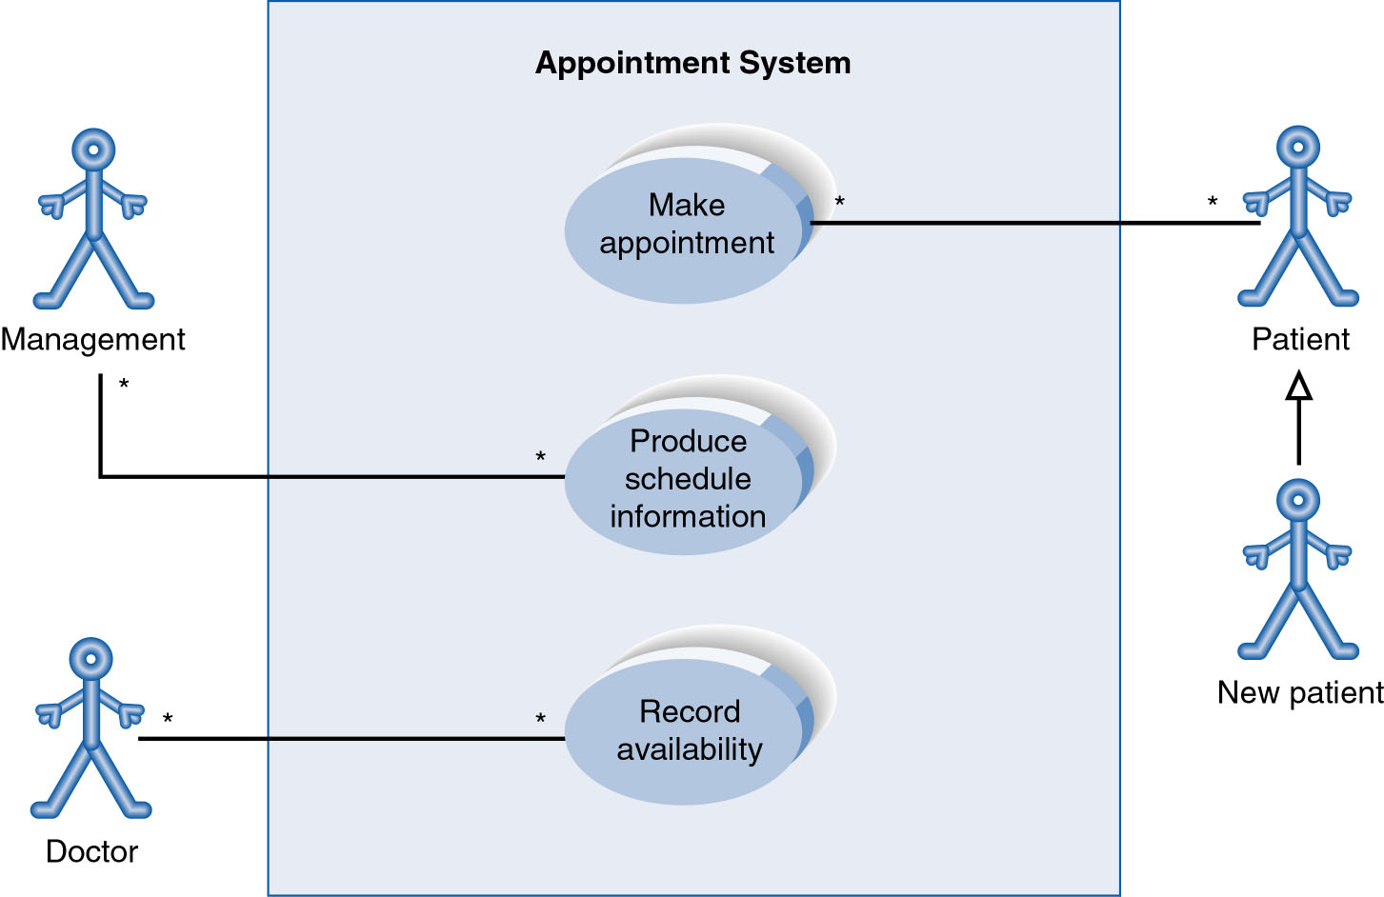
Use-Case Diagram with Specialised Actor
Slide <number>

Slide 15
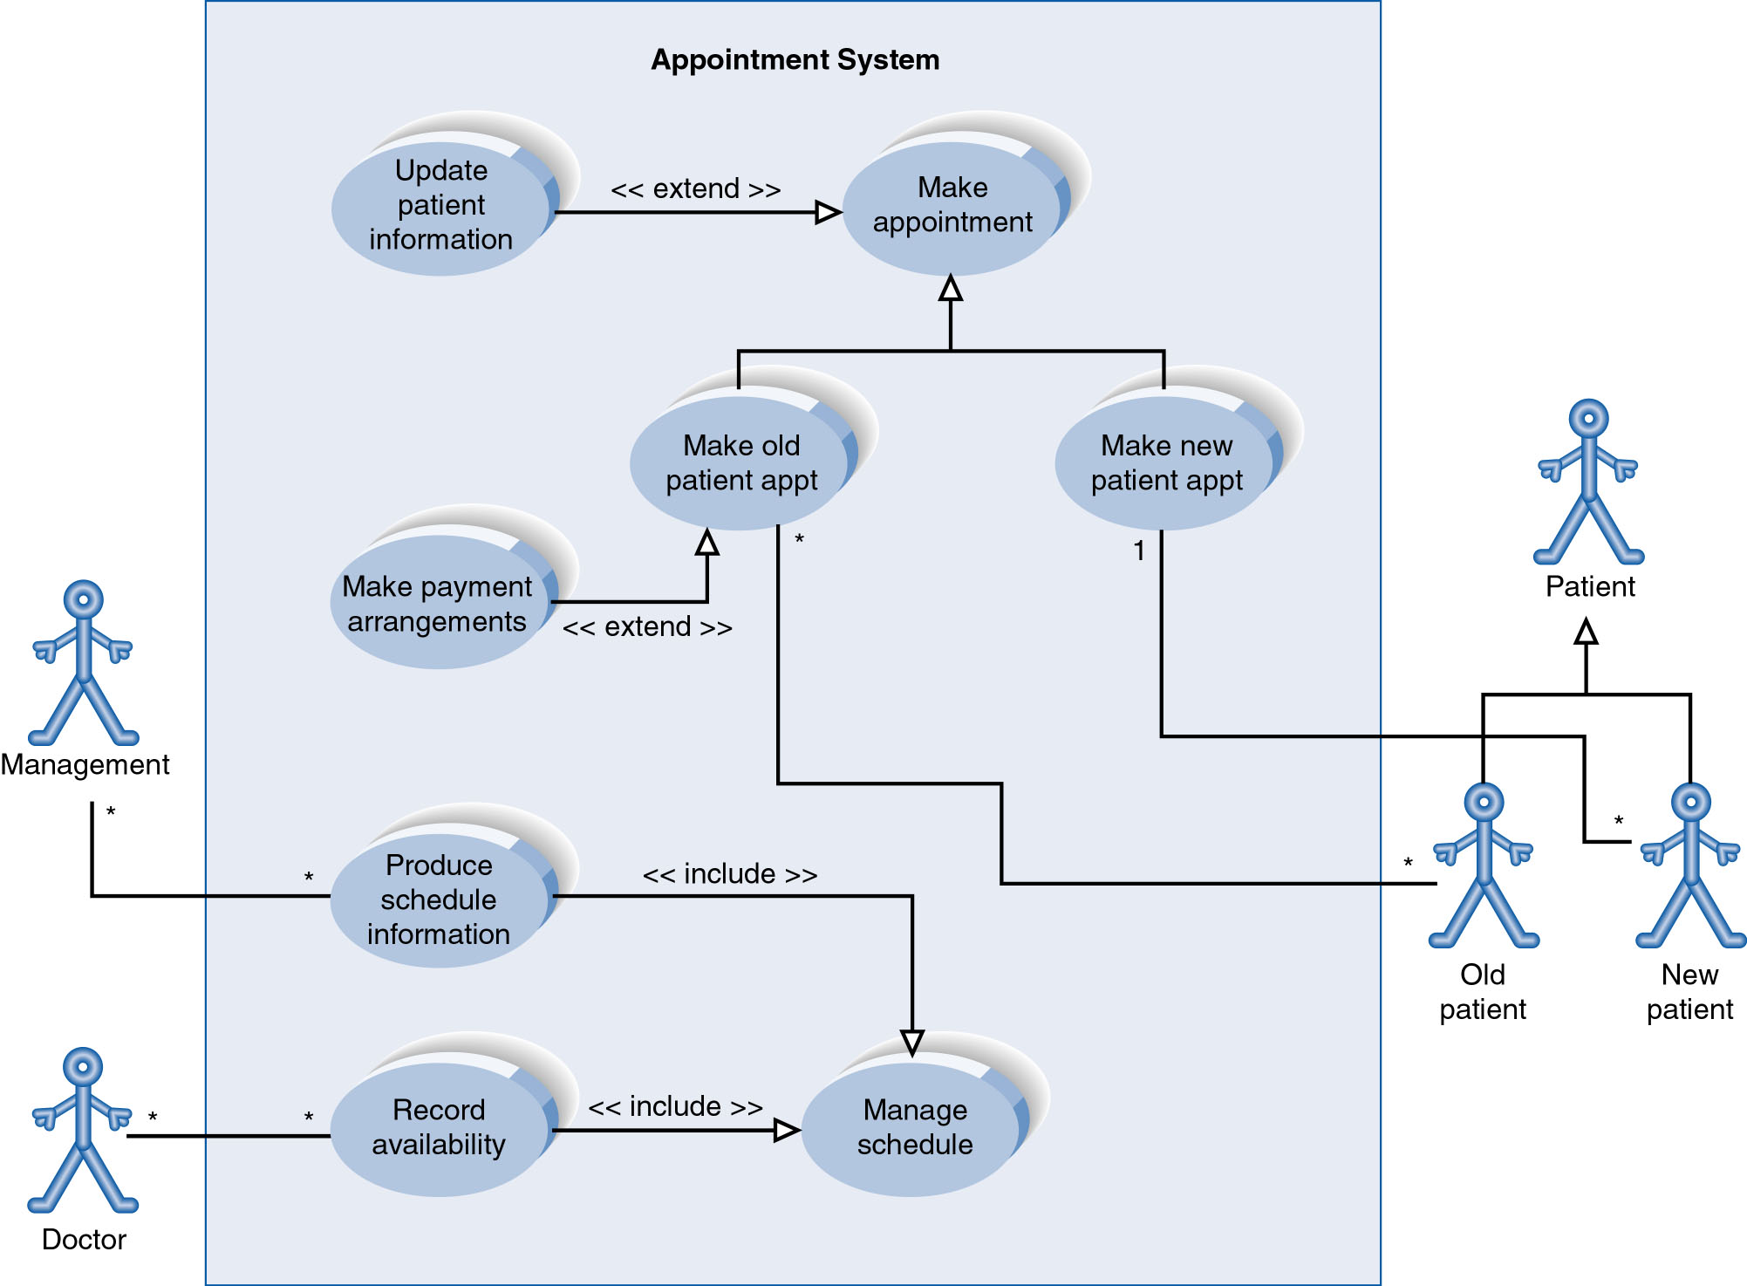
Extend and Include Relationships
Slide <number>

Slide 16
CREATING USE-CASE DESCRIPTIONS AND USE-CASE DIAGRAMS
Slide <number>

Slide 17
4 Major Steps in
Writing Use-Cases...
1. Identify the major use-cases
2. Expand the major use-case
3. Confirm the major use-cases
4. Create the use-case diagram
Slide <number>
Notes:
As can be seen by comparing this list to figure 6-7, it is a very high level
summary. Teachers of this material might want to spend significant time reviewing
what happens in each of these steps.

Slide 18
Identifying the
Major Use-Cases
Identify the system’s boundaries
List the primary actors
List the goals of each primary actor
Identify and write the major use-cases
Carefully review use-cases
Slide <number>

Slide 19
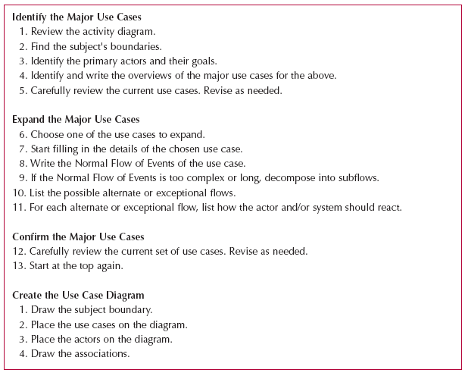
Writing Effective Use-Case Descriptions
Slide <number>

Slide 20
2. Expand the Major Use-Cases
Choose one major use-case to expand
Fill in details on the use-case template
Fill in the steps of the normal flow of events
Normalize the size of each step
Describe alternate or exceptional flows
Simplify and organize as necessary
Slide <number>

Slide 21

3. Confirm the Major Use Cases
Review the current set
  Consider semantics and syntax
  Helpful to involve the users
Iterate the entire set of steps until all use cases are defined
Slide <number>

Slide 22
4. Create the
Use-Case Diagram
Start with system boundary
Place elements in order to be easy to read
Place actors on the diagram
Conclude by connecting actors to use cases by lines
Slide <number>

Slide 23
Summary
Use-case descriptions are the basis for further analysis and design. They are created based on 7 guidelines and 13 steps.
Use-case diagrams present a graphical overview of the main functionality of a system.
Slide <number>

