Slide 1
Systems Analysis & Design
CS183 Spring Semester
Dr. Jonathan Y. Clark
Email: j.y.clark@surrey.ac.uk
Course Website: www.computing.surrey.ac.uk/personal
/st/J.Y.Clark/teaching/sad/cs183.html

Slide 2
Course Textbook:
Systems Analysis and Design With UML 2.0
An Object-Oriented Approach, Second Edition
Chapter 7:
Behavioural Modelling

Slide 3
Adapted from slides © 2005
John Wiley & Sons, Inc.

Slide 4

Key Ideas
Behavioral models describe the internal dynamic aspects of an information system that supports business processes in an organization
Key UML behavioral models are: sequence diagrams and behavioural state machines

Slide 5
Objectives
■ Understand the rules and style guidelines for sequence diagrams and behavioral state machines.
■ Understand the processes used to create sequence diagrams and behavioral state machines.
■ Be able to create sequence diagrams and behavioral state machines.
■ Understand the relationship between the behavioral models and the structural and functional models.

Slide 6
BEHAVIORAL MODELS

Slide 7
Purpose of Behavioral Models
Show how objects collaborate to support each use case in the structural model
Depict the internal view of the business process
To show the effects of varied processes on the system

Slide 8

Interaction Diagram Components
Objects
  Instance of a class
Operations
  Send and receive messages
Messages
  Tell object to execute a behavior

Slide 9
Sequence Diagrams
Illustrate the objects that participate in a use-case
Show the messages that pass between objects for a particular use-case

Slide 10
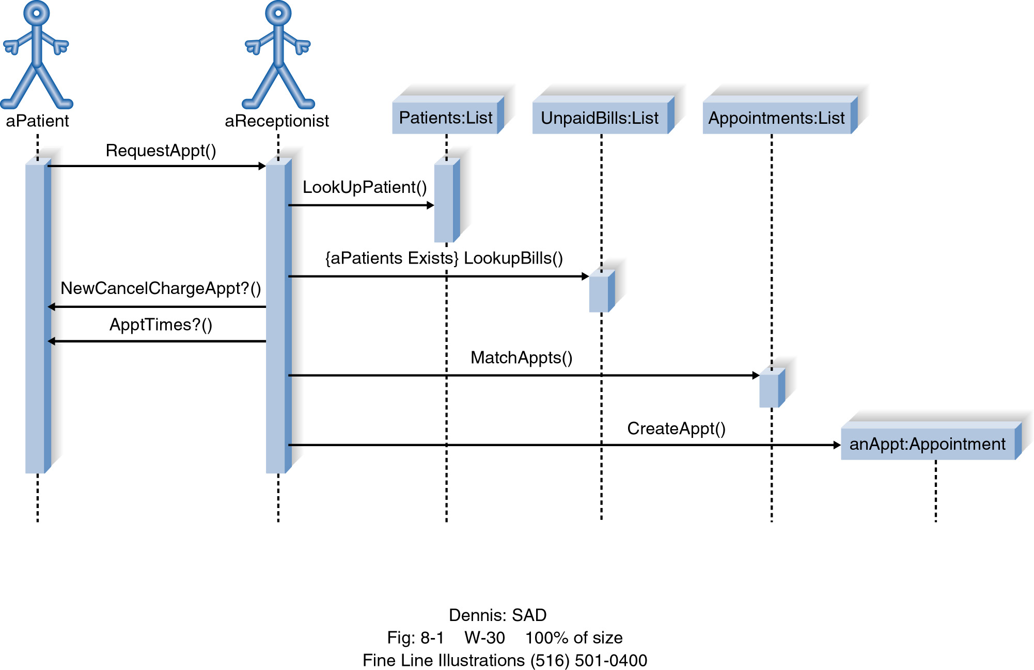
Example Sequence Diagram Make Appointment

Slide 11
Sequence Diagram Syntax
ACTOR
OBJECT
LIFELINE
EXECUTION OCCURRENCE
( FOCUS OF CONTROL)
MESSAGE
OBJECT DESTRUCTION
anObject:aClass
aMessage()
x

Slide 12
Building a Sequence Diagram
Determine the context of the sequence diagram
Identify the participating objects
Set the lifeline for each object
Add messages
Place the execution occurrence (focus of control) on each object’s lifeline
Validate the sequence diagram

Slide 13
Normal Flow of Events:
1. Customer submits a search request to the system.
2. The system provides the customer a list of recommended CDs.
3. The customer chooses one of the CDs to find additional
information.
4. The system provides the customer with basic information &
CD Reviews
5. The customer calls the maintain order use case.
6. The customer iterates over 3 through 5 until finished shopping.
7. The customer executes the checkout use case.
8. The customer leaves the website.

Slide 14
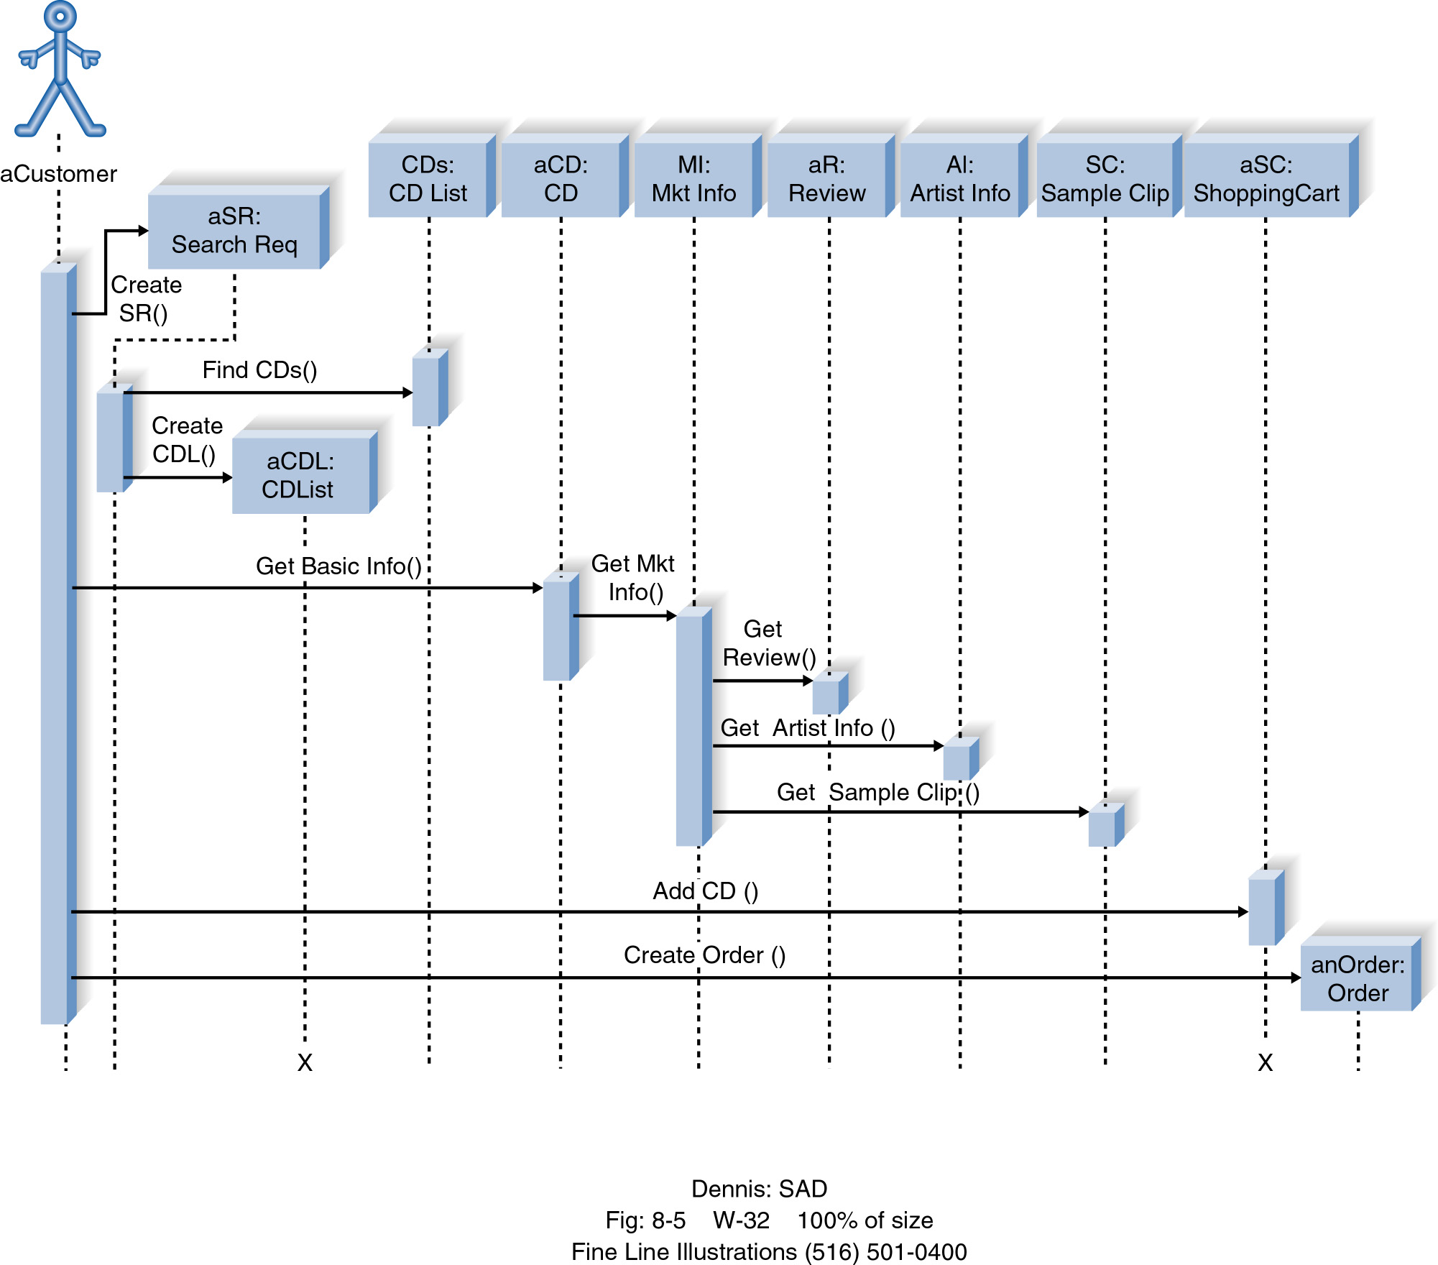

Slide 15
Behavioral State Machines (State Chart Diagrams)
The behavioral state machine is a dynamic model that shows the different states of the object and what events cause the object to change from one state to another, along with its responses and actions.

Slide 16
Elements of a Behavioral State Machine
States (idle conditions)
Events (triggers)
Transitions (changes in state)
Actions (cause transitions)
Activities (groups of actions)

Slide 17
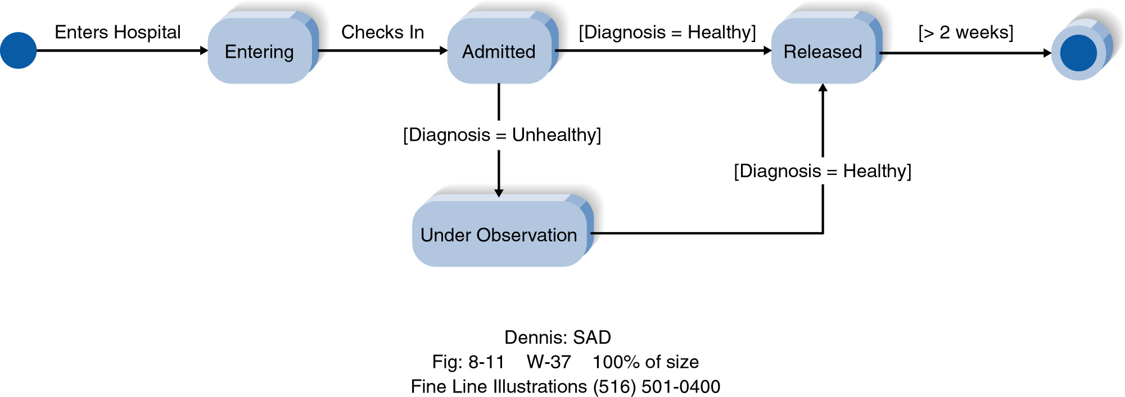
Example Behavioral State Machine Diagram

Slide 18



Behavioral State Machine Diagram Syntax
A STATE
AN INITIAL STATE
A FINAL STATE
AN EVENT
A TRANSITION
A Frame

Slide 19

Building Behavioral State Machine Diagrams
Set the context
Identify the initial final, and stable states of the object
Determine the order in which the object will pass through stable states
Identify the events, actions, and guard conditions associated with the transitions
Validate the state machine diagram

Slide 20
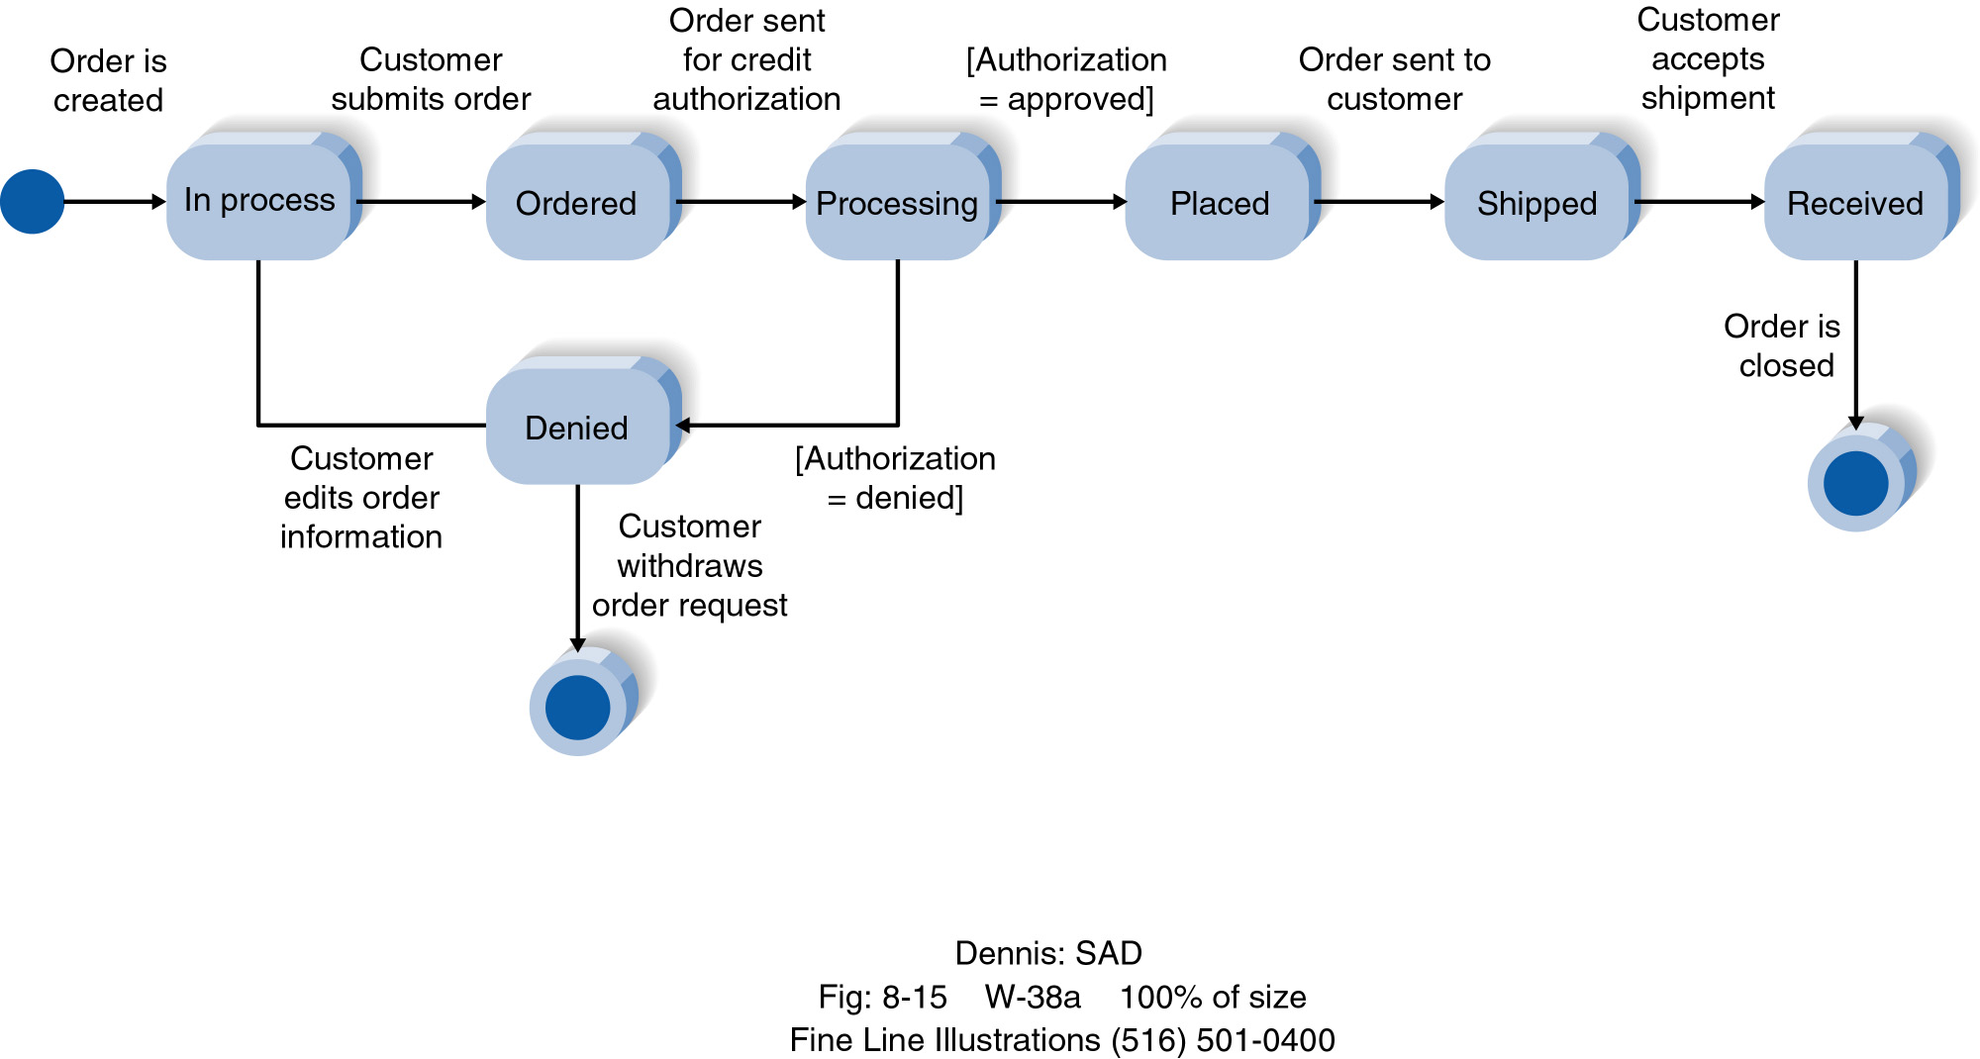

Slide 21
Summary
Sequence diagrams illustrate the classes that participate in a use case and the messages that pass between them.
Behavioral State Machine diagrams show the different states that a single class passes through in response to events.

