Slide 1
Systems Analysis & Design
CS183 Spring Semester 2008
Dr. Jonathan Y. Clark
Email: j.y.clark@surrey.ac.uk
Course Website: www.computing.surrey.ac.uk/personal
/st/J.Y.Clark/teaching/sad/cs183.html
Slide <number>

Slide 2
Course Textbook:
Systems Analysis and Design With UML 2.0
An Object-Oriented Approach, Second Edition
Chapter 13:
Physical Architecture Layer Design
Slide <number>

Slide 3
Adapted from slides © 2005
John Wiley & Sons, Inc.
Slide <number>

Slide 4
Physical Architecture Layer Design
Slide <number>

Slide 5

Objectives
Understand the different physical architecture components.
Understand server-based, client-based, and client server physical architectures.
Understand how operational, performance, security, cultural, and political requirements affect the design of the physical architecture layer.
Slide <number>

Slide 6


Physical Architecture
Software Components
  Data Storage
  Data Access Logic
  Application logic
  Presentation logic
Hardware Components
  Client computers
  Servers
  Connecting network
Slide <number>

Slide 7


Server Based Architecture
Client is a terminal
Server has functions of
  Presentation logic
  Application logic
  Data access logic
  Data storage
Slide <number>

Slide 8
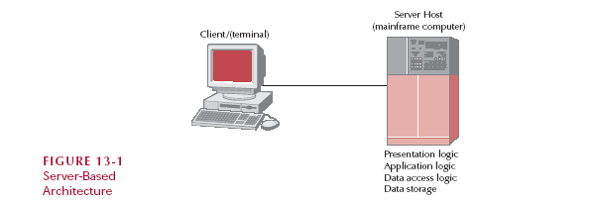
Server Based Architecture
Slide <number>

Slide 9
Client-Server Architectures
Thin Client/Fat Server
  Client is little more than a terminal
  Server handles all processing
Fat Client/Thin Server
  Client does all processing
  Server may just store data
Slide <number>

Slide 10
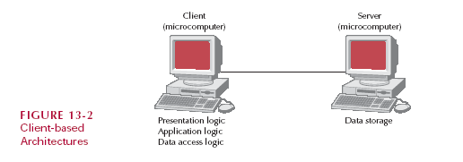
Fat (Thick) Client
Slide <number>

Slide 11
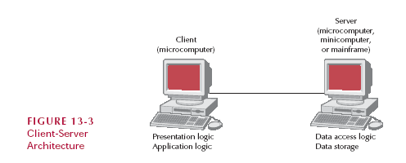
Server has Data
2-Tiered Architecture
Slide <number>

Slide 12
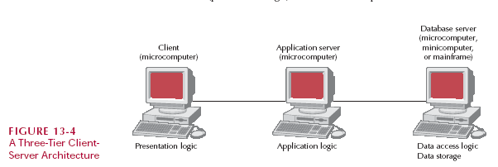
Client has Presentation Logic
3-tiered Architecture
Slide <number>

Slide 13
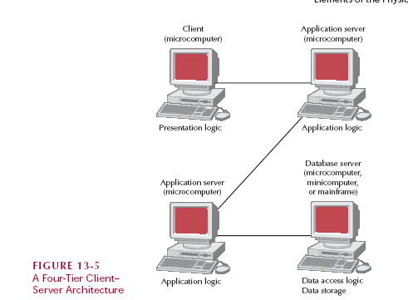
N-tiered Architecture
Slide <number>

Slide 14
Client-Server Benefits
Scalable
Support multiple clients and servers
Multiple servers make for a generally more reliable network
Slide <number>

Slide 15
Client-Server Limitations
Complexity
Updating the network computers is more complex
Development and Installation
  different on client and server
  training for developers
Slide <number>

Slide 16

Distributed Objects Computing (Middleware)
DOC allows the developer to simply concentrate on the users, objects, and methods of an application instead of worrying about which server contains which set of objects. The client object simply requests the “network” to locate and execute the server object’s method.
Middleware is a type of system software designed to translate between different vendors’ software, and is installed on both the client computer and the server computer.
Slide <number>

Slide 17
Competing Approaches
Object Management Group
  Common Object Request Broker Architecture (CORBA)
Sun
  Enterprise JavaBeans (EJB)
  Java 2 Enterprise Edition (J2EE)
Microsoft
  Distributed Component Object Model (DCOM)
  .net initiative
Slide <number>

Slide 18
Selecting a Physical Architecture
Cost of Infrastructure
Cost of Development
Ease of Development
Interface Capabilities
Control and Security
Scalability
Slide <number>

Slide 19
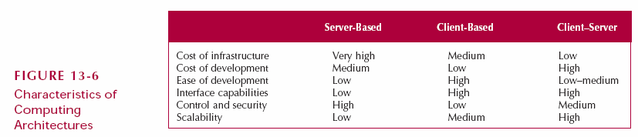
Characteristics
Slide <number>

Slide 20

NonFunctional Requirements
Operational
  Specify the operating environment
Performance requirements
  Speed, number of users, availability
Security
  Protect from disruption, data loss
Slide <number>

Slide 21
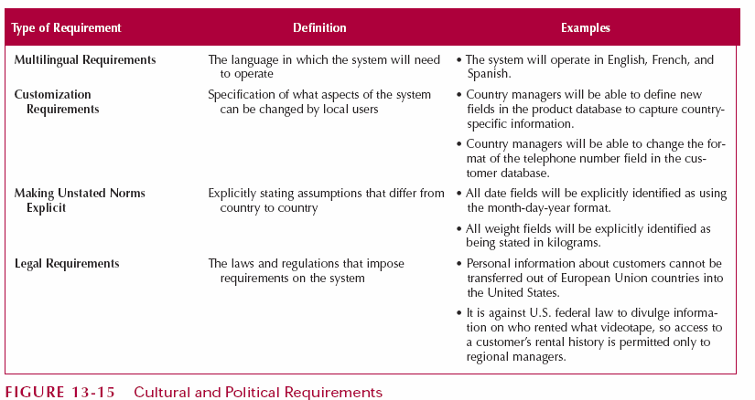
Cultural and Political Rqrts.
Slide <number>

Slide 22
Summary
Physical Architecture Layer
  Choose server vs. client-server
  Middleware
  Assess strengths and weaknesses
Infrastructure design
  Various clients
  Network equipment
Nonfunctional Requirements
  Operational
  Performance
  Security
Slide <number>

