Slide 1
Chapter 2:
Project Initiation,
Project Management & Requirements Determination

Slide 2
Objectives
Understand the importance of linking the information system to business needs.
Be able to create a system request.
Understand how to assess technical, economic, and organizational feasibility.
Be able to perform a feasibility analysis.
Understand how projects are selected in some organizations.

Slide 3
Successful Projects
Cost
  At project completion, no more money has been spent than was originally allocated
Schedule
  The project is delivered no later than the original delivery date
Performance
  When delivered, the project has all features and functionality that were originally required of it

Slide 4
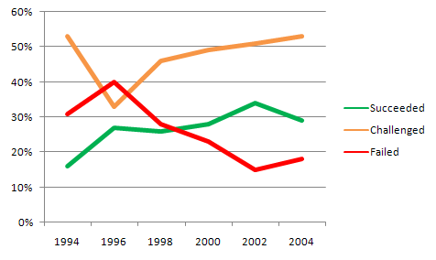
Why Should We Care?
Would you buy a car that only had a 28% chance of driving off the lot with no problems?
Notes:
Source: The Standish Group 2006 Chaos Report

Slide 5
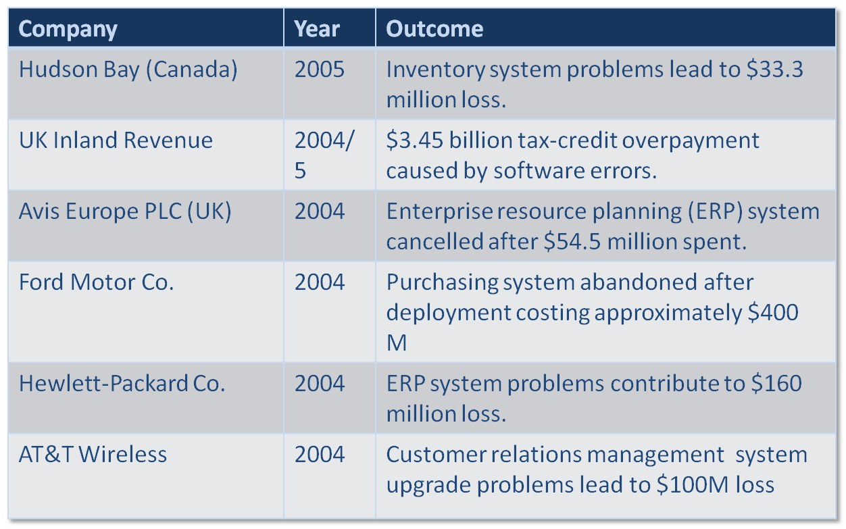
Recent Significant IT Failures
Notes:
Source: Charette, Robert N., “Why Software Fails,” IEEE Spectrum Online, Sept. 2005.

Slide 6
PROJECT IDENTIFICATION

Slide 7
Project Identification and Initiation
Projects are driven by business needs
  Identified by business people
  Identified by IT people
  (better yet) identified jointly by business and IT
The project sponsor believes in the system and wants to see it succeed
  Normally this is a business person
  Should have the authority to move it forward

Slide 8
Business Value
Tangible Value
  Can be quantified and measured easily
  Example: 2 percent reduction in operating costs
Intangible Value
  Results from an intuitive belief that the system provides important, but hard-to-measure, benefits to the organization
  Example: improved customer service

Slide 9
Elements of a System Request
Project sponsor
  Primary point of contact for the project
Business need
  Reason prompting the project
Business requirements
  Business capabilities the system will need to have
Business value
  Benefits the organization can expect from the project
Special issues
  Anything else that should be considered

Slide 10
FEASIBILITY ANALYSIS

Slide 11
Feasibility Analysis
Guides the organization in determining whether to proceed with a project
Identifies the project’s risks that must be addressed if the project is approved
Mayor components:
  Technical feasibility
  Economic feasibility
  Organizational feasibility

Slide 12
Technical Feasibility
Familiarity with application
  Less familiarity generates more risk
Familiarity with technology
  Less familiarity generates more risk
Project size
  Large projects have more risk
Compatibility
  Difficult integration increases the risk
Can we build it?

Slide 13
Economic Feasibility
Development costs
Annual operating costs
Annual benefits (cost savings and revenues)
Intangible costs and benefits
Should we build it?

Slide 14
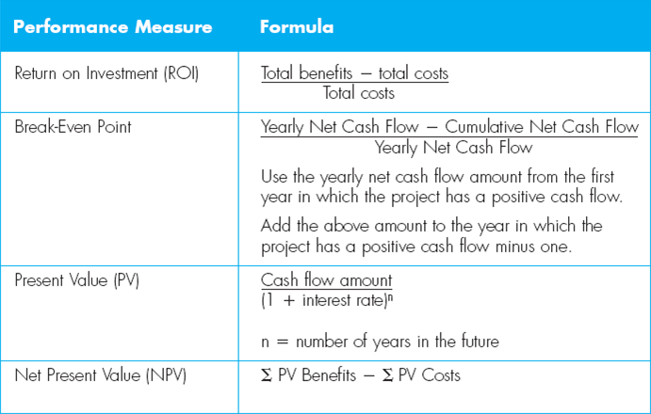
Cost-Benefit Analysis

Slide 15
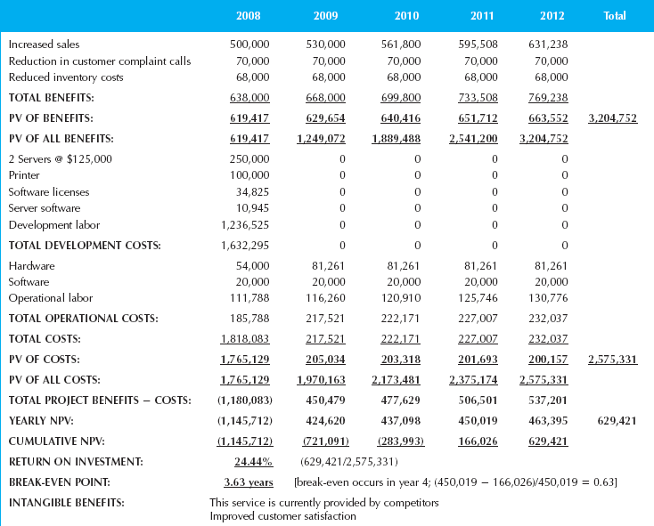
Cost-Benefit Analysis

Slide 16
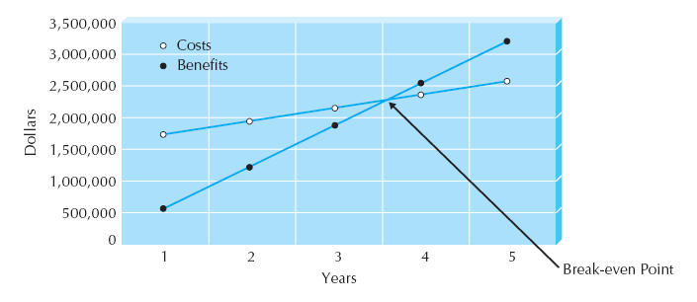
Break-Even Point

Slide 17
Organizational Feasibility
Stakeholders
  Project champion(s)
  Senior management
  Users
  Others
Is the project strategically aligned with the business?
If we build it, will they come?

Slide 18
PROJECT SELECTION

Slide 19
Project Selection
Project portfolio management
  A process that optimizes project selection and sequencing in order to best support business goals
  Business goals are expressed in terms of
    Quantitative economic measures
    Business strategy goals
    IT strategy goals
Once selected, projects enter the project management process

Slide 20
How Not to Select a Project
First in, first out
Political clout of project inventor
Squeaky wheel getting the grease
Any other method that does not involve a deliberate course of action analysis
A recent analysis found that between 2% and 15% of projects taken on by IT departments are not strategic to the business.

Slide 21
Review
Project Initiation
Feasibility Analysis
Project Selection

