Slide 1
Chapter 3:
Project Management

Slide 2
Objectives
Become familiar with estimation.
Be able to create a project workplan.
Understand why project teams use timeboxing.
Become familiar with how to staff a project.
Understand how computer-aided software engineering, standards, and documentation improve the efficiency of a project.
Understand how to reduce risk on a project.

Slide 3
Project Management
The discipline of planning, organizing, and managing resources to bring about the successful completion of specific project goals and objectives
  Cost
  Schedule
  Performance

Slide 4
IDENTIFYING PROJECT SIZE

Slide 5
Cost Schedule Performance Trade-offs
Cost
Project management involves balancing trade-offs among the three key project parameters
Project
Schedule
Performance

Slide 6
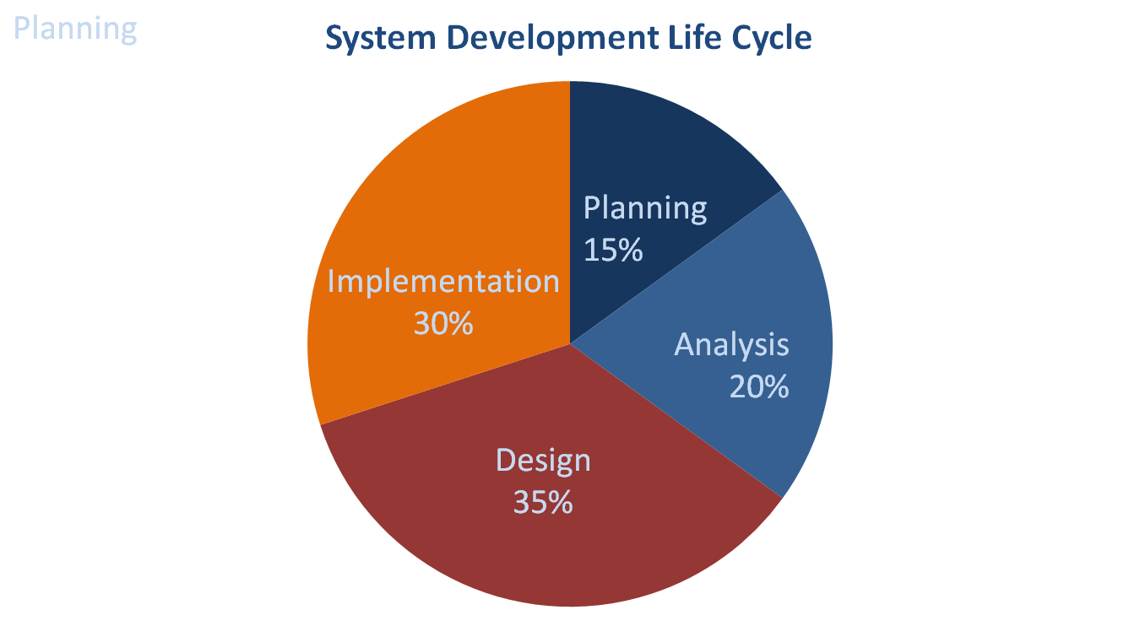
Estimating Project Timeframes

Slide 7
Function Point Approach
Estimate System Size
(function points and lines of code)
Estimate Effort Required
(person-months)
Estimate Time Required
(months)

Slide 8
CREATING AND MANAGING THE WORKPLAN

Slide 9
Developing Work Plans
A work plan, is a dynamic schedule that records and keeps track of all tasks to be accomplished over the course of the project
Created after a project manager has a general idea of the project’s size and rough schedule
The work plan is usually the main item in a project management software application

Slide 10
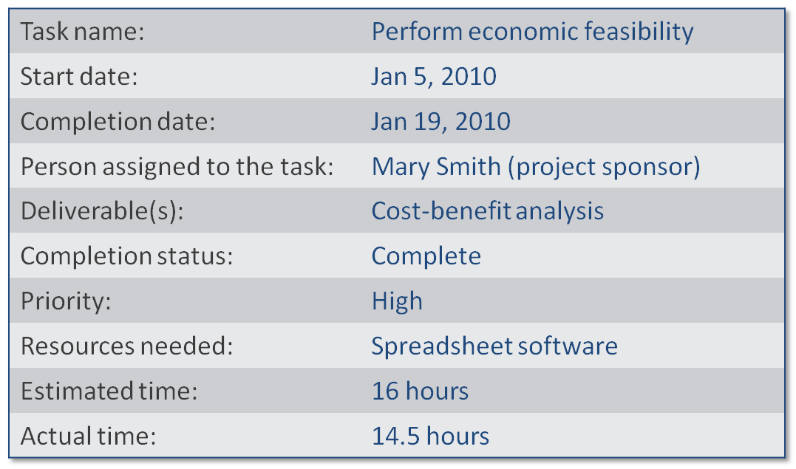
Sample Task

Slide 11
Identifying Tasks
Top-down approach
  Identify highest level tasks
  Break them into increasingly smaller units
Methodology
  Using standard list of tasks

Slide 12
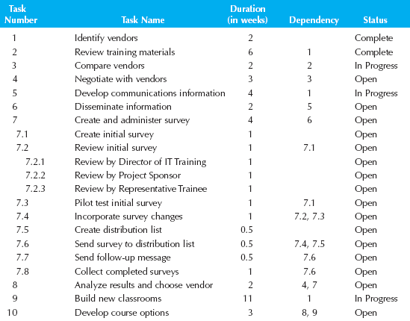
Work Breakdown Structure

Slide 13
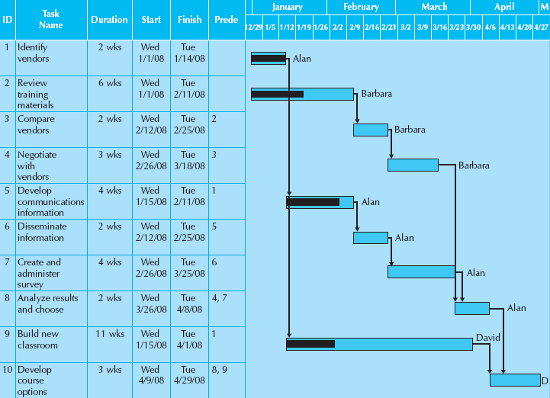
Gantt Chart

Slide 14
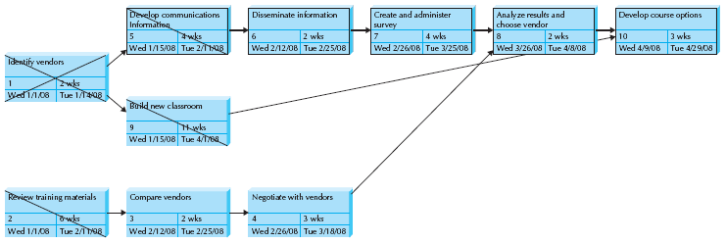
Pert Chart
Used to communicate task dependencies
Allows easier visualization of tasks on a critical path

Slide 15
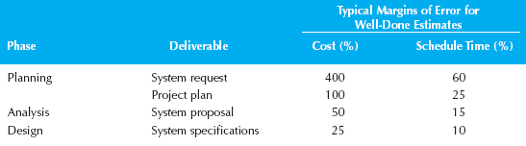
Scope Management
Scope creep happens when new requirements are added to the project after the original project scope was defined and “frozen.”

Slide 16
Timeboxing Steps
Set the date for system delivery
Prioritize the functionality that needs to be included in the system
Build the core of the system (the functionality ranked as most important)
Postpone functionality that cannot be provided within the time frame
Deliver the system with core functionality
Repeat steps 3 through 5 to add refinements and enhancements

Slide 17
STAFFING THE PROJECT

Slide 18
Staffing the Project
Determine average number of people needed
  Divide total person-months of effort by the optimal schedule
  Adding more people will not reduce schedule
Create a staffing plan
  Roles required for the project
  Reporting structure

Slide 19
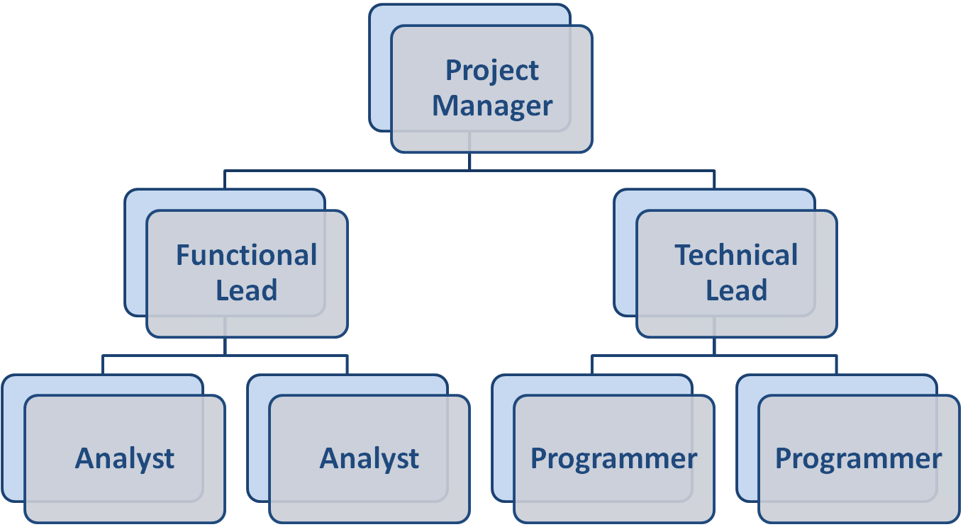
Reporting Structures

Slide 20
Motivation
Use monetary rewards cautiously
Use intrinsic rewards
  Recognition
  Achievement
  The work itself
  Responsibility
  Advancement
  Chance to learn new skills

Slide 21
Motivational Don’ts
Assign unrealistic deadlines
Ignore good efforts
Create a low-quality product
Give everyone on the project a raise
Make an important decision without the team’s input
Maintain poor working conditions

Slide 22
Conflict Avoidance Strategies
Clearly define roles and project plans
Make sure the team understands how the project is important to the organization
Develop detailed operating procedures and communicate these to the team members
Develop a project charter
Develop schedule commitments ahead of time
Forecast other priorities and their possible impact on project

Slide 23
COORDINATING PROJECT ACTIVITIES

Slide 24
CASE Tools
Computer-Aided Software Engineering (CASE) tools automate some or all of the development process
Not a silver bullet, but advantages include:
  Reduced maintenance costs
  Improve software quality
  Enforce discipline
  Some project teams even use CASE to assess the magnitude of changes to the project

Slide 25
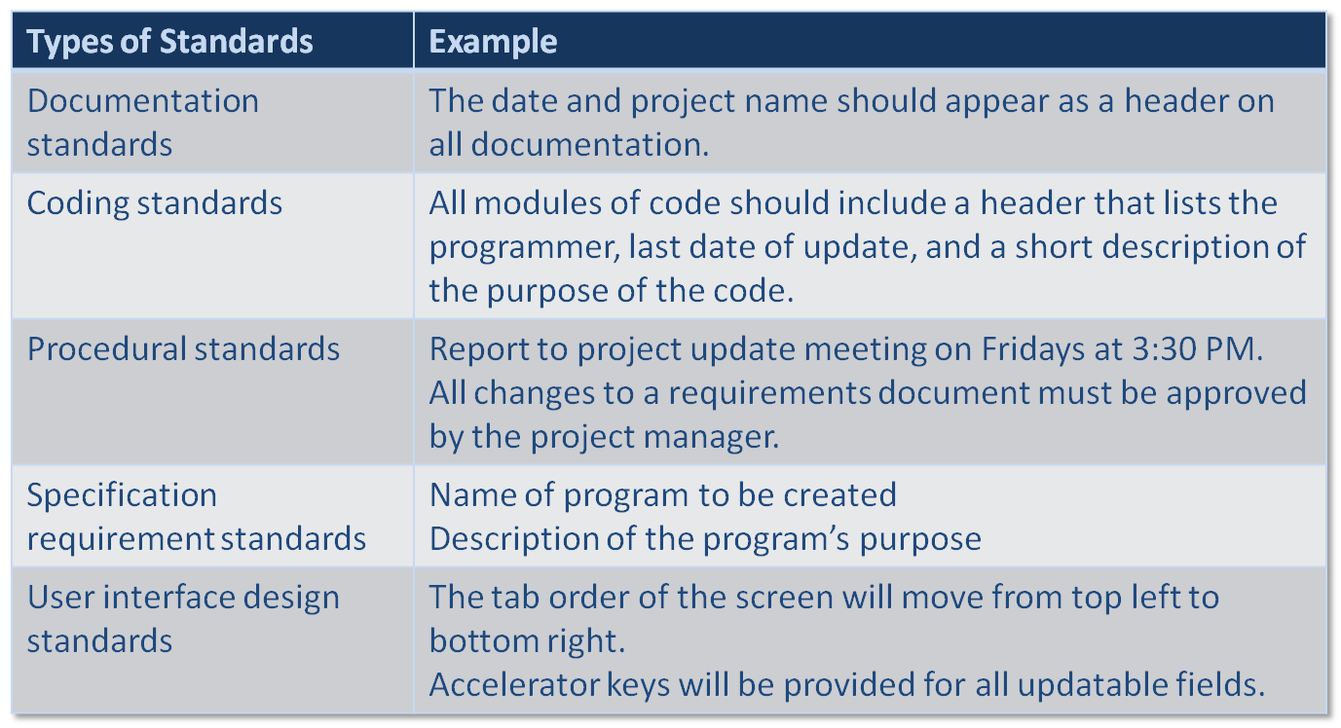
Standards

Slide 26
Documentation
Good documentation happens up front
  Documentation that occurs only at the tail end of a project/phase is not very useful
Project binder(s) are best practices containing
  All internal communications (e.g. minutes from status meetings)
  Written standards
  Letters to and from the business users
  Deliverables from each task

Slide 27
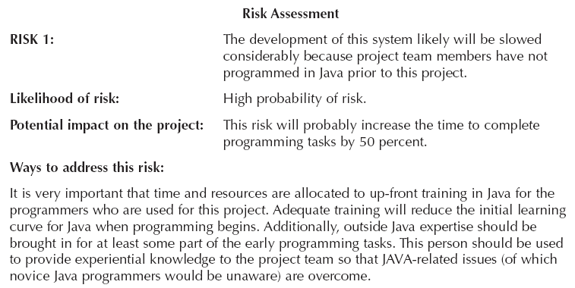
Managing Risk

Slide 28
Summary
Project Management
Identifying Project Size
Creating And Managing the Workplan
Staffing the Project
Coordinating Project Activities

