Slide 1
Chapter 7:
Behavioral Modeling

Slide 2
Objectives
Understand the rules and style guidelines for sequence and communication diagrams and behavioral state machines.
Understand the processes used to create sequence and communication diagrams and behavioral state machines.
Be able to create sequence and communication diagrams and behavioral state machines.
Understand the relationship between the behavioral models and the structural and functional models.

Slide 3
Key Ideas
Behavioral models describe the internal dynamic aspects of an information system that supports business processes in an organization
Key UML behavioral models are: sequence diagrams, collaboration diagrams, and statechart diagrams

Slide 4
BEHAVIORAL MODELS

Slide 5
Behavioral Models
Systems have static &dynamic characteristics
  Structural models describe the static aspects of the system
  Behavioral models describe the dynamics and interactions of the system and its components
Behavioral models describe how the classes described in the structural models interact in support of the use cases.

Slide 6
INTERACTION DIAGRAMS

Slide 7
Interaction Diagram Components
Objects
  an instantiation of a class
Operations
  the behaviors of an instance of a class
Messages
  information sent to objects to tell them to execute one of their behaviors

Slide 8
Sequence Diagrams
Illustrate the objects that participate in a use-case
Show the messages that pass between objects for a particular use-case

Slide 9
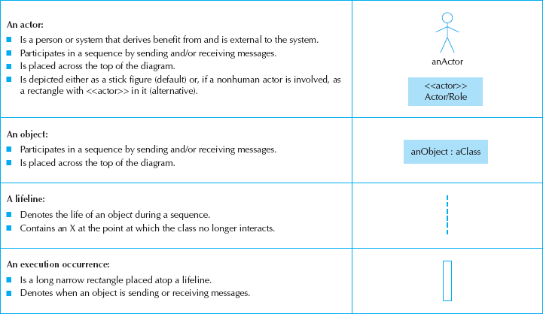
Sequence Diagram Syntax

Slide 10
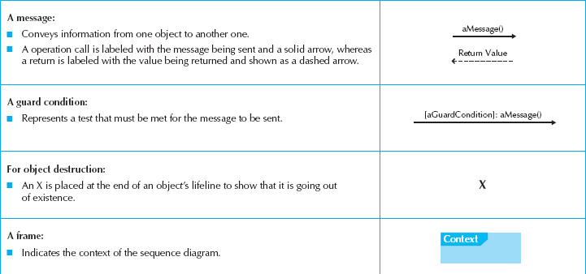
More Sequence Diagram Syntax

Slide 11
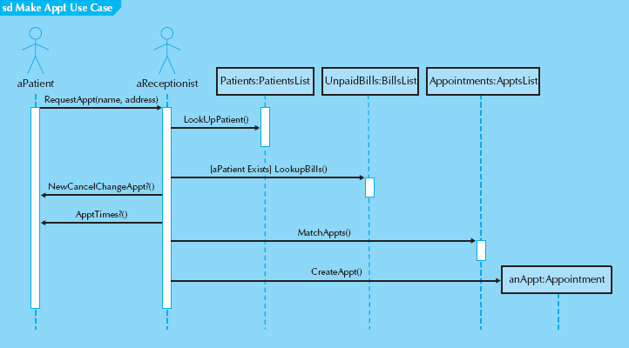
Sample Sequence Diagram

Slide 12
Steps to Build Sequence Diagrams
Set the context
Identify which objects will participate
Set the lifeline for each object
Lay out the messages from top to bottom of the diagram based on the order in which they are sent
Add execution occurrence to each object‘s lifeline
Validate the sequence diagram

Slide 13
BEHAVIORAL STATE MACHINES

Slide 14
Behavioral State Machines
A dynamic model that shows the different states through which a single object passes during its life in response to events, along with its responses and actions
Typically not used for all objects
  Just for complex ones

Slide 15
Components of State Machines
States
  values of an object’s attributes at a point in time
Events
  change the values of the object’s attributes
Transitions
  movement of an object from one state to another
Actions
  atomic, non-decomposable processes
Activities
  non-atomic, decomposable processes

Slide 16
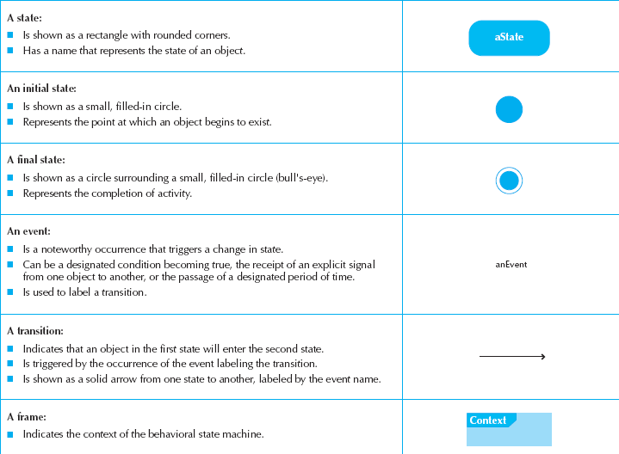
State Machine Syntax

Slide 17
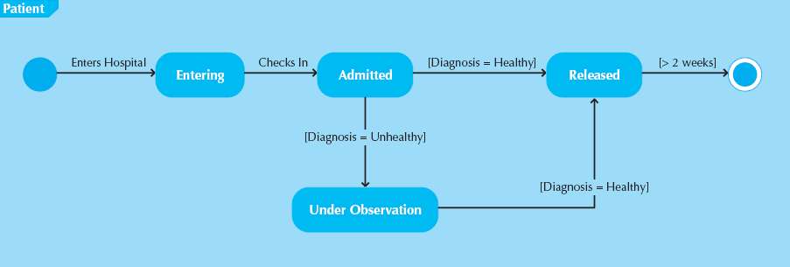
Sample State Machine

Slide 18
Steps to Build a State Machine
Set the context
Identify the initial, final, and stable states of the object
Determine the order in which the object will pass through the stable states
Identify the events, actions, and guard conditions associated with the transitions
Validate the behavioral state machine

Slide 19
CRUD ANALYSIS

Slide 20
CRUD Analysis
Labels object interaction in 4 possible ways
  Create
  Read
  Update
  Delete
Matrix representation of objects and interactions
Most useful as a system-wide representation

Slide 21
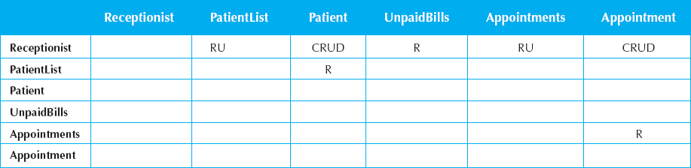
Sample CRUD Matrix

Slide 22
Summary
Behavioral Models
Interaction Diagrams
Behavioral State Machines
CRUD Analysis

